Slide 1
Supplementary data

Slide 2
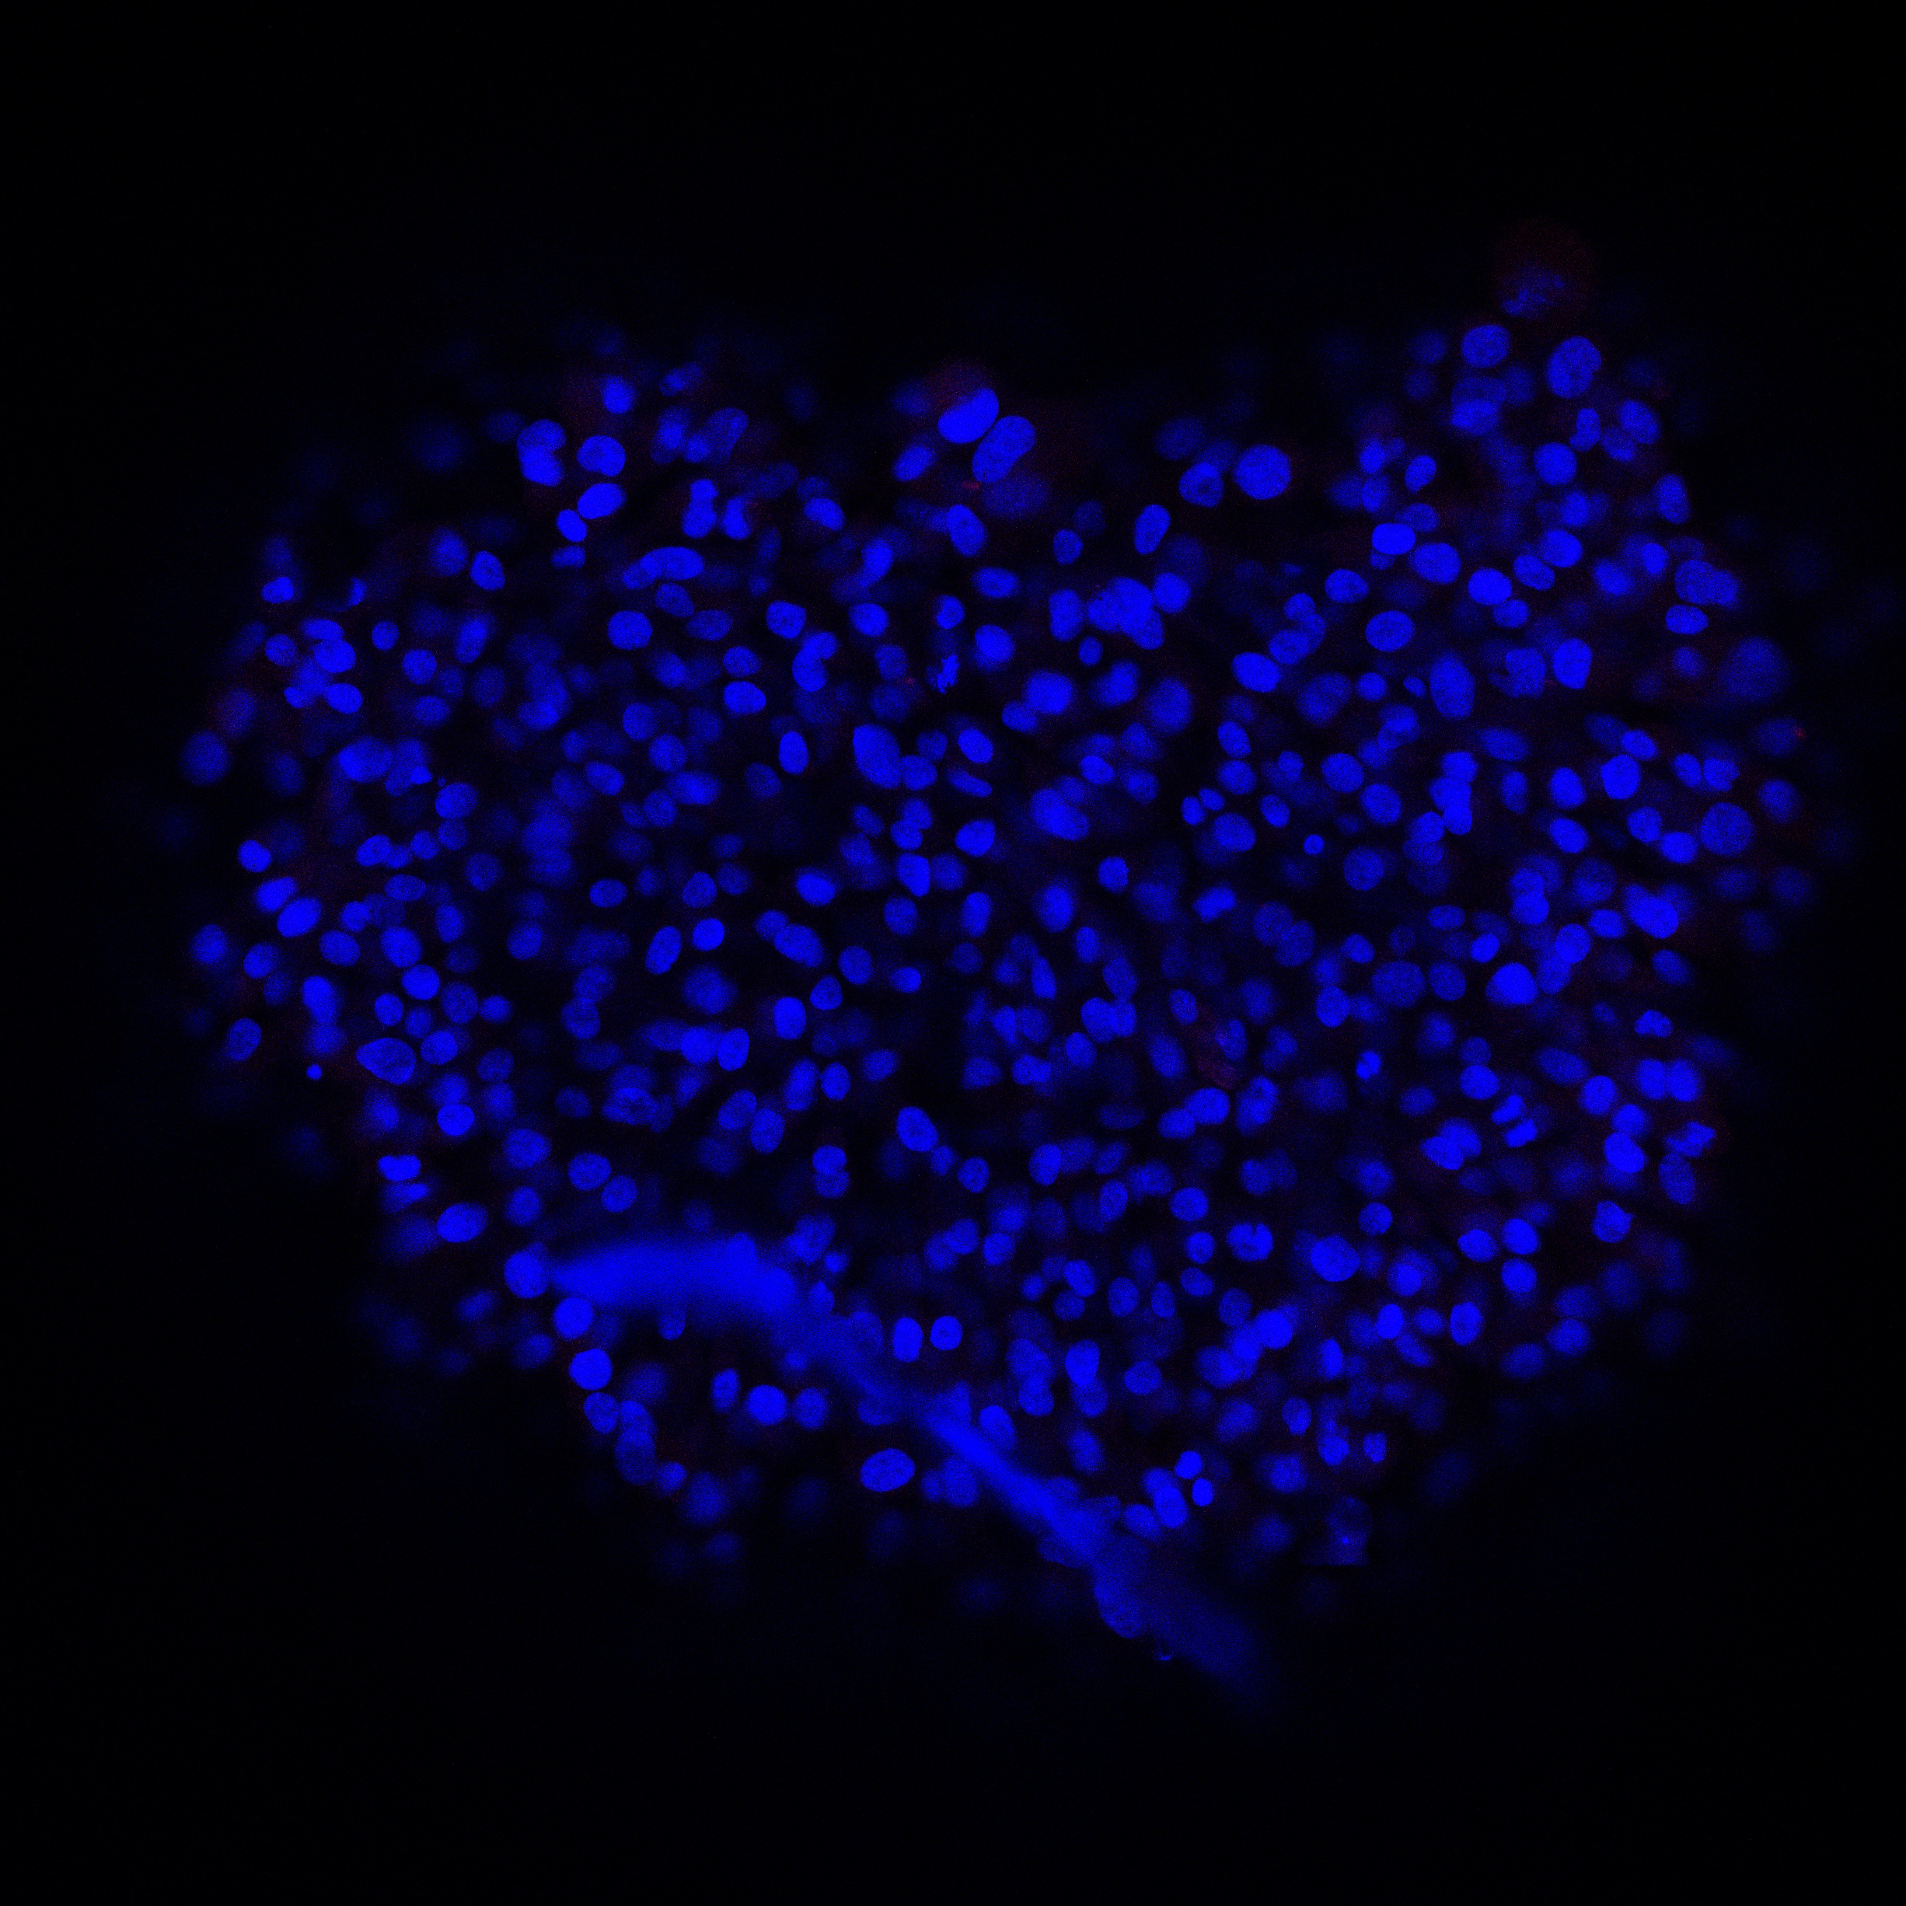
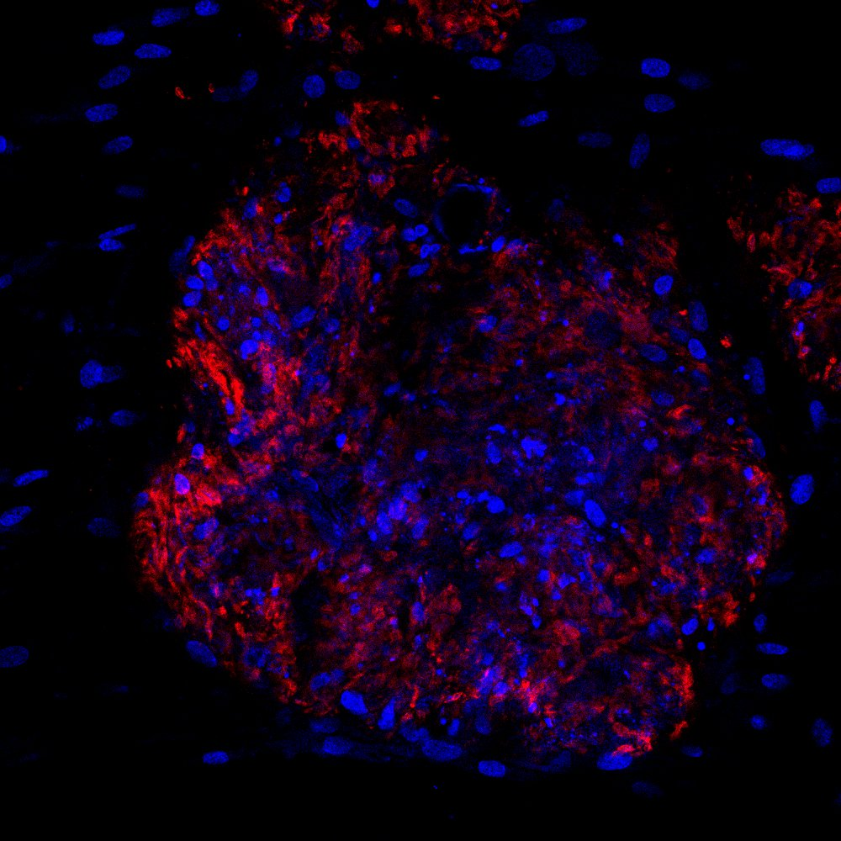
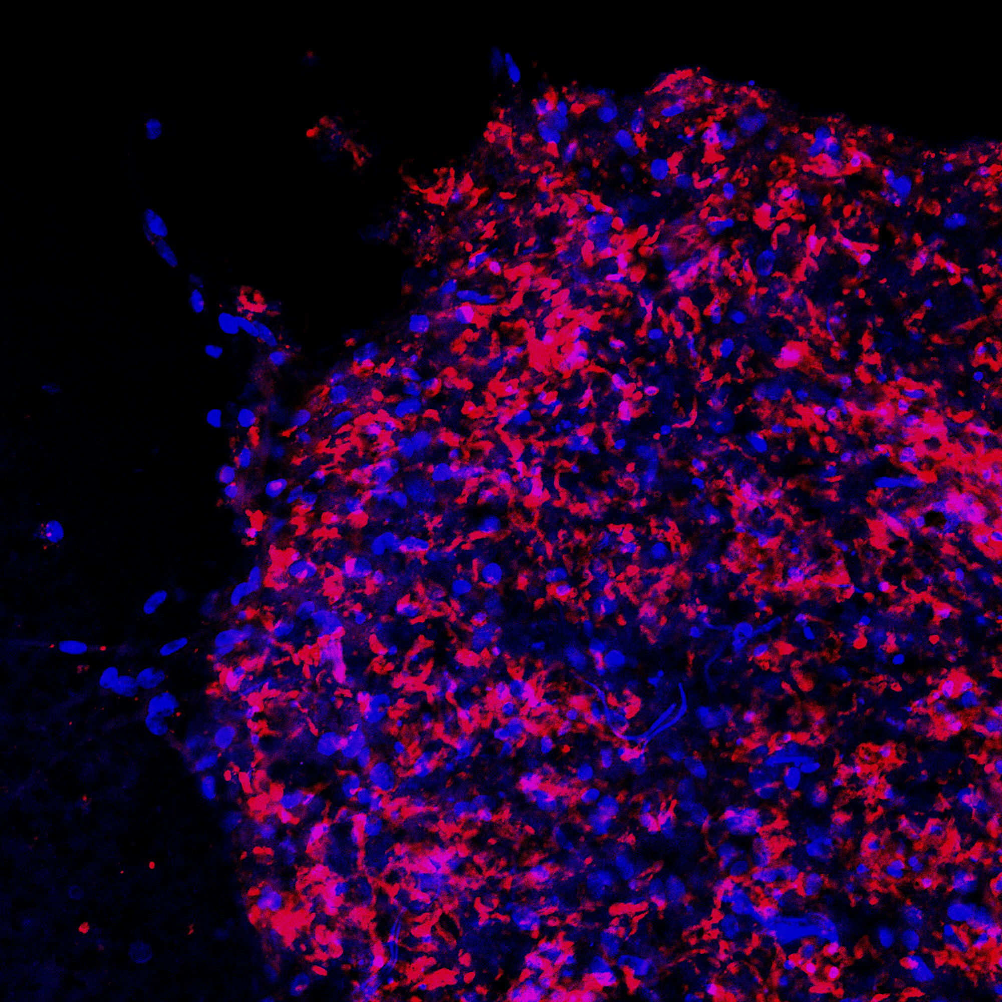
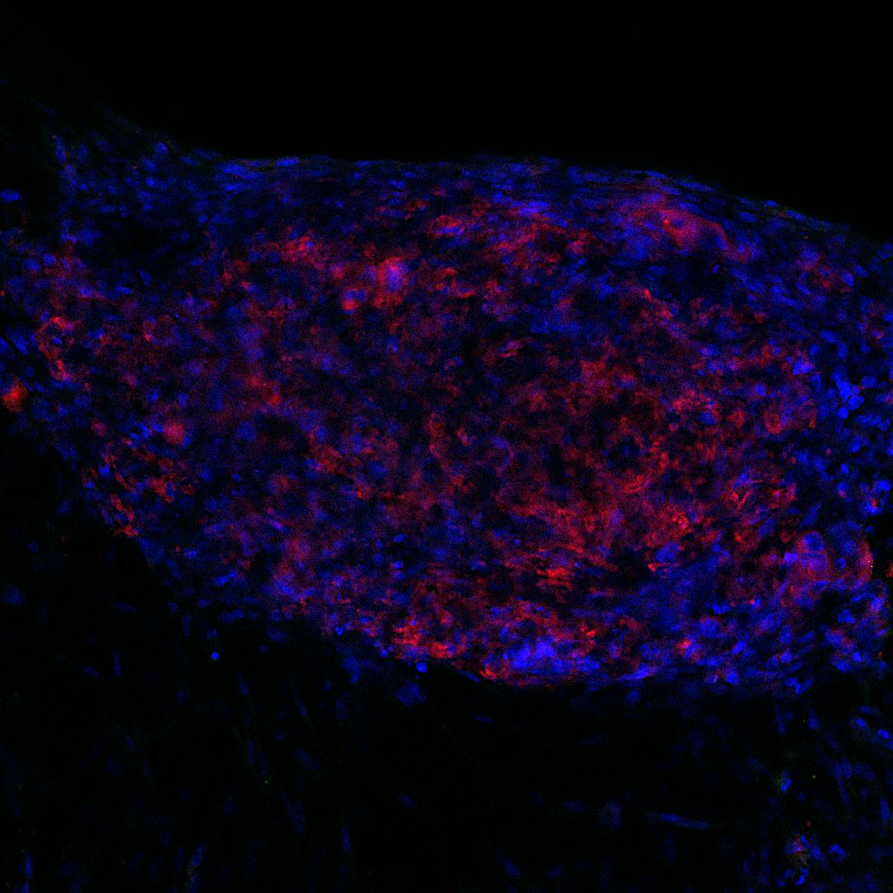
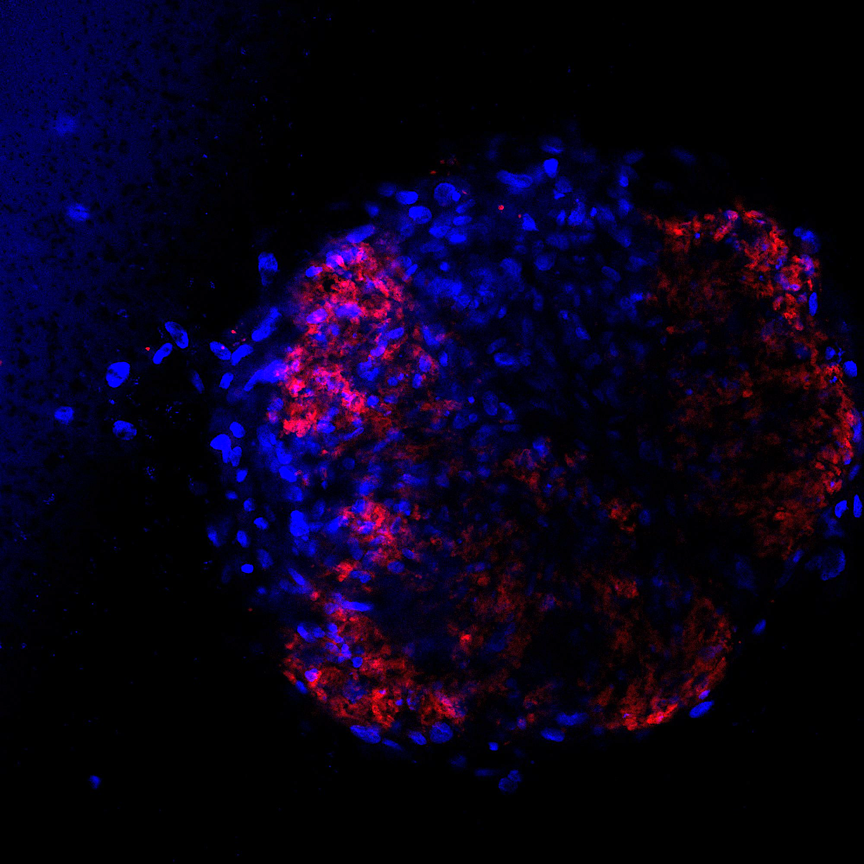
Isotype
21T 414
21T 469
21T 554
21T 226
DAPI UEA-lectin
Supplementary figure 1. UEA-lectin staining within vasc-PDTs. Scale bar, 100µm

Slide 3
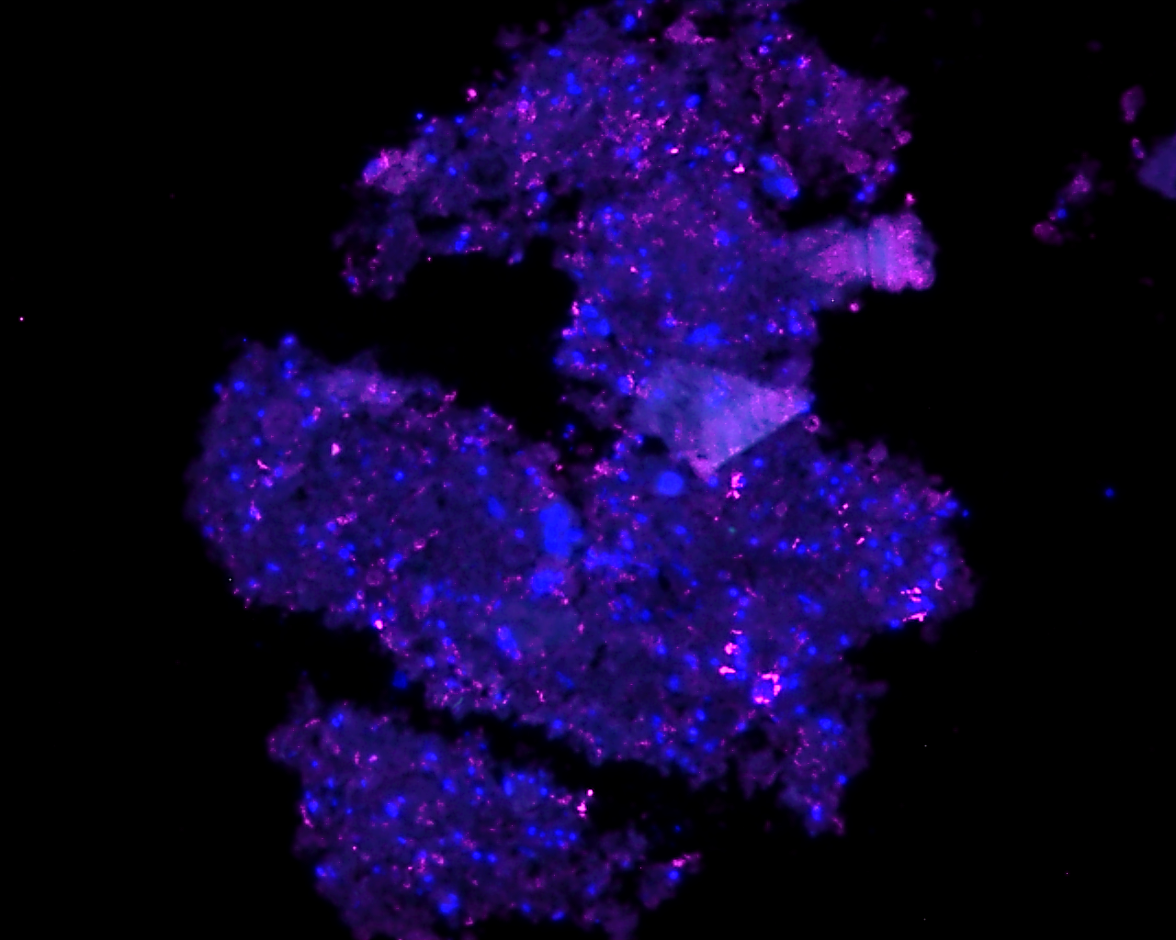
21T 469
Primary tissue
Synaptophysine CD56 (NCAM1)
Vasc-PDTs
Supplementary figure 2. Expression of synaptophysine and CD56, markers for neuroendocrine carcinoma on patient 2. Scale bar, 100µm

Slide 4
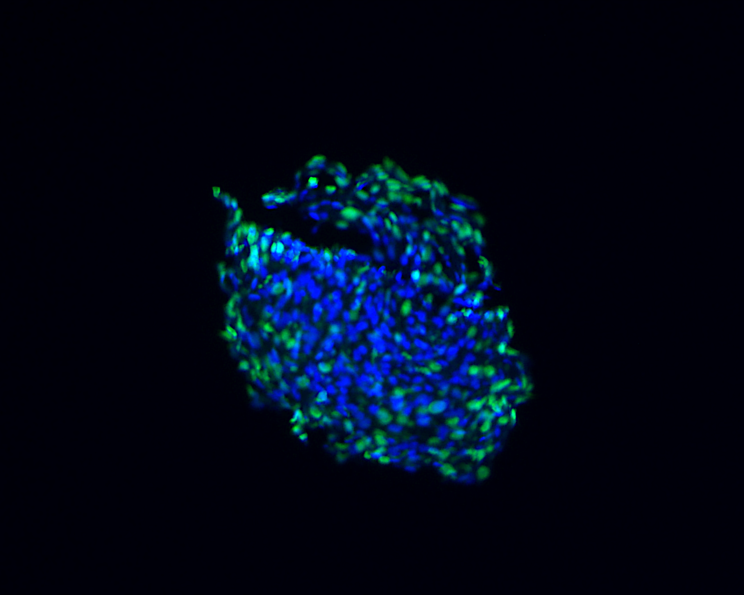
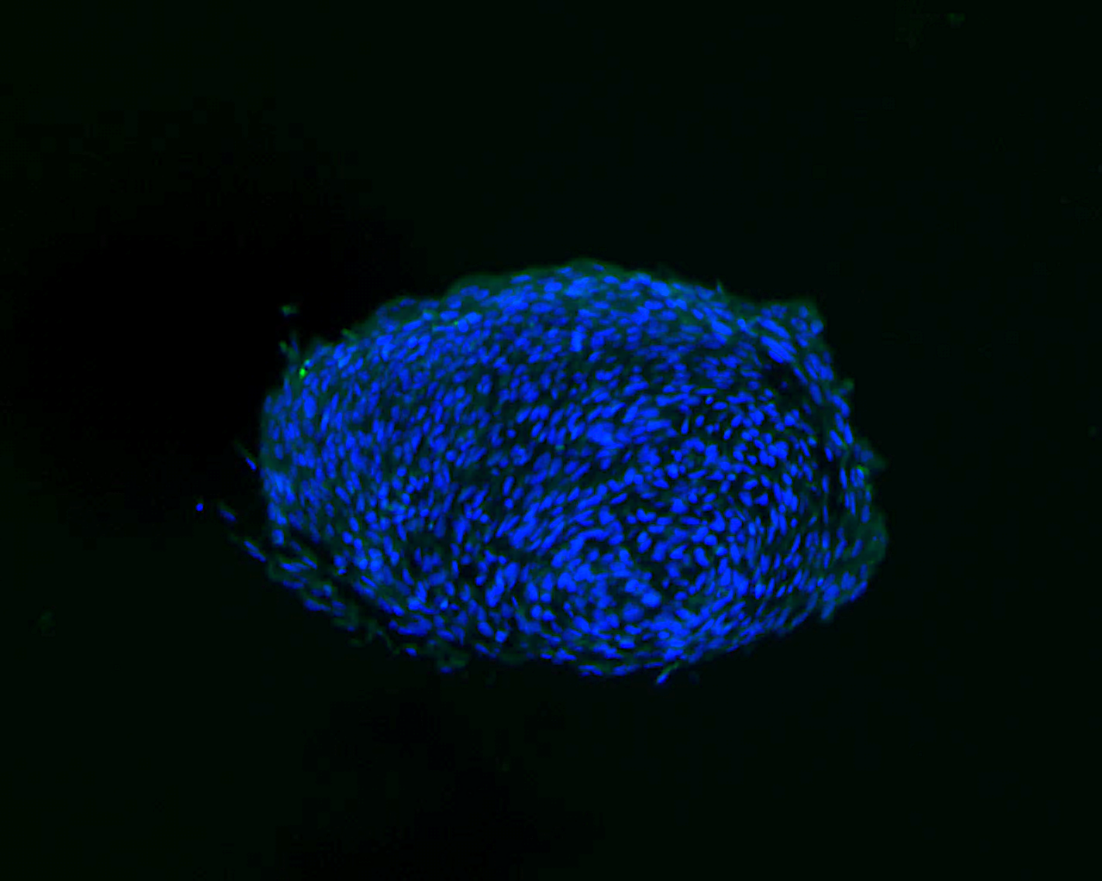
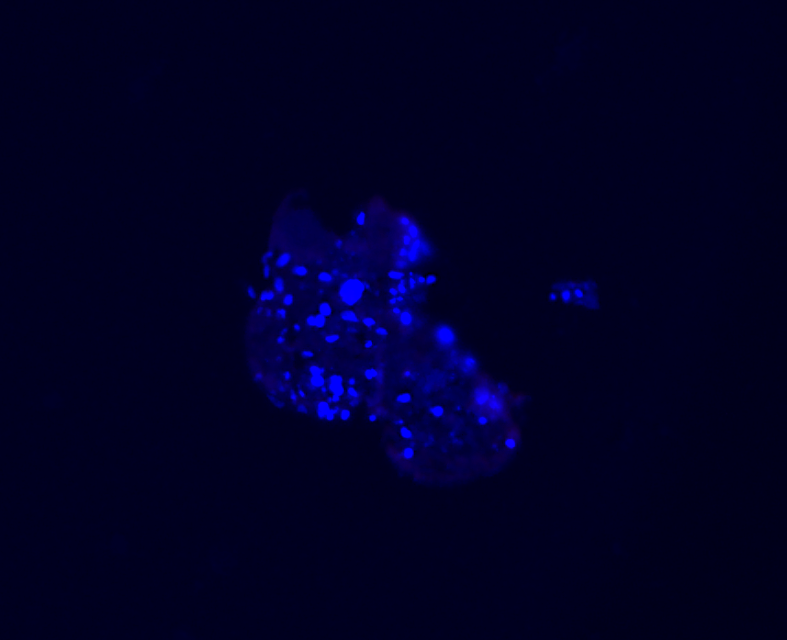
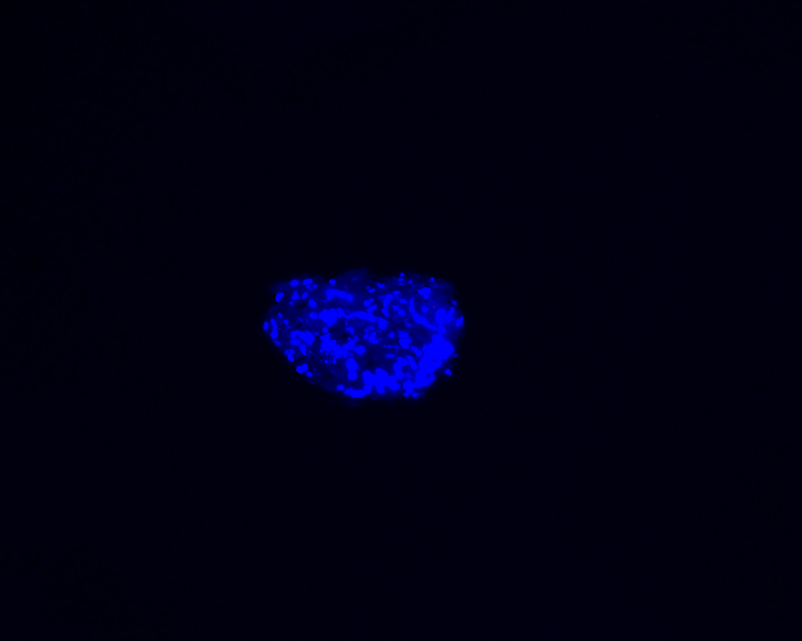
Isotype TTF-1/Ki67
Isotype p40
Isotype CK7
Isotype MUC1
Isotype Synaptophysine
Isotype CD56 (NCAM1)
Isotype CD31
Supplementary figure 3. Isotypes. Scale bar, 100µm

Slide 5
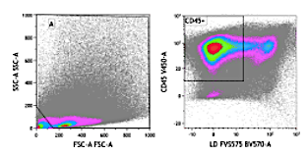
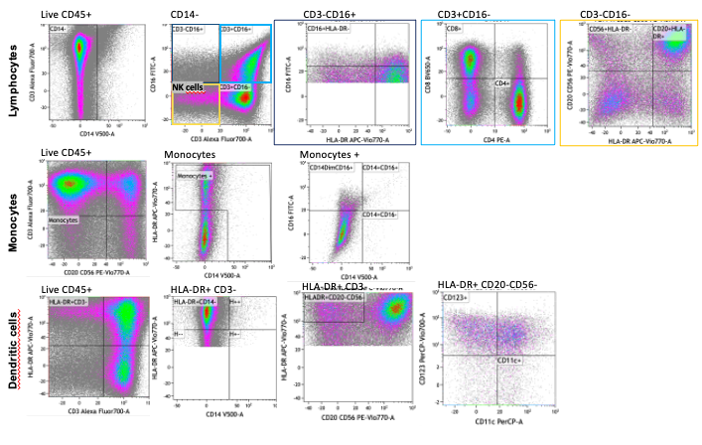
Supplementary figure 4. Gating strategy for immune cells profiling in infiltered-Vasc-PDTs. Kaluza software analysis was used to analyze immune cells subpopulations.

Slide 6
Supplementary figure 5. PBMCs subpopulations were checked before co-culture with Vasc-PDTs by flow cytometry
Figure 4. Other experiments in co-culture of vascularized PDTs + autologous immune cells. a. ELISA of IFN-$γ$ in the supernatant b. Assessment of immunosuppressive proteins and immune-checkpoints in vPDTs lysates

Slide 7
(A)
(B)
CD80
CD137
CD27
Supplementary figure 6. Supplementary data regarding the co-culture of Vasc-PDTs + autologous immune cells (A) ELISA of IFN-$γ$ in the supernatant (B) Assessment of costimulatory proteins in Vasc-PDTs lysates with the Procarta Plex kit Immuno-Oncology 14-plex.

