Slide 1
Supplementary Table S1. The clinical information of pancreatic cancer patients in TCGA training cohort
Factors | N (%) | Missing
Age at diagnosis
> 65 | 84 (47.5%)
≤ 65 | 93 (52.5%)
Pathologic T stage |  | 0.60%
T1 | 7 (4.0%)
T2 | 24 (13.6%)
T3 | 141 (79.7%)
T4 | 3 (1.7%)
Pathologic N stage |  | 2.80%
N0 | 49 (27.7%)
N1 | 123 (69.5%)
TNM stage |  | 1.70%
Stage I | 21 (11.9%)
Stage II | 146 (82.5%)
Stage III | 3 (1.7%)
Stage IV | 4 (2.3%)

Slide 2
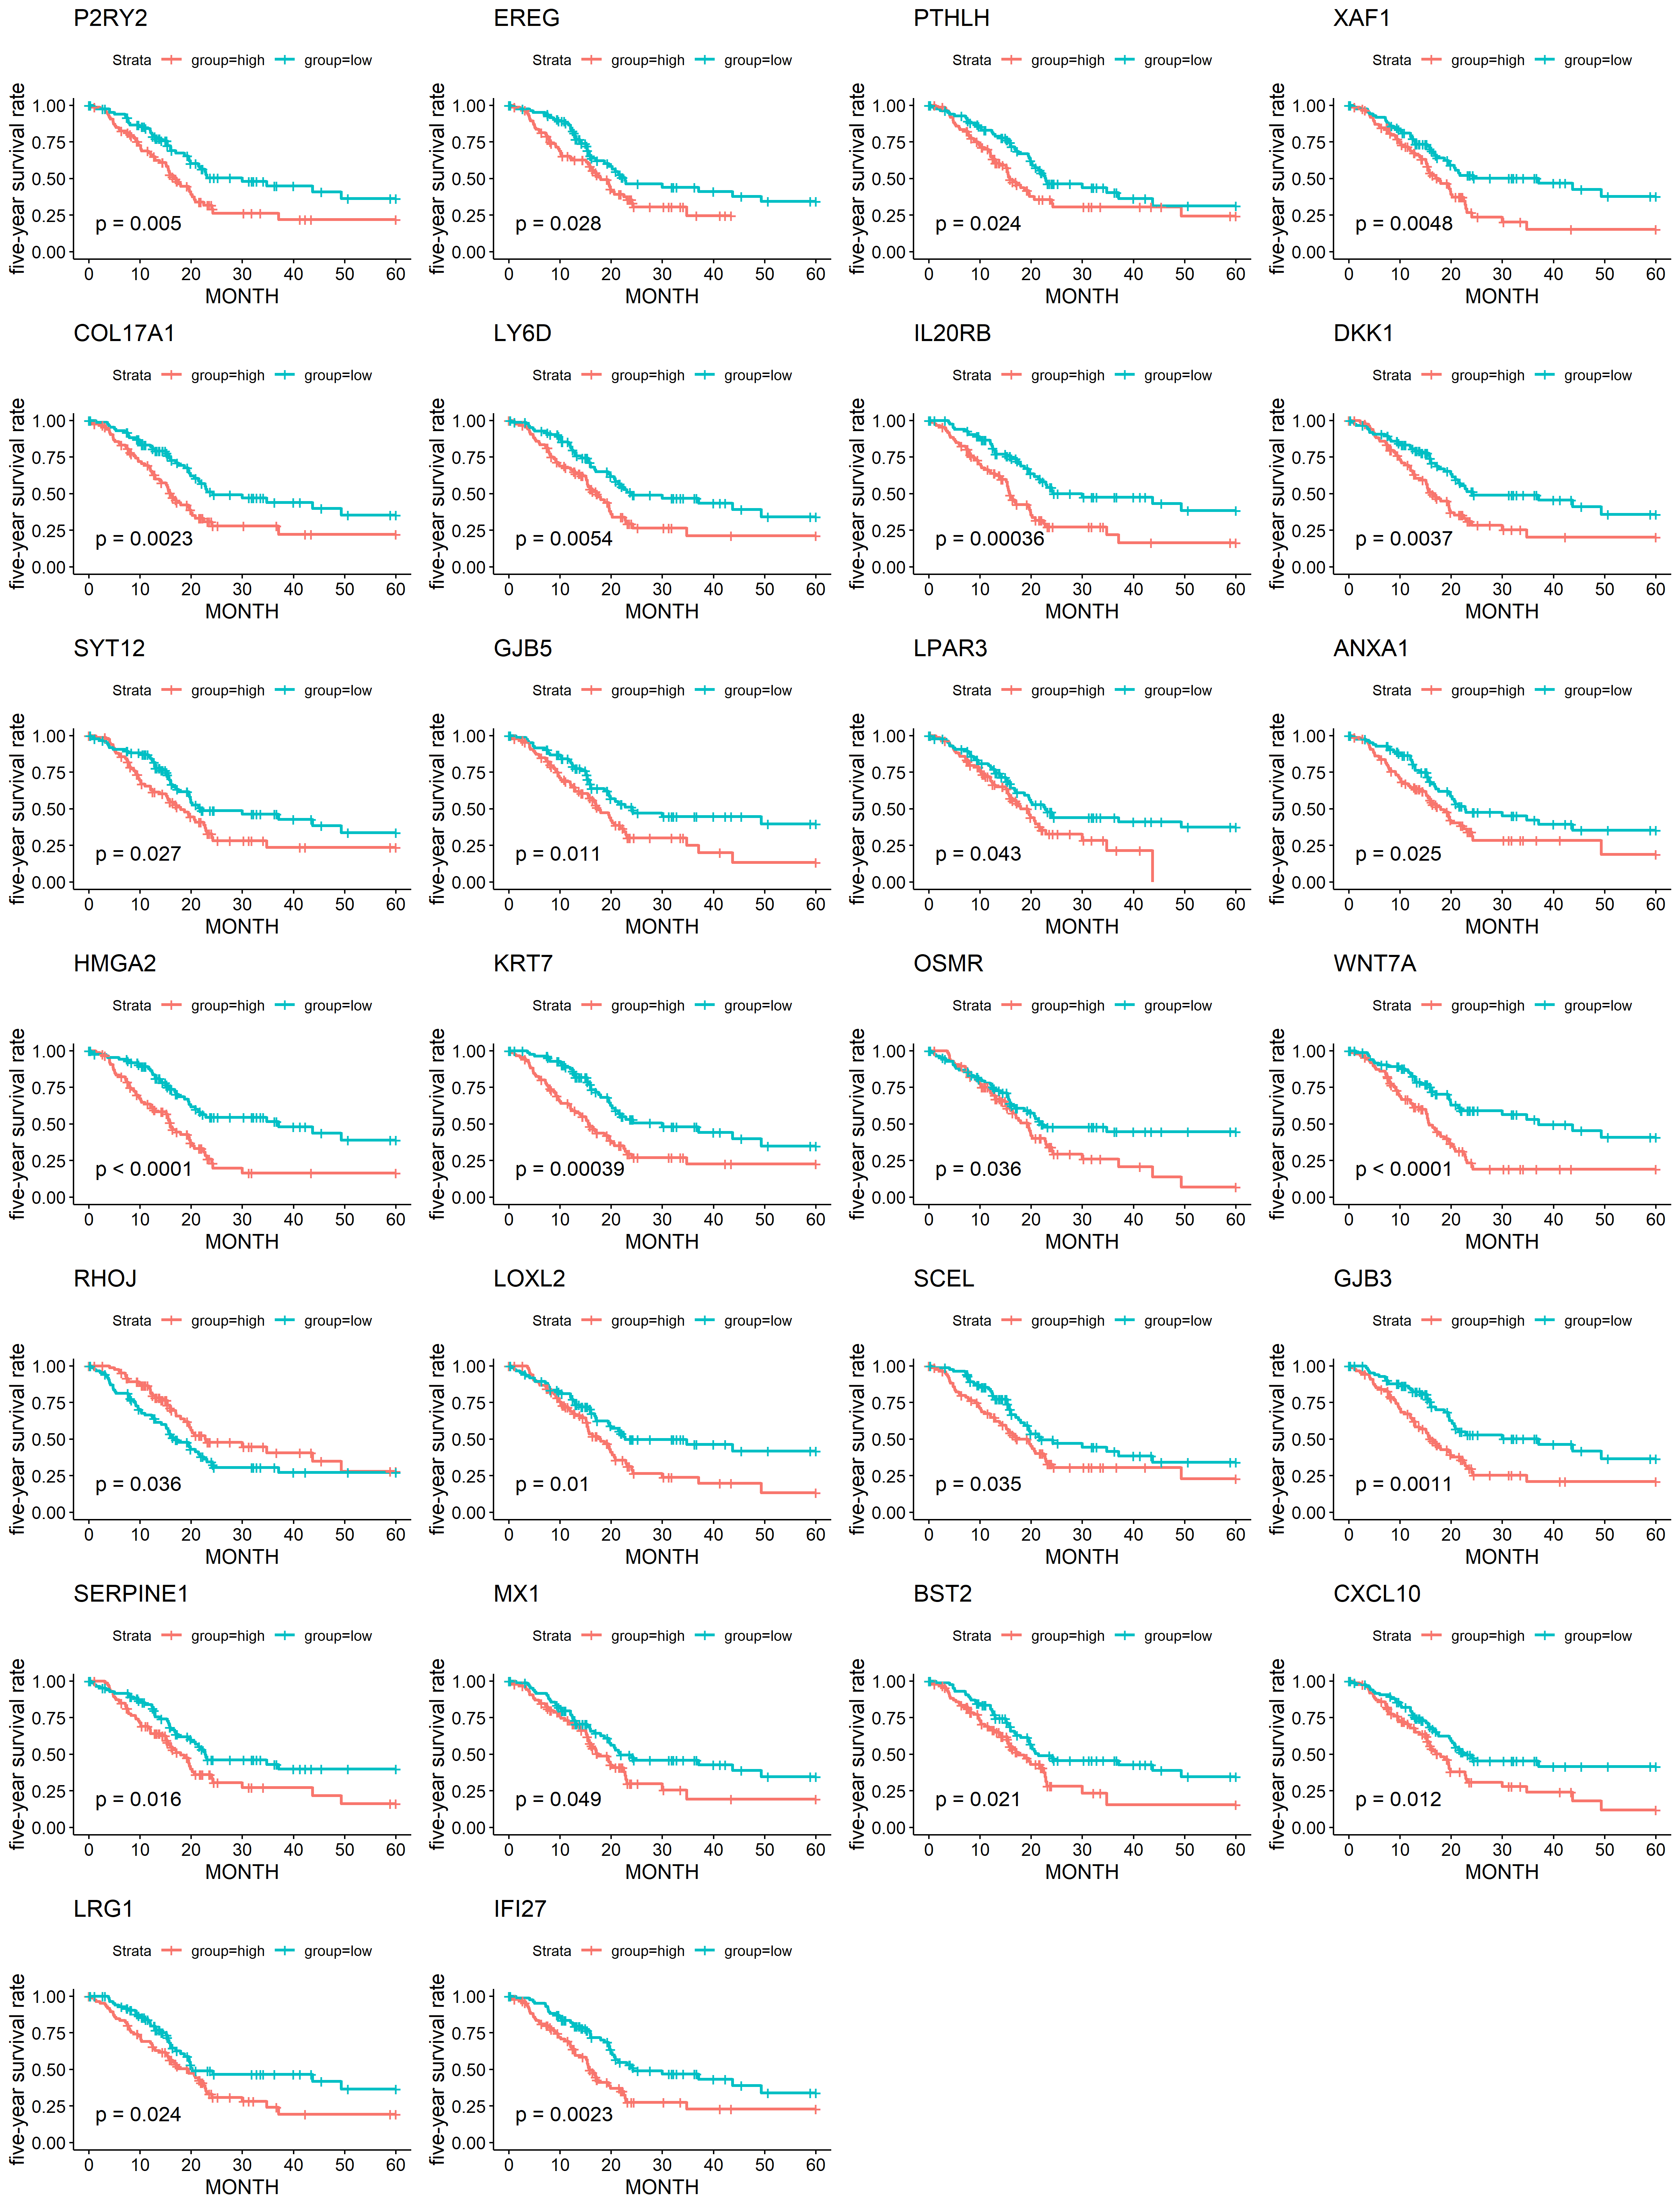
Supplementary Figure S2. ICGC cohort validation

Slide 3
Supplementary Figure S3. Top 10 ncRNAs significantly associated with pancreatic cancer prognosis
ncRNA-pivot | p value
WSPAR | 7.23E-05
hsa-miR-4425 | 0.00148618
hsa-miR-4536-5p | 0.002892394
hsa-miR-410-5p | 0.003154022
hsa-miR-8064 | 0.007506798
hsa-miR-6871-5p | 0.007815596
hsa-miR-4767 | 0.009781273
hsa-miR-608 | 0.011562024
hsa-miR-4481 | 0.012256619
hsa-miR-3605-3p | 0.01294337
Supplementary Figure S4. The pivotal TF nodes obtained by screening the TRRUST v2 database
TF-pivot | p value
RFWD2 | 0.004034
GATA6 | 0.051019
CITED2 | 0.073261
PER2 | 0.073261
TGIF1 | 0.073261
RARA | 0.084142
NR5A1 | 0.091414

Slide 4
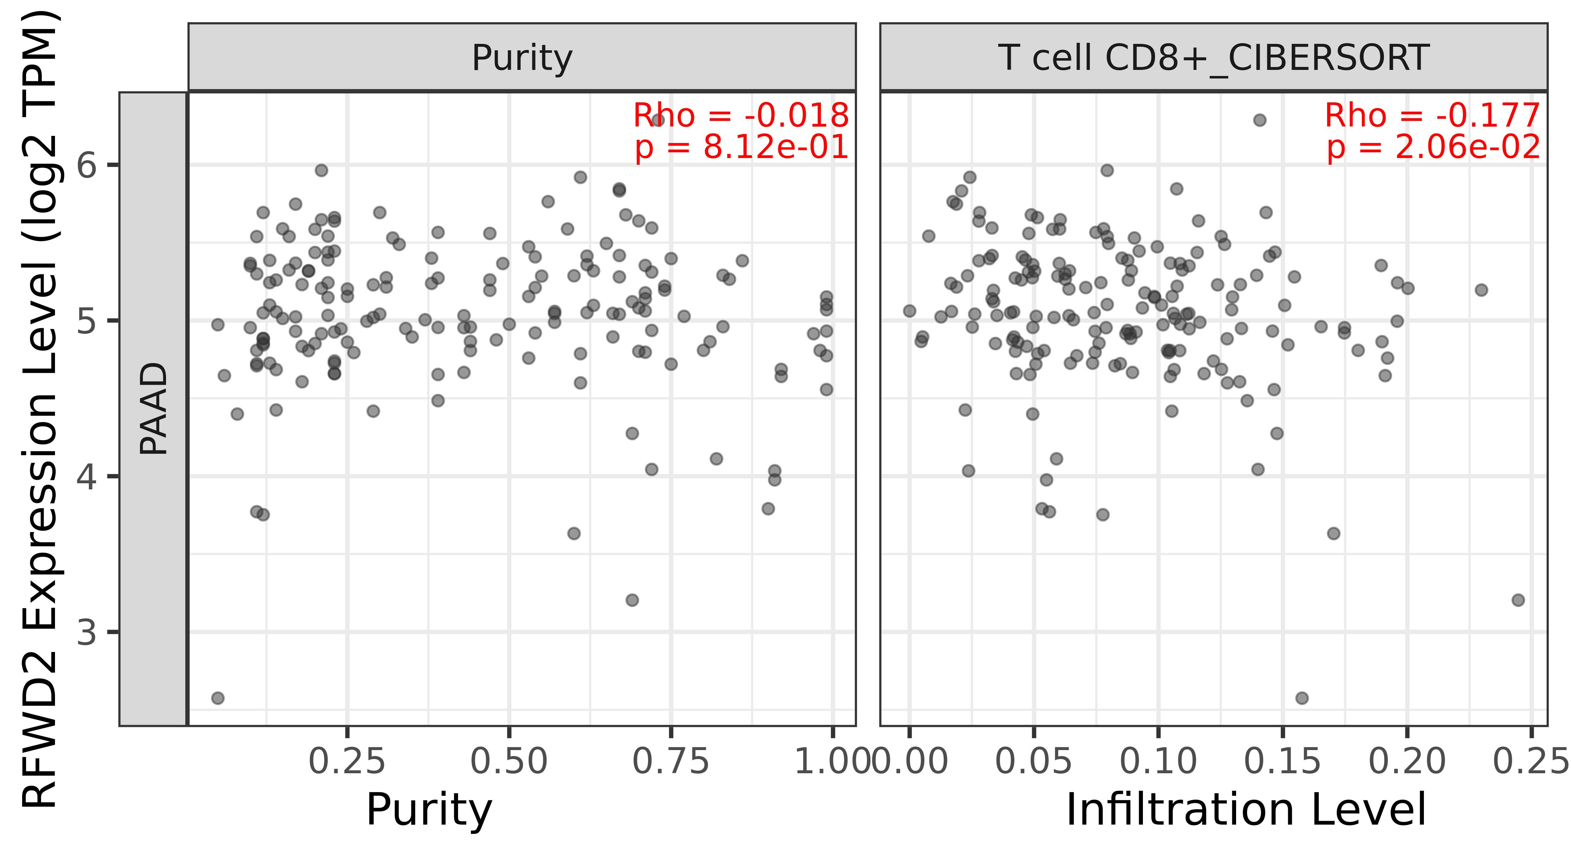
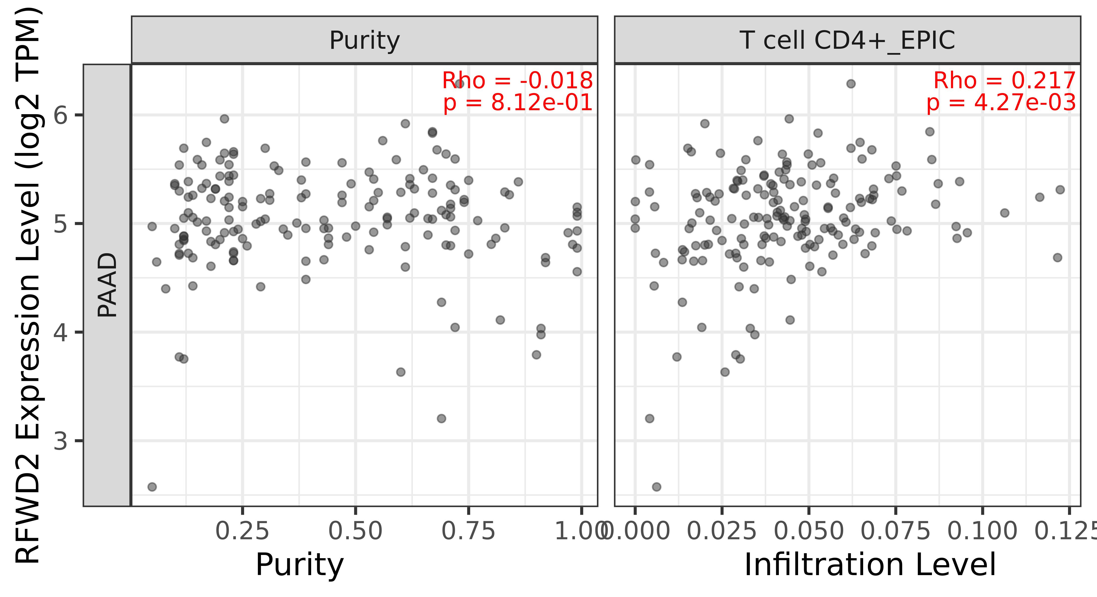
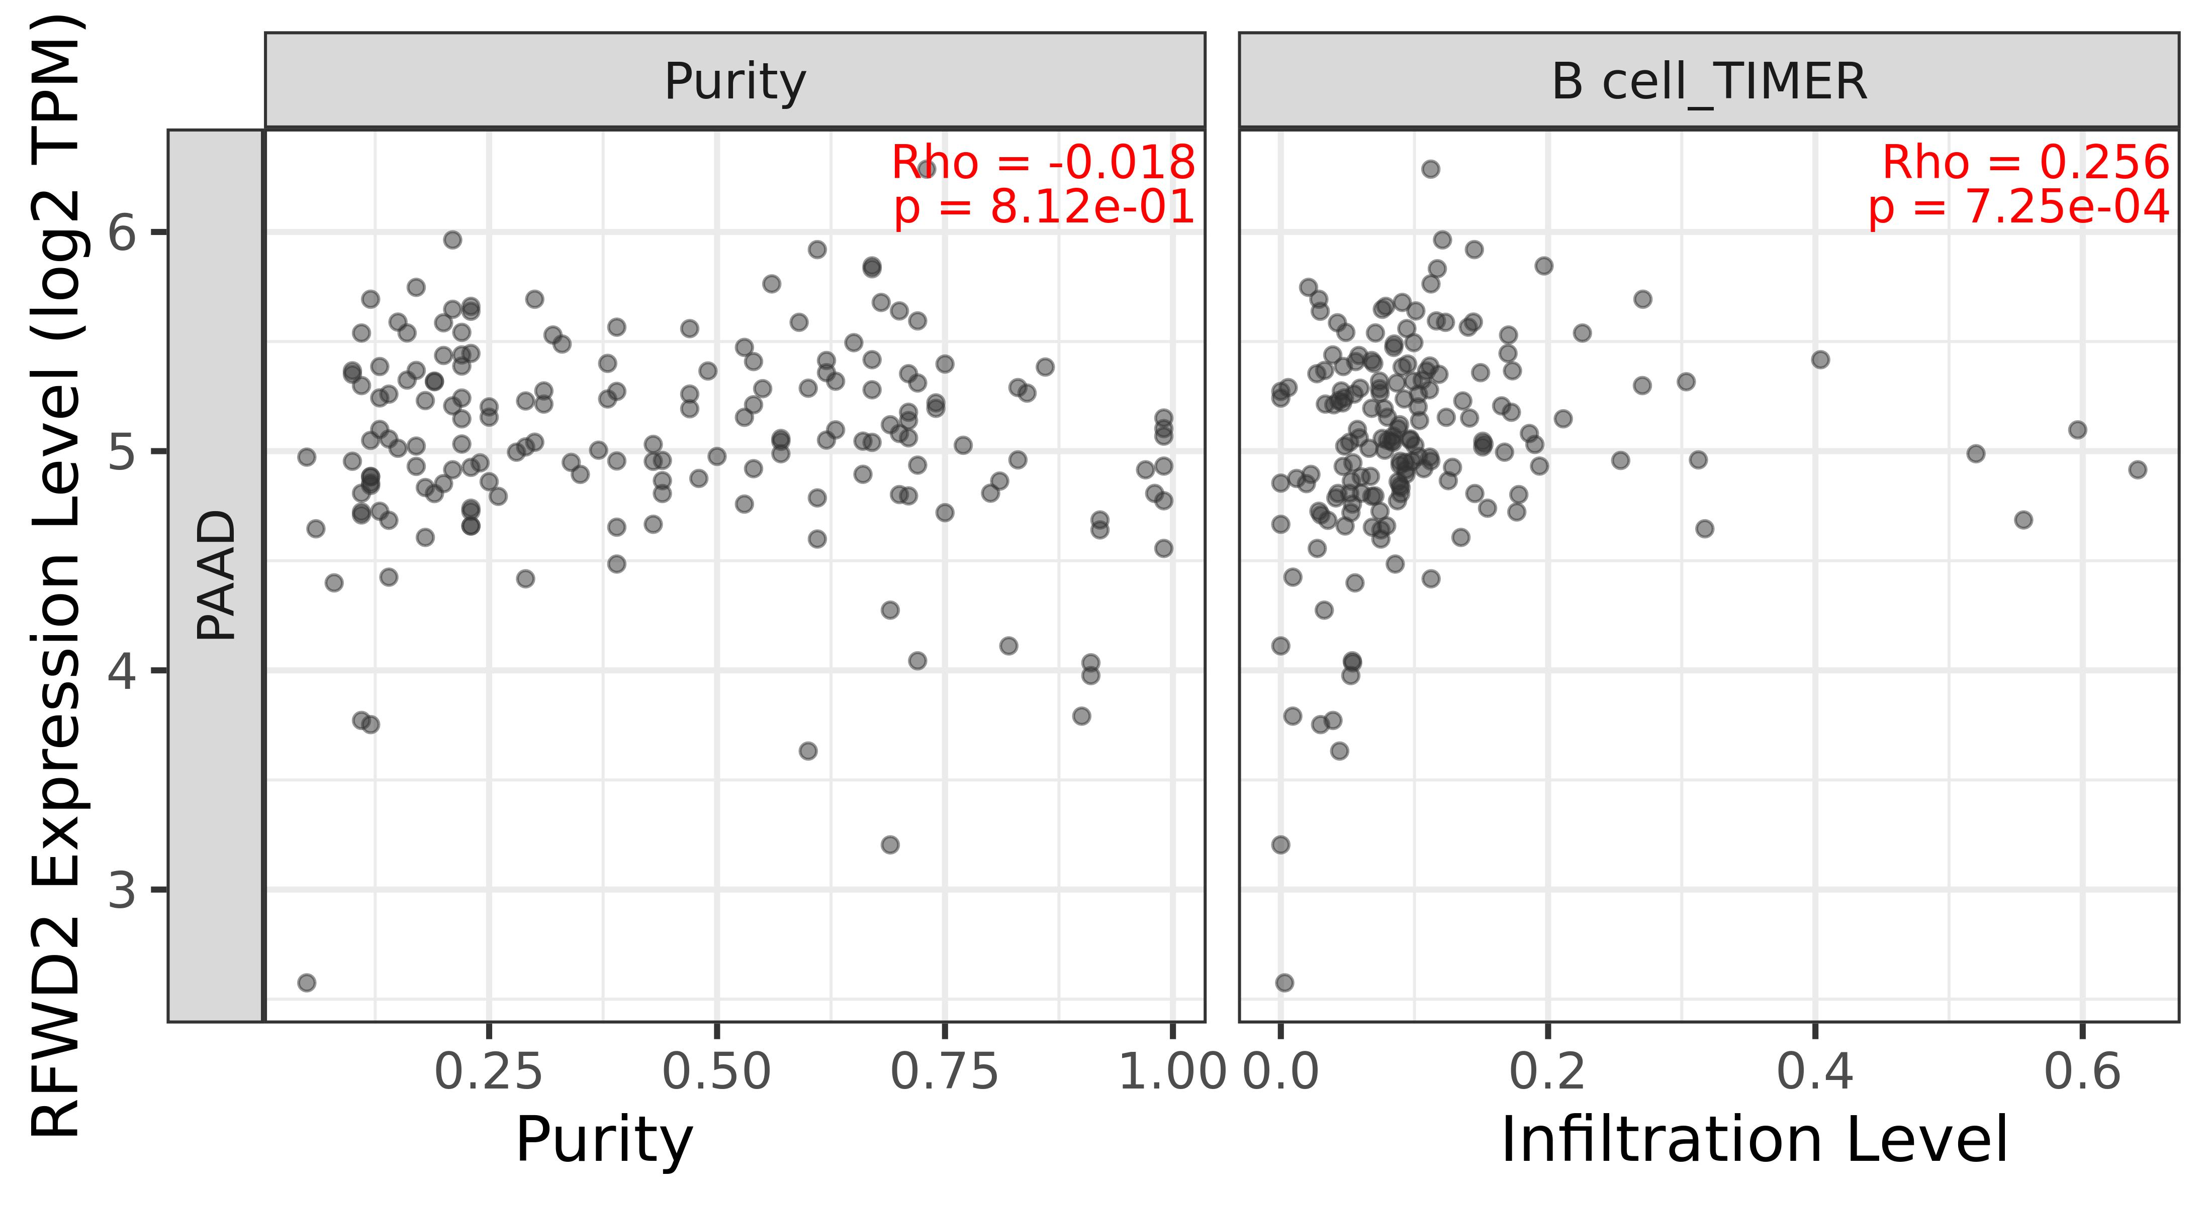
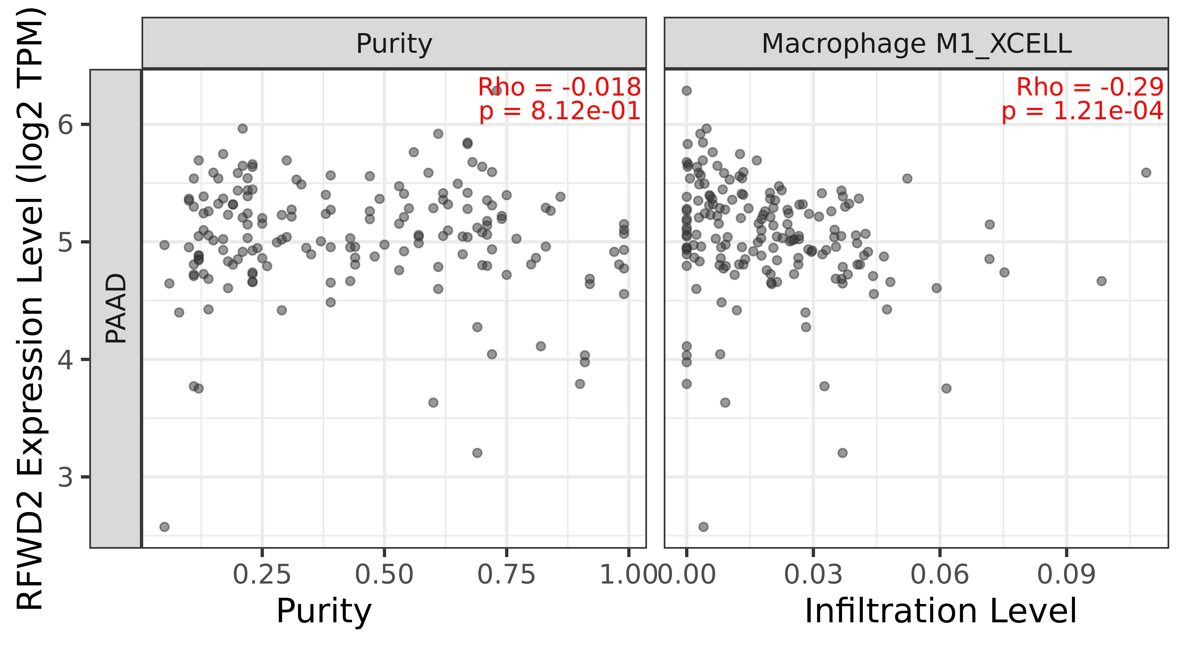

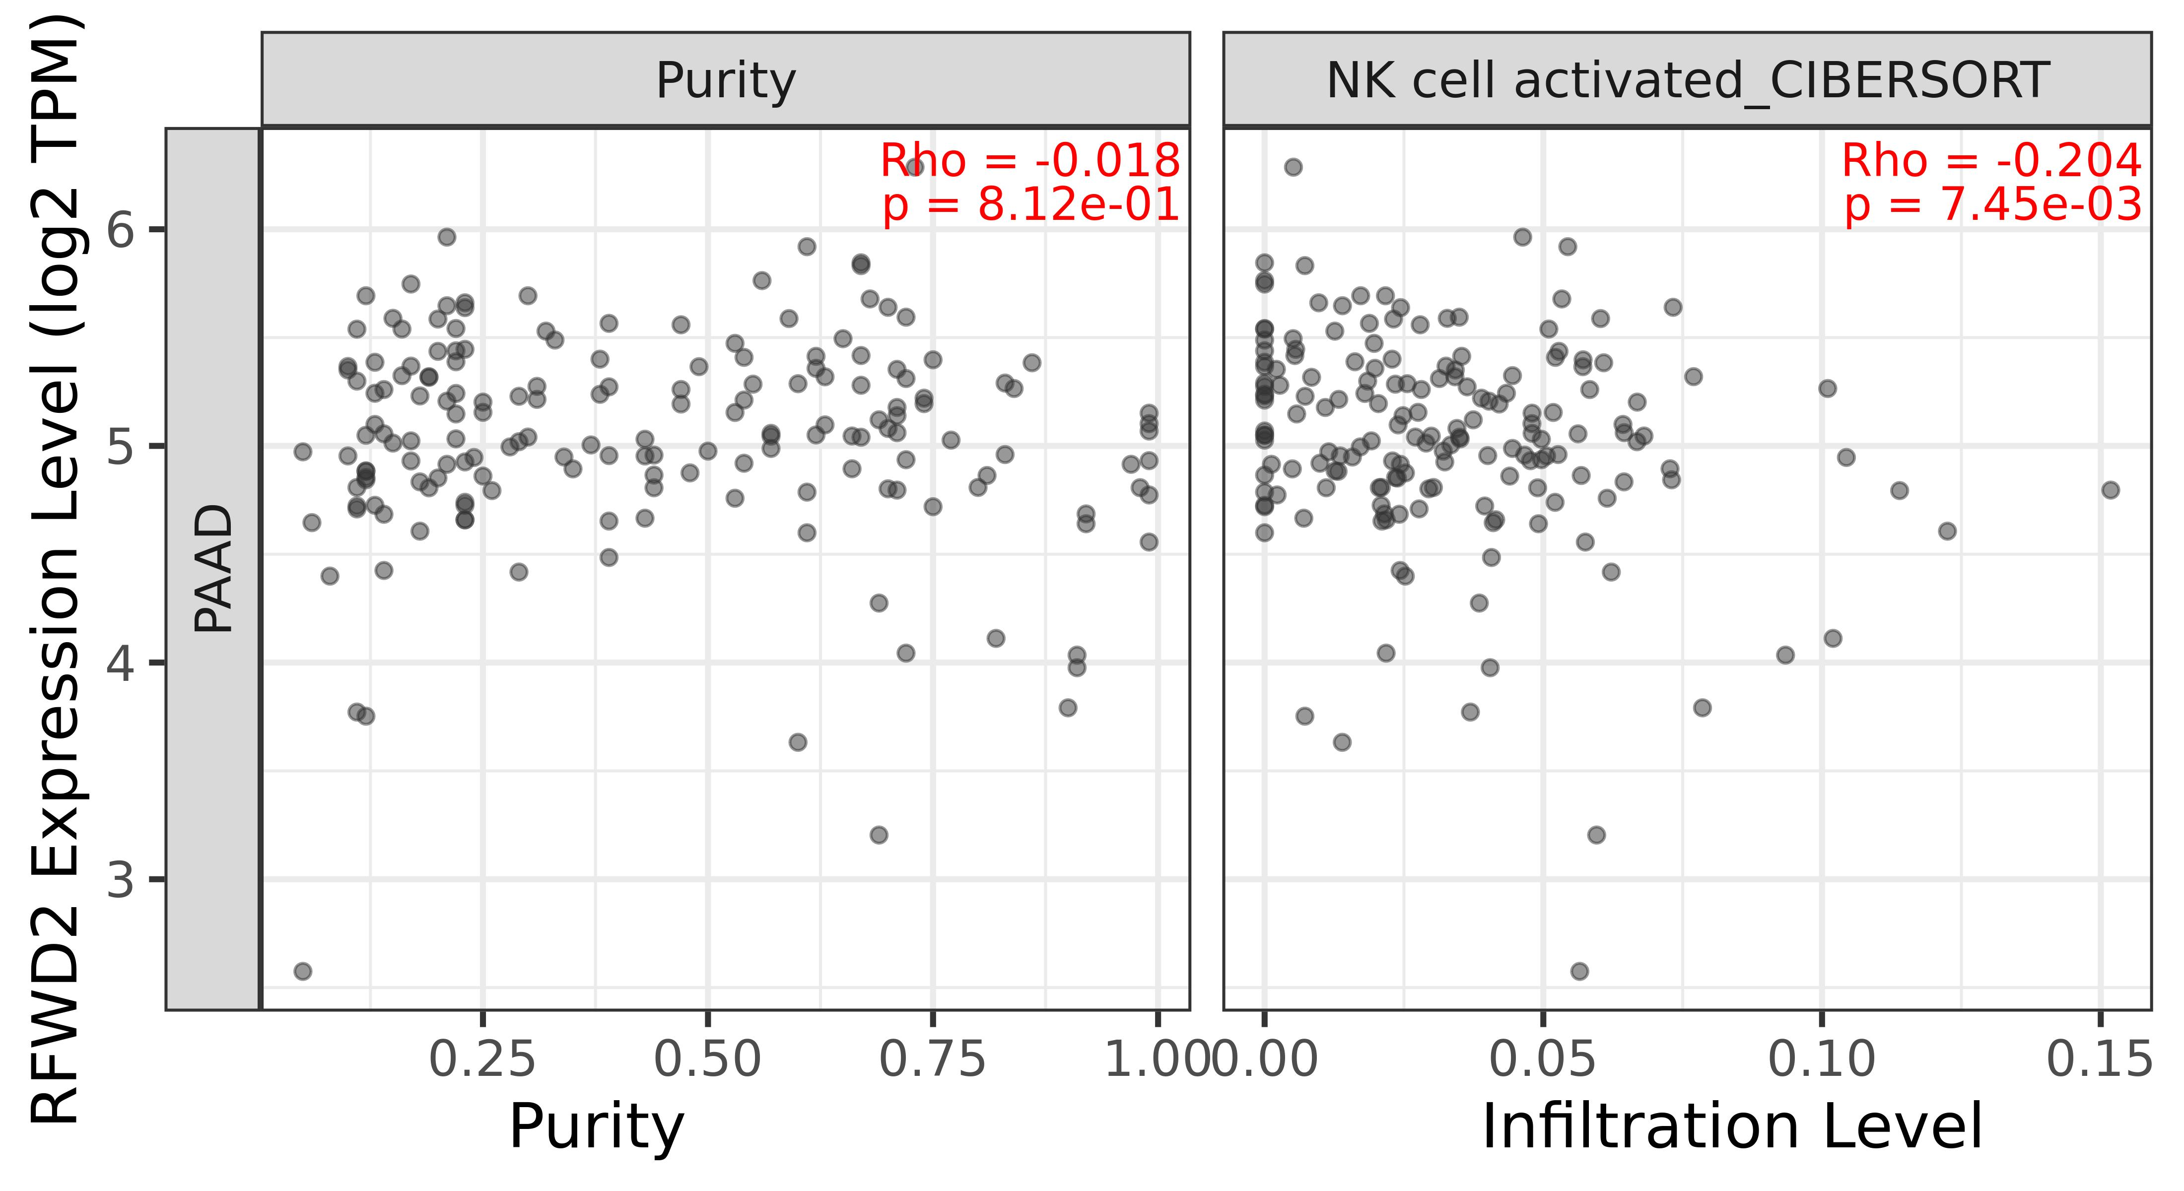
Supplementary Figure S5. Correlation of RFWD2 expression with infiltration levels of CD8+ T cell, CD4+ T cell, B cell, macrophage and natural killer cell in pancreatic cancer at TIMER 2.0 database.

