Slide 1
S. Fig. 1.A Primary Efficacy Endpoint (TLR)
P=NS
DEB vs
1st generation DES
HR 0.86 [0.37–1.97], p=0.71
DEB vs
2nd generation DES
HR 1.21 [0.63–2.34], p=0.56
2nd DES vs 1st DES
HR 0.71 [0.29–1.69], p=0.44
All P=0.71
months
Months

Slide 2
S. Fig. 1.B Primary Safety Endpoint (Cardiac death, MI, Target lesion thrombosis)
DEB vs 1st generation DES
HR 0.29 [0.08–1.01], p=0.03
DEB vs
2nd generation DES
HR 0.43 [0.16–1.16], p=0.12
2nd DES vs 1st DES
HR 0.67 [0.18–2.56],p=0.46
All P=0.09
months
Months

Slide 3
S. Fig. 2.A Cardiac death
P=NS
DEB vs
1st generation DES
HR 0.51 [0.11–2.42], p=0.33
DEB vs
2nd generation DES
HR 0.57 [0.16–2.04], p=0.40
2nd DES vs 1st DES
HR 0.89 [0.17–4.59],p=0.96
All P=0.60
months
Months

Slide 4
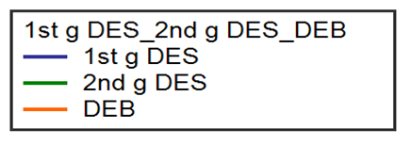
S. Fig. 2.B Myocardial infarction
P=NS
DEB vs
1st generation DES
HR 0.19 [0.03–1.26], p=0.14
DEB vs
2nd generation DES
HR 0.14 [0.03–0.65],p= 0.03
2nd DES vs 1st DES
HR 1.39 [0.18–10.41], p=0.75
All P=0.11
months
Months

Slide 5
S. Fig. 2.C Target lesion thrombosis
P=NS
DEB vs 1st DES
P=0.002
DEB vs 2nd DES
P=0.03
2nd DES vs 1st DES
HR 0.46 [0.04–5.22], p=0.34
All P=0.02
months
Months

