Slide 1
Supplemental Table 1
Correlations between Brachyury expression and clinical characteristics in HNSCC patients.
 | Brachyury
 | IHC score
Features | <4 | ≧4 | P value
Gender
male | 15 | 32
female | 1 | 4 | >0.9999
Age(years)
< 70 | 10 | 25
≧70 | 6 | 11 | 0.7509
T classification
T1,T2 | 9 | 22
T3,T4 | 7 | 14 | 0.7678
N classification
N0 | 5 | 13
N1-3 | 11 | 23 | >0.9999
Stage
Ⅰ, Ⅱ | 6 | 22
Ⅲ, Ⅳ | 10 | 14 | 0.1408
HPV p16 status
HPV p16(ー) | 11 | 13
HPV p16(＋) | 5 | 23 | 0.0384

Slide 2


Supplemental Figure S1
UM-SCC-47
SCC090
SCC152
Brachyury
β-actin

Slide 3
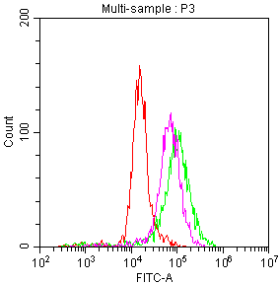

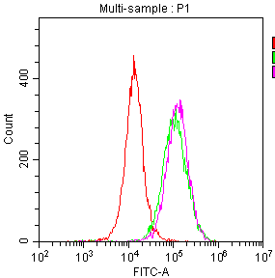
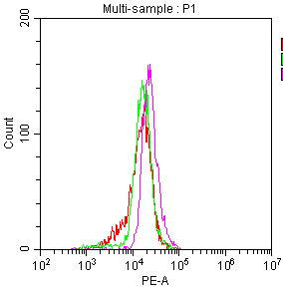
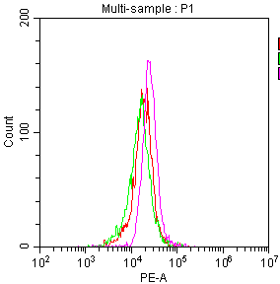
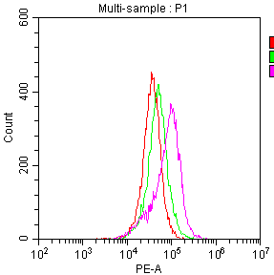
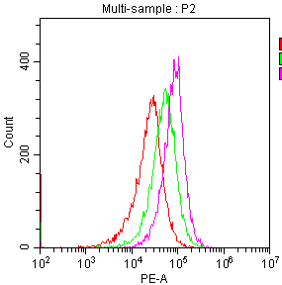
Supplemental Figure S2
a
b
MFI
HPC92Y
HSC4
HPC92Y
HSC4
Isotype
Isotype
HLA-class I
HLA-class I
No treatment
No treatment
CDDP
CDDP
HLA-class I
Isotype
Isotype
HLA-DR
HLA-DR
No treatment
No treatment
CDDP
CDDP
HLA-DR
Isotype
Isotype
PD-L1
PD-L1
No treatment
No treatment
CDDP
CDDP
PD-L1

Slide 4

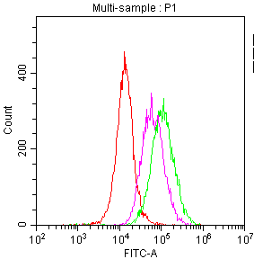
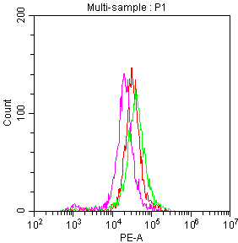
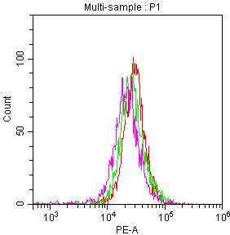
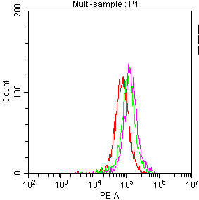
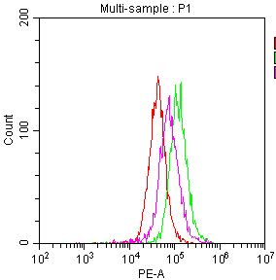
Supplemental Figure S2
c
d
MFI
HPC92Y
HSC4
HPC92Y
HSC4
Isotype
Isotype
HLA-class I
HLA-class I
No treatment
No treatment
RT
RT
HLA-class I
Isotype
Isotype
HLA-DR
HLA-DR
No treatment
No treatment
RT
RT
HLA-DR
Isotype
Isotype
PD-L1
PD-L1
No treatment
No treatment
RT
RT
PD-L1

Slide 5
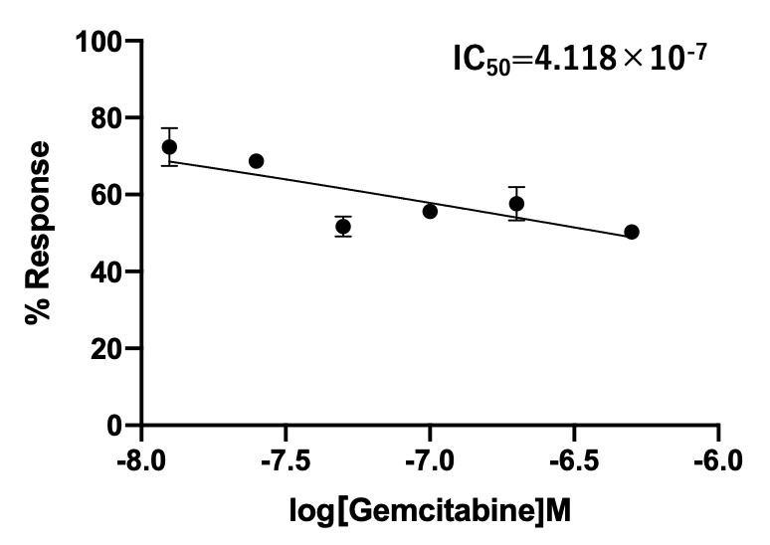
Supplemental Figure S3
HPC92Y

Slide 6
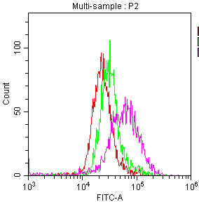
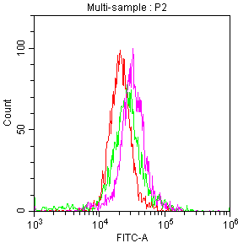
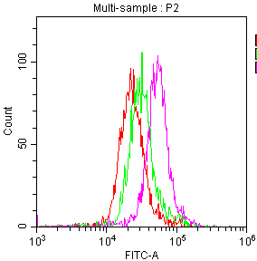
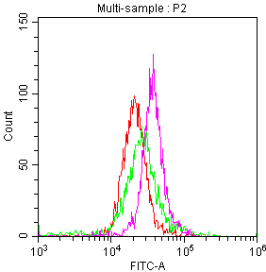
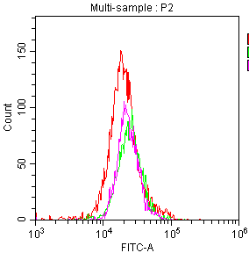
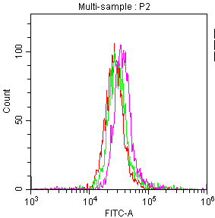
Supplemental Figure S4
a
b
MFI
HPC92Y
HSC4
HPC92Y
HSC4
Isotype
Isotype
No treatment
No treatment
GEM
GEM
Isotype
Isotype
No treatment
No treatment
CDDP
CDDP
Isotype
Isotype
No treatment
No treatment
RT
RT

