Slide 1
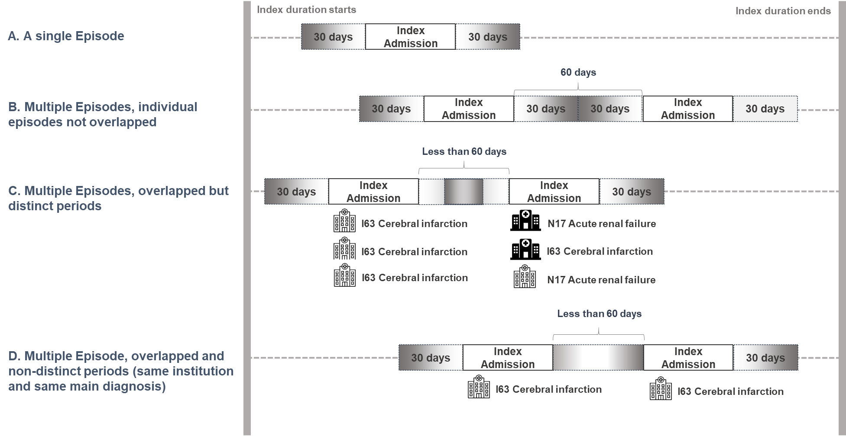
Modified from the classification of overlapped episode windows [16].
Notes:
Additional file 1. Overlapping episode windows

