Slide 1
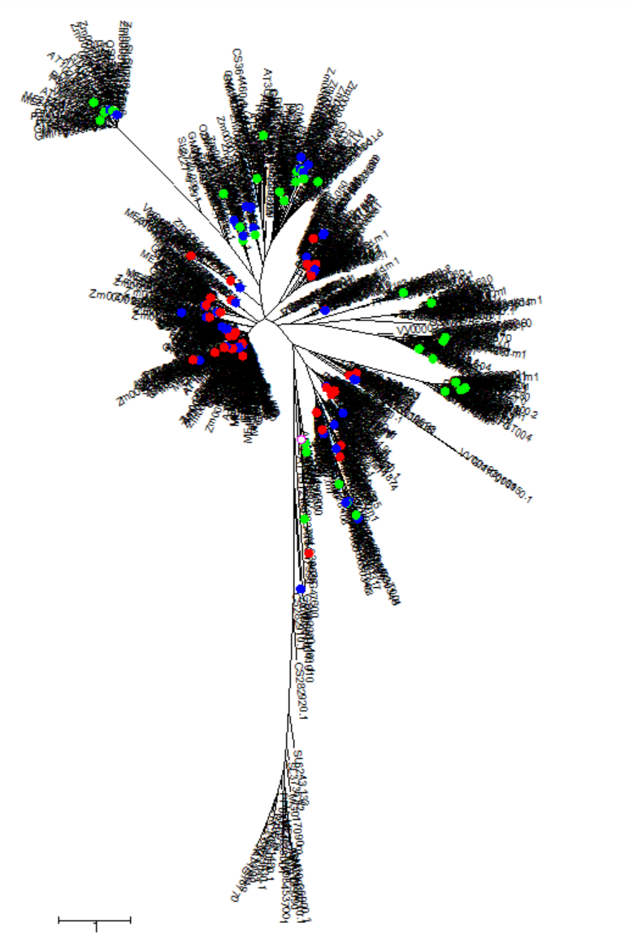
Supplemental Figure 1
Supplemental Figure 1. Phylogenetic analysis of plant ACD proteins. The unrooted neighbor-joining phylogenetic tree was conducted with17 complete plant ACD protein sequences [1] with bootstrap values shown for each clade. The red dots stand for Hsp20 from rice and Arabidopsis. The green dots stand for ACD proteins from rice and Arabidopsis except Hap20. The blue dots stand for ACD proteins from maize.
[1] Bondino, Hernán Gabriel, Estela Marta Valle, and Arjen Ten Have. "Evolution and functional diversification of the small heat shock protein/α-crystallin family in higher plants." Planta 235 (2012): 1299-1313.

Slide 2
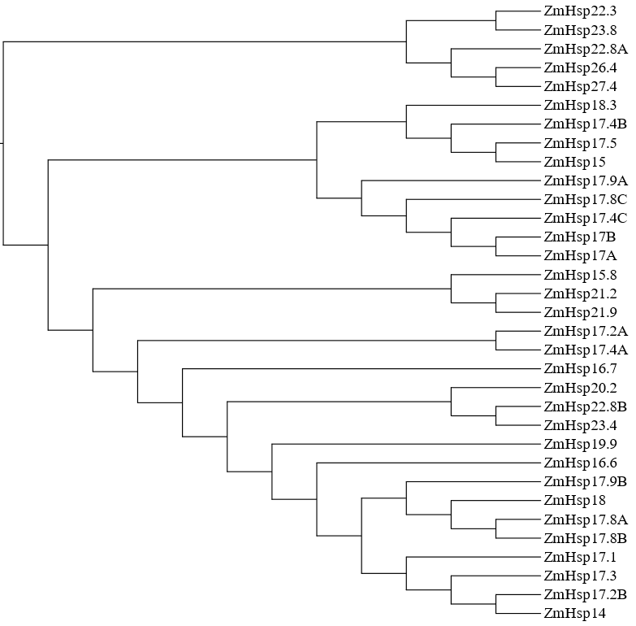
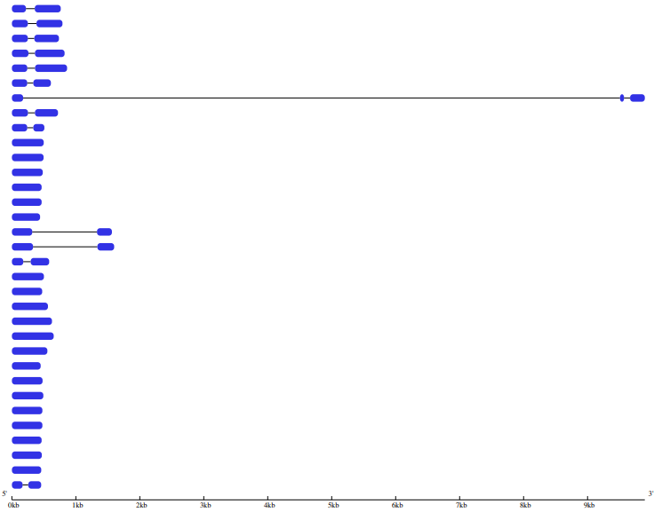

Supplemental Figure 2
Supplemental Figure 2. Phylogenetic relationships (A) and gene structures (B) of HSP20s in maize. (A) Unrooted phylogenetic tree was generated based on the amino acid sequences by the neighbor-joining (NJ) method using MEGA 6.0. Bootstrap supports from 1000 replicates are indicated at each branch. (B) Gene structure was analyzed using the Gene Structure Display Server online. Blue boxes indicate exons, lines indicate introns

Slide 3
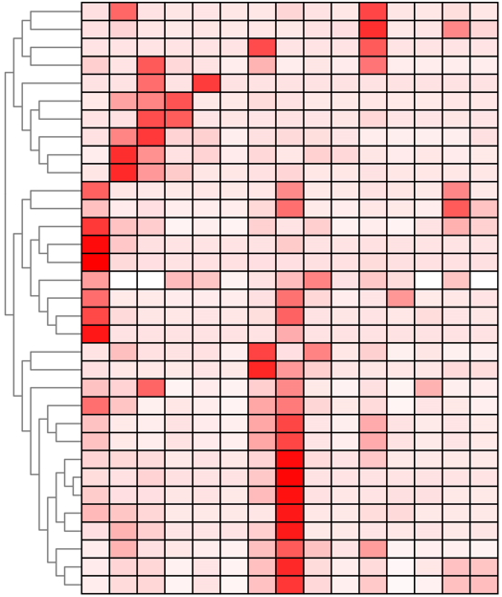

Supplemental Figure 3
ZmHsp17.8A
ZmHsp17.8B
ZmHsp22.8A
ZmHsp14
ZmHsp20.2
ZmHsp15.8
ZmHsp17.2B
Clade Ⅰ
ZmHsp17.3
ZmHsp17B
ZmHsp17A
ZmHsp17.1
ZmHsp27.4
ZmHsp17.9A
ZmHsp18.3
ZmHsp17.9B
ZmHsp26.4
ZmHsp17.4C
ZmHsp15
Clade Ⅱ
ZmHsp18
ZmHsp23.4
ZmHsp23.8
ZmHsp17.8C
ZmHsp22.8B
ZmHsp19.9
ZmHsp21.2
ZmHsp17.2A
ZmHsp17.4A
ZmHsp21.9
Clade Ⅲ
ZmHsp17.5
ZmHsp16.7
ZmHsp17.4B
ZmHsp22.3
Ear
ZmHsp16.6
Root
Cob
Silk
Tassel
Pollen
Leaf
Anther
Roothair
Shoot
SAM
Ovule
Embryo
Seed
Endosperm
Supplemental figure 3 :Analysis of expression profile of maize Hsp20 genes. The data are normalized by “Row scale”. The color scale signal values are shown on the right. White represents a low level and red indicates a high level of transcript abundance. The different tissues and/or organs are noted on the bottom of each lane. Cluster dendrograms are shown on the left.

Slide 4
Supplemental Figure 4
Log10(raw data)
Supplemental Figure 4. proteomic data of ZmHSP26.4 under four treatments. Proteins with log2(fold-change)|≥1 and FDR<0.05 were considered to be differentially expressed proteins. NN, normal day/normal night. DNH, hot day/hot night. DH, hot day/normal night. NH, normal day/hot night.

