Slide 1
PhotoVoice images
Result: The barriers to MHM differ depending on the functional limitation person’s impairment
Participants requested that their real names are credited whenever their photos and captions are used.

Slide 2
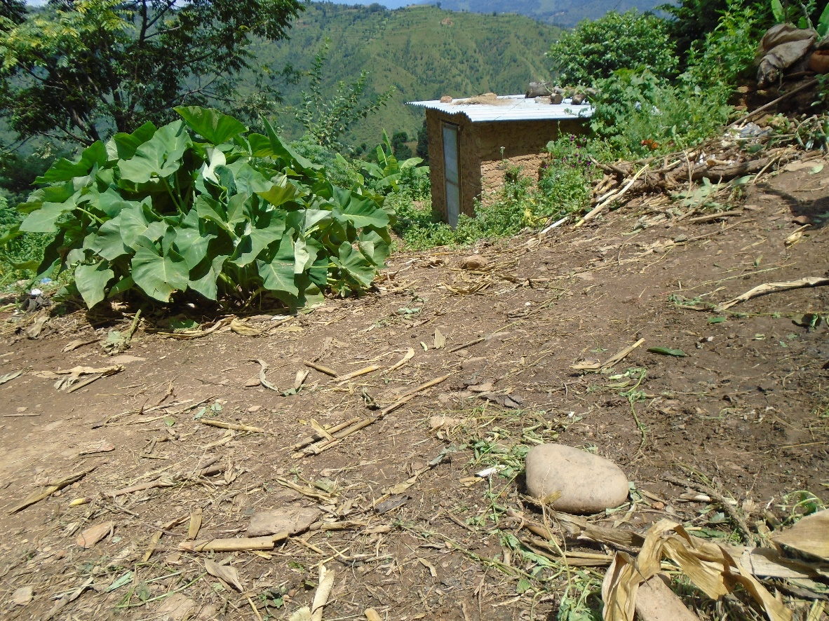
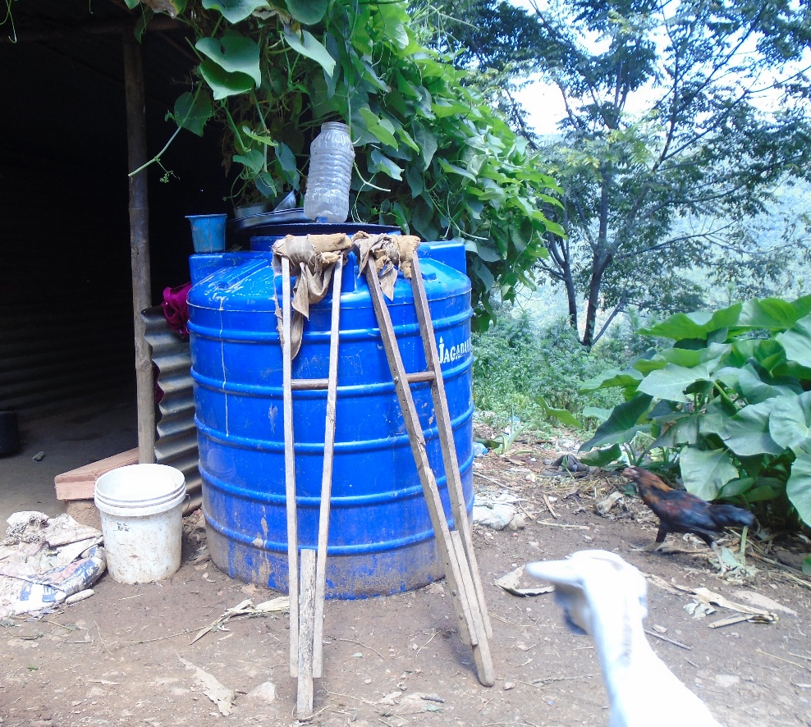
Caption: It is difficult to go to toilet
Ranked 1 out of 4
Caption: Water issue is also there, I would have to carry water which is difficult
Ranked 2 out of 4
©Sharmila

Slide 3
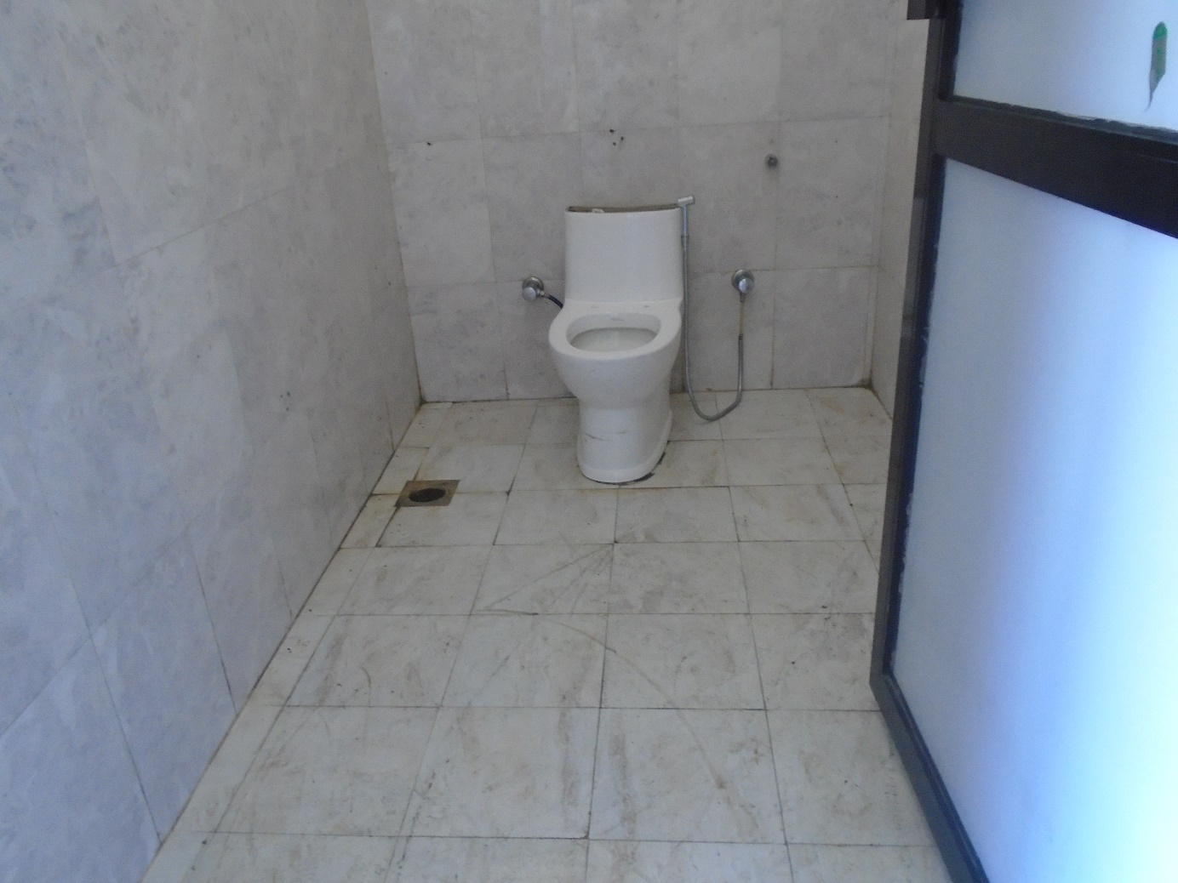
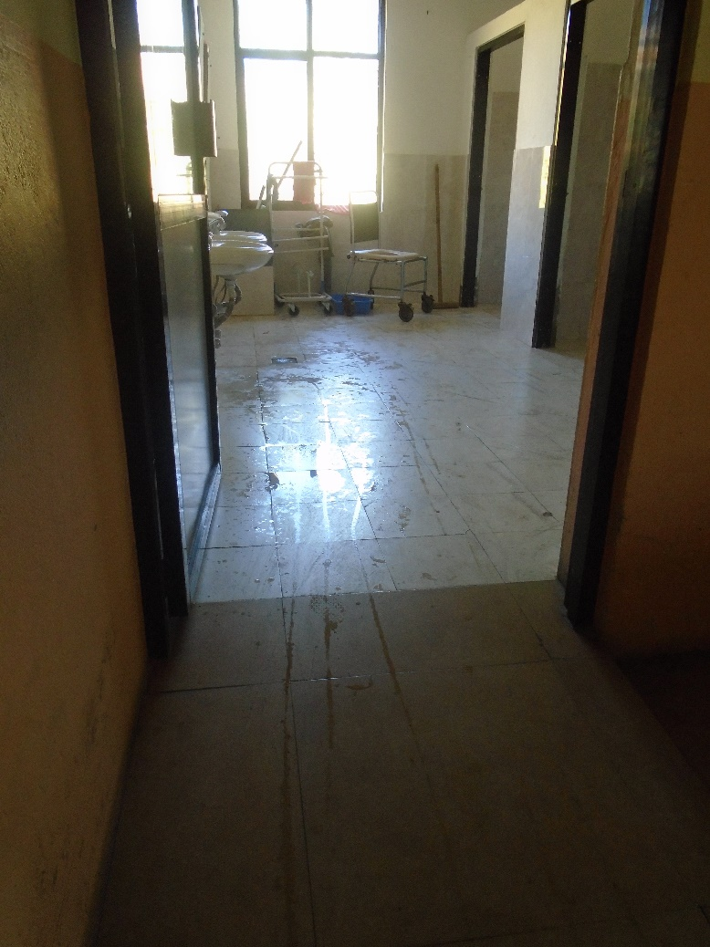
©Babati
Caption: During period one should be careful using bathroom. Our legs might already feel weak (lulo) so we might fall down and meet an accident. Here the toilets are made for everyone to use but if it was to built at home for crutches user, it is to be made in a way that it is not slippery. Marble should not be used as it is slippery.
Ranked 3 out of 5
Caption: It is not only easier to use this type of toilet for those with spinal cord injury but it is a necessity. So even in villages, these types of toilets should be built for people as not everyone can live in the cities. During period also it is difficult to stand to change pads so these kind is easier to use.
Ranked 1 out of 5

Slide 4
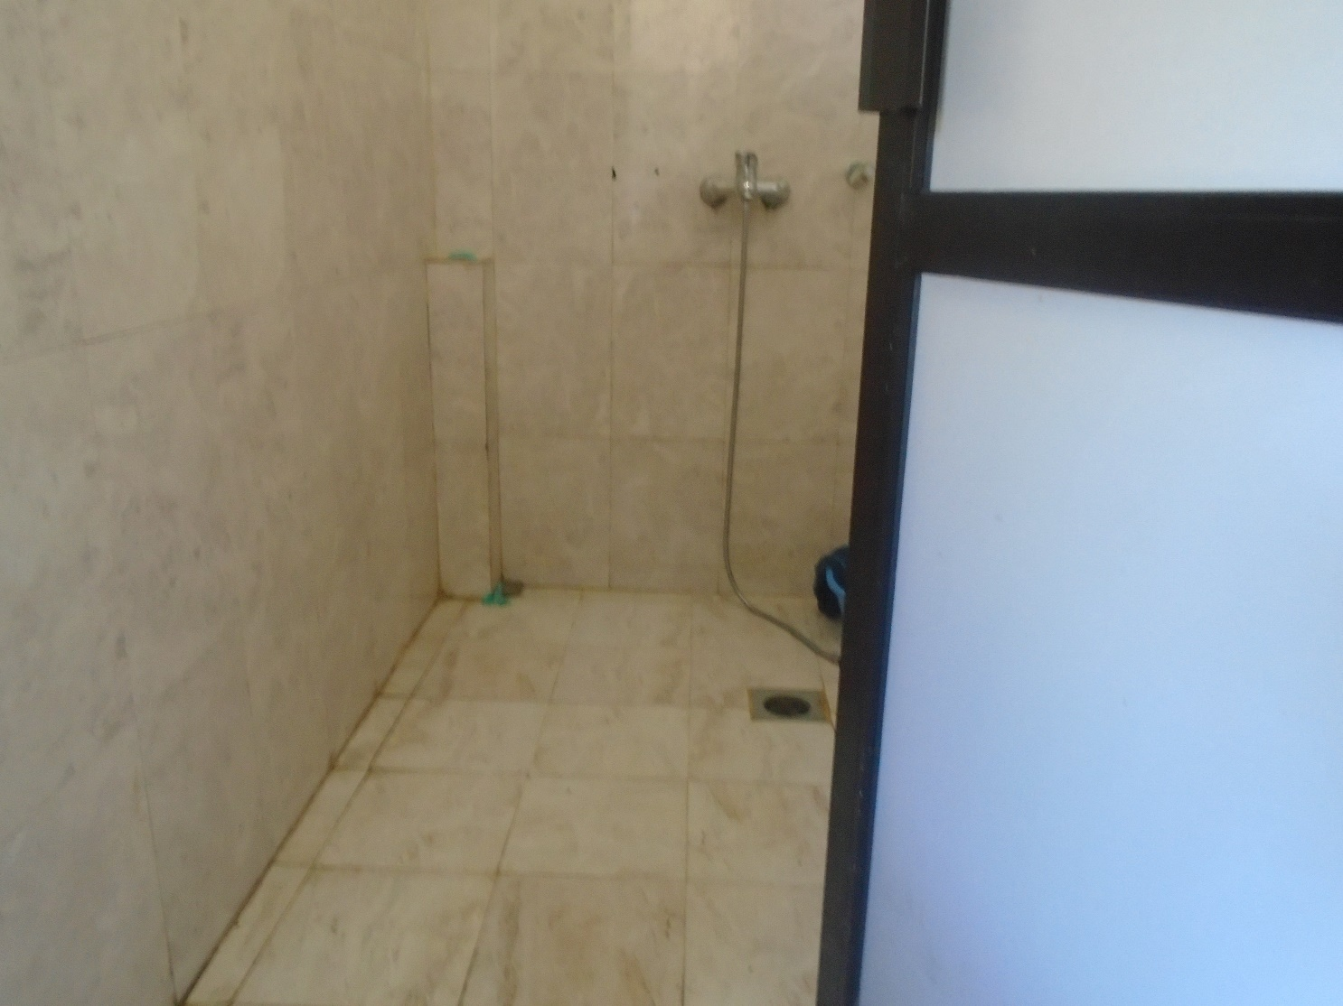
©Babati
Caption: For us to be able to wash our own clothes, bathroom should be made in such a way that we can wash our clothes ourselves while sitting on wheelchair. It will be much easier.
I can’t wash clothes while standing or sitting. At home, I sit in a small stool but there is none here. If the washing space could be reached while sitting on a wheelchair, it would be good.
(Ranked 5 out of 5)

Slide 5
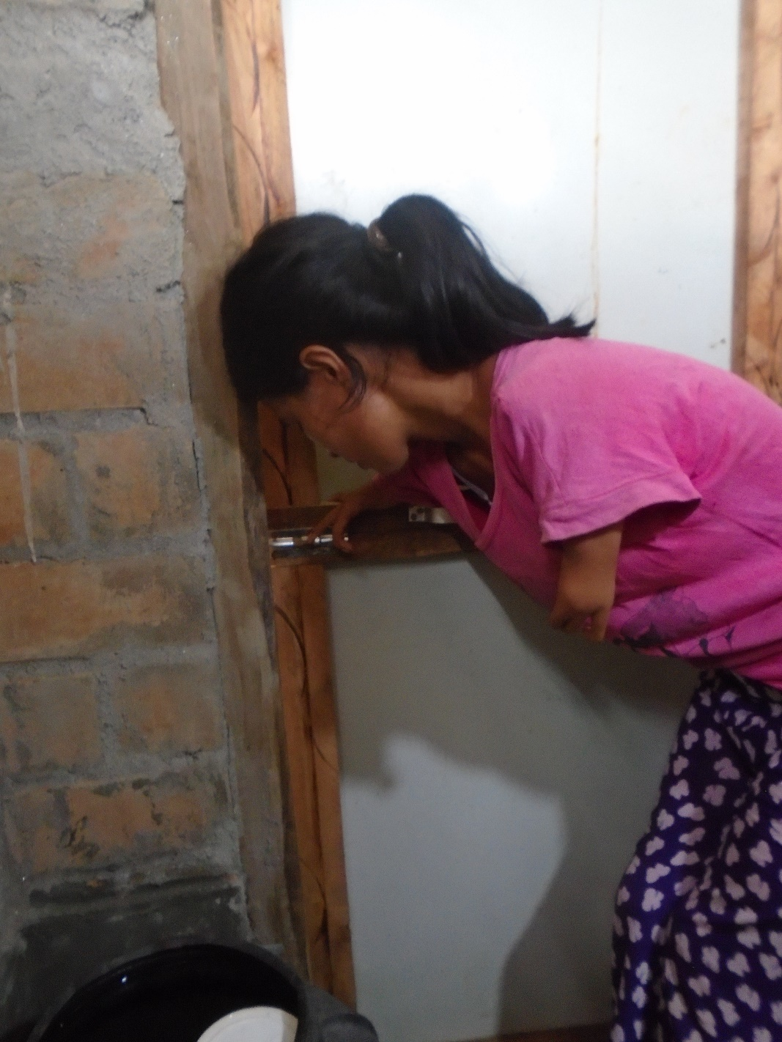
Caption: When I have to use the toilet, I need someone else to help with the latch otherwise I can’t do it myself.
Ranked 3 out of 4
©Tulasa

Slide 6
Result: Disposable menstrual pads are preferable, but disposal practices and services are inadequate

Slide 7
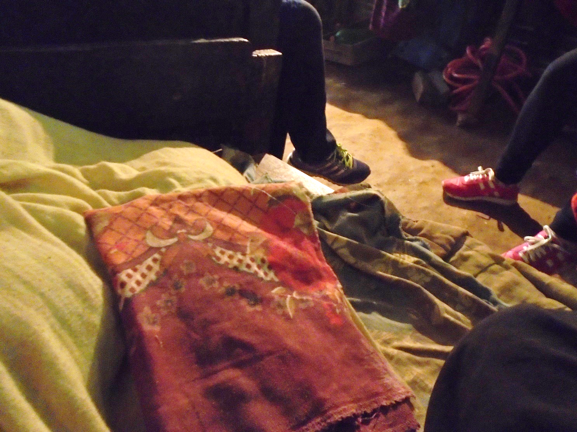
Caption: Pad is easy to use compared to cloth.
Ranked 3 out of 4
©Sharmila

Slide 8
Result: Impacts of menstrual restrictions

Slide 9
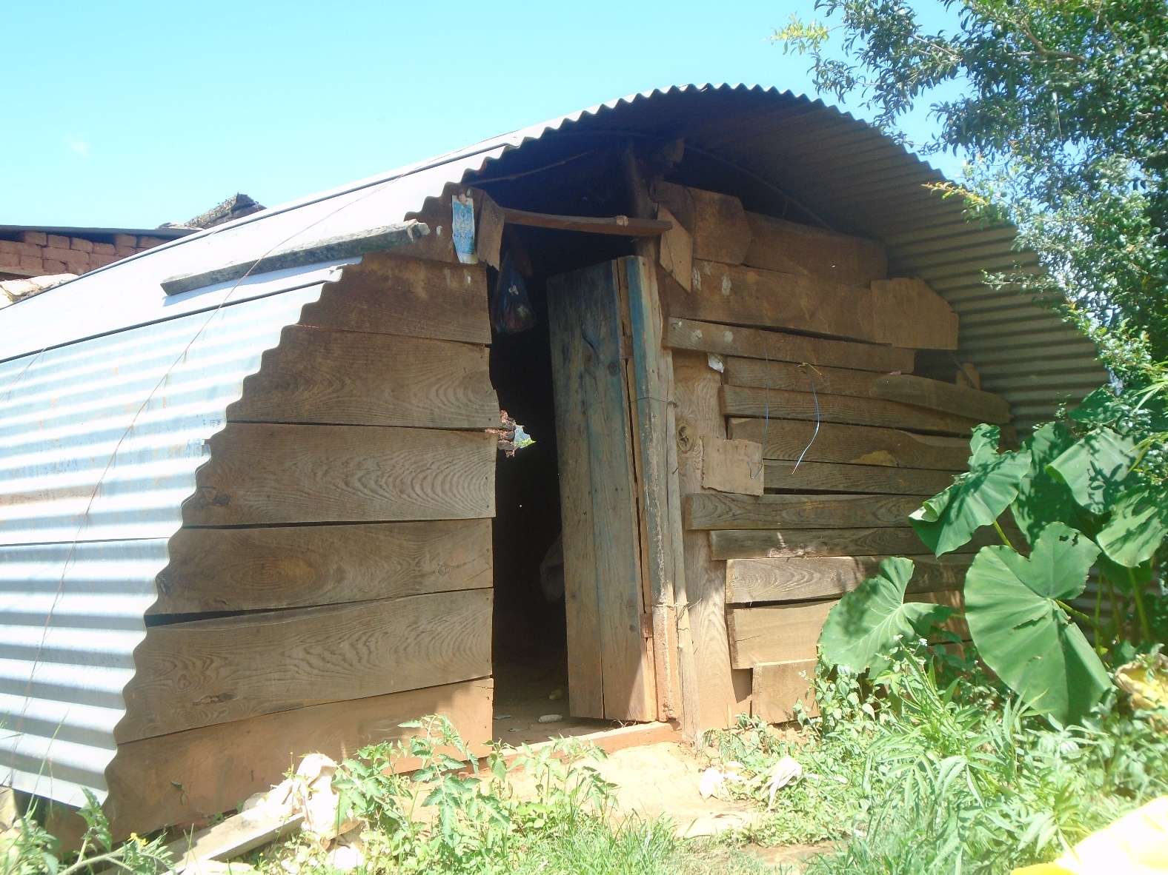
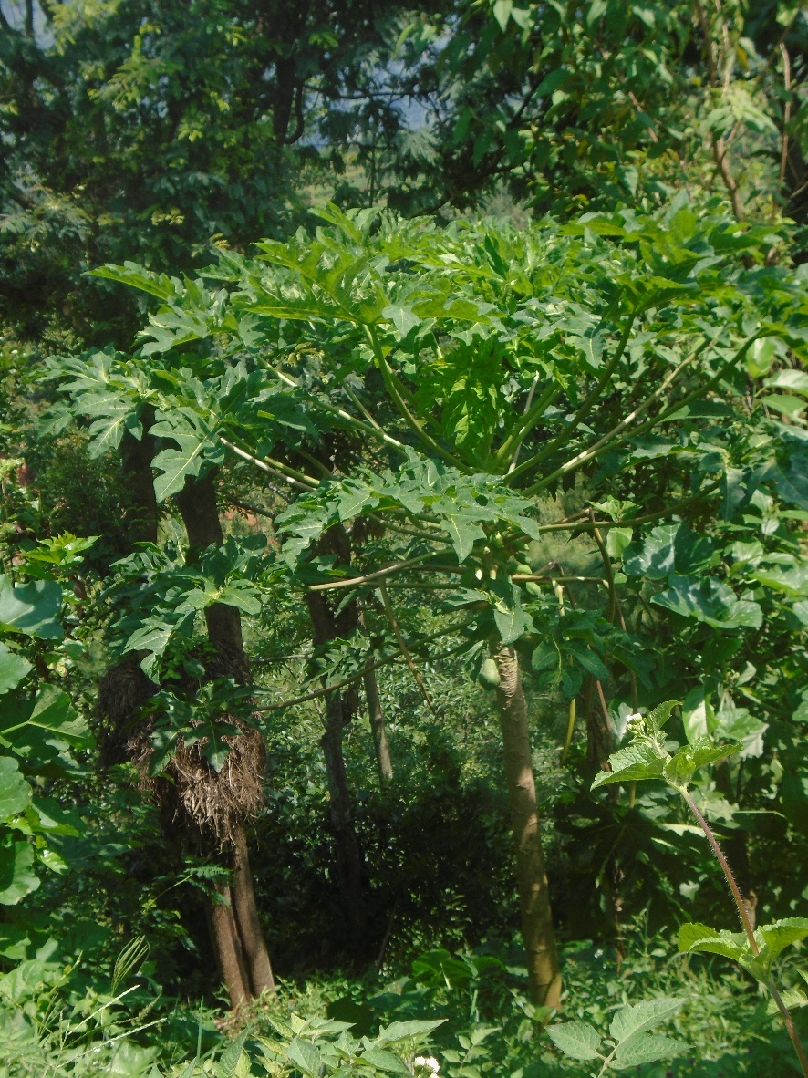
Caption: During menstruation we are not allowed to enter the house. [The image is of the hut Tulasa sleeps in when menstruating].
Ranked 2 out of 4
Caption: There is a belief that if you touch plants during period, it will rot.
Ranked 4 out of 4
©Tulasa

Slide 10
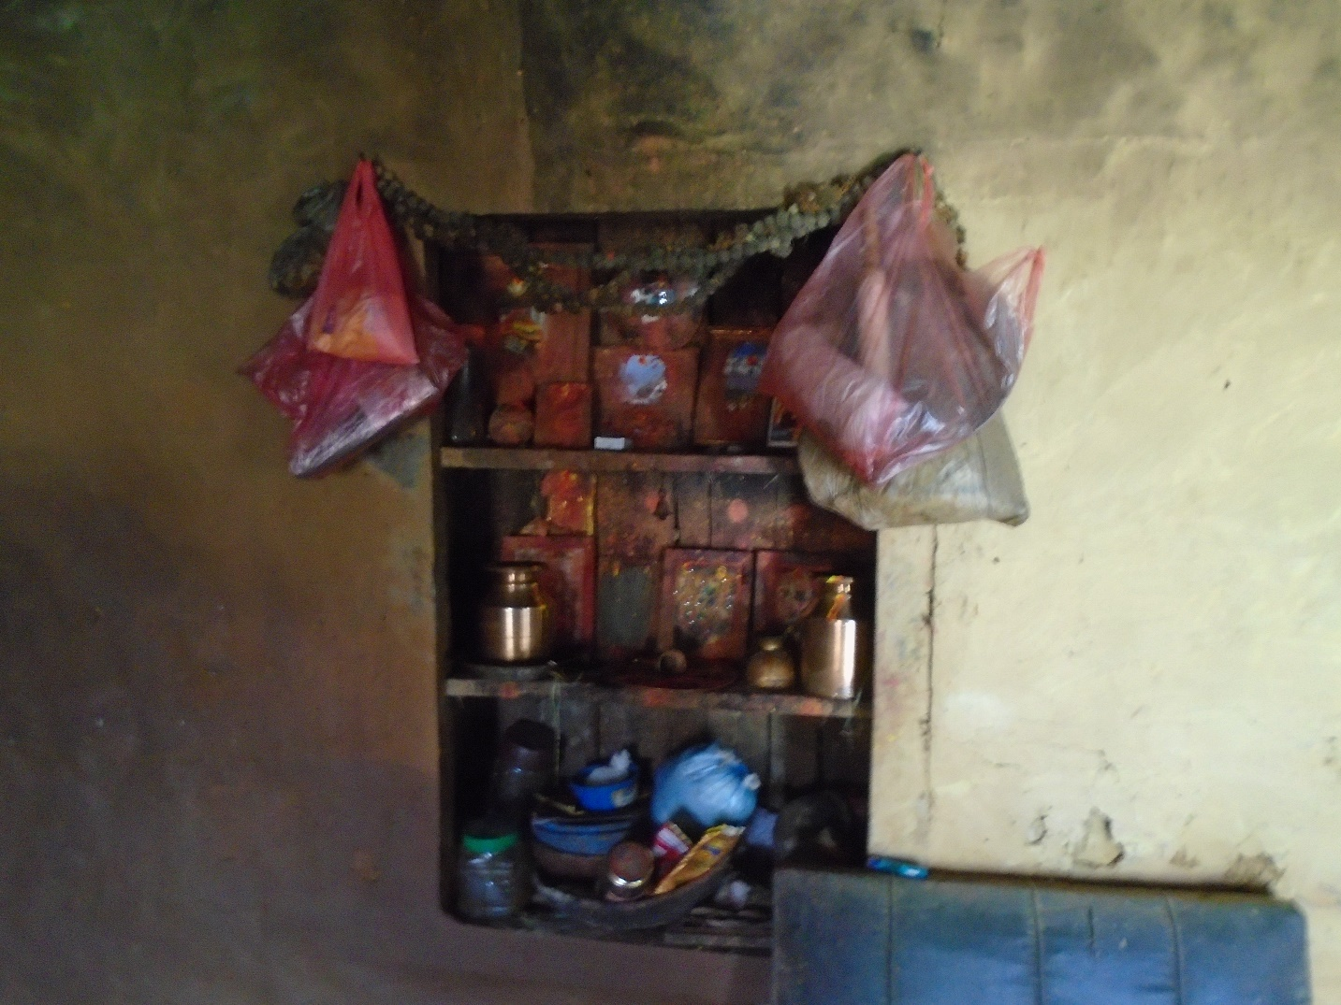
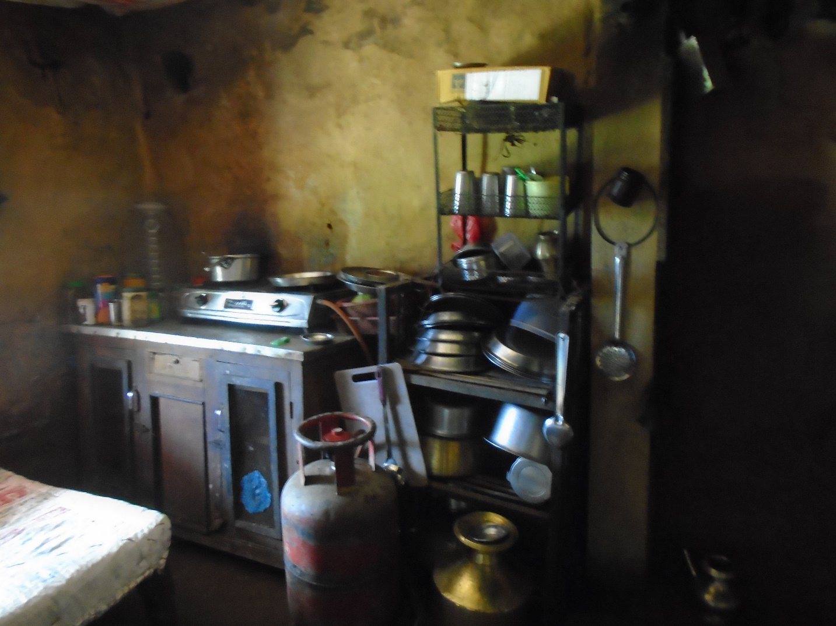
Caption: Cannot touch during period as per our tradition.
[The image is of worshiping area inside the home.]
Ranked 1 out of 4
Caption: We have to follow our tradition, so should not touch kitchen during period. If one touches kitchen, worshipping are is also touched. If touched, I feel discomfort and fear that something might happen. However in case of my daughter if she touches, god will forgive her.
Ranked 2 of 4
©Bishnu

