Slide 1
Additional File 1
Fig. S1-S18

Slide 2
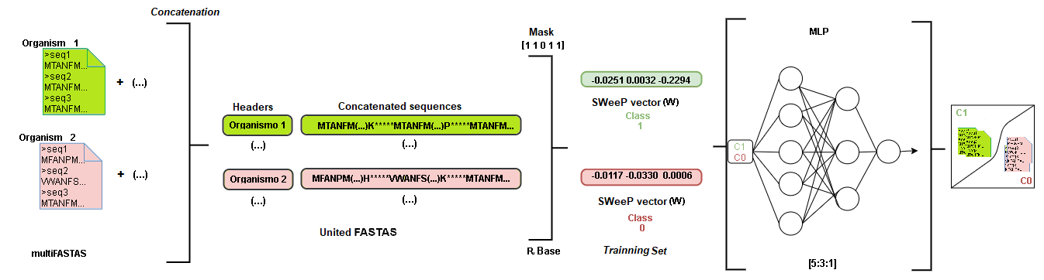
Fig. S1 - the Data mining strategy of diazotrophic candidates using SWeeP method. We concatenated the proteomes sequences (in FASTA format) of obtained diazotrophic species converting into SWeeP vectors. Those vectors was used to compound the Class 1 set (the “true” class), in the training and classification of the ANN. We selected the MLP configured at 5:3:1 (values for the input layer, hidden layers, and the output layer, respectively). The Class 0 set was composed of 5,000 non-fixing species proteomes (non-independent type test, training performed to debug).

Slide 3
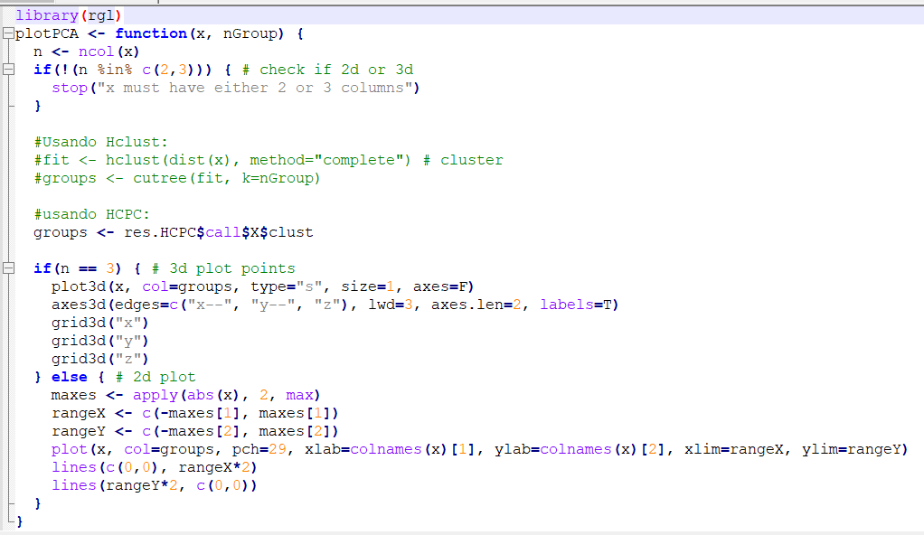
Fig. S2 - script plotpca to PCA in 3D in R. In this example to plot HCPC clusters in 3D, the function calls the res.HCPC$call$X$clust dataframe obtaneid with factoextra and factoshiny packages (The library rgl is necessary).

Slide 4
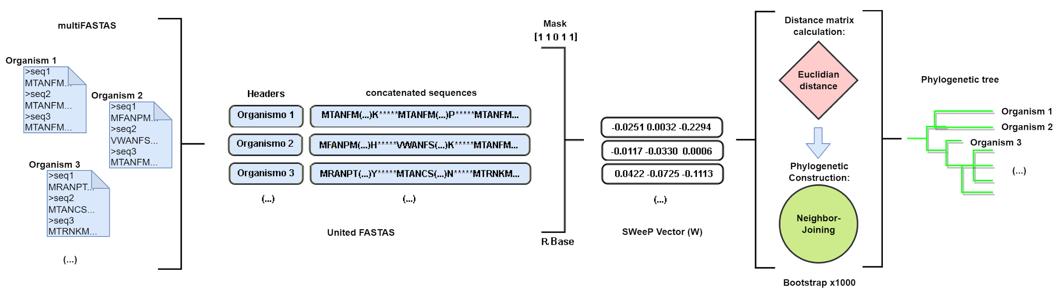
Fig. S3 - phylogenetic trees construction using SWeeP method to Proteome and core data. The parameters used for SWeeP were spaced words "11011" and the matrix (W) of 1369 coordinates. The Euclidean distance was calculated for the vectors in each approach and the NJ method for phylogenetic construction. We evaluated the branches' reliability using the bootstrap method, a function available at the Analyses of Phylogenetics and Evolution (APE) version 5.6-1 package (https://cran.r-project.org/web/packages/ape/index.html) with a sampling of 1,000 replicates.

Slide 5
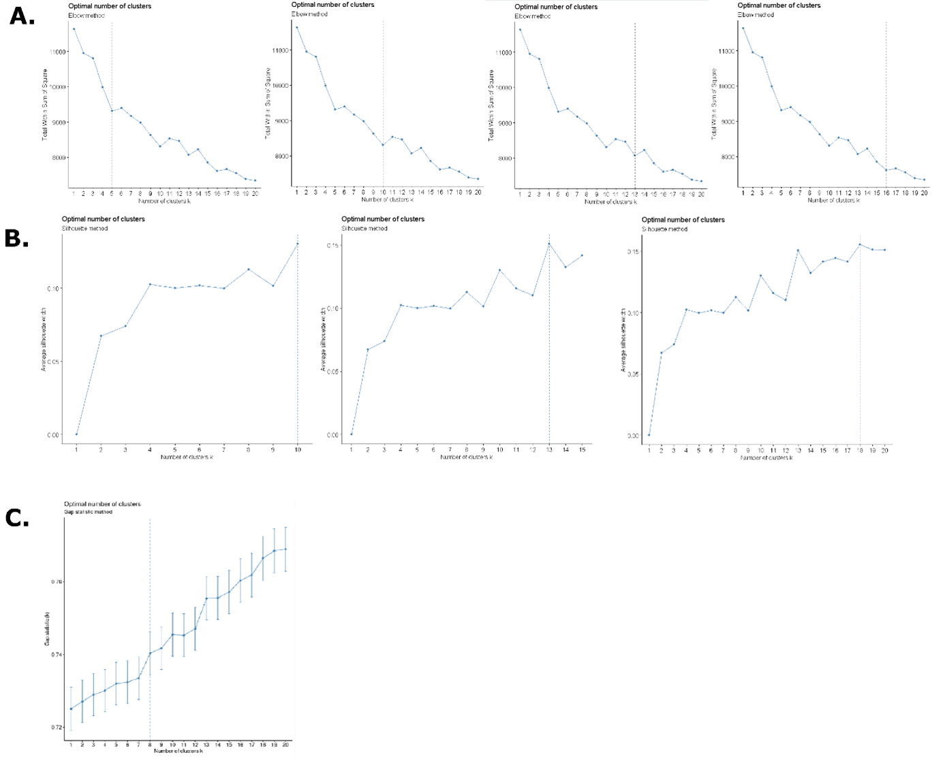
Fig. S4 - Statistics results to Elbow method (A.), SIlhouette coefficient (B.), Gap statistics (C.) and the k-indicated values obtained with the statistics(D.)
D.
Statistic applied | k-indicated values (clusters)
Elbow method (A.) | 5, 10, 13 e 16
silhouette coefficient (B.) | 10, 13 e 18
Gap statistics (C.) | 8

Slide 6
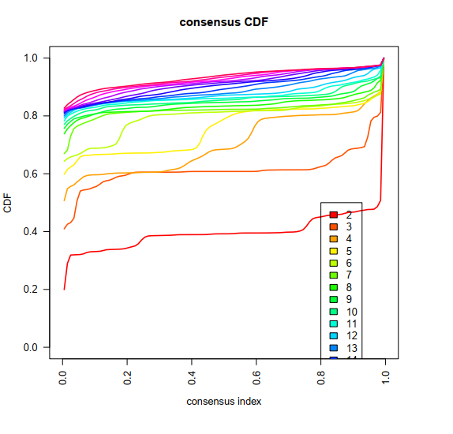
Fig. S5 - Consensus Matrix plot. Built with consensus CDF in the consensusclusterplus function for HCPC (https://bioconductor.org/packages/release/bioc/html/ConsensusClusterPlus.html)

Slide 7
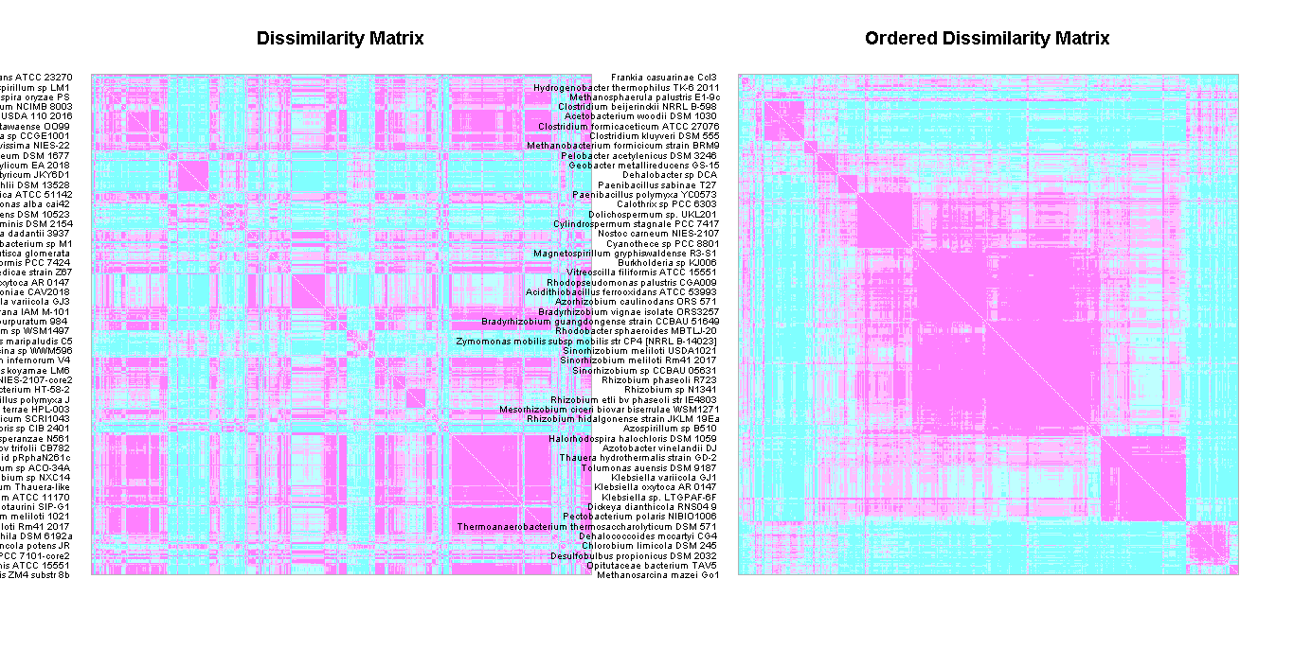
Fig. S6 - Dissimilarity and Ordered DIssimilarity Matrices plotted with coldiss function.

Slide 8
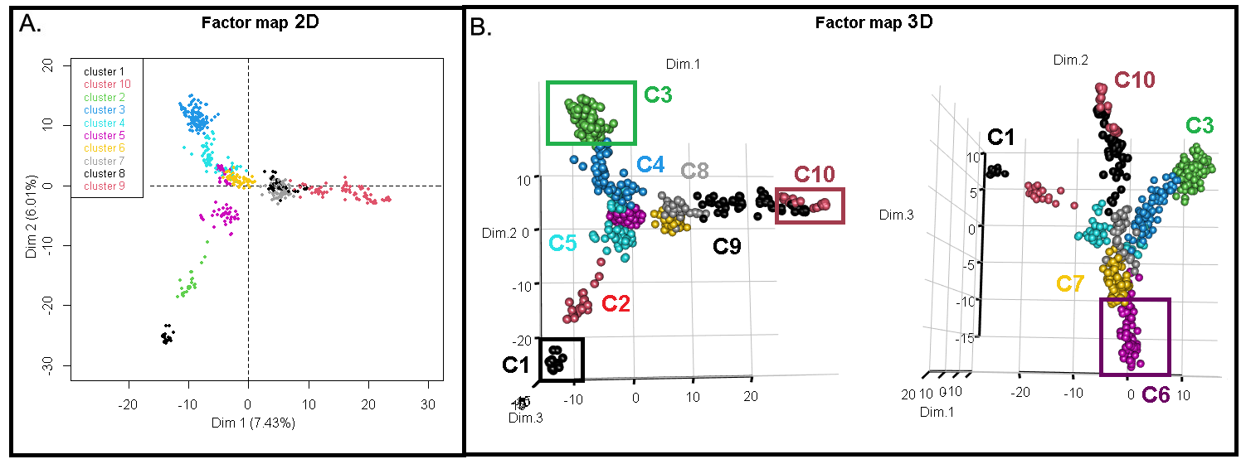
Fig. S7 – Plots of 2D (A.) and 3D (B.) PCA highlighting the clusters (groups) in different colours.. The plots were obtained in R (vers 4.1). To plot the PCA in 3D the RGL library is necessary.

Slide 9
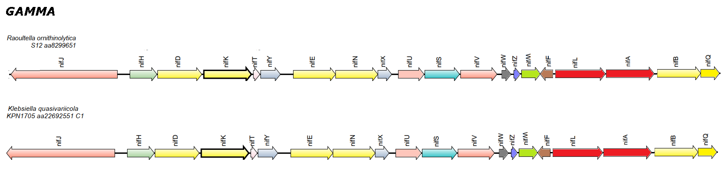
Fig. S8 – Genomic synteny obtained to G1 with SyntTax web tool.
G1

Slide 10
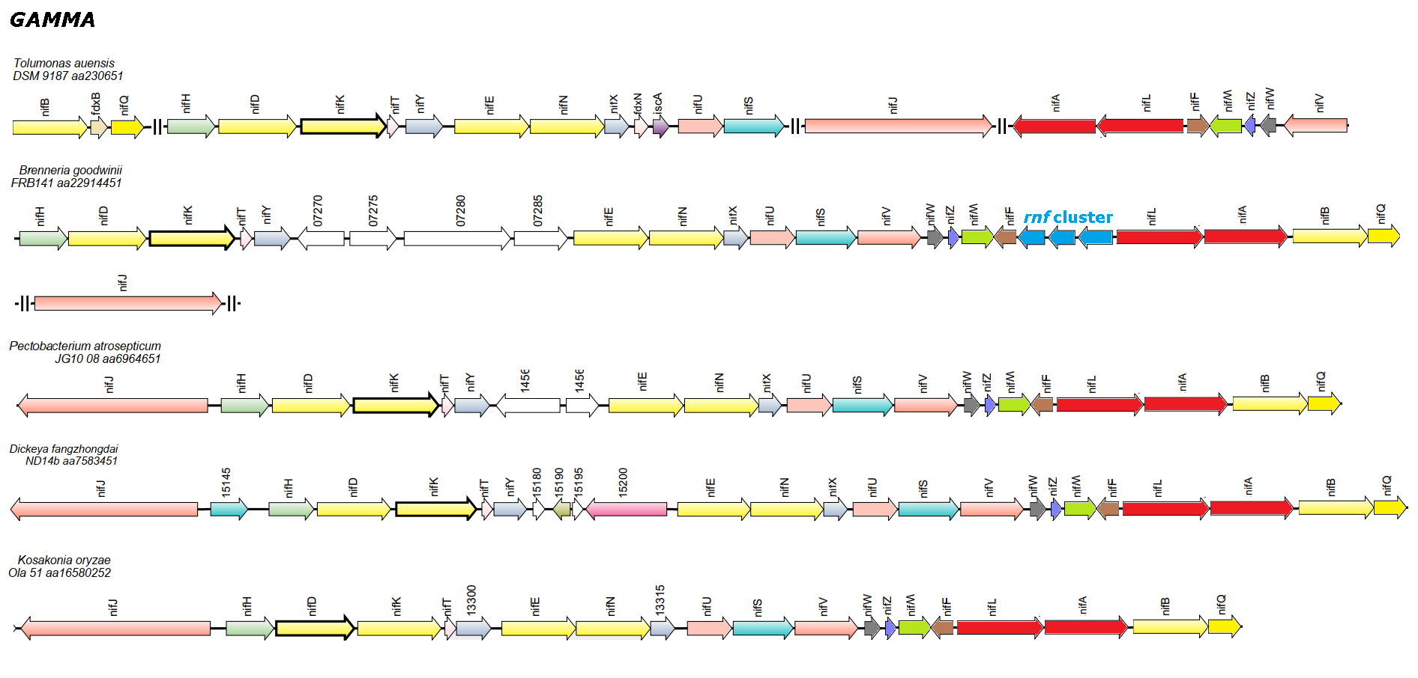
Fig. S9 – Genomic synteny obtained to G2 with SyntTax web tool.
G2

Slide 11
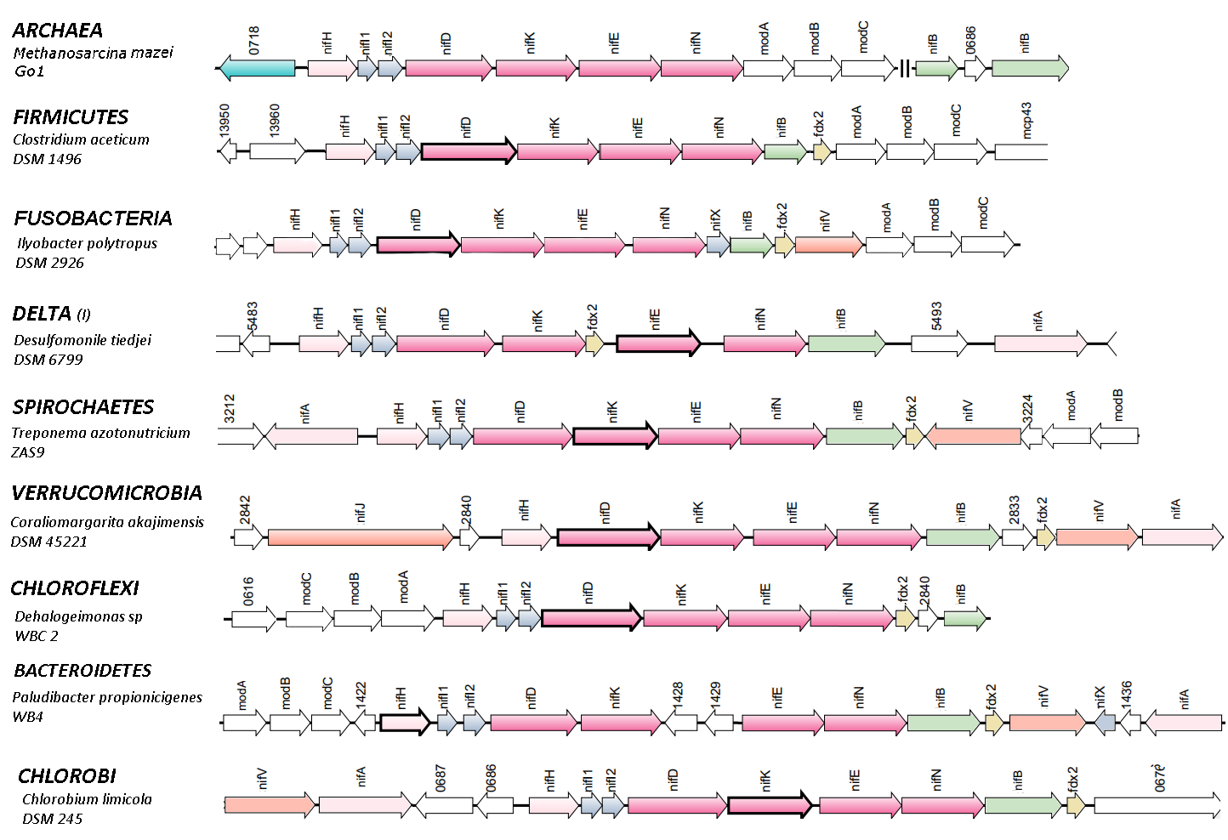
Fig. S10 – Genomic synteny obtained to G3 with SyntTax web tool.

Slide 12
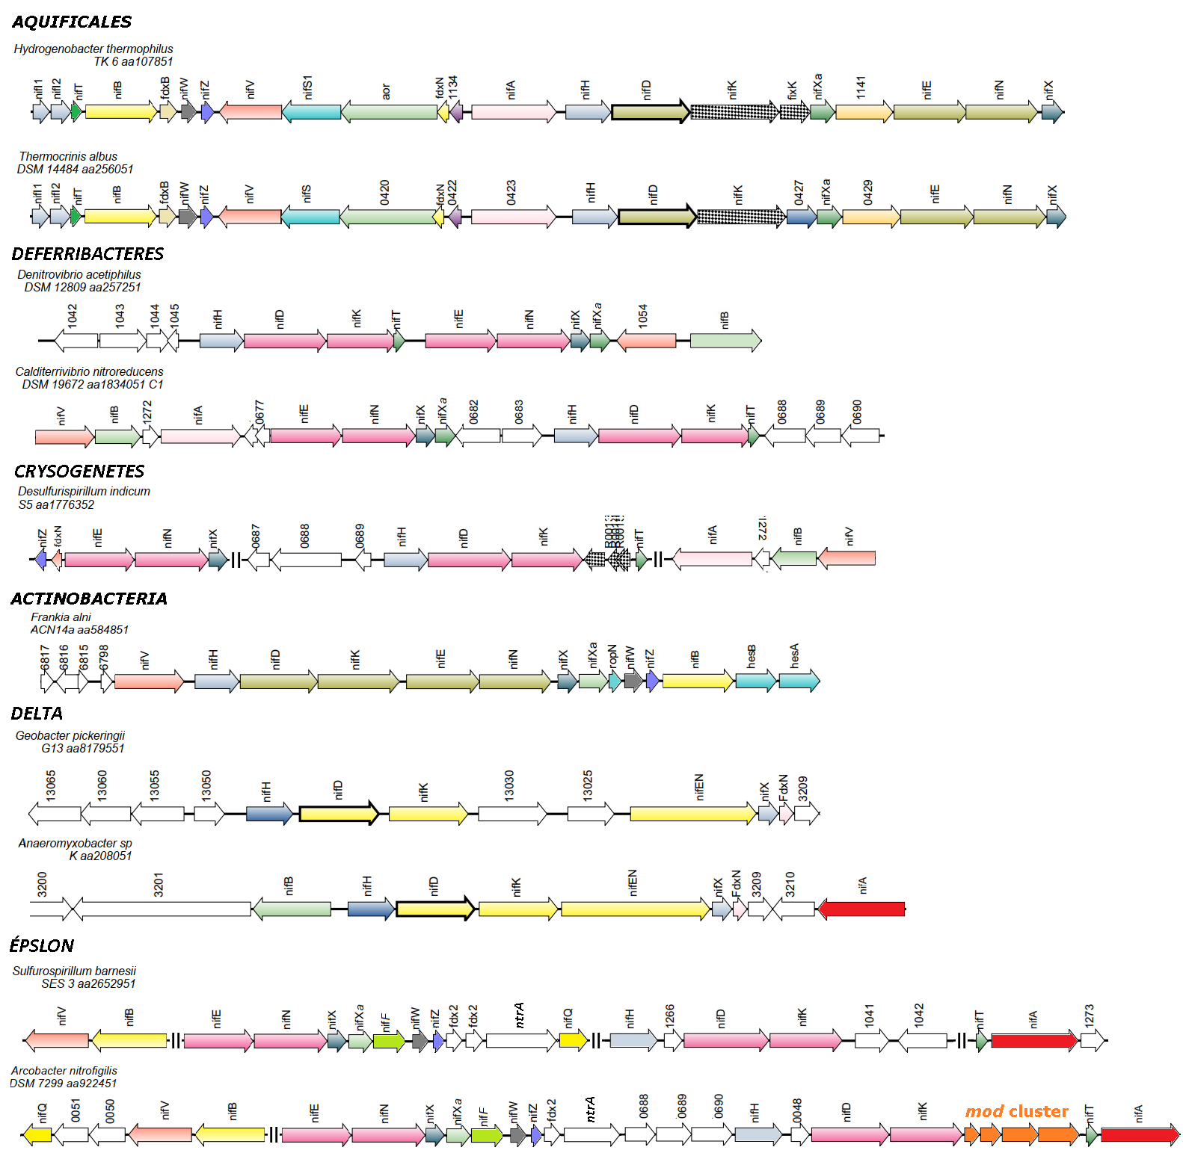
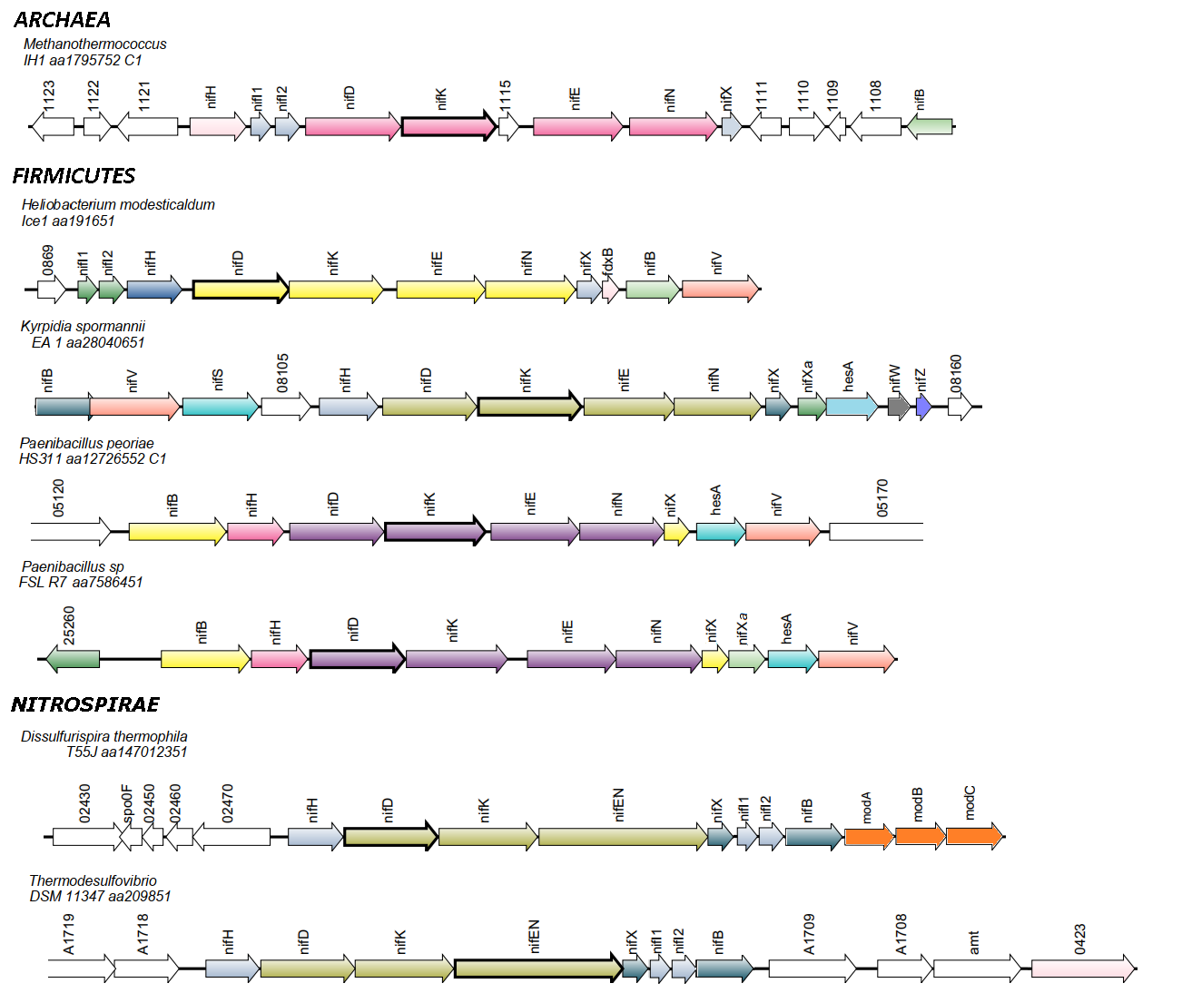
Fig. S11 – Genomic synteny obtained to G4 with SyntTax web tool.
G4

Slide 13
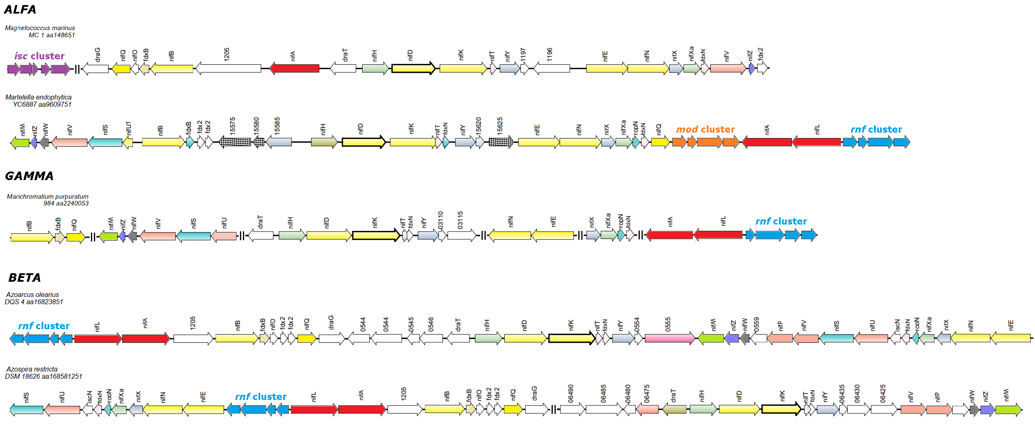
Fig. S12 – Genomic synteny obtained to G5 with SyntTax web tool.
G5

Slide 14
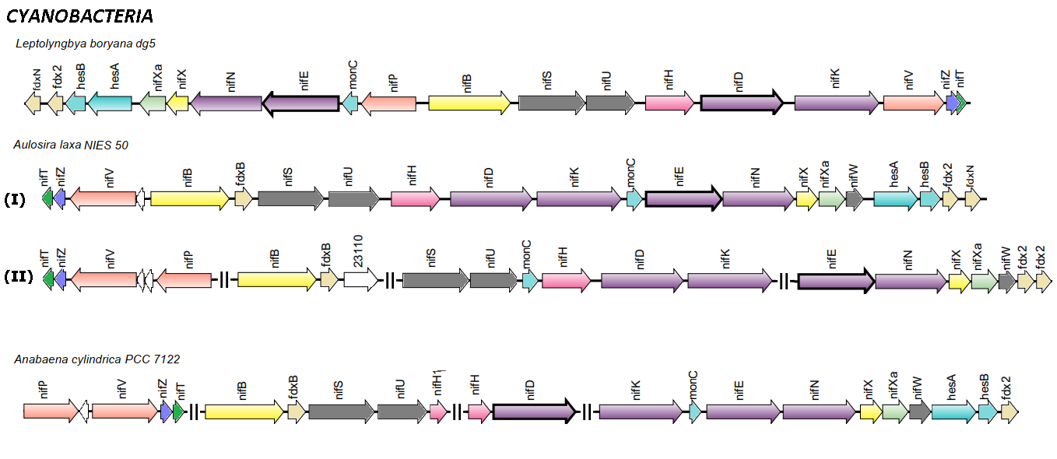
Fig. S13 – Genomic synteny obtained to G6 with SyntTax web tool.
G6

Slide 15
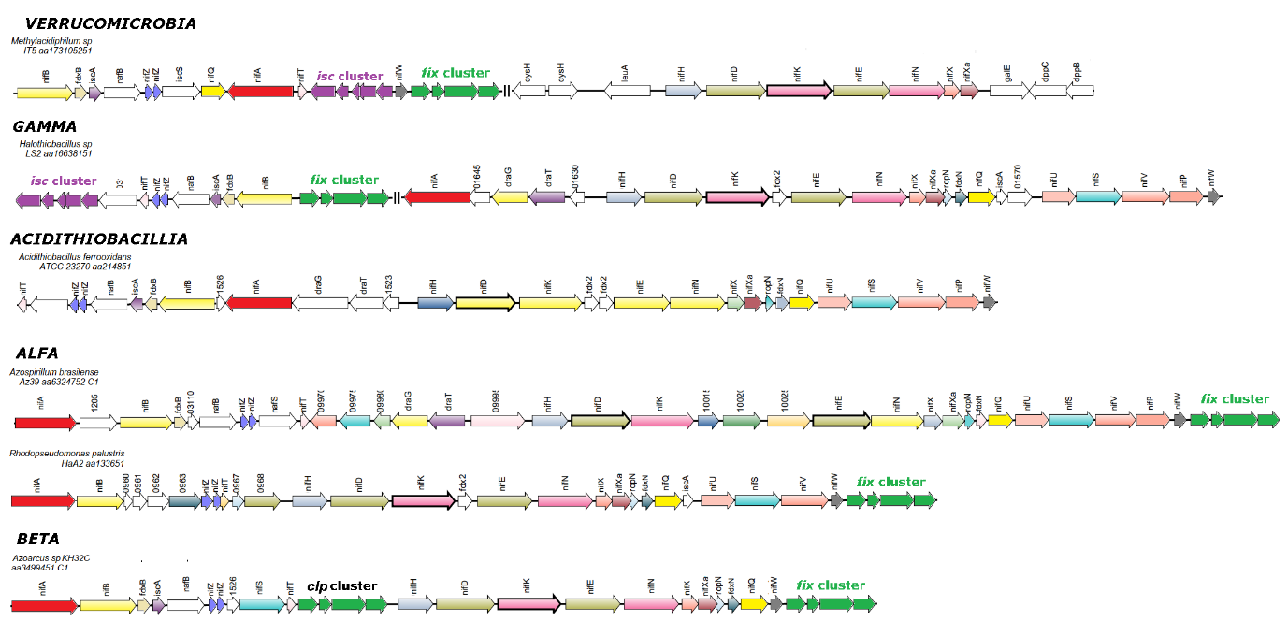
Fig. S14 – Genomic synteny obtained to G7 with SyntTax web tool.
G7
LEGENDA: as barras paralelas (-//-) representam os gaps de regiões genômicas.
FONTE: O Autor (2022).

Slide 16
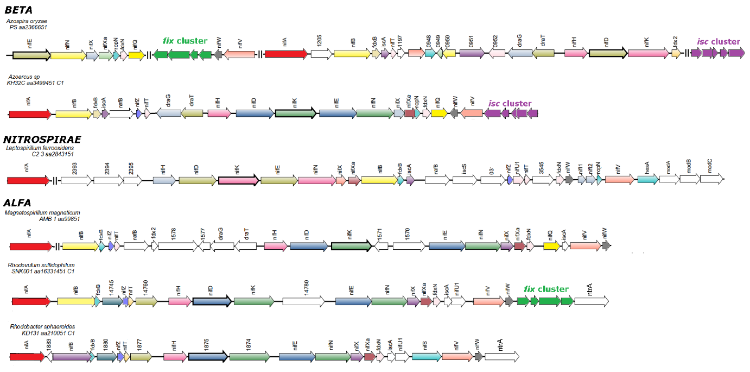
Fig. S15 – Genomic synteny obtained to G8 with SyntTax web tool.
G8
LEGENDA: as barras paralelas (-//-) representam os gaps de regiões genômicas.
FONTE: O Autor (2022).

Slide 17
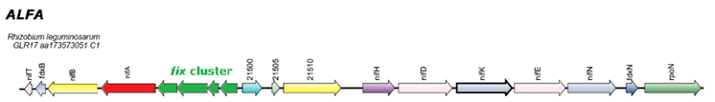
Fig. S16 – Genomic synteny obtained to G9 with SyntTax web tool.
G9

Slide 18
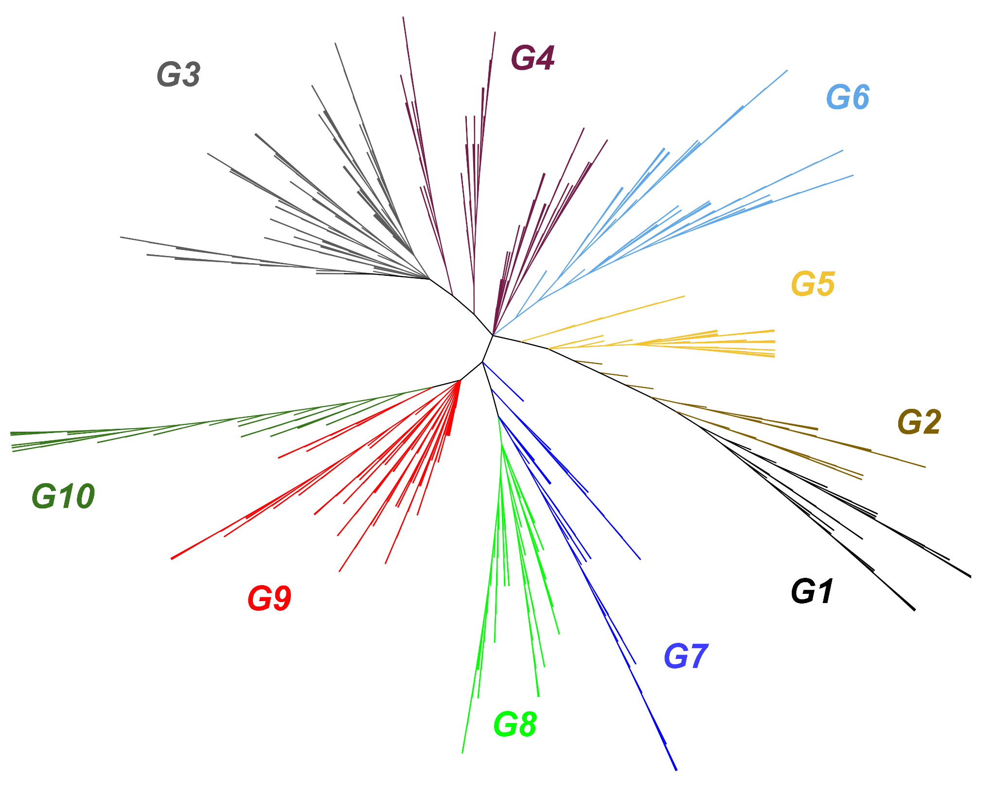
Fig. S17 - The distribution of ten groups in Nif Core tree (unrooted tree).

Slide 19
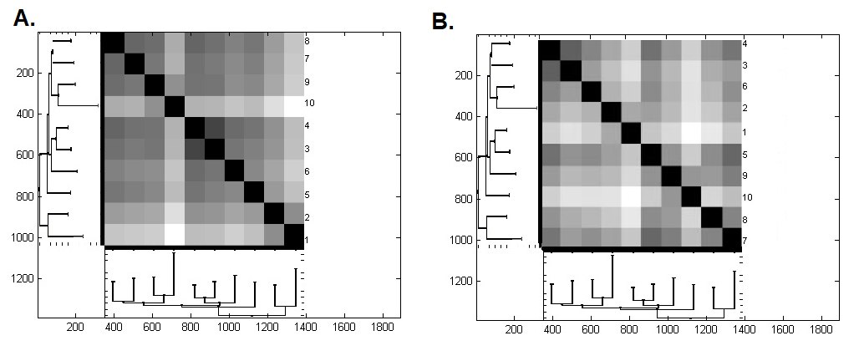
Fig. S18 - Heat map of the 10 groups

