Slide 1

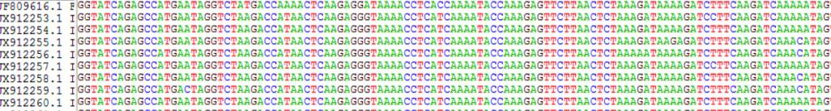

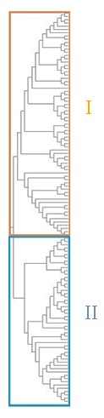
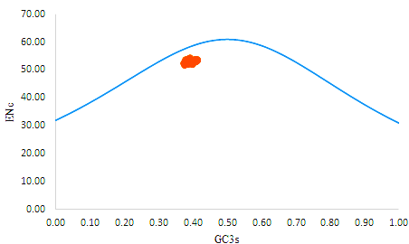
Synonymous Codon Pattern of Cauliflower Mosaic Virus in phylogeny and evolution
Multiple sequence alignment | Sequence Acquisition
Bioinformatic analysis
Codon usage bias analysis
Isolates from:
Irananin
Japanese
American
European
RSCU in CaMV:
Prefers A-ending codons
Codon GGA overrepresented
CaMV host adaptation:
The greatest adaptation for B. oleracea
and the lowest for R. sativus
Analyze dinucleotide composition:
-The most abundant nucleotide: A
- The most frequent nucleotide at the third codon position: A3S
ENC-plot analysis suggested that codon usage in CaMV is mainly influenced by natural selection and other factors.
Isolates from:
Grecian
Turkish
Iranian
Conclusions: The bias of codon use in Cauliflower Mosaic Virus is influenced by selection, translation, and other factors. Briefly, the study provides useful information on the codon usage analysis of CaMV and may be utilized to understand the host's adaptation to the virus environment and its evolution. this is the first study on codon usage bias of CaMV in the world.
Conclusions: The bias of codon use in Cauliflower Mosaic Virus is influenced by selection, translation, and other factors. Briefly, the study provides useful information on the codon usage analysis of CaMV and may be utilized to understand the host's adaptation to the virus environment and its evolution. this is the first study on codon usage bias of CaMV in the world.

