Slide 1
Supplemental Information
Three-dimensional in vivo monitoring of mycobacterial infections and therapeutic efficacy based on tissue-clearing technology CUBIC
Mariko Hakamata, Akihito Nishiyama, Erina Inouchi, Akira Yokoyama, Shaban A. Kaboso, Gebremichal Gebretsadik, Tomoya Yamasaki, Hiroshi Moro, Yuriko Ozeki, Yoshitaka Tateishi, Riuko Ohashi, Todd P. Primm, Toshiaki Kikuchi, Kazuki Tainaka, and Sohkichi Matsumoto

Slide 2
Video S1. The comparison of the three-dimensional animation of the BCG infected and non-infected lungs.
Whole-lung imaging of the experimental lung infection model by intranasal injection with PBS and DsRed-fluorescent BCG in C57BL/6 mice. These videos show the lungs on the day after infection.

Slide 3
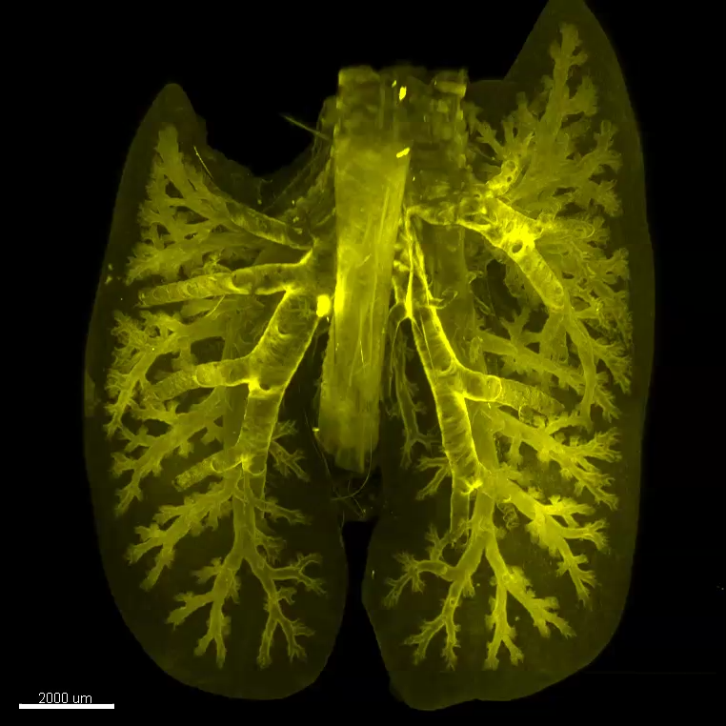
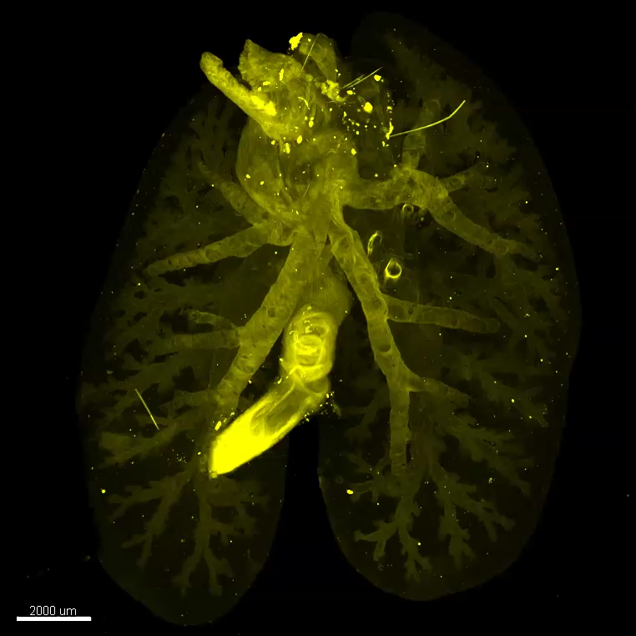
Intranasal infection
PBS
DsRed BCG
Hakamata et al. Supplementary Video. S1

Slide 4
Video S2. The three-dimensional animation of the M. tuberculosis infected lung
Whole-lung imaging of the experimental lung infection model by intranasal injection with DsRed-fluorescent M. tuberculosis in C57BL/6 mice. These videos show the lungs on the day after infection.

Slide 5
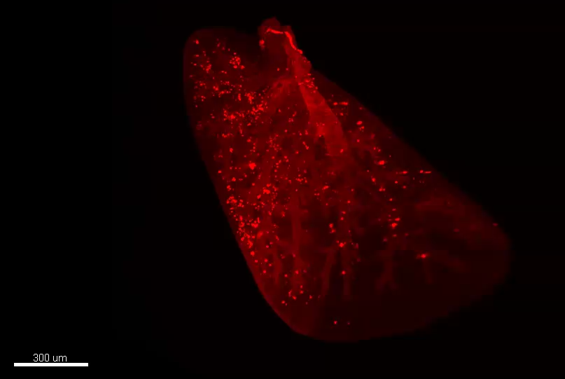
Hakamata et al. Supplementary Video. S2

