Slide 1
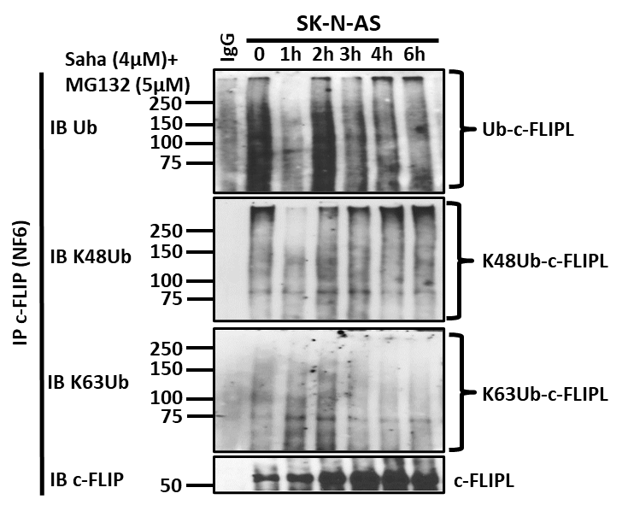
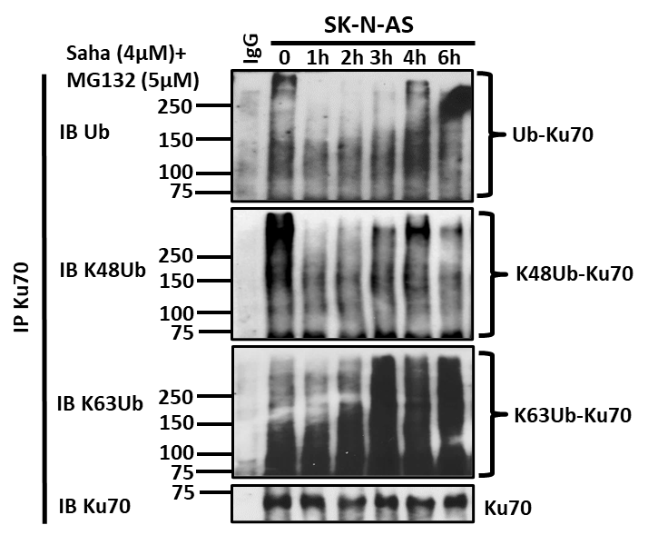
Supplemental Figure 3 - HDAC inhibitor-mediated induction of Ku70 and c-FLIPL Lys48/Lys63 polyubiquitination.
A
Medium MW K48Ub
Low MW K48Ub
High MW K48Ub
0
1h
High MW K48Ub
Medium MW K48Ub
2h
Low MW K48Ub
3h
4h
B
6h
SK-N-AS SC
C
High MW
Ub-c-FLIPL
High MW
K48Ub-c-FLIPL
High MW
K63Ub-c-FLIPL
High MW
Ub-Ku70
High MW
K48Ub-Ku70
High MW
K63Ub-Ku70
D
SK-N-SH SC
SK-N-SH SC + MG132
High MW
Ub-c-FLIPL
High MW
K48Ub-c-FLIPL
High MW
K63Ub-c-FLIPL
E
SK-N-SH SC
SK-N-SH SC
+ MG132
High MW
Ub-Ku70
High MW
K48Ub-Ku70
High MW
K63Ub-Ku70

