Slide 1
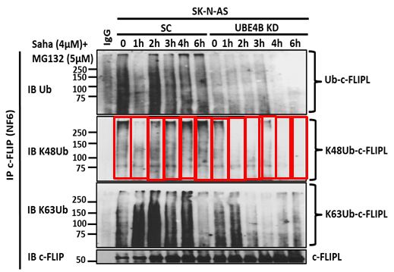
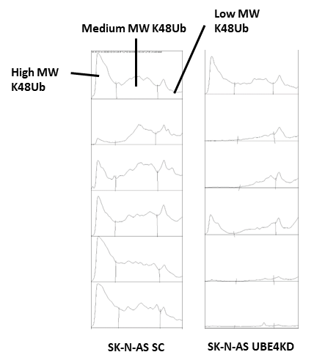
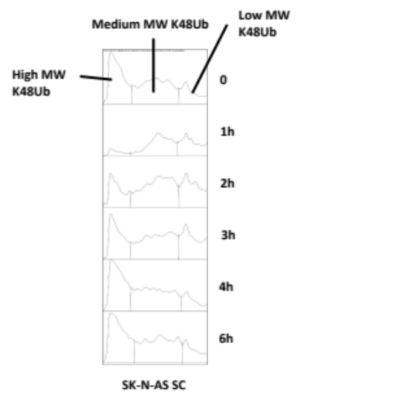
Supplemental Figure 4 – UBE4B depletion reduces Ku70 and c-FLIPL polyubiquitination.
A
High MW K48Ub
Medium MW K48Ub
Low MW K48Ub
B
C
D
E

