Slide 1
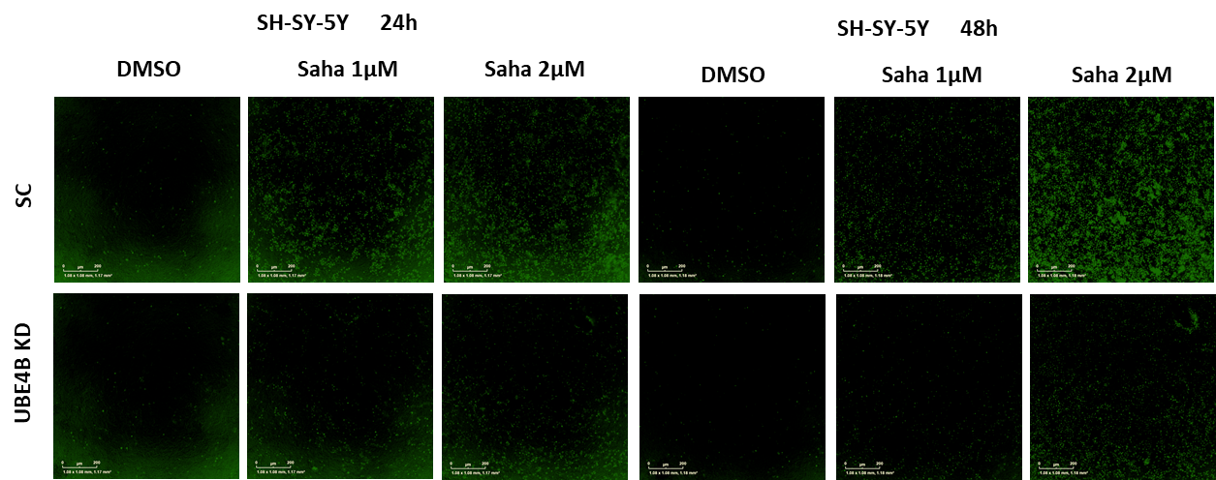
Supplemental Figure 2 - UBE4B depletion strongly reduces Saha induced neuroblastoma cell apoptosis and caspase 3/7 activation
SH-SY5Y
A
B
C
***
***
*
***

Slide 2
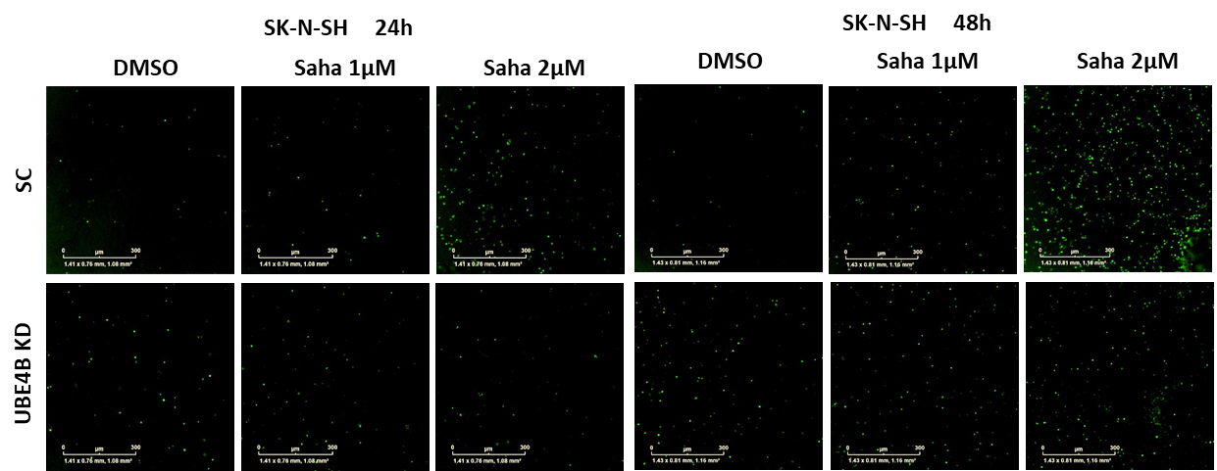
Supplemental Figure 2 - UBE4B depletion strongly reduces Saha induced neuroblastoma cell apoptosis and caspase 3/7 activation
D
SK-N-SH
E
F
***
***
*
***

Slide 3
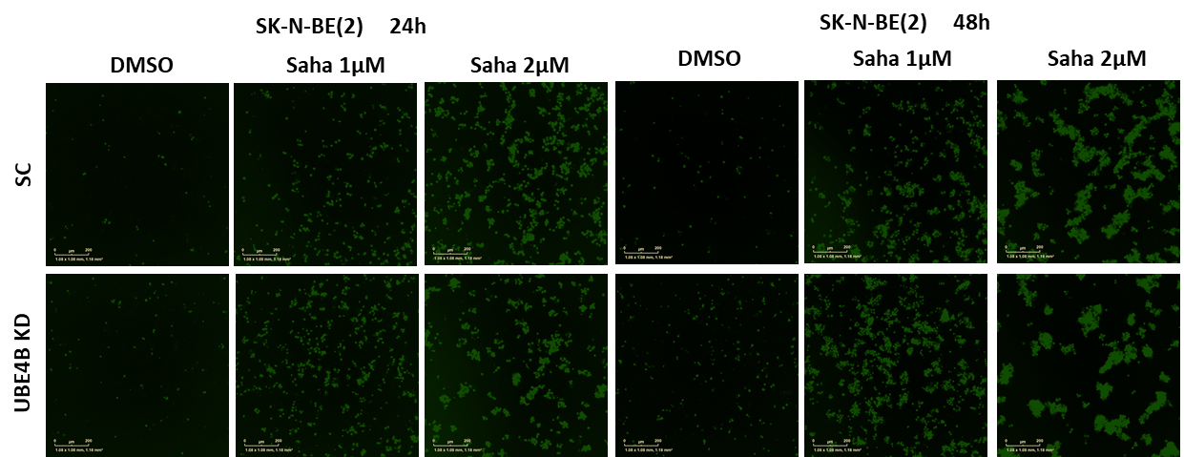
Supplemental Figure 2 - UBE4B depletion strongly reduces Saha induced neuroblastoma cell apoptosis and caspase 3/7 activation
SK-N-BE(2)
G
H
I
***
***
*
*

Slide 4
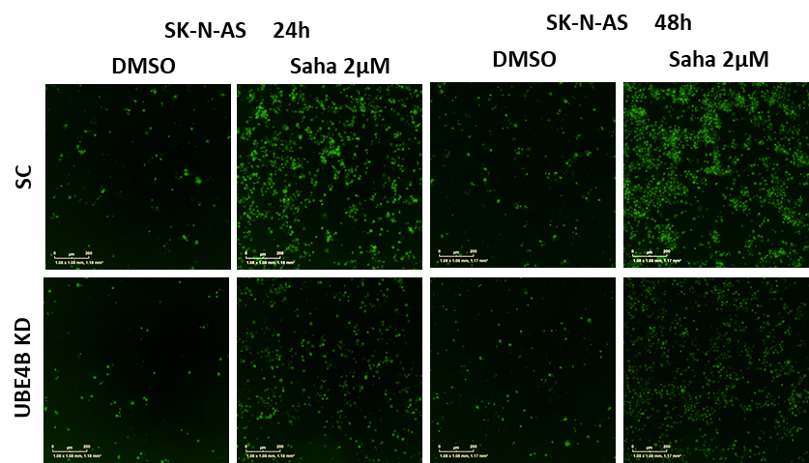
Supplemental Figure 2 - UBE4B depletion strongly reduces Saha induced neuroblastoma cell apoptosis and caspase 3/7 activation
J
SK-N-AS
K
L
***
***
*
*

