Slide 1
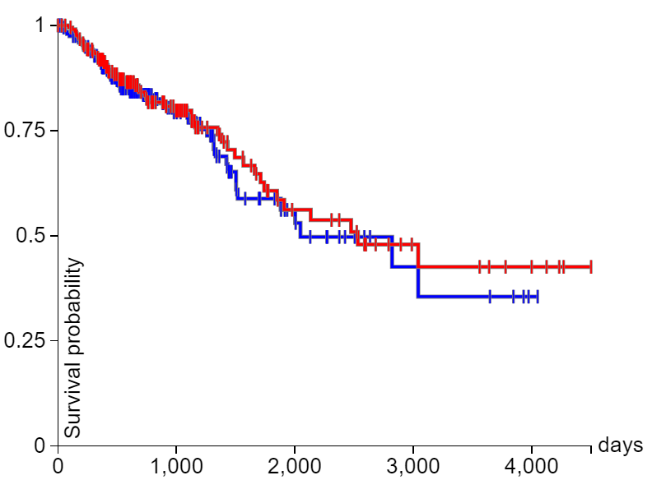
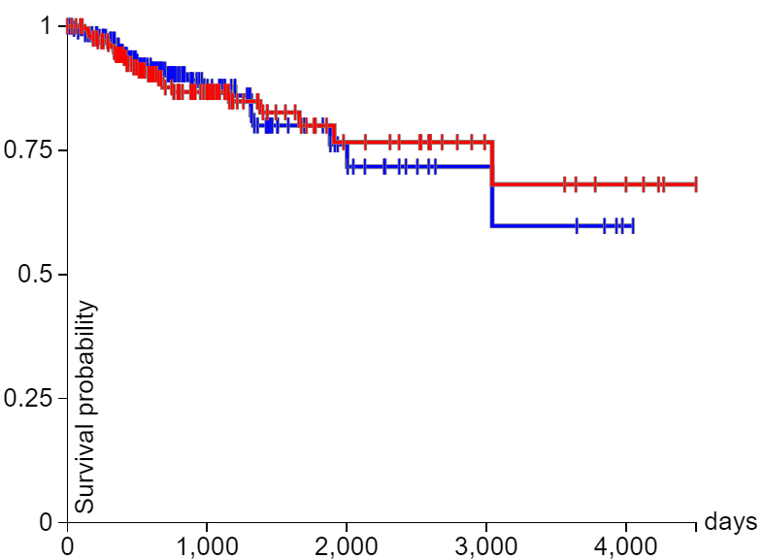
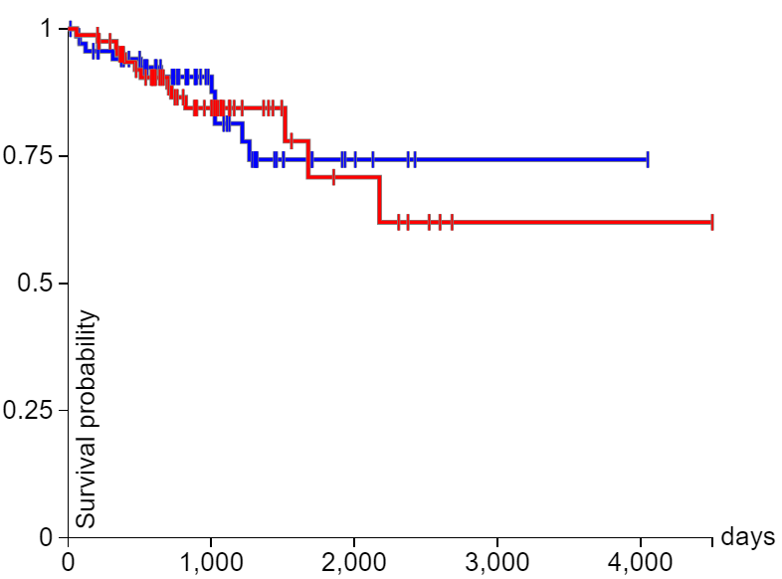
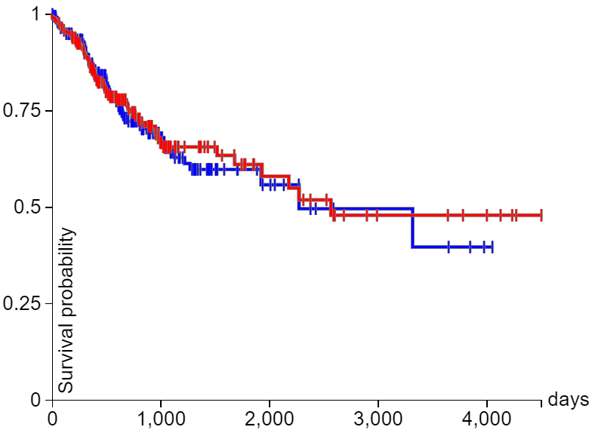
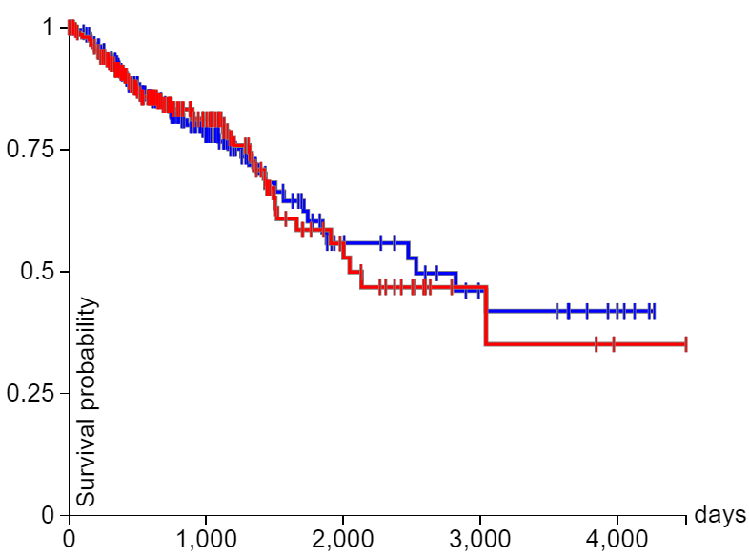
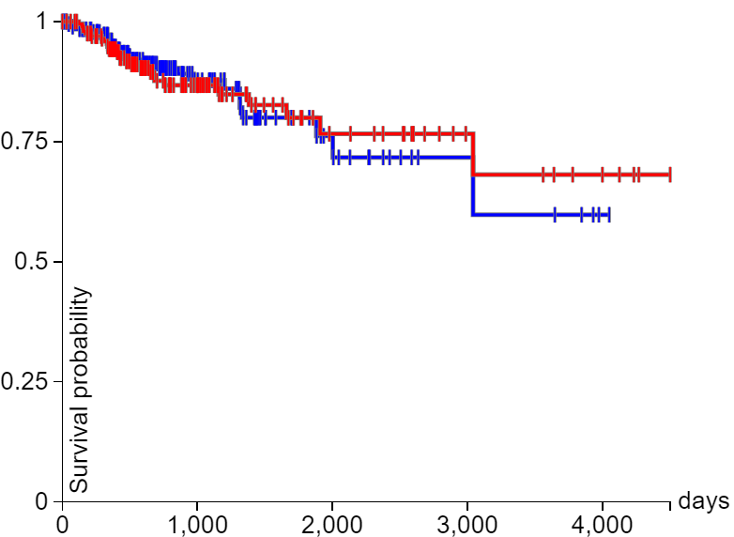
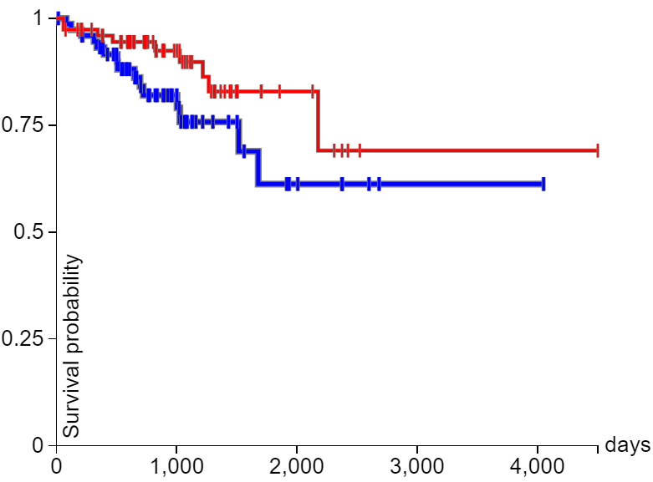
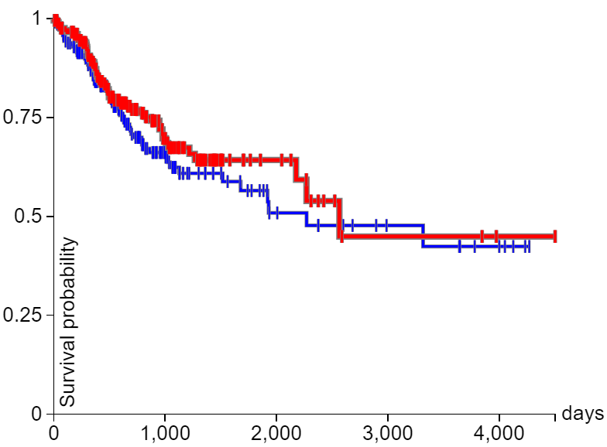







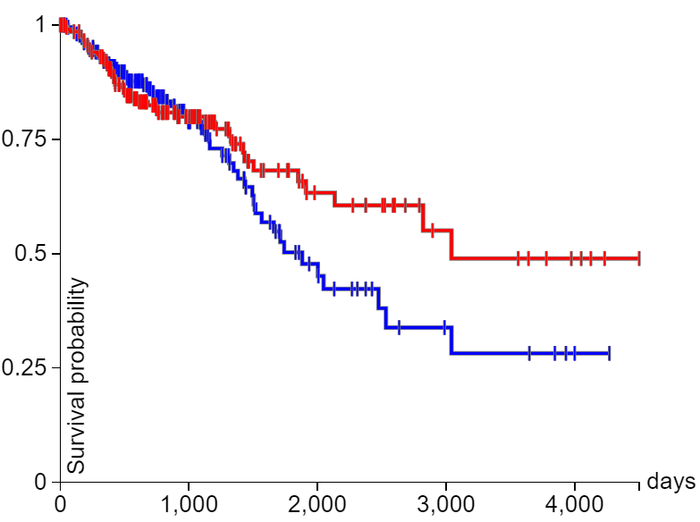
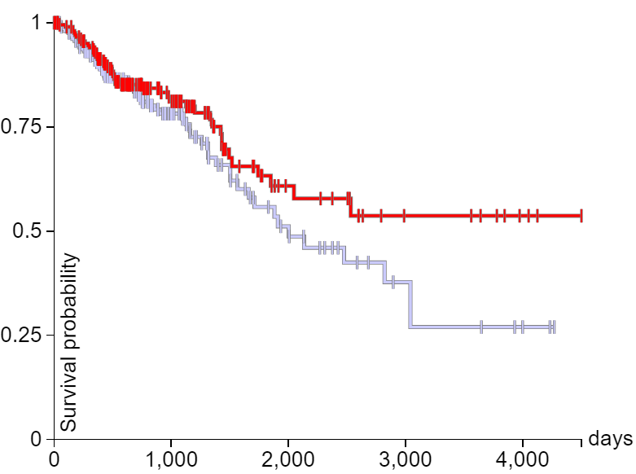
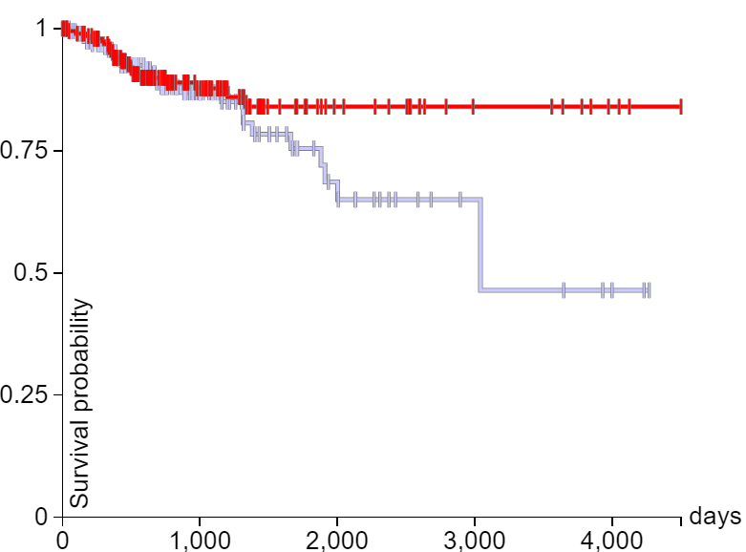
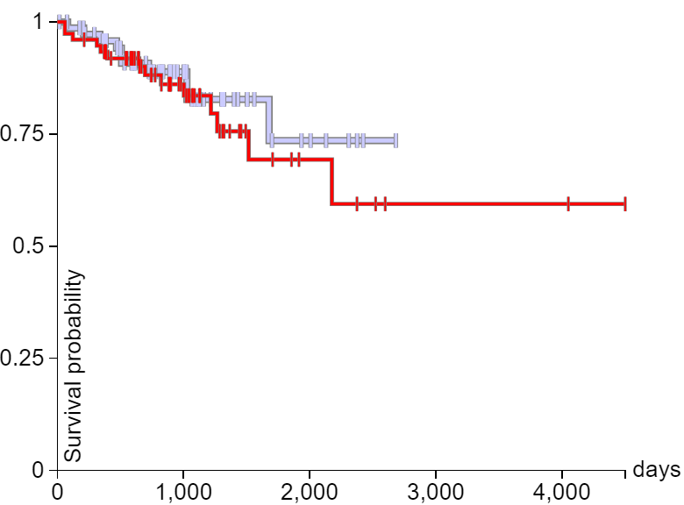
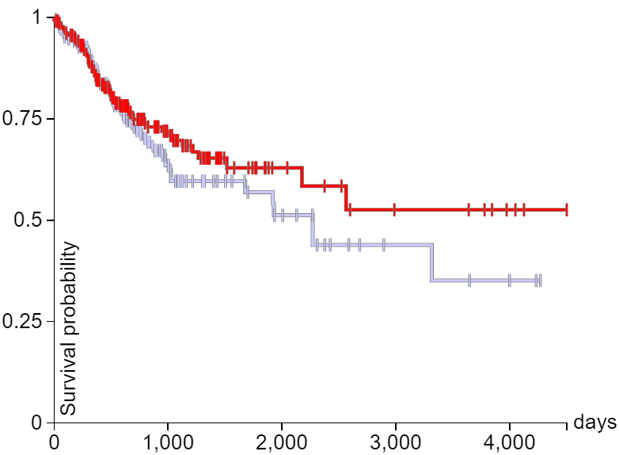
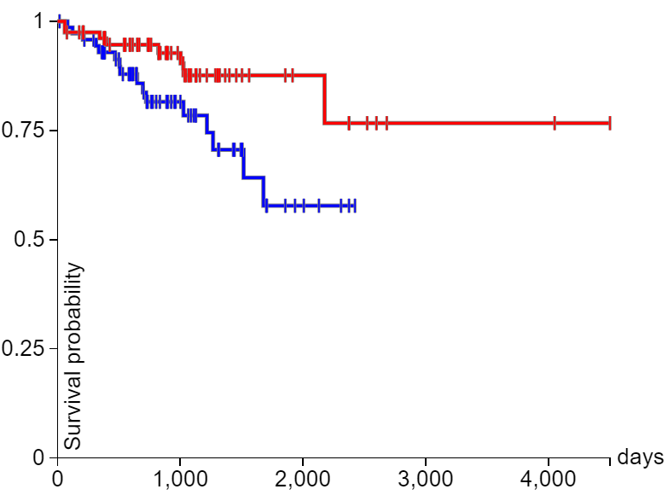
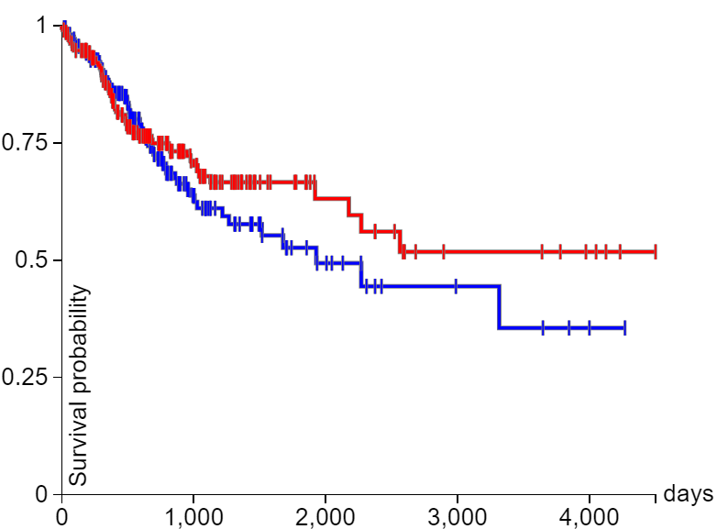
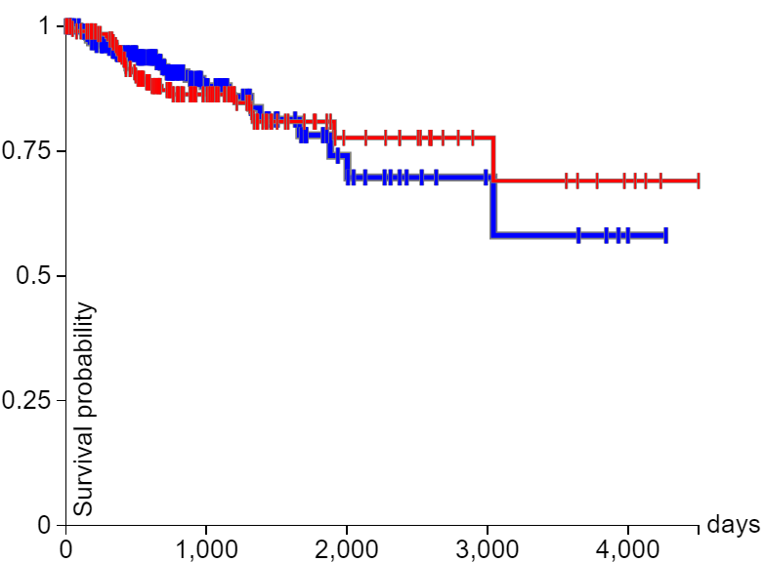

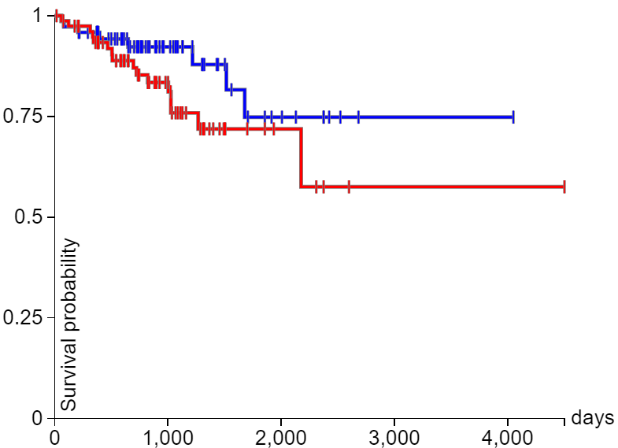
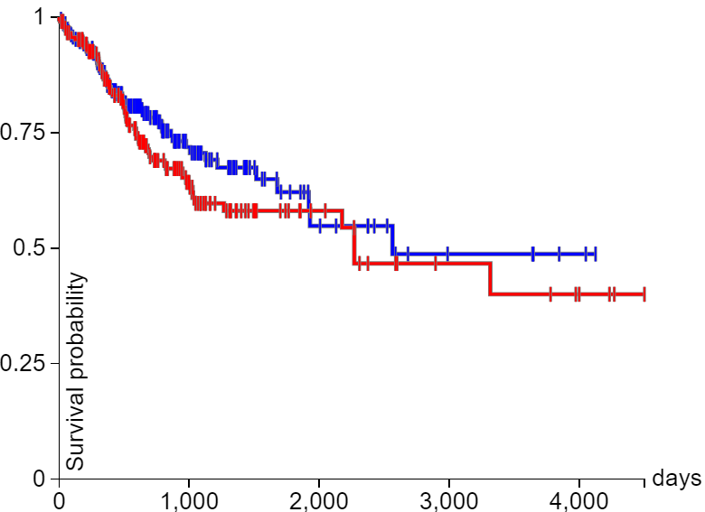
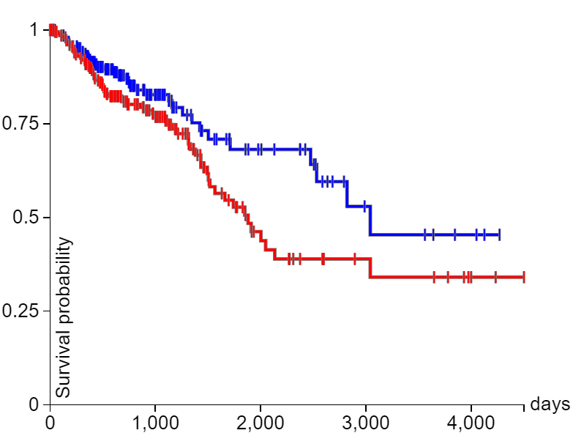
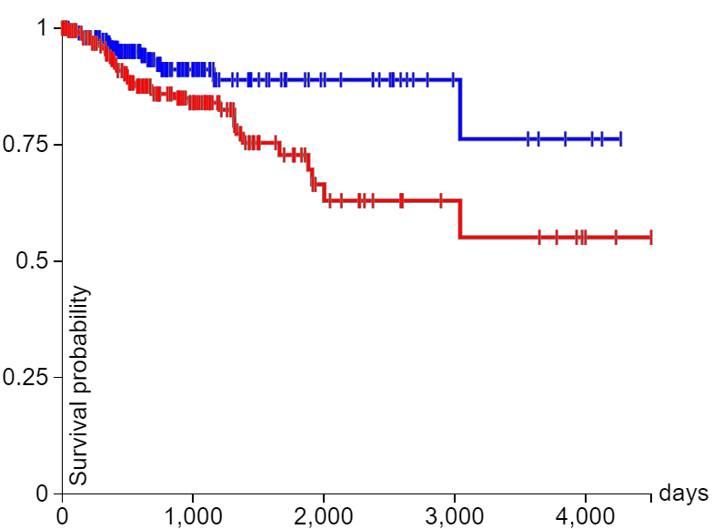
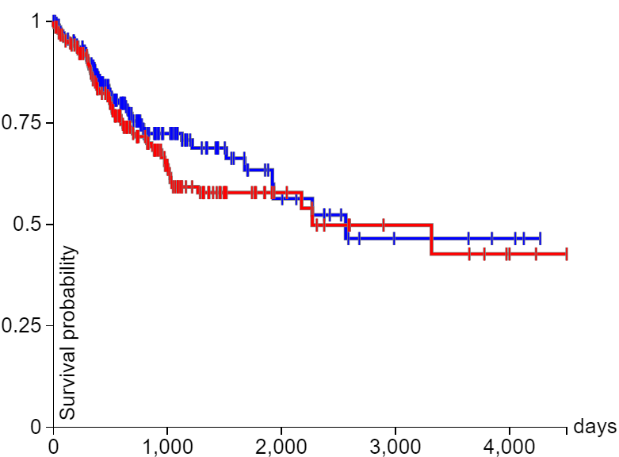
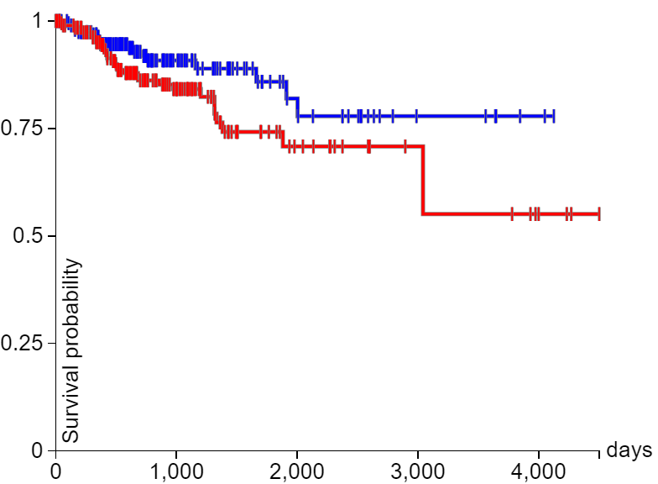

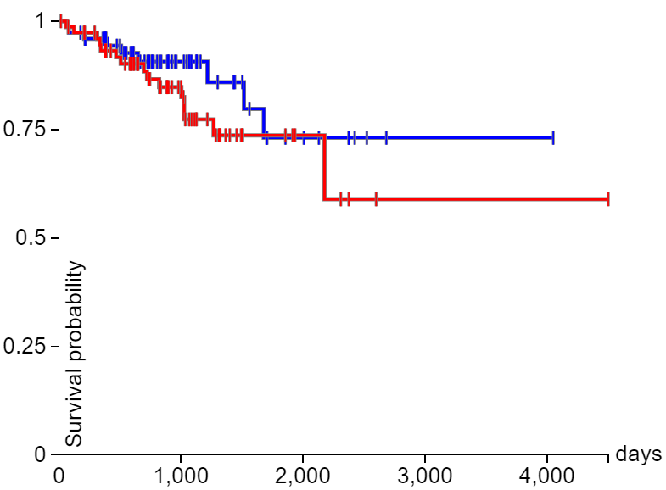
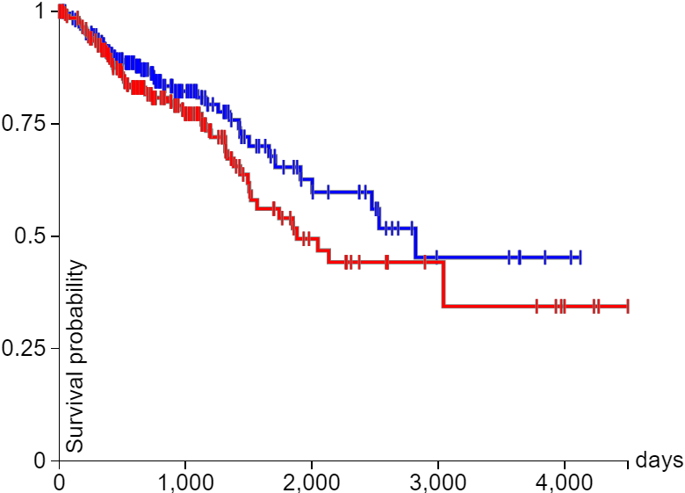

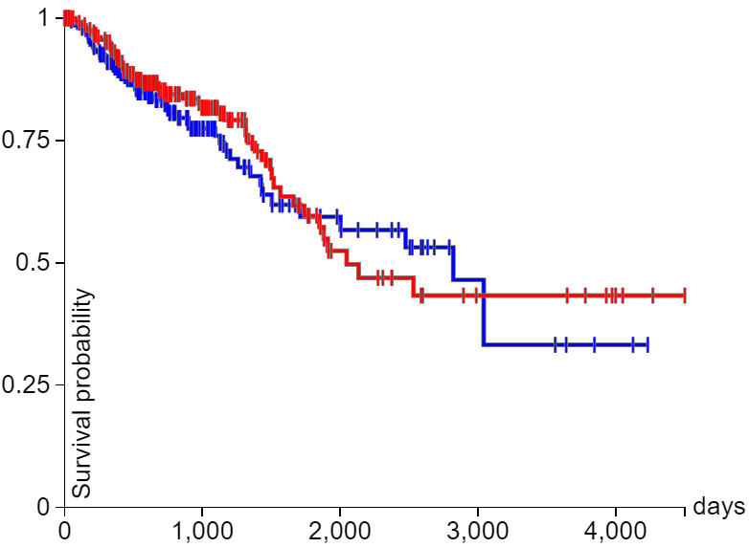
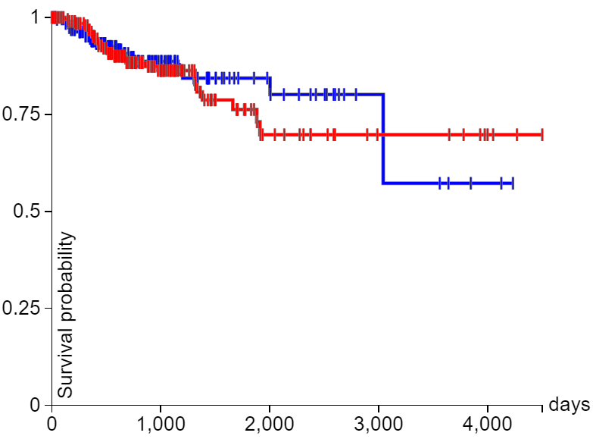
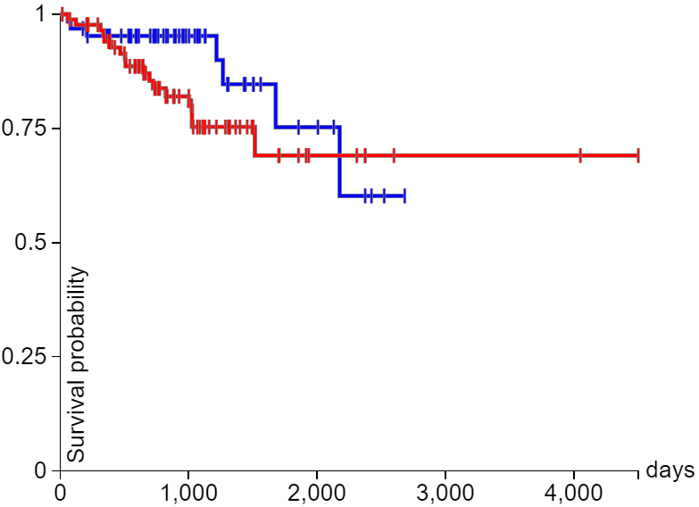
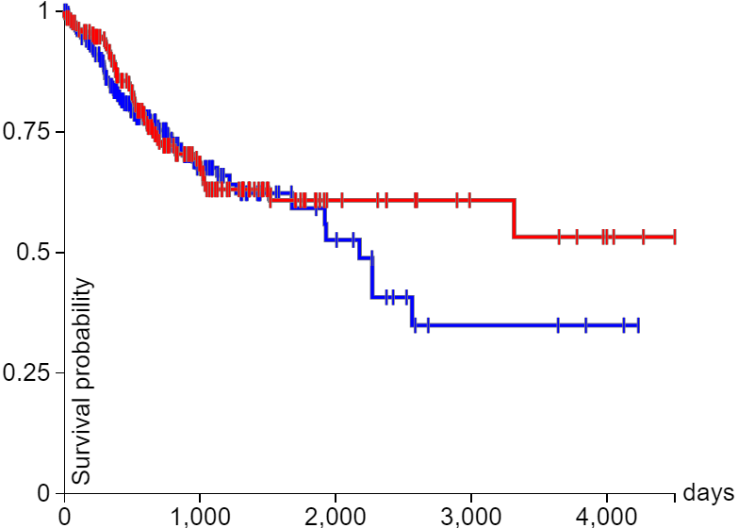
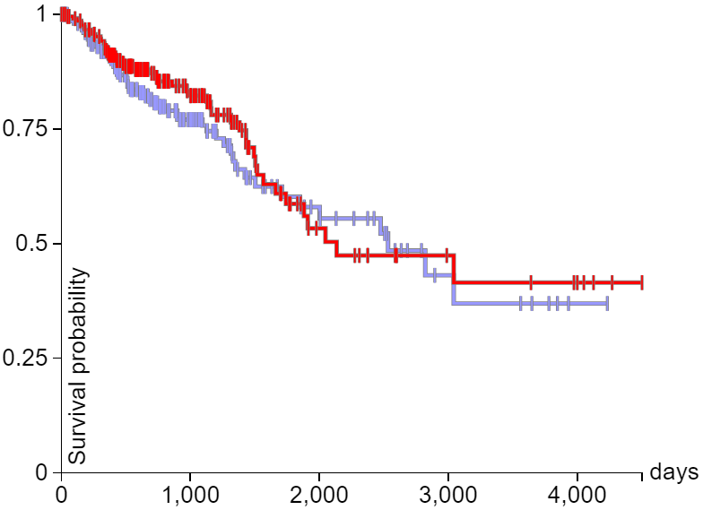
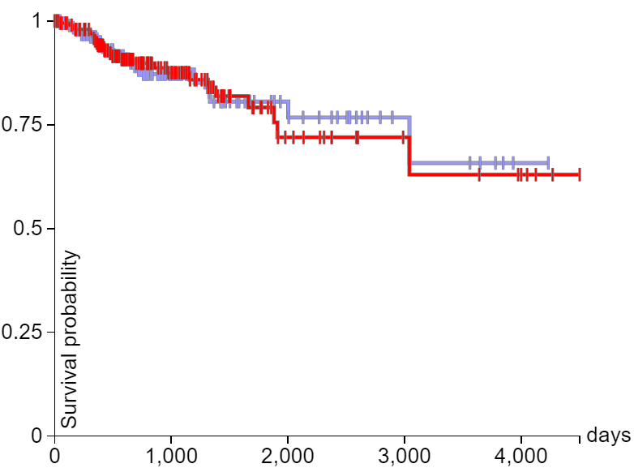
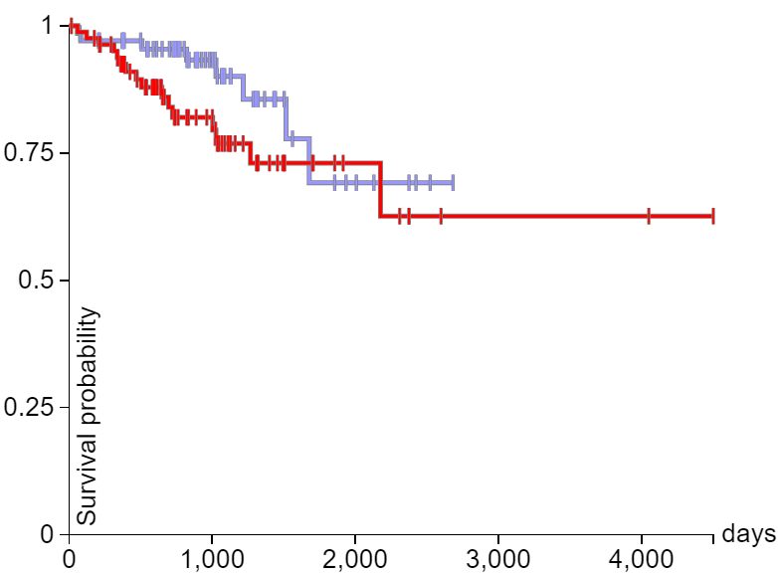
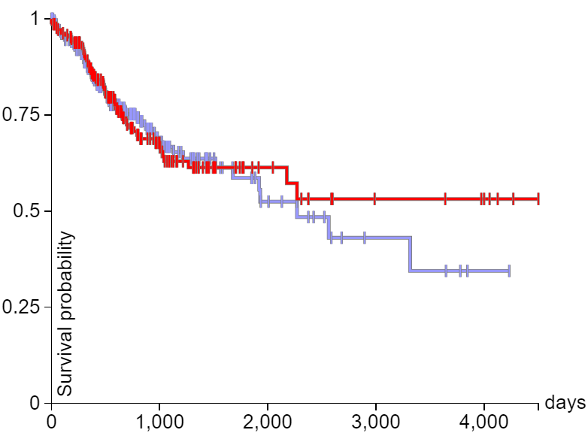
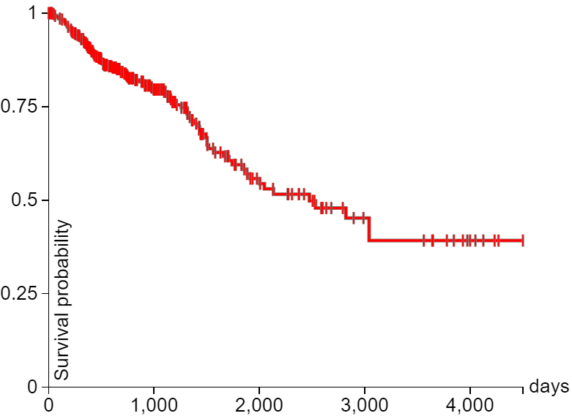
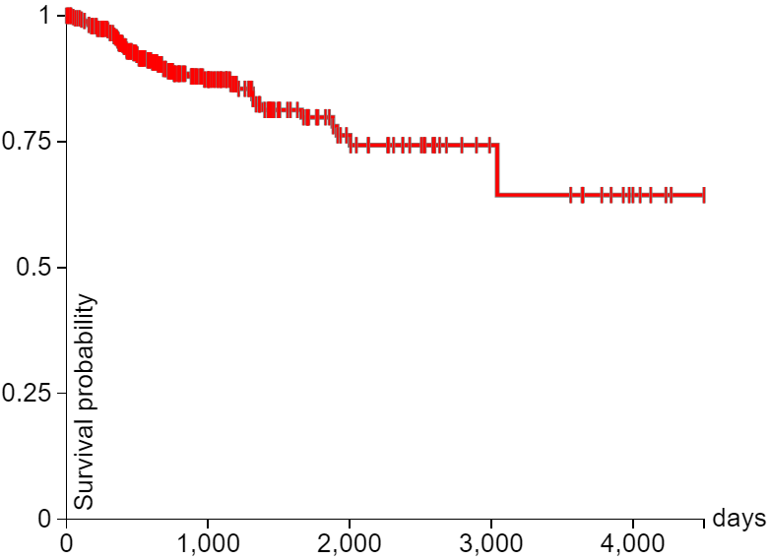
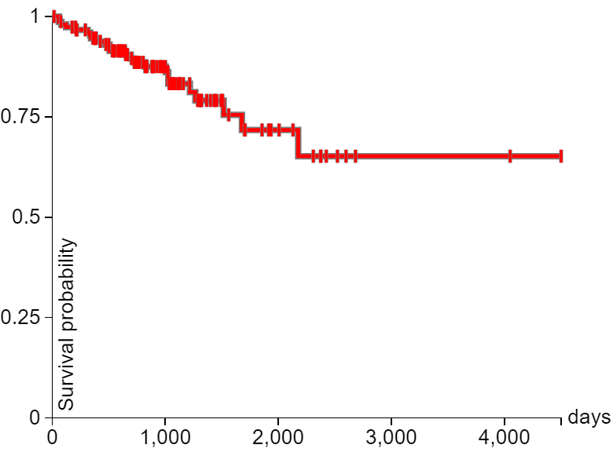
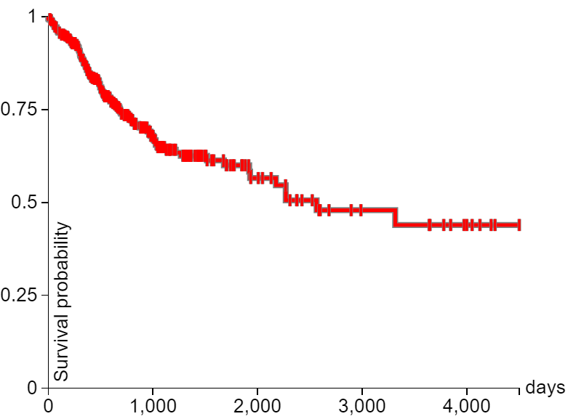
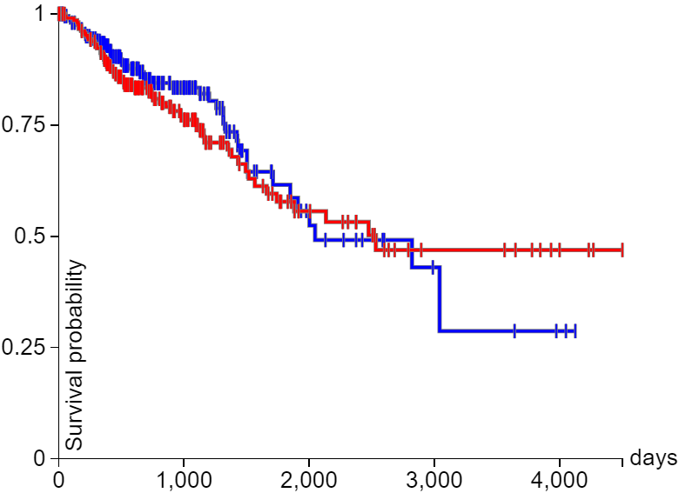
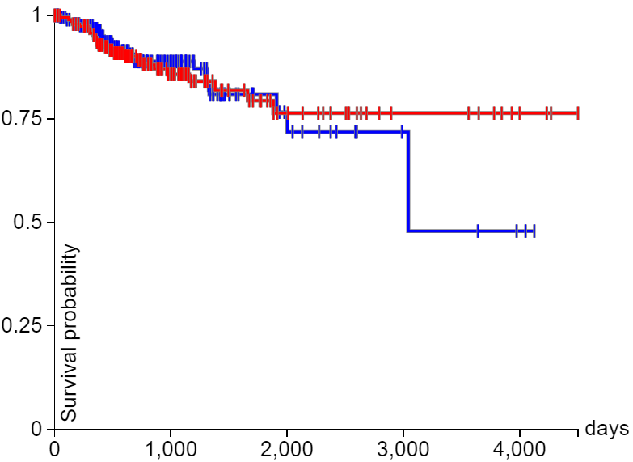
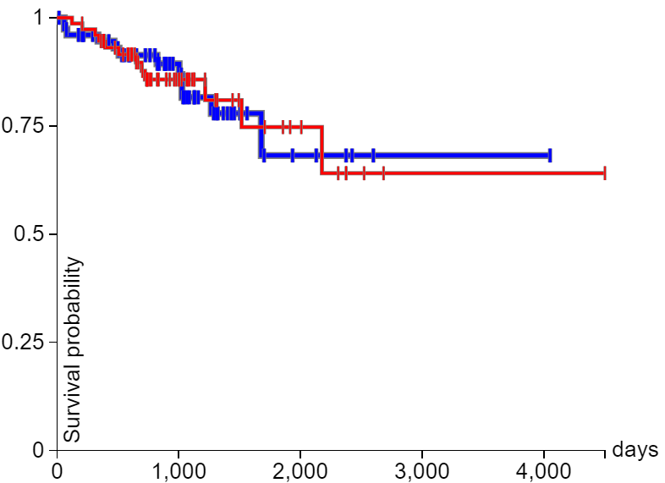
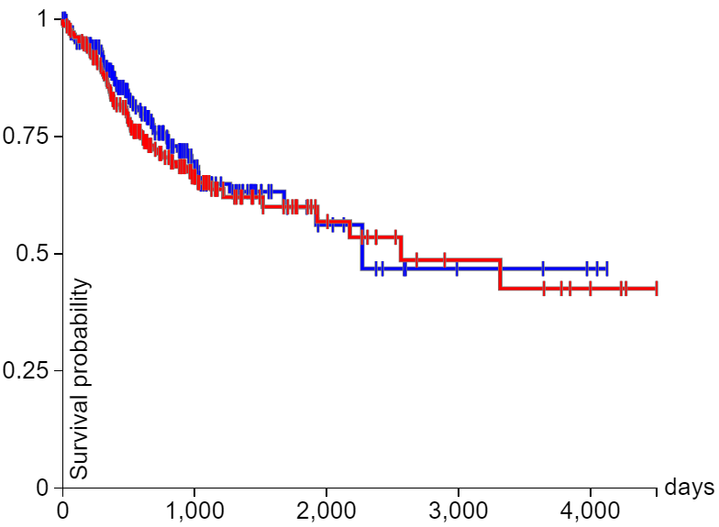

Supplement 3 The prognostic value of AKR1 mRNA levels in CRC patients (Kaplan‒Meier Plotter) OS, overall survival; DSS, disease-specific survival; DFI, disease-free interval; PFI, progression-free interval.
OS
DSS
DFI
PFI
OS
DSS
DFI
PFI
AKR1A1
AKR1B1
p-value= 0.6397
p-value = 0.9670
p-value = 0.9129
p-value = 0.7733
p-value= 0.8594
p-value = 0.9670
p-value = 0.09566
p-value = 0.3035
OS
DSS
DFI
PFI
OS
DSS
DFI
PFI
AKR1B10
AKR1B15
p-value= 0.2519
p-value=0.8992
p-value=0.03563
p-value=0.3467
p-value=0.1383
p-value=0.1801
p-value=0.5295
p-value=0.2909
OS
DSS
DFI
PFI
OS
DSS
DFI
PFI
OS
DSS
DFI
PFI
AKR1C1
AKR1C2
p-value= 0.1458
p-value= 0.05485
p-value=0.1104
p-value= 0.2394
p-value=0.03456
p-value=0.009152
p-value=0.2501
p-value= 0.2771
p-value= 0.2394
p-value=0.2001
OS
DSS
DFI
PFI
OS
DSS
DFI
PFI
AKR1C3
AKR1C4
p-value= 0.4999
p-value= 0.6776
p-value= 0.1747
p-value=0.4116
p-value= 0.3987
p-value=0.9294
p-value=0.1401
p-value= 0.8293
OS
DSS
DFI
PFI
OS
DSS
DFI
PFI
AKR1D1
AKR1E2
p-value= ∅
p-value= ∅
p-value= ∅
p-value= ∅
p-value=0.5843
p-value= 0.9017
p-value= 0.9805
p-value= 0.4996

