Slide 1
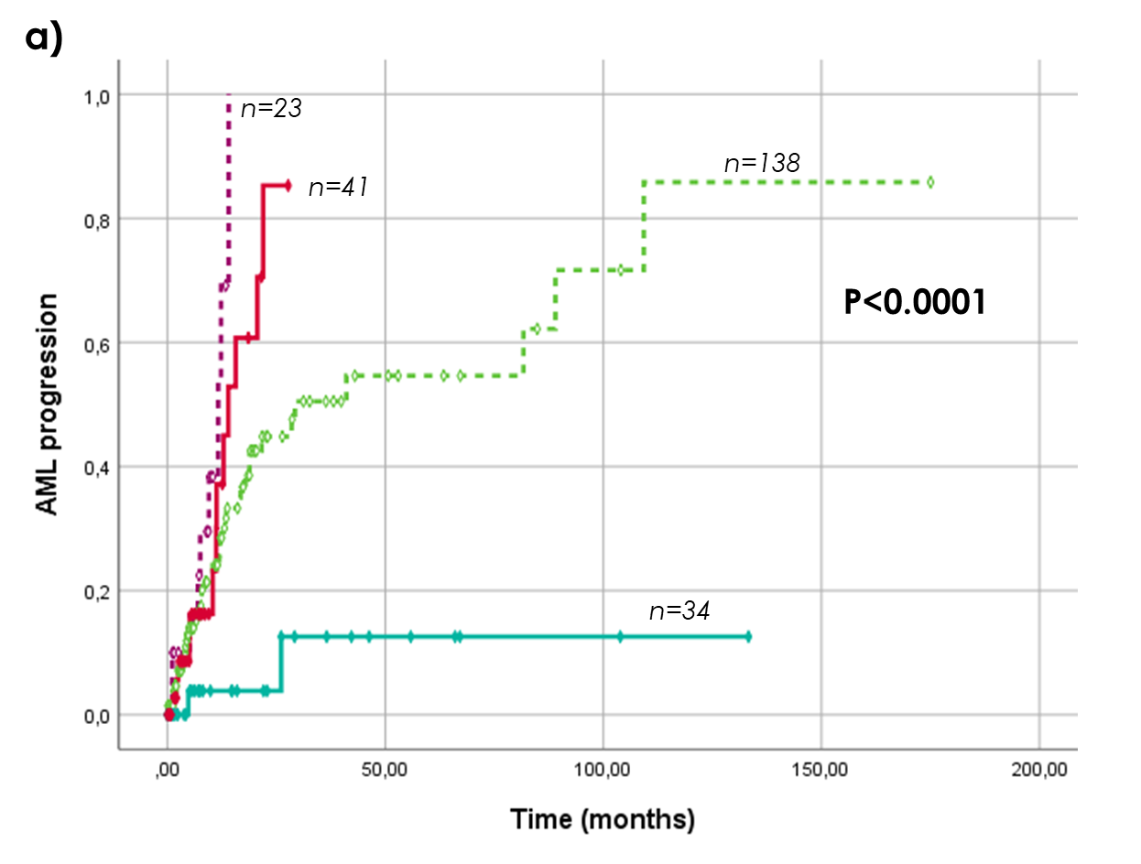
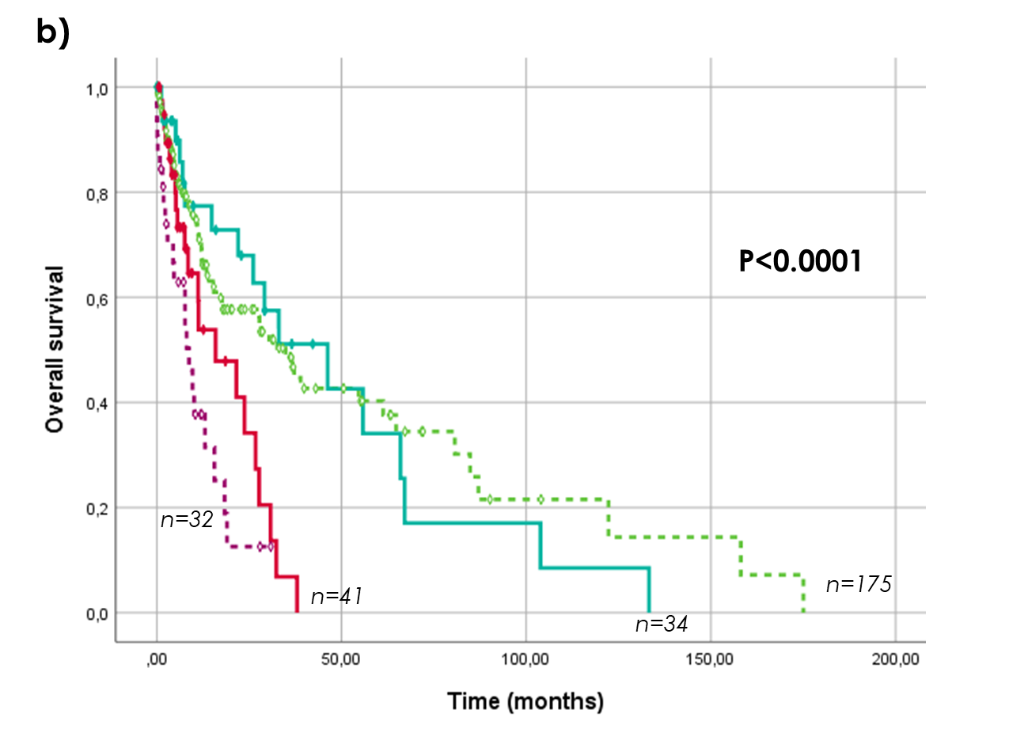
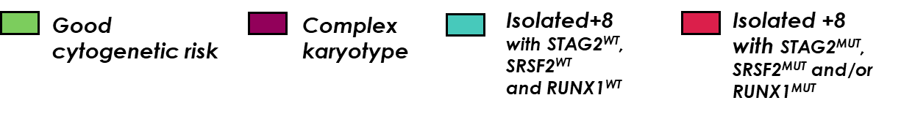
Supplementary figure 1: a) Time to AML progression in newly described isolated +8 MDS subgroups compared to non-trisomy 8 MDS patients with normal and complex karyotypes; b) overall survival in newly defined risk subgroups in isolated +8 MDS patients compared to non-trisomy 8 MDS patients with normal and complex karyotypes.

Slide 2
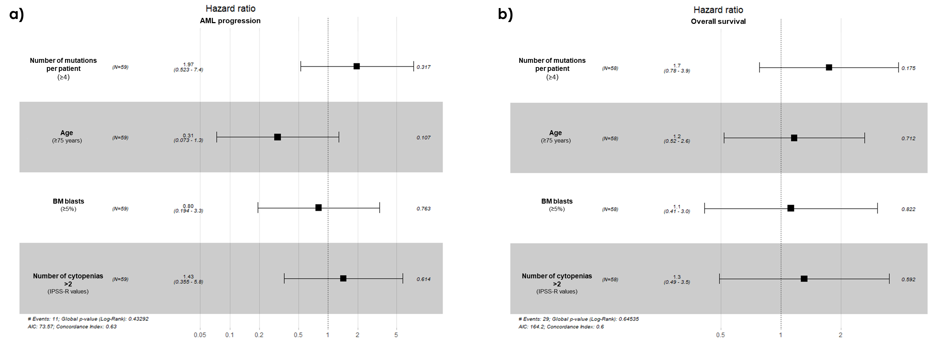
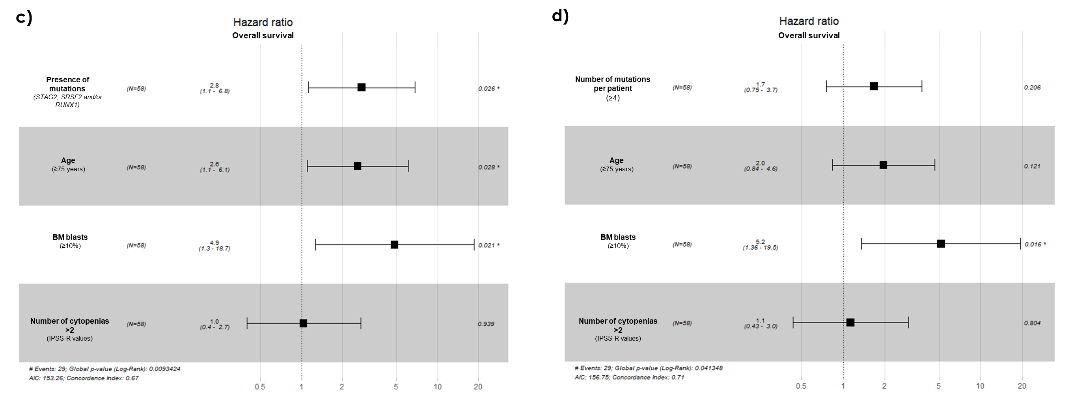
Supplementary figure 2: a) Multivariate analysis of patients with isolated +8 depending on number of mutations per patient (≥4) in AML progression; b) Multivariate analysis of OS in isolated +8 MDS patients depending on the number of mutations per patient; c) Multivariate analysis of OS in isolated +8 MDS considering 10% of BM blasts in patients with mutations in STAG2, SRSF2 and/or RUNX1; d) Multivariate analysis of patients with isolated +8 MDS regarding percentage of BM blasts (>10%) and the number of mutations per patient (≥4).

Slide 3
Supplementary figure 3: a) Percentage of patients with isolated +8 MDS with and without mutations in STAG2, SRSF2 and/or RUNX1 stratified by the IPSS-R; b) Percentage of patients with MDS and isolated +8 with and without mutations in STAG2, SRSF2 and/or RUNX1 stratified by the IPSS-M.

Slide 4
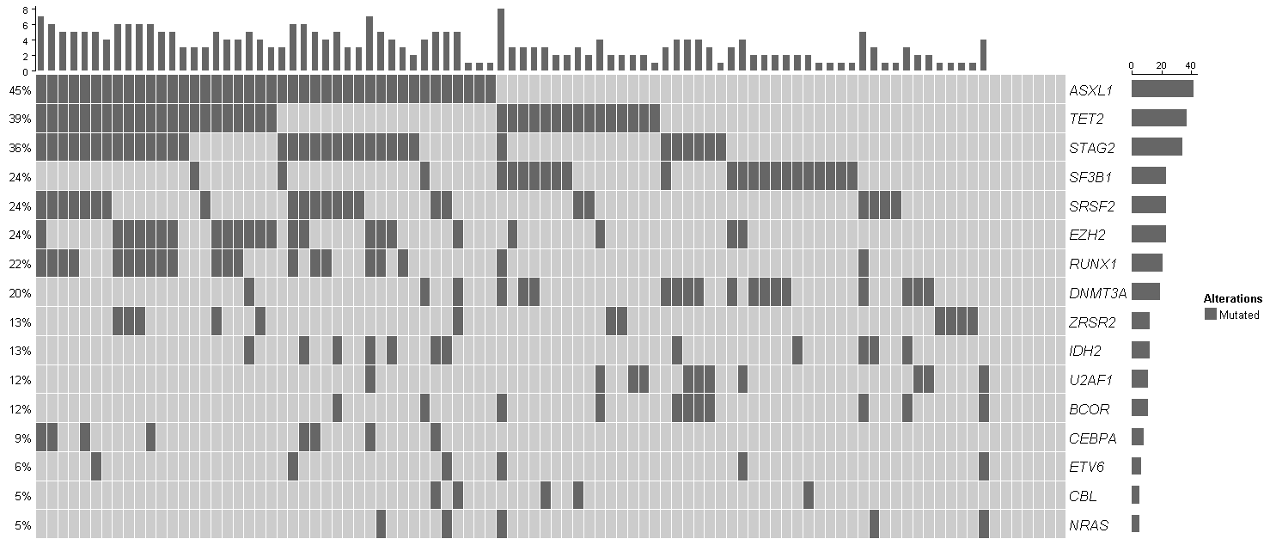
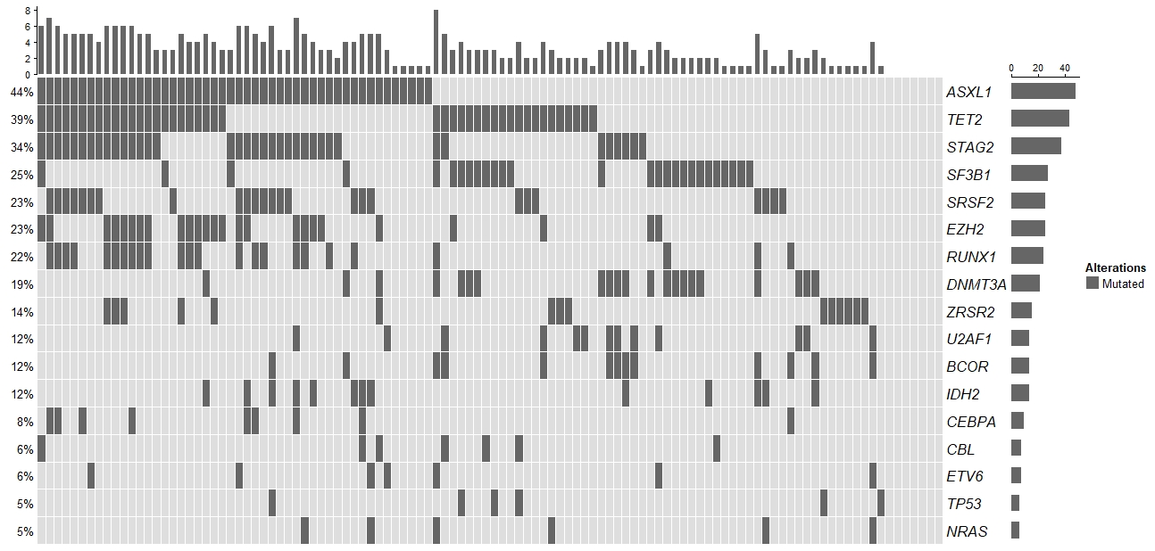
Supplementary Figure 4: Mutational pattern of mutated genes in more than 5% of isolated +8 MDS patients of the International Working Group for the Prognosis of MDS.

Slide 5
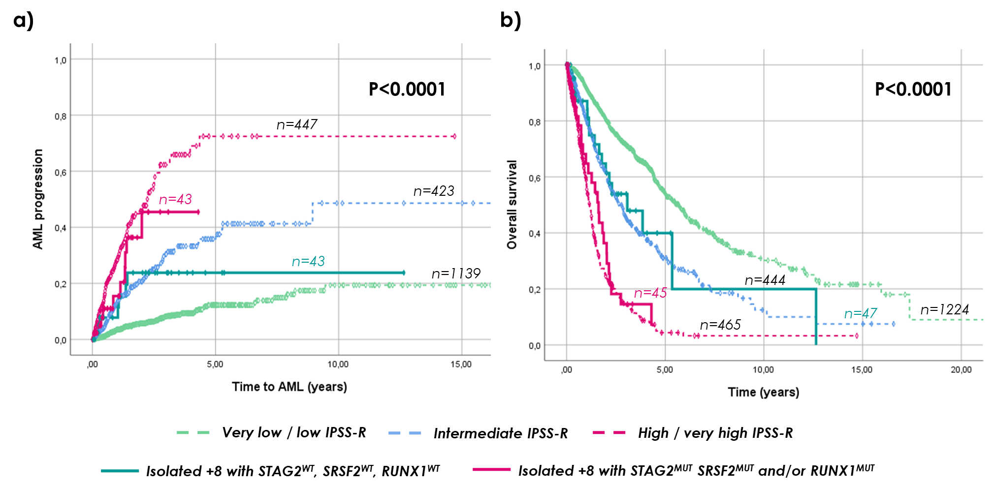
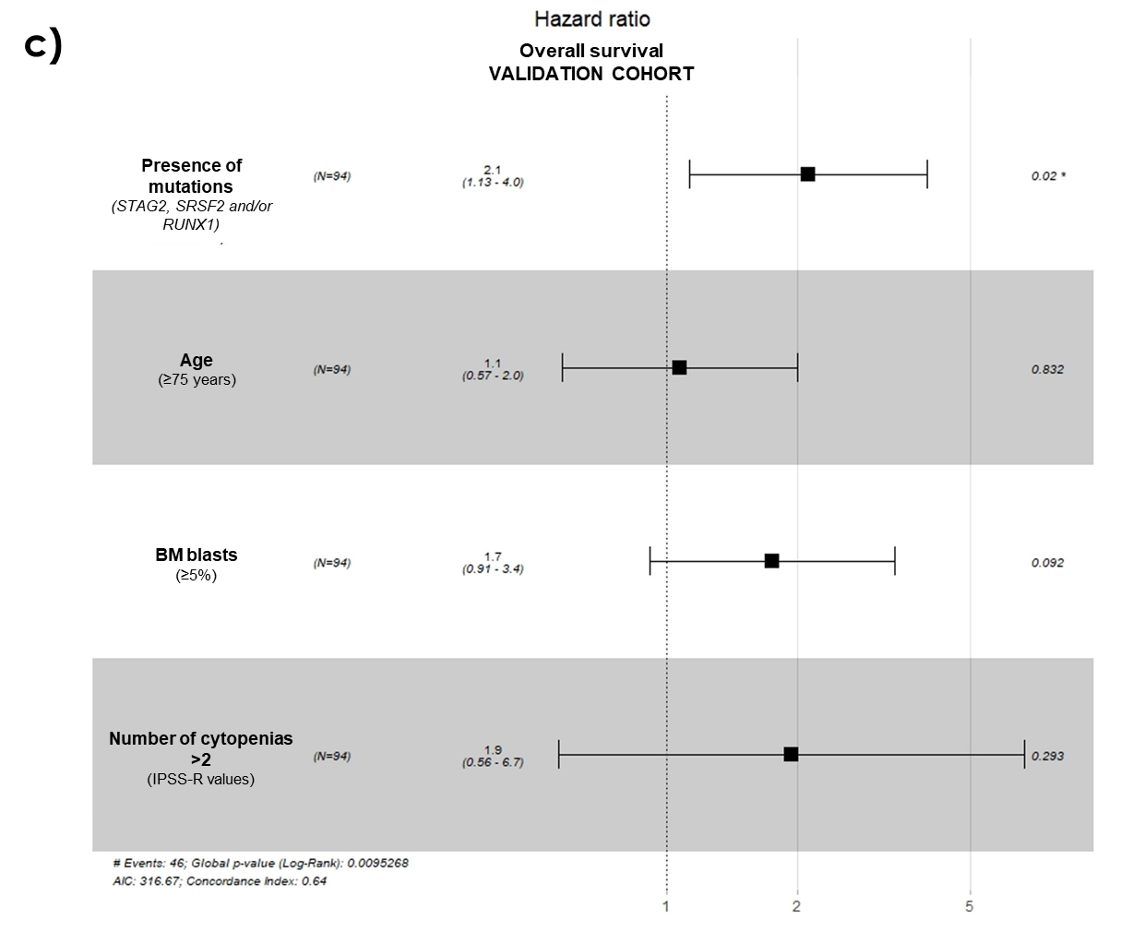
Supplementary Figure 5: a) Time to AML progression in newly defined prognostic subgroups in isolated +8 compared to the control MDS without +8 stratified by IPSS-R risk subgroups; b) OS of isolated +8 MDS patients reclassified in prognostic groups according to mutational profile within IPSS-R MDS control groups; c) Multivariate analysis for OS in isolated +8 patients of the validation cohort.

Slide 6
a)
IPSS-R
IPSS-M
b)
Supplementary figure 6: a) Percentage of patients from the validation cohort stratified within IPSS-R and IPSS-M categories reconsidered as low risk and high risk based on mutational profile; b) Percentage of patients classified by the IPSS-R and IPSS-M in patients with isolated +8 MDS depending on mutational status of STAG2, SRSF2 and RUNX1.

