Slide 1
Additional Figure

Slide 2
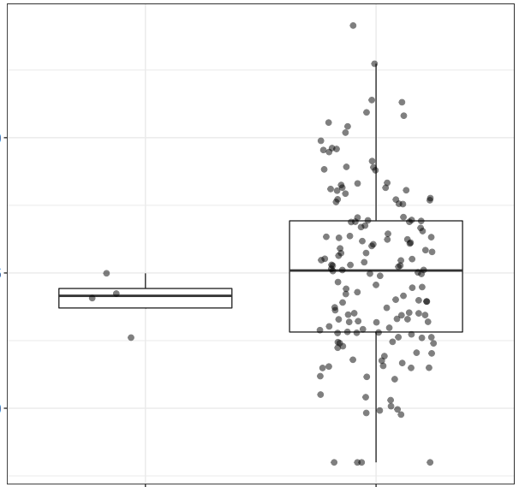
mRNA expression
5
2.5
0
Non-tumor
GBM
Histology
Notes:
Fig 1S TIGIT

Slide 3
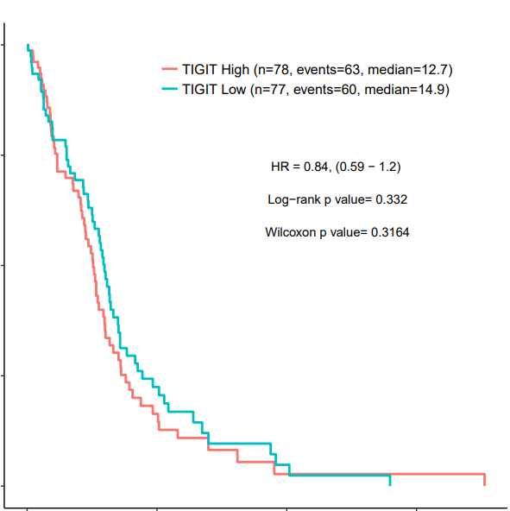
100
TIGIT High (n=78, events=63, median=12.7)
TIGIT Low (n=77, events=60, median=14.9)
75
HR=0.84 (0.59 – 1.2)
*** Log-rank p value=0.332
Surviving(%)
50
25
0
0
25
50
75
Survival time (Months)
Notes:
Fig 2S

Slide 4
ns
1.5 x 10⁷
ns
mock NK
TIGIT target 1-edited NK
TIGIT target 2-edited NK
cell number (cells)
ns
1.0 x 10⁷
ns
ns
5.0 x 10⁶
ns
day1
day 4
day 7
culture period (days)
Notes:
Figure 3S

Slide 5
2
mock NK
TIGIT target 1-edited NK
TIGIT target 2-edited NK
Normalized cell index
1
0
0
60
120
240
480
720
1440
2880
Time (min)
Notes:
4S

Slide 6
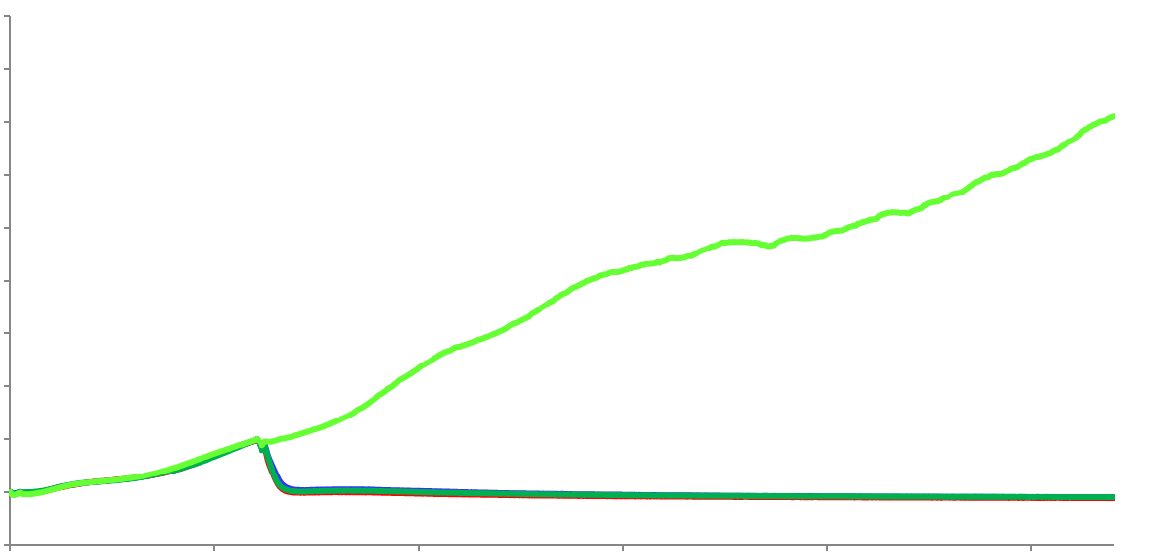
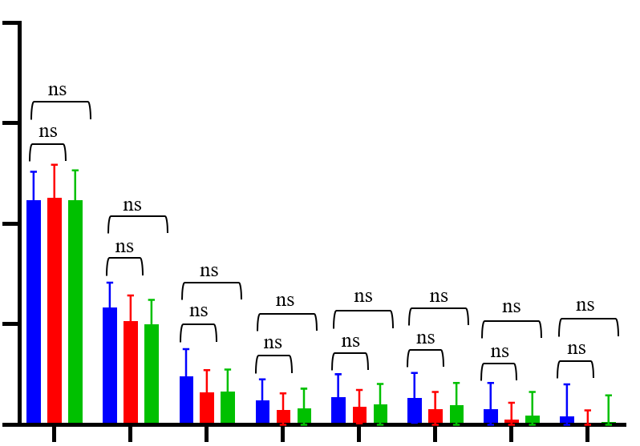

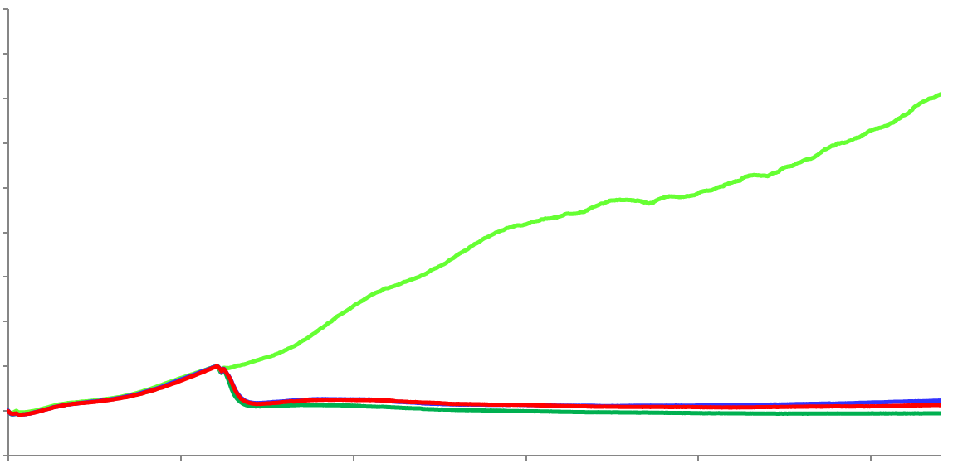
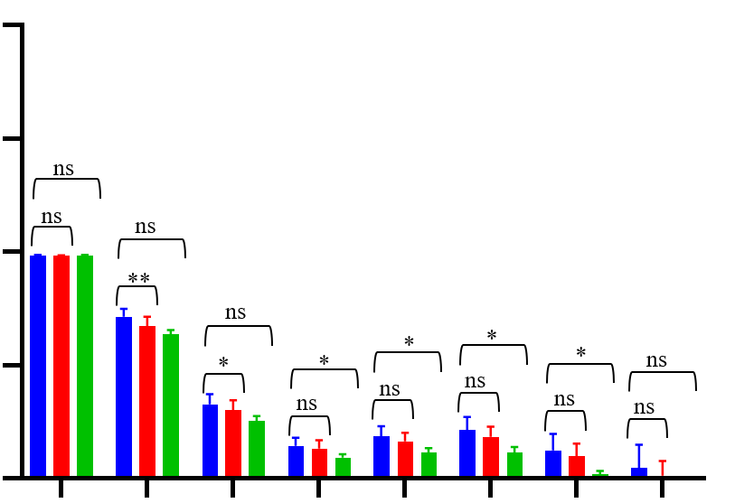

Normalized cell index
Normalized cell index
2
mock NK
TIGIT target 1-edited NK
TIGIT target 2-edited NK
E:T=1:1
6.0
4.0
1
2.0
0
0
20
30
40
50
60
70
0
60
120
240
480
720
1440
2880
Time (hrs)
Time (min)
Normalized cell index
E:T=0.5:1
Normalized cell index
2
mock NK
TIGIT target 1-edited NK
TIGIT target 2-edited NK
6.0
4.0
1
2.0
0
0
20
30
40
50
60
70
0
60
120
240
480
720
1440
2880
Time (hrs)
Time (min)
Notes:
5S LN-18

Slide 7
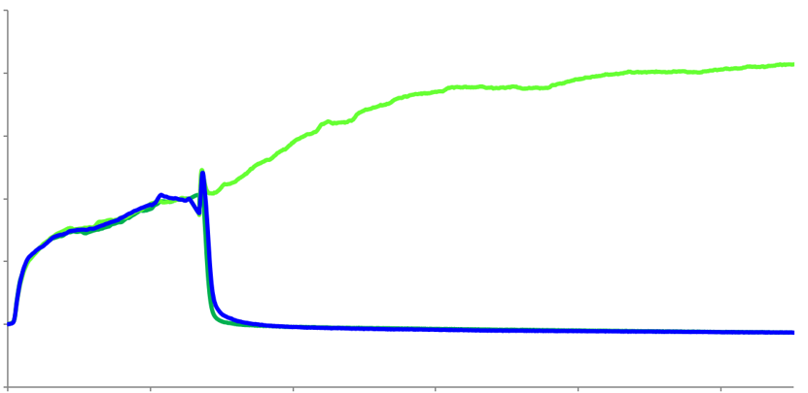
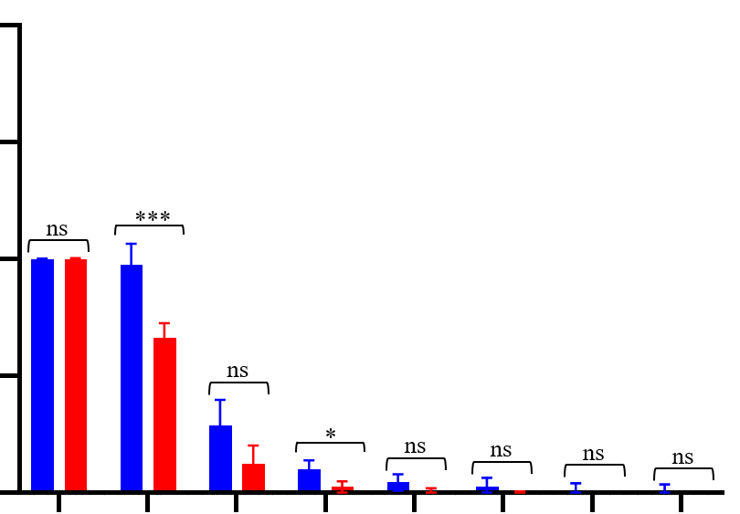
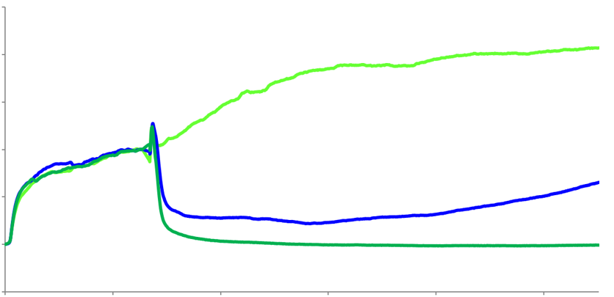
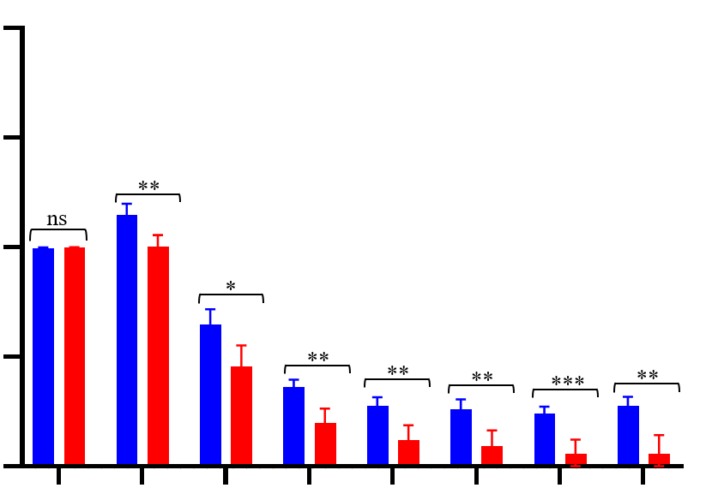
Normalized cell index
Normalized cell index
2
mock NK
TIGIT target 2-edited NK
2.0
E:T=2:1
1.0
1
0
0
20
30
40
50
60
70
0
60
120
240
480
720
1440
2880
Time (hrs)
Time (min)
Normalized cell index
E:T=1:1
Normalized cell index
2.0
2
mock NK
TIGIT target 2-edited NK
1.0
1
0
0
20
30
40
50
60
70
0
60
120
240
480
720
1440
2880
Time (hrs)
Time (min)
Notes:
6S T98G

Slide 8
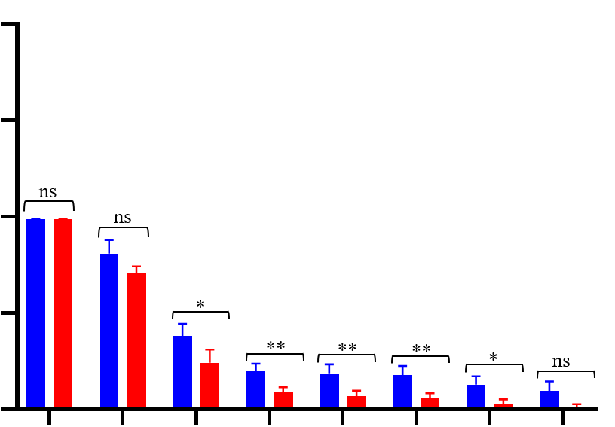
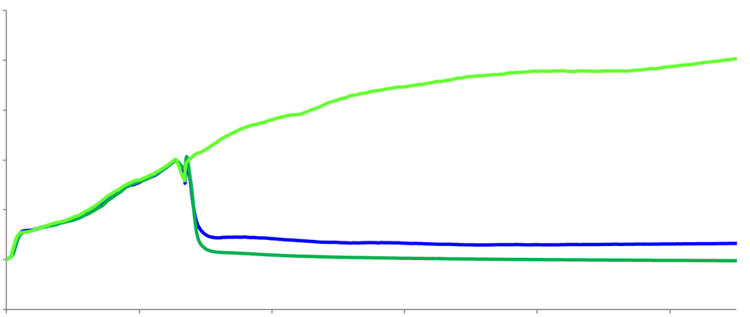
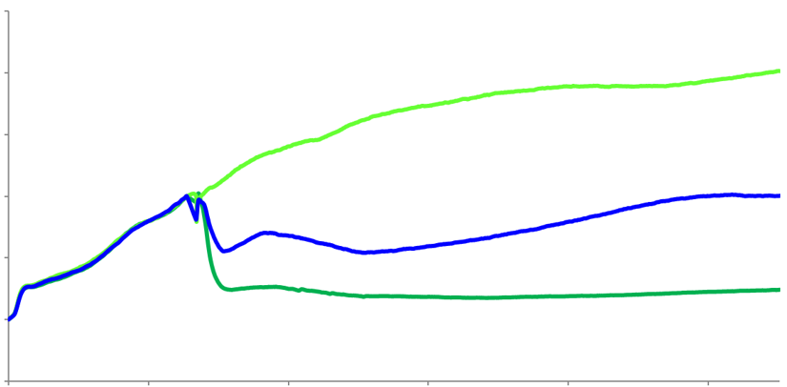
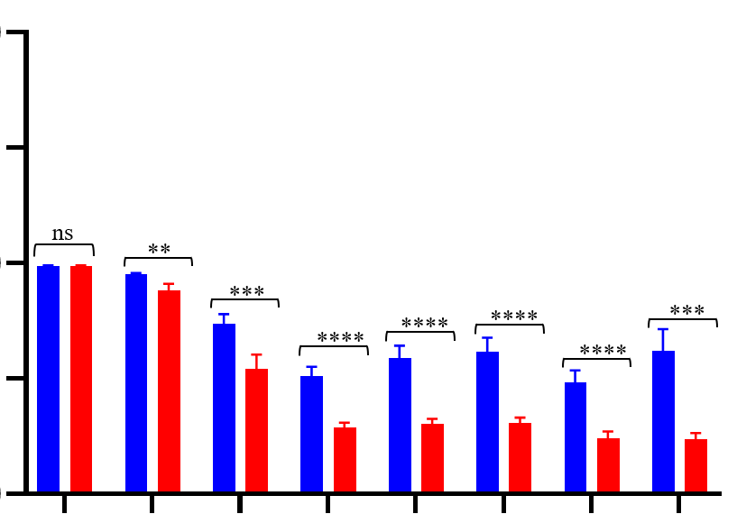
Normalized cell index
Normalized cell index
2
mock NK
TIGIT target 2-edited NK
E:T=2:1
2.0
1
1.0
0
0
20
30
40
50
60
70
0
60
120
240
480
720
1440
2880
Time (hrs)
Time (min)
Normalized cell index
E:T=1:1
Normalized cell index
2
mock NK
TIGIT target 2-edited NK
2.0
1.0
1
0
0
20
30
40
50
60
70
0
60
120
240
480
720
1440
2880
Time (hrs)
Time (min)
Notes:
7S U251MG

Slide 9
 | Locus | Sequence | PAM | forward | reverse | length
On target of TIGIT target 1-targeting sgRNA | chr3:+114295820 | ACCCTGATGGGACGTACACT | GGG | ACATGTGCTTCGTCCTCTTC | GCCTCGGCATCAGTATGATTTA | 500
On target of TIGIT target 2-targeting sgRNA | chr3:-114295724 | TGGGGCCACTCGATCCTTGA | AGG | GGACTGGGAGCCTTGAATAAC | CCATCAGGGTAGGTGTGATAGA | 504
 | Locus | sequence | PAM | forward | reverse | length
Off target of TIGIT target 1-targeting sgRNA | chr2:-241039993 | ACCCCTGGGACGTACACT | GAG | TGAATTAGACCCAGTTCAGACAG | CCCACTAGGTCAACACAAGA | 504
Off-target 2 | chr6:-86438519 | ATTCTGATGGGAAGTACACA | GGG | CCTGTCCTGCTCTGAAGTAATG | TCTGATGCACAGTGAAGATTAAGA | 500
Off-target 3 | chr20:-62660663 | ACCCAGATGGGAAGAACACT | GAG | TTGGGAGACTGTCCCTTAGT | CATTTCCGCCGCTCTCAT | 536
 | Locus | sequence | PAM | forward | reverse | length
Off target of TIGIT target 2-targeting sgRNA | chr11:-45435080 | TGGTCCCCCTCCATCCTTGA | TGG | GGTGAGATGGAAAGGTCCTAAA | ACTGAAGCCTGCCCAATAG | 492
Off-target 2 | chr13:-40667866 | TGGCCCCACT-GATCCTTGA | CAG | CCCAAATTCCTTGAGGCTACT | GGACTAGAGAGACGATAGTGAGAA | 510
Off-target 3 | chr4:+42066201 | TGGGGCCCCTC-ATCTTTGA | AAG | CGCTGTTACTTGCCGATTCA | CTATTTGGCAGCACCACACTAA | 585
Notes:
Figure 8S

