Slide 1
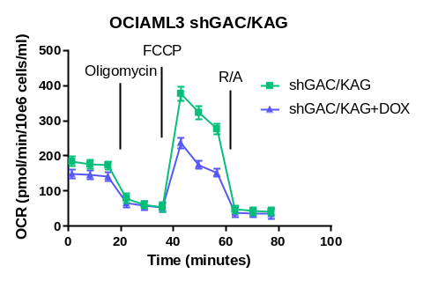
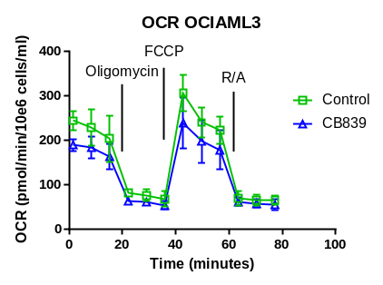
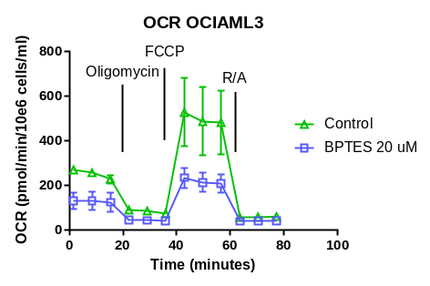
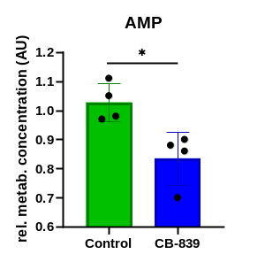
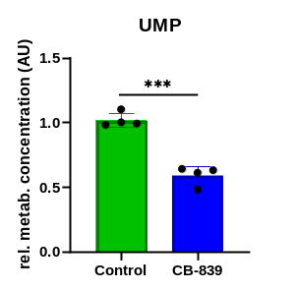
Supplementary Figure 1
A
1
2
3
4
5
6
7
8
9
B
GAC
1: Parental OCI-AML3
2: shRNA control vector
3: shRNA control vector+DOX
4: shGAC
5: shGAC+DOX
6: shGAC/KGA (clone 1)
7: shGAC/KGA (clone 1)+DOX
8: shGAC/KGA (clone 2)
9: shGAC/KGA (clone 2)+DOX
GAC
KGA
KGA
β-actin
β-actin
C
D
E
F
Notes:
Supplementary Figure 1
Expression of Glutaminase in shGAC /KAC AML cell lines
Expression….
Effects of BPTES on Oxygen Consumption Rate (OCR) by Seahorse Analyzer.
Pretreatment with 0.014-1µM CB-839 decreased basal and maximal respiratory capacity in OCI-AML3 cells.
OCI-AML3 cells infected with DOX-inducible GLS (GAC/KGA) shRNA.
Intracellular levels (relative to control) of UMP and AMP in HL-60 cells treated with 1 μM CB-839 for 24 hours.

