Slide 1




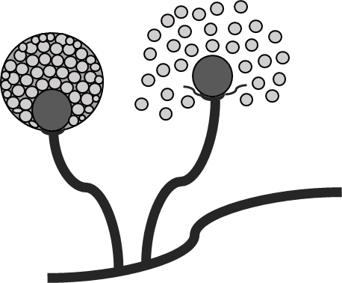




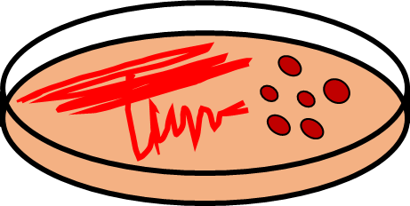


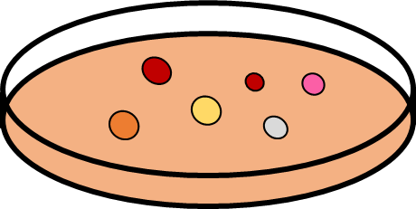





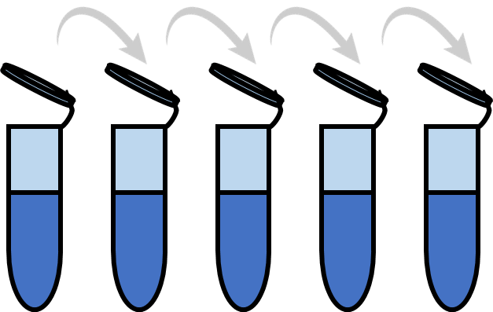
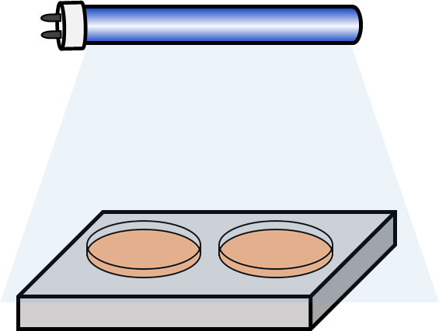
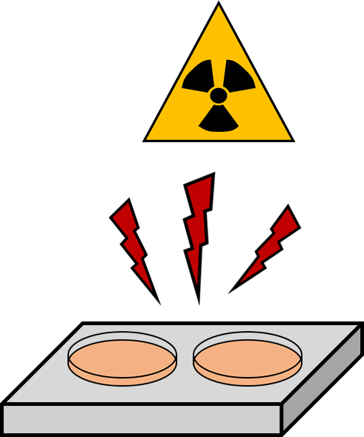
A
1 X PBS
Spore
Streaking
Harvest
Spore
WT strain
cultivation
28˚C, 10 day
Scrape the spores
NTG 5 mg/1 ml(PBS) treatment
Filtration
Spore suspension
Centrifugation
Mutant single colony isolation
28˚C,
7 day
Spreading
10⁸ CFU/ml spore suspension
30 min
Washed by the sterile water (x3)
After vortxing, stationary culture
10-fold dilution
Refrigerated storage
Diluted sample preparation
Selected mutant
4˚C, 1 h
B
Spore
Spore suspension
UV irradiation
28˚C,
7 day
Mutant single colony isolation
Spreading
Refrigerated storage
10⁸ CFU/ml spore suspension
4˚C, 1 h
10-fold dilution
Selected mutant
Diluted sample preparation
γ-ray irradiation
Figure S1. Spontaneous mutagenesis methodology for constructing primary mutant libraries.
(A) Mutagenesis through physical (UV, γ-ray irradiation) and (B) chemical treatment (NTG).

Slide 2
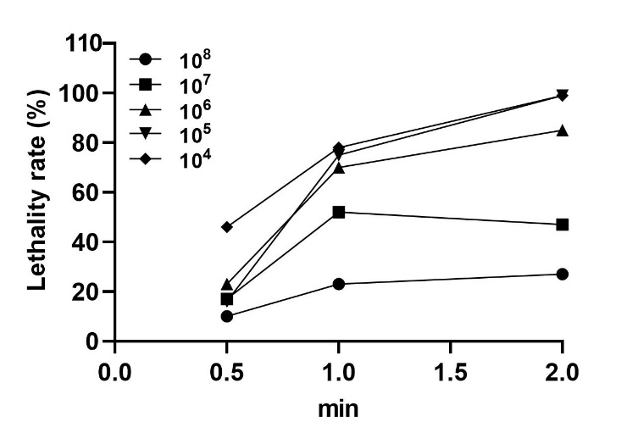
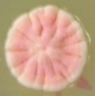
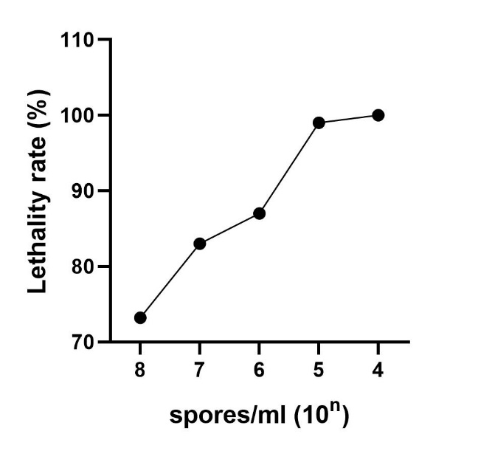
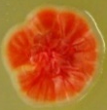
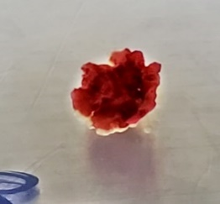
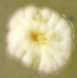
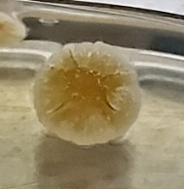
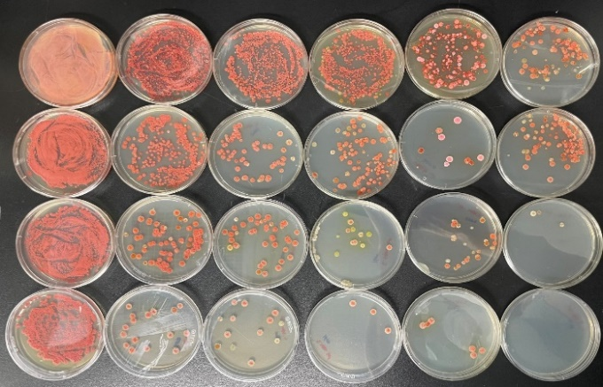
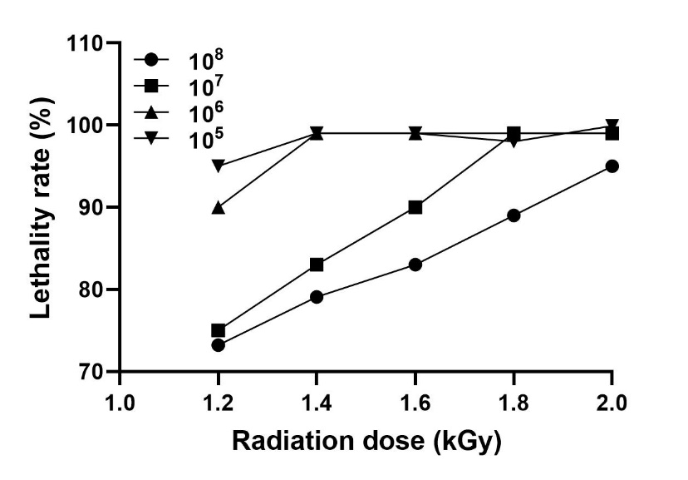
A
B
C
WT colony
Mutant colony
D
E
8
7
Spore/ml (10^{n})
6
5
No
treated
1.2
1.4
1.6
1.8
2.0
Radiation dose (kGy)
Figure S2. Primary selection strategy for the construction of mutants based on morphological change. (A) Lethality rate after UV irradiation (B) Lethality rate after NTG treatment (C) Changes in colony phenotype after NTG mutagenesis (D) Confirmation of lethality tendency according to radiation dosage and WT spore concentration after γ-ray irradiation (E) Lethality rate after γ-ray irradiation.

Slide 3
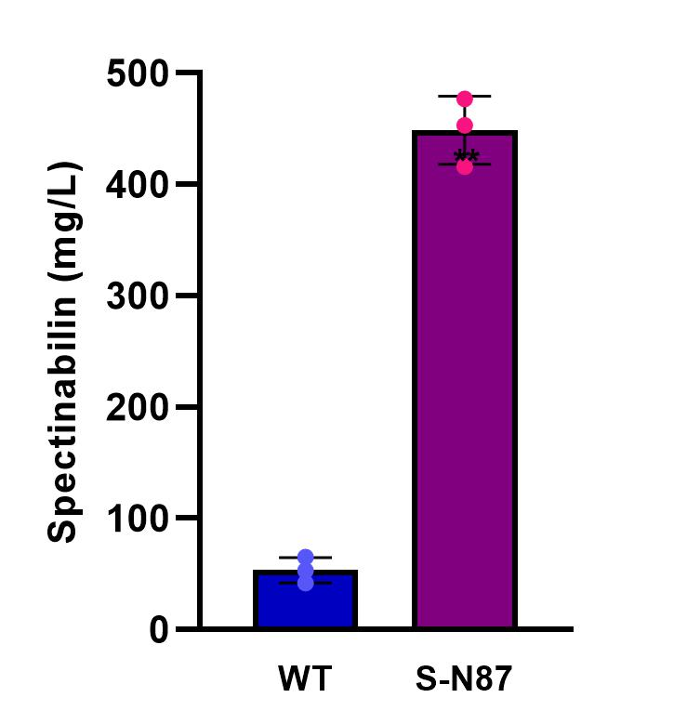
Fig S3. Spectinabilin production amount of WT and S-N87 after culture in 50 ml flask. Values are expressed as the mean ± SD of two independent experiments with three replicates.

