Slide 1
Supplementary material for
Investigation of the mechanism of novel molten salt electrolysis of Cu₂S at 473 K
for the production of Cu metal and elemental S
Tae-Hyuk Lee¹, Hee-Nam Kang¹, Jin-Young Lee^{1,2}, and Jungshin Kang^{1,2,*}
¹Korea Institute of Geoscience and Mineral Resources, 124 Gwahak-ro Yuseong-gu, Daejeon 34132, Korea
²University of Science and Technology, 217 Gajeong-ro Yuseong-gu, Daejeon 34113, Korea
³School of Materials Science and Engineering, Pusan National University, 2 Busandaehak-ro, Geumjeong-gu, Busan 44241, Korea

Slide 2
Figure S-1 Binary phase diagram of the CuCl – KCl system.

Slide 3
E_{cathode}
E_{anode}
Inlet
Outlet
Exhaust gas
C crucible
C rod
Na₂S₂O₃ solution
CuCl – KCl
Figure S-2 Schematic of experimental apparatus for electrolysis in CuCl – KCl molten salt using C crucible cathode and C anode at 473 K

Slide 4
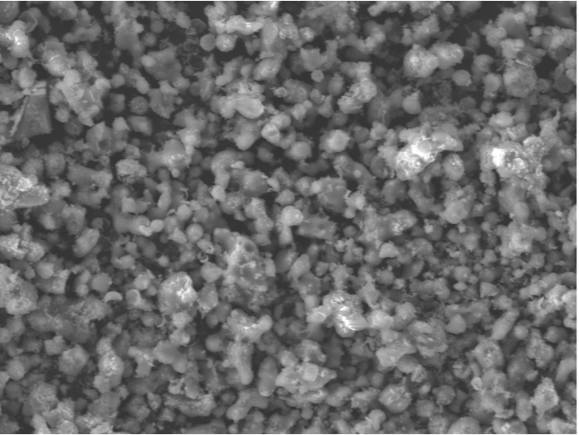
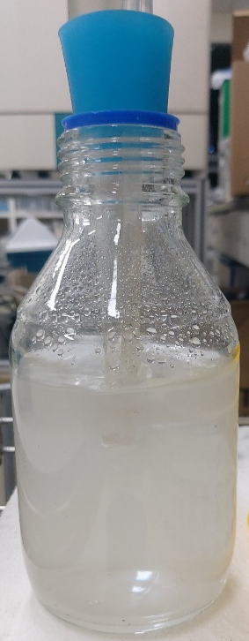
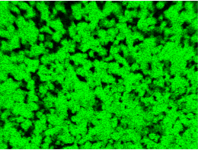
(a)
(b)
10 μm
(c)
S
10 mm
10 μm
Figure S-3 (a) Photograph of the Na₂S₂O₃ solution after electrolysis and analytical results of (b) microstructure and (c) element distribution of precipitates

Slide 5
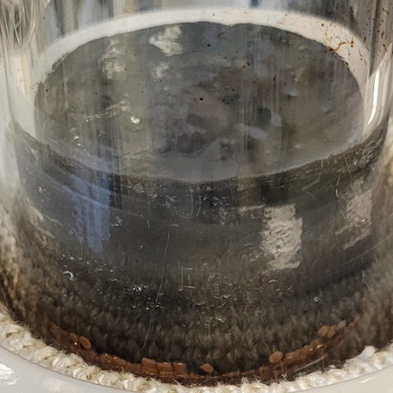
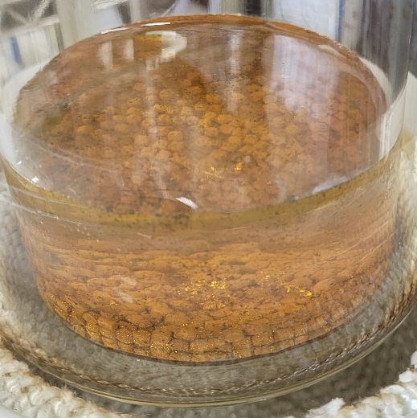
(a)
(b)
10 mm
10 mm
Figure S-4 Photograph of the CuCl – KCl molten salt obtained (a) after pre-electrolysis and (b) after CuCl₂ converting to CuCl by chemical reaction with Cu metal at 473 K

Slide 6
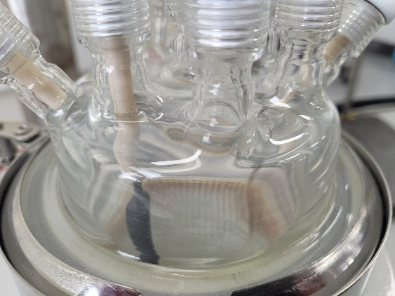
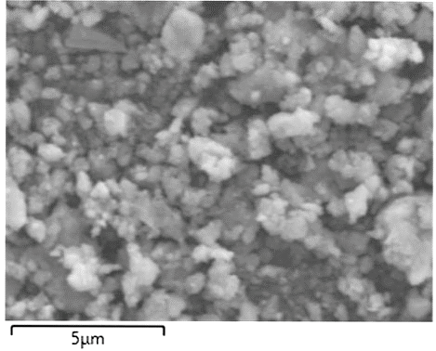
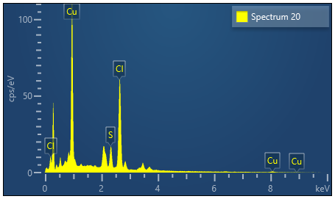
(a)
(b)
20 mm
1 μm
(c)
Concentration of element i, C_{i} (at.%)
S | Cu | Cl
10.49 | 48.71 | 40.81
Figure S-5 (a) Photograph of the lid of the PYREX reactor after electrolysis and analytical results of (b) microstructure, and (c) concentration of elements of particles obtained at the lid of the reactor

