Slide 1
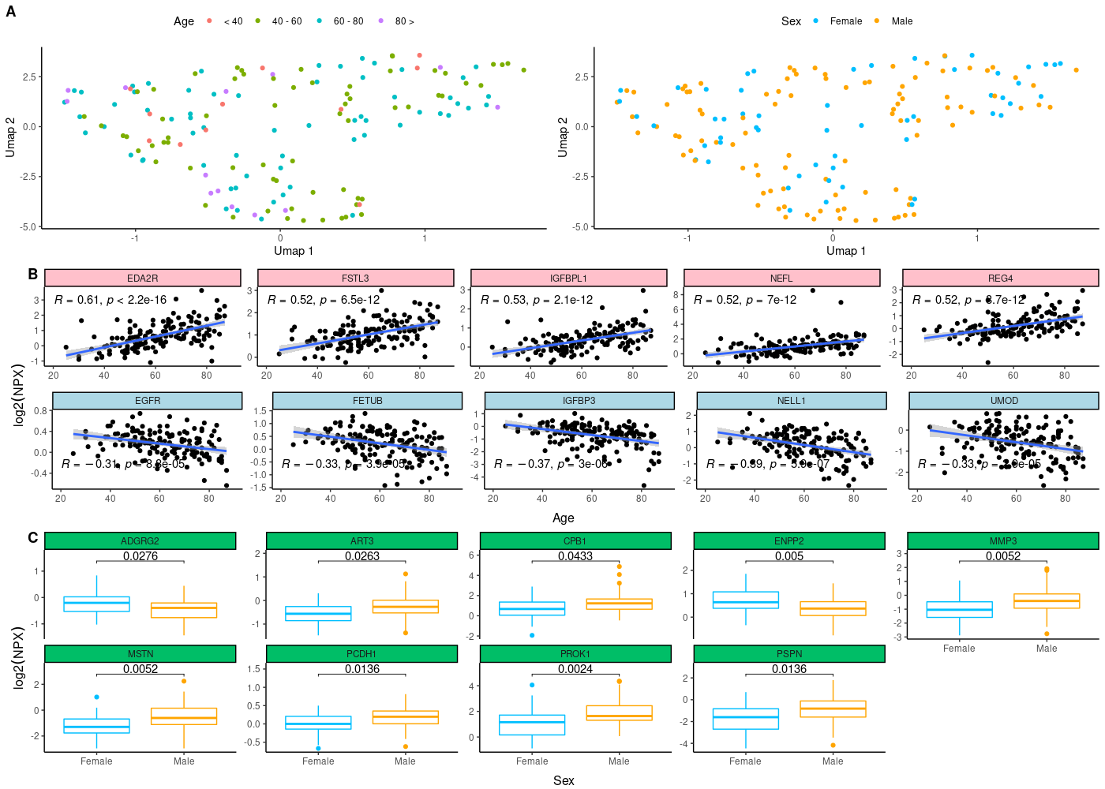
Notes:
Additional figure 1: Proteins associated with demographics
(a) Visualizing of unsupervised clustering using UMAP. Colors represents the different groupings used. (age, sex, WHO score) (b) Dot plot shows the distribution for protein levels stratified by sex. The y-axis represents the log2(NPX) values, while the x-axis shows the sex. Median levels are indicated by the black line and subsequently p-values are determined using the Wilcoxon rank sum test. (c) Scatter plot visualizing the five proteins which show positive (pink) and negative (blue) correlation with age. The y-axis represents the log2(NPX) values, while the x-axis shows the age in years. Correlations are estimated using the Spearman correlation coefficient. Each point is colored based on the WHO severity score, where blue dots indicate WHO score 4, while pink dots indicate WHO score 5.

Slide 2
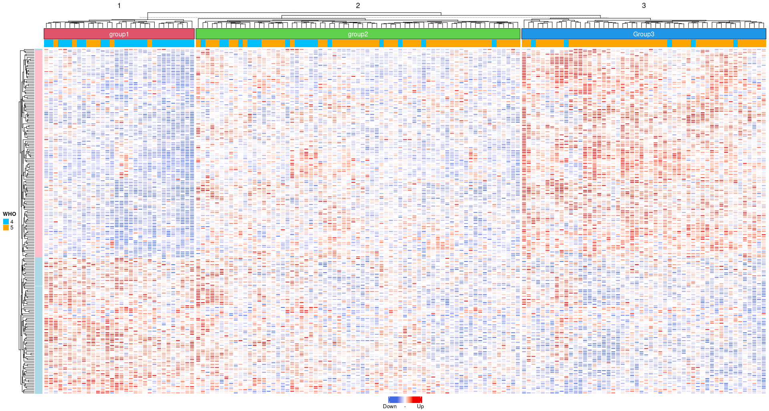
Notes:
Additional figure 2: Heatmap with all DE proteins associated with severity (SAVE)
Heatmap visualizing proteins associated with severity. We selected all proteins that were found to be significantly associated with severity after multiple testing correction. (adjusted p-value < 0.05). Hierarchical clustering is performed on both rows and columns. Each row represents a protein, whereas individuals are the columns. Proteins and individuals are both ordered by. Column annotation shows the WHO score for each individual.

Slide 3
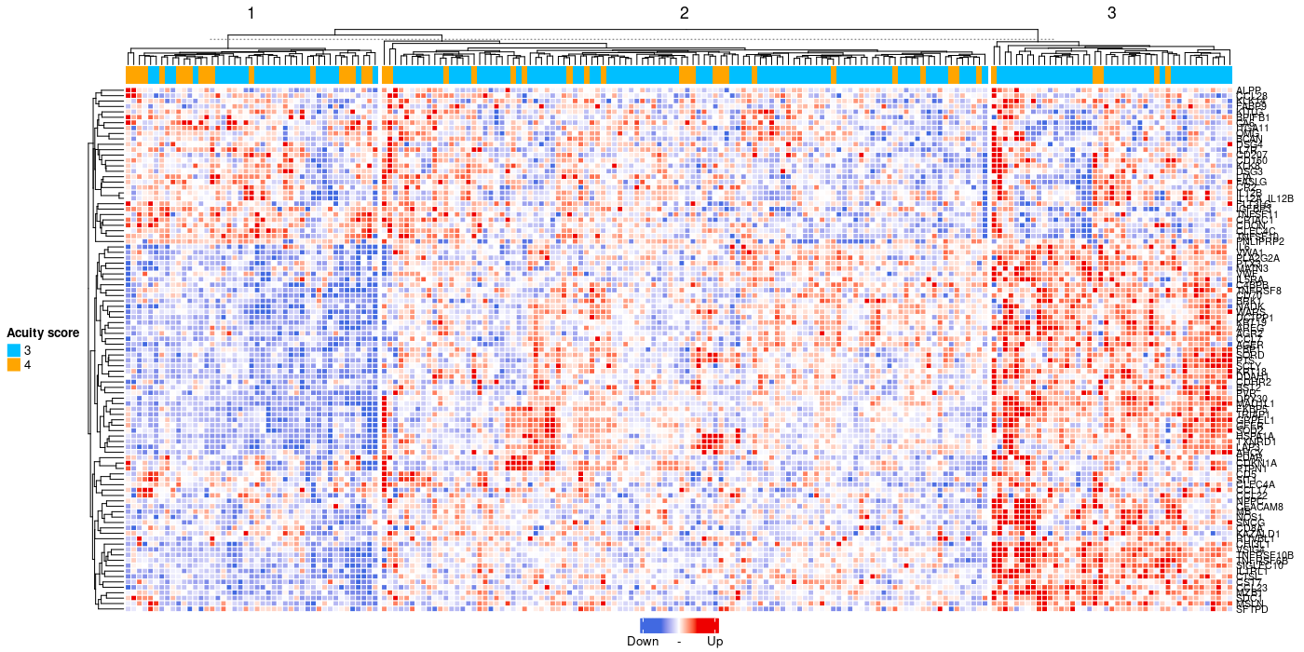
Notes:
Additional figure 3: Heatmap with all DE proteins associated with severity (MGH)
Heatmap visualizing proteins associated with severity. We selected the same 97 proteins that were found to be significantly associated with severity in the SAVE cohort. Hierarchical clustering is performed on both rows and columns. Each row represents a protein, whereas individuals are the columns. Proteins and individuals are both ordered by. Annotation shows the WHO score for each individual.

Slide 4
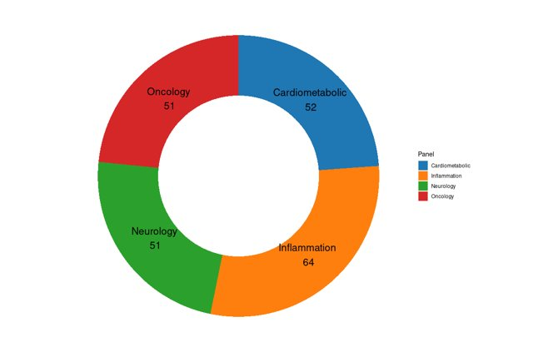
Notes:
Additional figure 4: Visualization of DEP by Olink panel
Donut plot visualizing the distribution of differentially expressed proteins among the different Olink panels. (red = Oncology, blue=Cardiometabolic, green= Neurology, orange=inflammation)

Slide 5
Characteristic | Cluster 1, N = 35¹ | Cluster 2, N = 73¹ | Cluster 3, N = 45¹ | p-value²
Age | 56 (46, 71) | 61 (52, 74) | 64 (52, 74) | 0.2
Sex |  |  |  | 0.4
Female | 16 (46%) | 25 (34%) | 14 (31%)
Male | 19 (54%) | 48 (66%) | 31 (69%)
suPAR | 8.20 (6.70, 11.15) | 9.50 (7.75, 11.30) | 10.30 (9.00, 12.70) | 0.006
PSI | 62 (42, 76) | 64 (52, 80) | 70 (54, 80) | 0.12
CMI | 1.00 (0.00, 4.00) | 2.00 (1.00, 4.00) | 2.00 (1.00, 4.00) | 0.4
Apache | 4.0 (2.0, 6.0) | 5.0 (3.0, 7.0) | 7.0 (4.0, 9.2) | 0.002
SOFA score | 1.00 (0.50, 1.50) | 2.00 (1.00, 3.00) | 2.00 (1.00, 3.00) | <0.001
WHO score | 1.00 (1.00, 1.00) | 2.00 (2.00, 2.00) | 2.00 (2.00, 2.00) | <0.001
¹Median (IQR); n (%)
²Kruskal-Wallis rank sum test; Fisher's Exact Test for Count Data with simulated p-value (based on 2000 replicates)
Notes:
Additional table 1: Summary of the cluster enrichment using clinical features (SAVE)

Slide 6
Characteristic | Cluster 1, N = 45¹ | Cluster 2, N = 108 | Cluster 3, N = 43¹ | p-value²
Age | 3 (2, 5) | 3 (2, 4) | 3 (2, 5) | 0.11
BMI | 2 (2, 3) | 3 (2, 3) | 2 (2, 3) | 0,6
Heart disease | 10 (22%) | 13 (12%) | 12 (28%) | 0.042
Lung disease | 15 (33%) | 27 (25%) | 10 (23%) | 0.5
Kidney disease | 4 (8.9%) | 10 (9.3%) | 10 (23%) | 0.058
Diabetes mellitus | 14 (31%) | 34 (31%) | 13 (30%) | >0.9
Acuity score | 3 (3, 4) | 3 (3, 3) | 3 (3, 3) | 0.004
Lymphocyte count | 3 (2, 4) | 3 (2, 3) | 2 (2, 3) | 0.004
Neutrophile count | 3 (2, 3) | 3 (2, 3) | 3 (3, 4) | <0.001
Monocyte count | 3 (2, 3) | 2 (2, 3) | 2 (2, 3) | 0.4
C-reactive protein (CRP) | 2 (1, 3) | 4 (3, 4) | 4 (3, 5) | <0.001
lactate dehydrogenase (LDH) | 2 (2, 2) | 3 (2, 3) | 4 (2, 5) | <0.001
¹Median (IQR); n (%)
²Kruskal-Wallis rank sum test; Fisher's Exact Test for Count Data with simulated p-value (based on 2000 replicates)
Notes:
Additional table 2: Summary of the cluster enrichment using clinical features (MGH)

Slide 7
Characteristic | Cluster 1 vs Cluster 2 | Cluster 1 vs Cluster 3 | Cluster 2 vs Cluster 3
Age | 0.15 | 0.91 | 0.15
BMI | 0.77 | 0.77 | 0.77
Lymphocyte count | 0.38 | 0.005 | 0.006
Neutrophile count | 0.07 | 0.00002 | 0.0005
Monocyte count | 0.54 | 0.62 | 0.62
C-reactive protein (CRP) | <0.00001 | <0.00001 | <0.0001
lactate dehydrogenase (LDH) | <0.00001 | <0.00001 | 0.01
¹Median (IQR); n (%)
²Kruskal-Wallis rank sum test; Fisher's Exact Test for Count Data with simulated p-value (based on 2000 replicates)
Notes:
Additional table 3: Pairwise cluster enrichment using clinical features (MGH)

