Slide 1






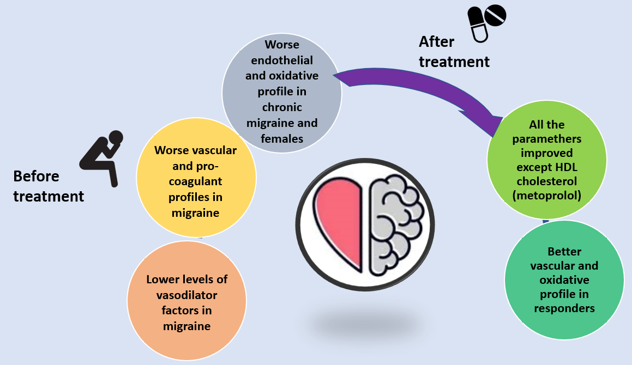




Preventive treatment modifies endothelial function and oxidative stress status in patients with migraine:
an observational study
Migraine as a neurovascular disorder
      Endothelial dysfunction in migraine is mediated by oxidative stress
      Is it possible to reduce cardiovascular risk by controlling migraine attacks?
      Objective: To evaluate whether preventive treatment can modify endothelial function and the oxidative stress profile of patients with migraine.
RESULTS
FINISH
START: 144 subjects
88 patients
68 patients
56 healthy controls
STUDY DESIGN AND METHODS
P
88 treatment-naive patients with migraines and 56 healthy controls
I
Metoprolol or topiramate for 3 months
C
Observational prospective case-control study
O
Endothelial function and oxidative stress parameters before and after treatment
Total, high-density lipoprotein (HDL),
low-density lipoprotein (LDL) cholesterol
Triglycerides
C-reactive protein (CRP)
Prothrombin activity
Antithrombin
Fibrinogen
Plasminogen
Platelet count
Factor II
Homocysteine
Von Willebrand factor (vWF)
Carotid intima-media thickness (CIMT)
Pulsatility index (PI)
Nitrate
Nitrite
Isoprostanes
Total oxidant status (TOS)
Thiol
Thiobarbituric acid reactive substances (TBARS)
PICO: Patients, Intervention, Comparator, Outcomes

