Slide 1

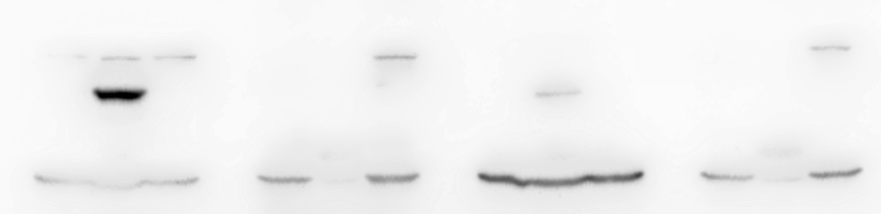
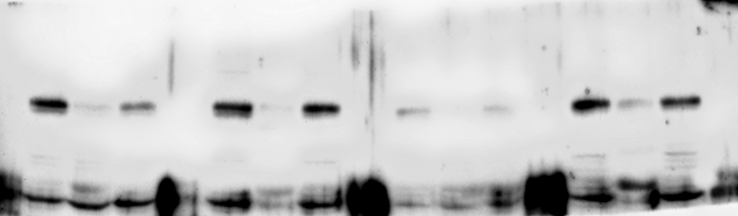
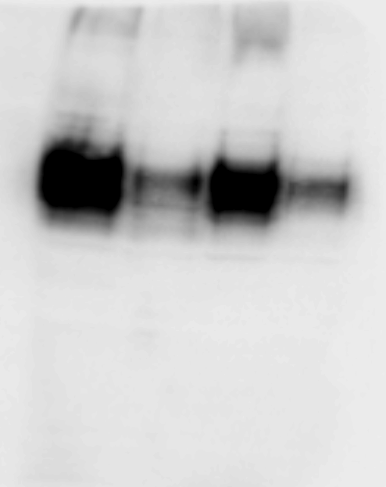
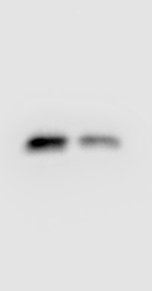

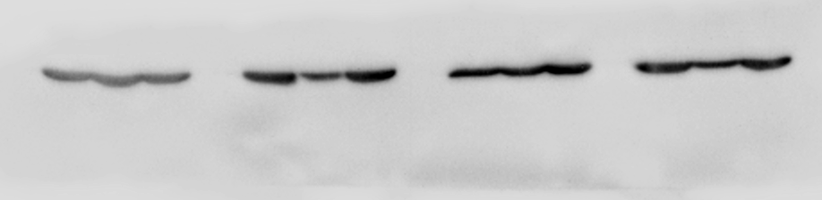
Uneidited images for WB
CMeC-1
LMeC
miR-634
miR-634
miR-NC
miR-NC
cCas3
CMeC-1
LMeC
miR-634
miR-634
miR-NC
miR-NC
cPARP
CMeC-1
LMeC
miR-NC
miR-634
miR-NC
miR-634
NRF2
CMeC-1
LMeC
CMeC-1
LMeC
miR-NC
miR-634
miR-NC
miR-634
miR-NC
miR-634
miR-NC
miR-634
ASCT2
Survivin
CMeC-1
LMeC
miR-634
miR-NC
miR-634
miR-NC
β-actin

