Slide 1
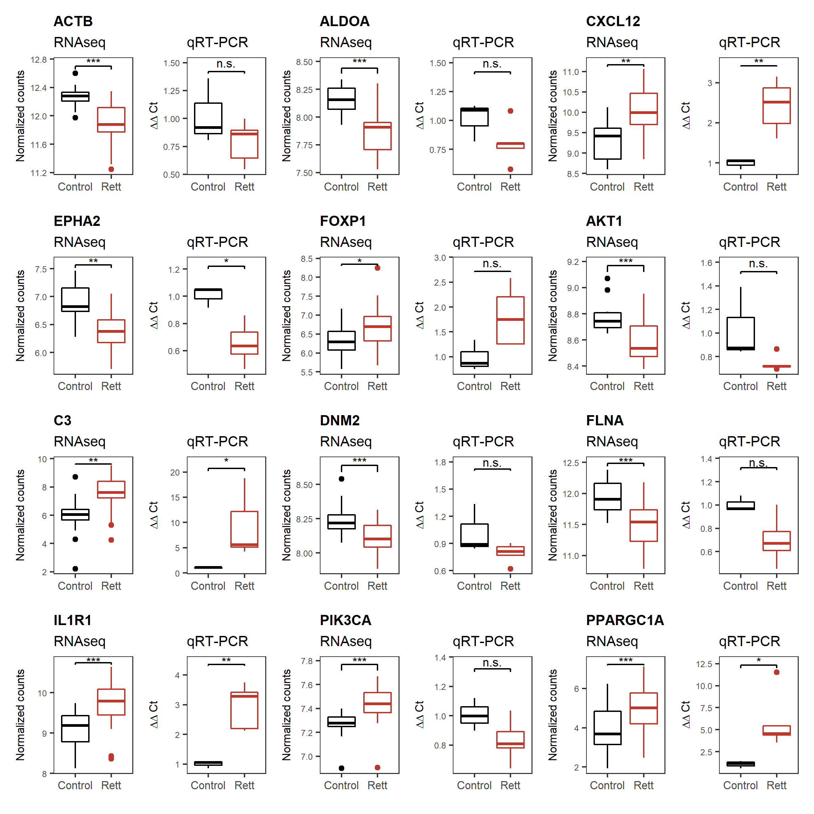
Figure S2. Comparison of the gene expression results between RNAseq and RT-qPCR. In RNAseq, significance was calculated with q-value (p-value adjusted by BH), being *** BH<0.001, ** BH<0.01, * BH<0.05 and n.s. non significant. RT-qPCR significance was calculated with nominal p-value, being *** p-value<0.001, ** p-value<0.01, * p-value<0.05 and n.s. non significant.

Slide 2
