Slide 1
584 bp insertion
BrFLC5
G/A
BrFLC5_pro-F1
BrFLC5_pro-R1
BrFLC5-F
BrFLC5-R
673 bp
500bp
BrFLC5_pro-F2
BrFLC5_pro-R2
Figure S1. Gene structure of BrFLC5. Black boxes represent exons. Arrows represent the position of primers for PCR or sequencing.

Slide 2
Figure S2. Number of rosette leaves in three T₂ populations with overexpressing BrFLC5. TG+ and TG- represent the presence and absence of transgenes (TG), respectively.

Slide 3
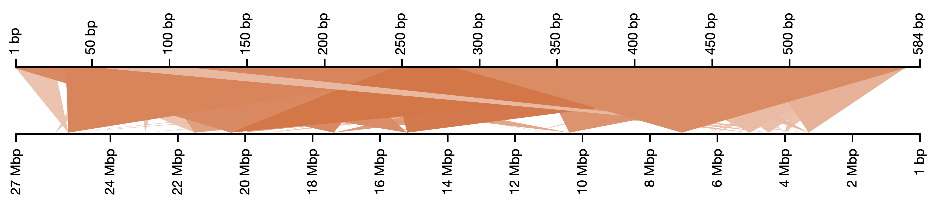
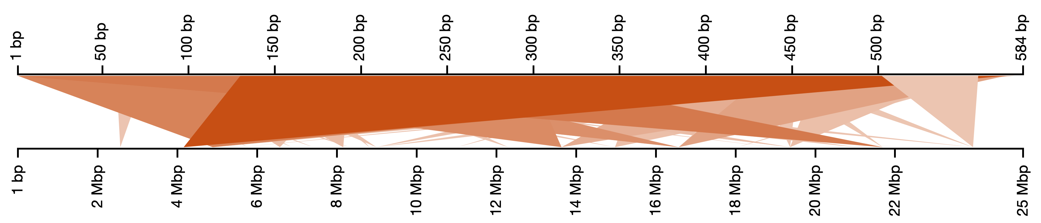
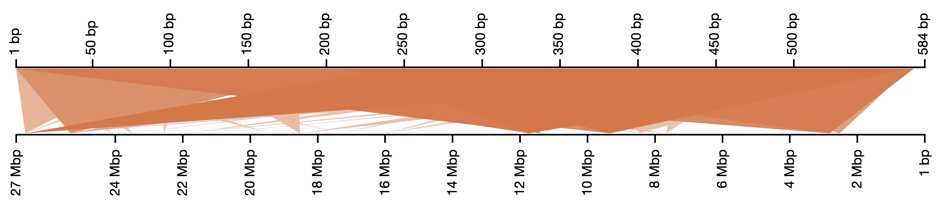
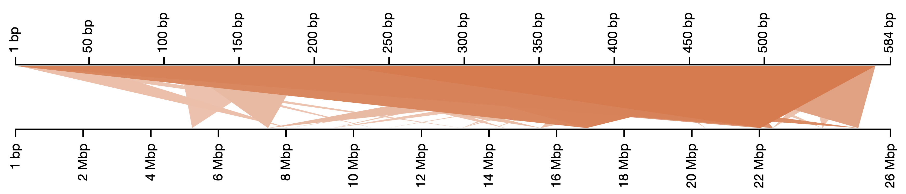
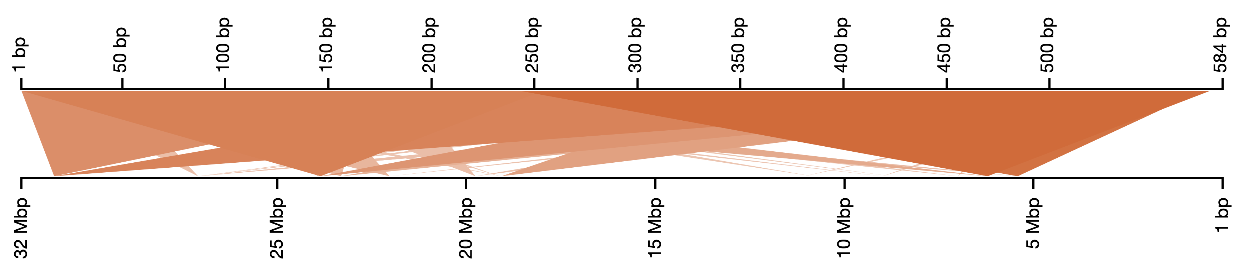
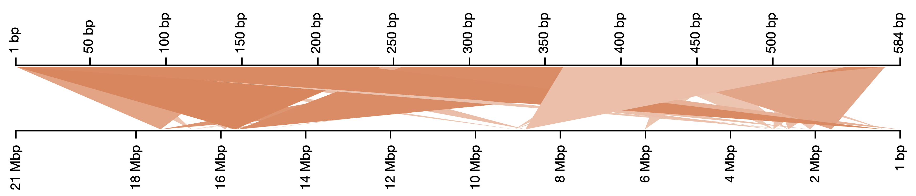
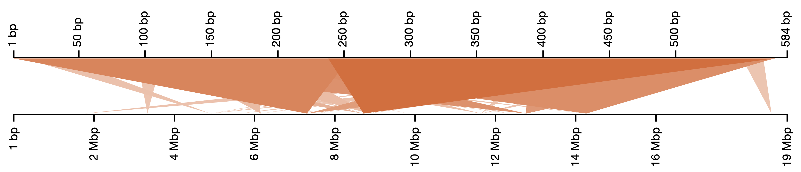
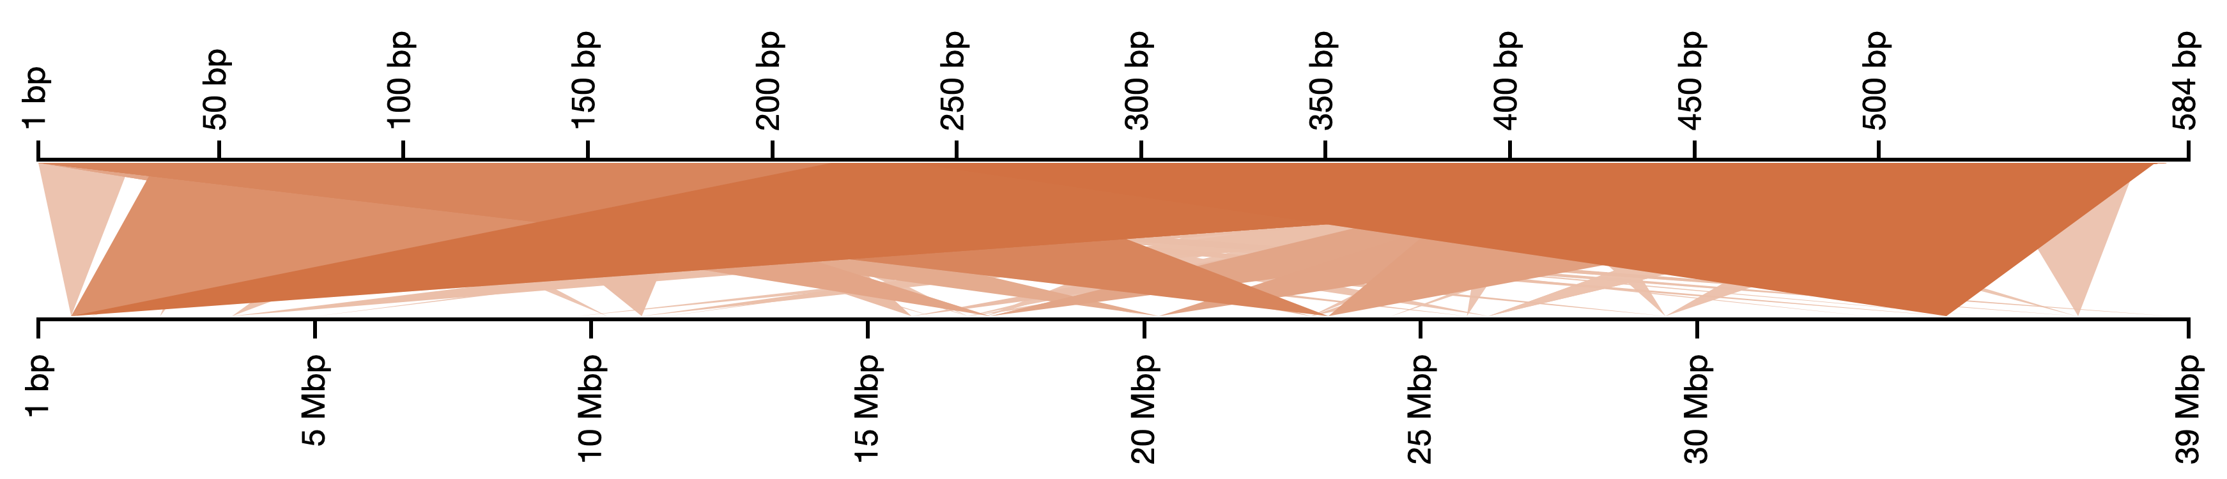
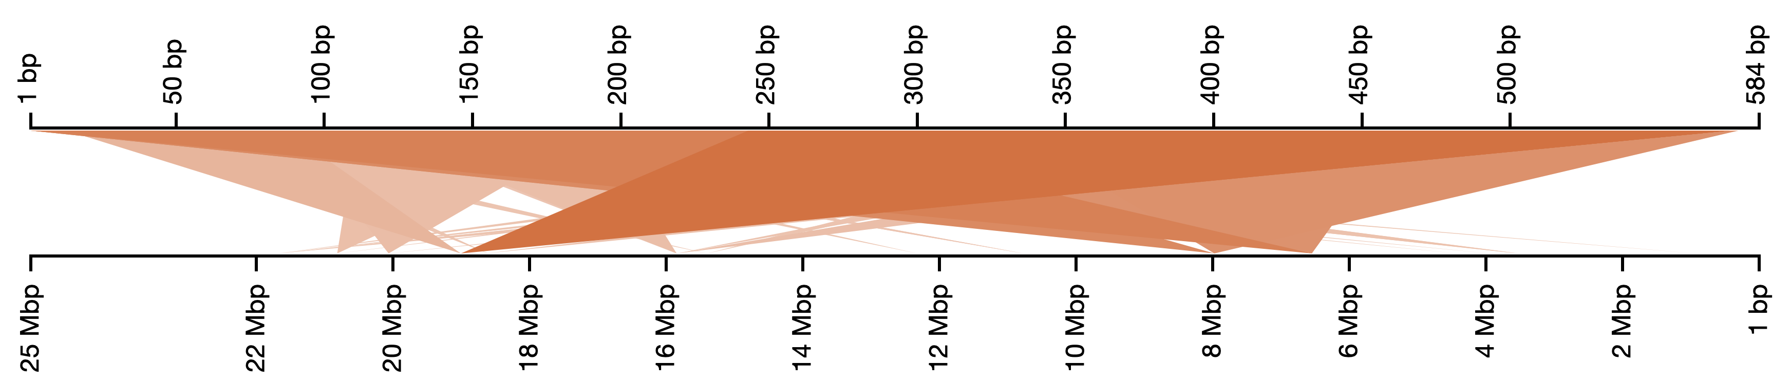
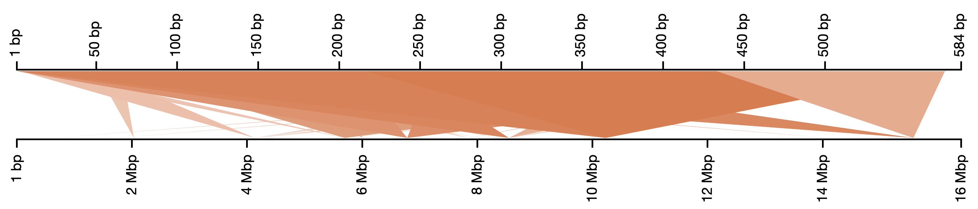
A01
A06
A02
A07
A03
A08
A04
A09
A05
A10
Figure S3 Blast search using 584 bp inserted sequence of BrFLC5 promoter as a query showed that there were various homologous regions across the B. rapa genome.

