Slide 1
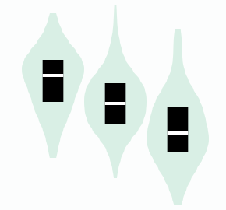
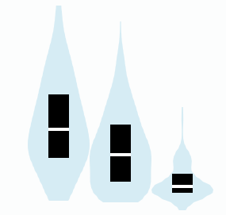
Supplementary Fig. S3
(A)
Toxicity |  | p value
Toxicity |  | ABCB1 rs1045642 A>G | ERCC1 rs11615 A>G
Hematologic
 | Neutrophil count decreased | 0.0495
 | Platelet count decreased | <0.0001
Non-hematologic
 | Peripheral sensory neuropathy |  | 0.0090
Grade 0-2 vs grade 3-4; p value <0.05, Fisher’s exact test.
(B)
(C)
ABCB1 rs1045642
Testis
ERCC1 rs11615
Tibial Nerve
2.0
3.0
1.0
2.0
0.0
1.0
Normalized Gene Expression
Normalized Gene Expression
-1.0
0.0
-2.0
-1.0
Homo Ref
(n=73)
Het
(n=154)
Homo Alt
(n=95)
Homo Ref
(n=178)
Het
(n=222)
Homo Alt
(n=132)
A/A
A/G
G/G
A/A
A/G
G/G

