Slide 1
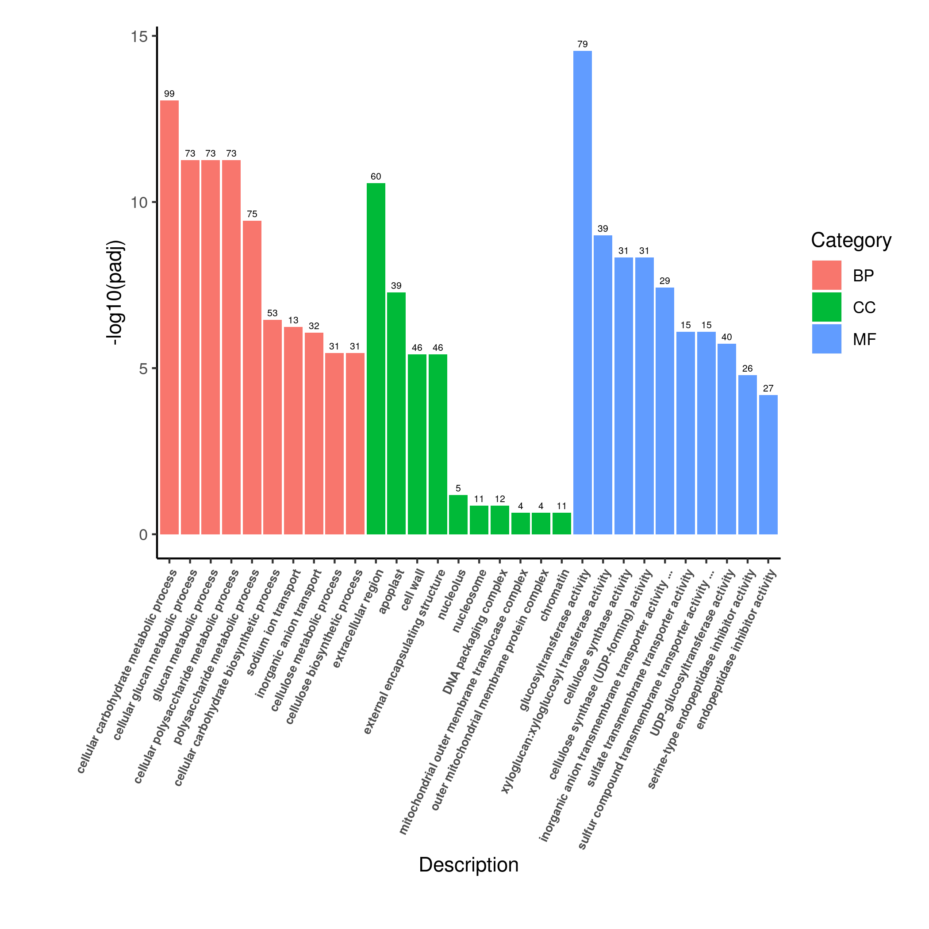
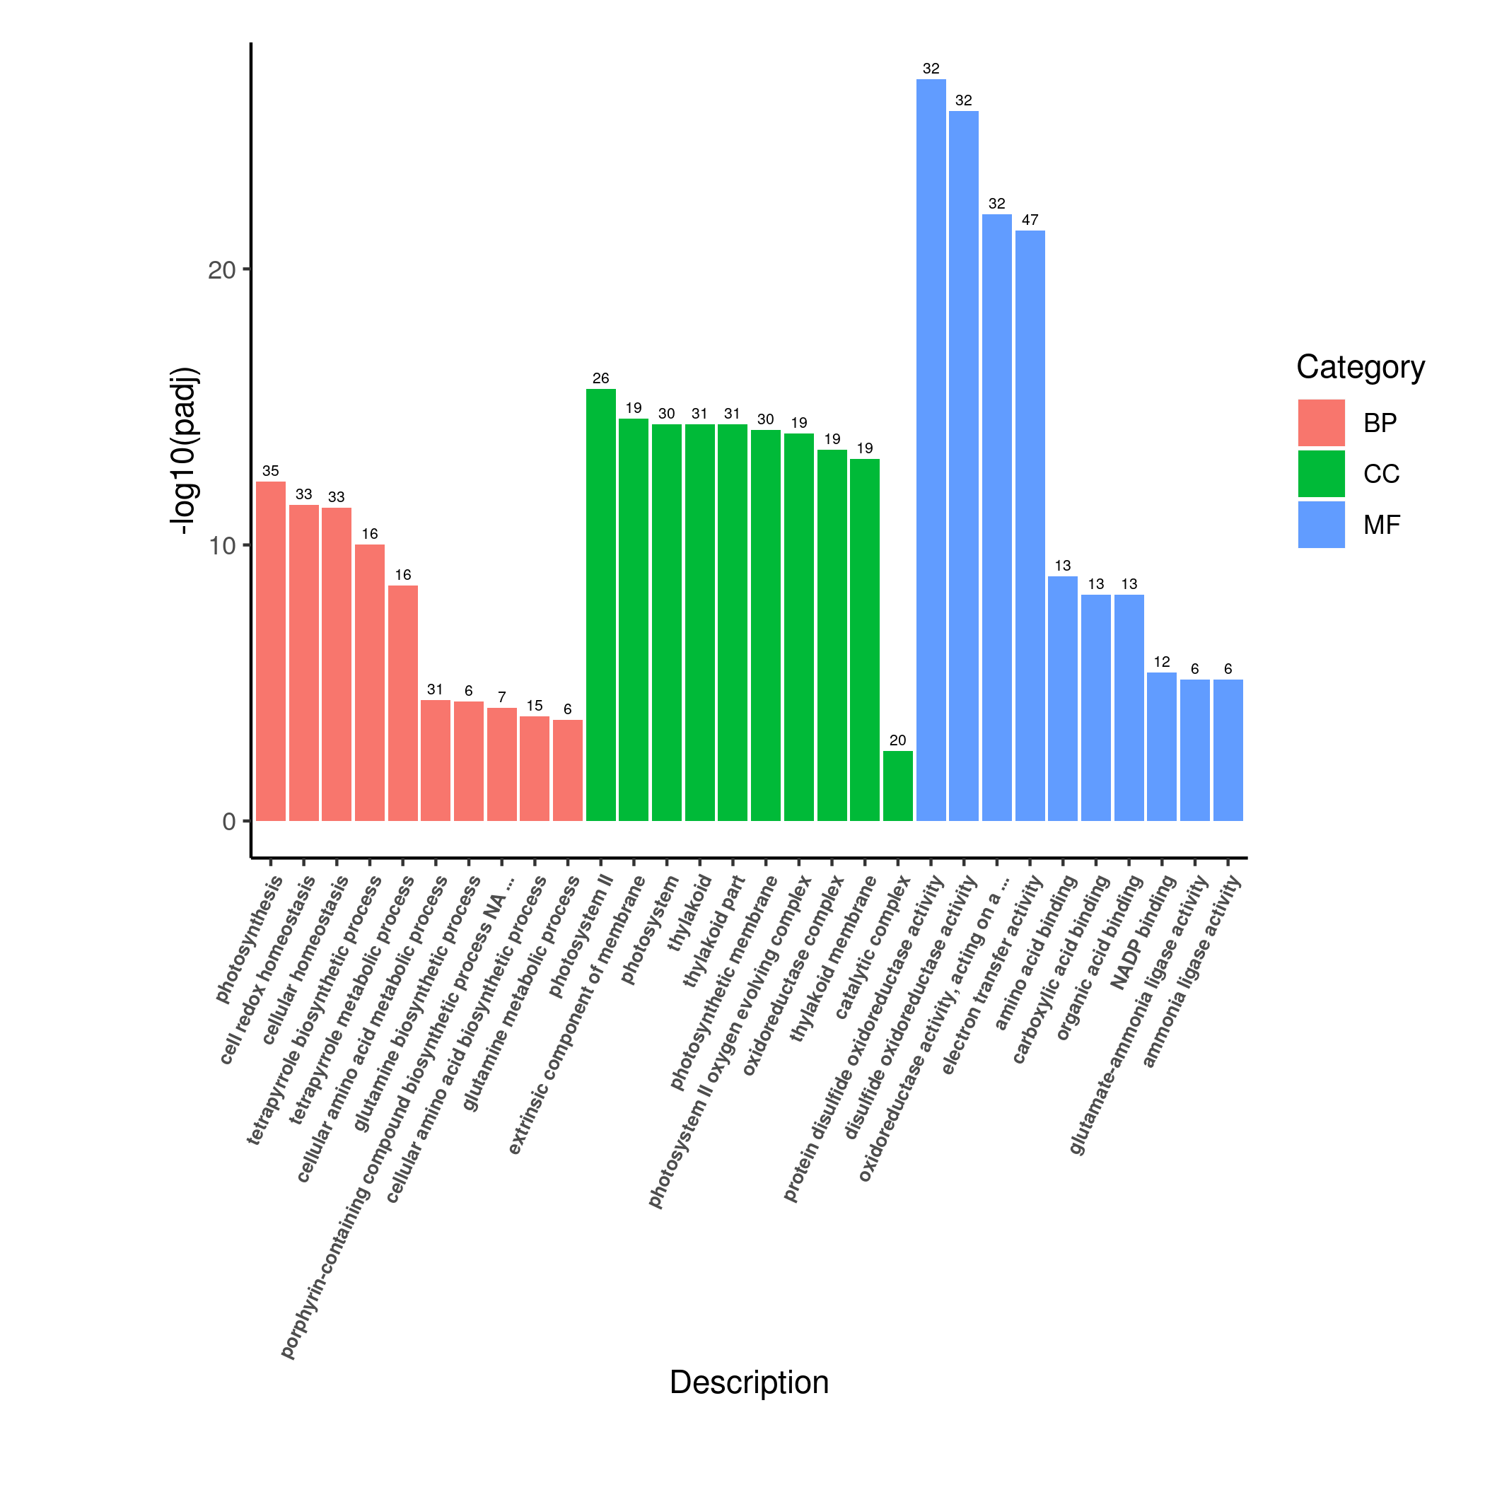
Root Shoot
Fig. S1. Gene classification was based on GO analysis for DEGs under nitrate deficiency condition. The numbers of DEGs in each GO term was significantly enriched in root (a) and shoot (b). Functional categorization of genes based on the biological process of gene ontology. Different classes are shown for BP (biological process) ,CC (cellular component) and MF (molecular function). The y‑axis shows the counts of differently expressed genes, and the x‑axis shows GO term of gene enriched in each biological process.

Slide 2
Table S1. Phosphorus signaling pathway genes respond to low nitrogen stress
Gene ID | LN-1-FPKM | LN-2-FPKM | LN-3-FPKM | HN-1-FPKM | HN-2-FPKM | HN-3-FPKM | Log2 (Fold Change) | P-value | Gene function
TraesCS7D03G0963300 | 18.290 | 13.586 | 6.419 | 1.106 | 0.937 | 0.983 | 3.654 | 2.38E-18 | PHR transcription factor (central regulator of Pi responses)
TraesCS7A03G1007200 | 12.852 | 6.423 | 6.240 | 0.621 | 0.774 | 0.844 | 3.503 | 1.52E-17 | PHR transcription factor (central regulator of Pi responses
TraesCS7B03G0847700 | 8.369 | 4.704 | 3.833 | 1.041 | 0.695 | 0.513 | 2.901 | 3.53E-11 | PHR transcription factor (central regulator of Pi responses
TraesCS7A03G0242200 | 2.314 | 1.325 | 2.158 | 0.021 | 0.024 | 0.000 | 7.048 | 2.35E-10 | Purple acid phosphatase 27 (PAP)
TraesCS4D03G0797500 | 1.424 | 12.856 | 5.761 | 53.225 | 40.187 | 38.095 | -2.75 | 5.77E-07 | Purple acid phosphatase 27 (PAP)
TraesCS5B03G1149900 | 2.017 | 2.523 | 1.448 | 0.766 | 0.317 | 0.433 | 1.95 | 7.44E-06 | Inorganic phosphate transporter 1-8
TraesCS2B03G1062100 | 1.014 | 0.366 | 0.917 | 0.126 | 0.054 | 0.016 | 3.52 | 3.96E-06 | SPX domain-containing membrane protein (Pi signal response gene)
TraesCS6B03G1176600 | 0.756 | 0.381 | 0.356 | 0.016 | 0.019 | 0.000 | 5.42 | 9.55E-06 | Phosphate transporter PHO1-2

Slide 3
Table S2. Primers used in this study.
Gene | F (5’-3’) | R (5’-3’)
TaNRT2-6A.2 | GGGAATGATGCACATCGTGA | ATGTCCGGTAGTTGGTGACG
TaNRT2-6A.6 | TGCTTTCTGTCTCTGGCTGG | CTCCGCTCATGCCTGAAATG
TaNRT2-6B.4 | ATCATTGGCACGGTGAATGG | ACAAGCAACCCCATGACGAT
α-Tubulin | ATCTCCAACTCCACCAGTGTCG | TCATCGCCCTCATCACCGTC

