Slide 1
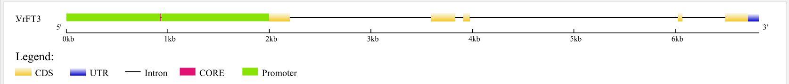
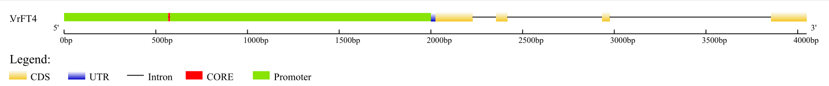
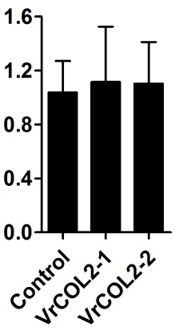
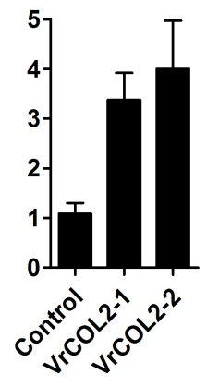
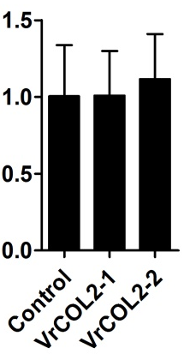
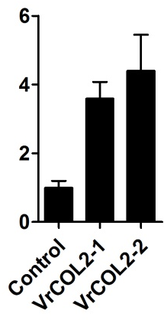
a
XP_014496932
5’
3’
-2kb -1kb 0kb 1kb 2kb 3kb 4kb
XP_014497364
5’
3’
-2kb -1.5kb -1kb -0.5kb 0kb 0.5kb 1kb 1.5kb 2kb
CDS
UTR
Intron
CORE
Promoter
b
LD
SD
LD
SD
XP_014496932
XP_014496932
XP_014497364
XP_014497364
***
***
***
***
Relative expression

