Slide 1
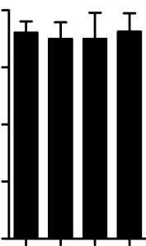
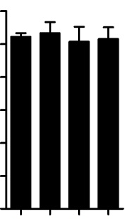
16
LD
54
SD
12
45
Number of rosette leaves
36
8
27
4
18
9
0
Col
Empty vector-1
Empty vector-2
Empty vector-3
0
Col
Empty vector-1
Empty vector-2
Empty vector-3

