Slide 1

Key points
The meta-analysis suggested that motor performance is impaired in
elderly people with LBP.
2. Physical therapy may be an effective way to improve the motor performance .
3. We should pay more attention to the balance control of elderly patients with low back pain
Le Ge, Chuhuai Wang, Haohan Zhou, Qiuhua Yu , Xin Li(2020) . The Effects of Low Back Pain on Motor Performance in Older People: A Systematic Review and Meta-analysis.

Slide 2
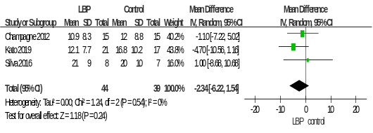
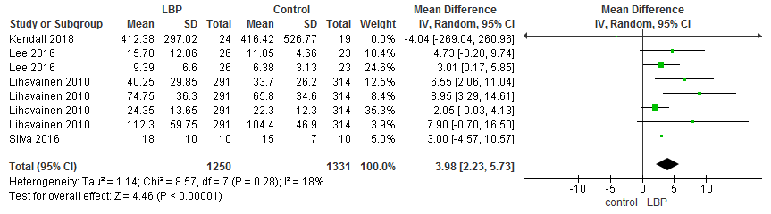
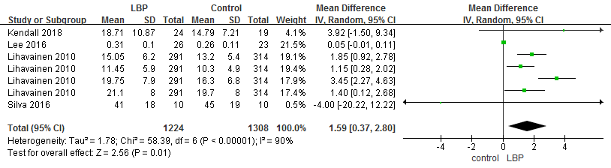
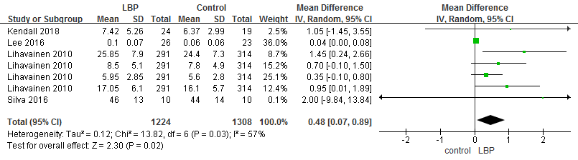
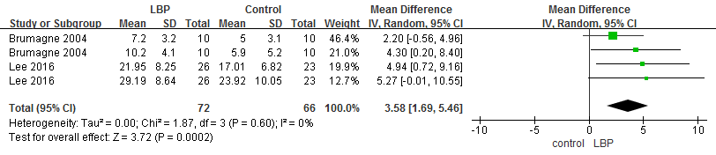
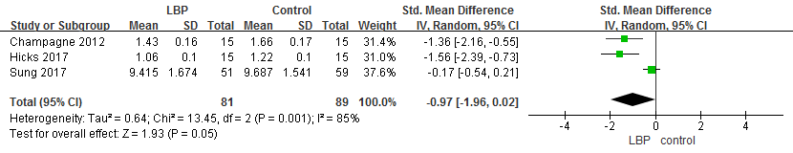
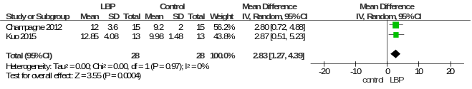
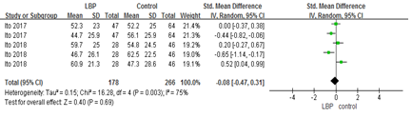
One-leg stance
Center of pressure area
COP AP velocity
COP ML velocity
COP AP range
gait speed
TUG
RPW
Le Ge, Chuhuai Wang, Haohan Zhou, Qiuhua Yu , Xin Li(2020) . The Effects of Low Back
Pain on Motor Performence in Older People: A Systematic Review and Meta-analysis.

Slide 3
Take Home Messages
1. There is some evidence that low back pain has impacted the equilibrium of older with low back pain.
2.Only one study assessed the reactive motor control function and no study assessed the effect of dual task on motor control in older individual with LBP,future study should focus on this area.
3.Physical therapists in the clinical setting should be aware of an increased risk of falling among their patients.
Le Ge, Chuhuai Wang, Haohan Zhou, Qiuhua Yu , Xin Li(2020) . The Effects of Low Back Pain on Motor Control in Older People: A Systematic Review and Meta-analysis.

