Slide 1
Additional file 1:
Figure S1. Scheme summarizing the experimental set-up and methods used in the study
Culture & RNA sampling
High/low acetate conditions
Late expo/ early stat
time points
Overview RNAseq data
Description of
Low Ac. transcriptome
High Ac. Transcriptome
Integrating RNAseq
& metaproteomic data
Focus
Import system category
Ferrous iron transport
(Feo family)
Iron regulation of feoB
(RT-PCR)

Slide 2
Additional file 2:
See Excell file Tables S1-S7, RNA-Seq data

Slide 3
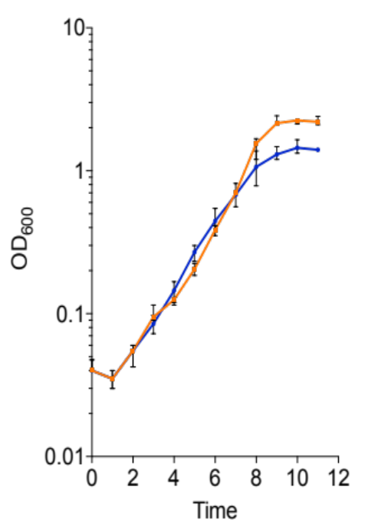
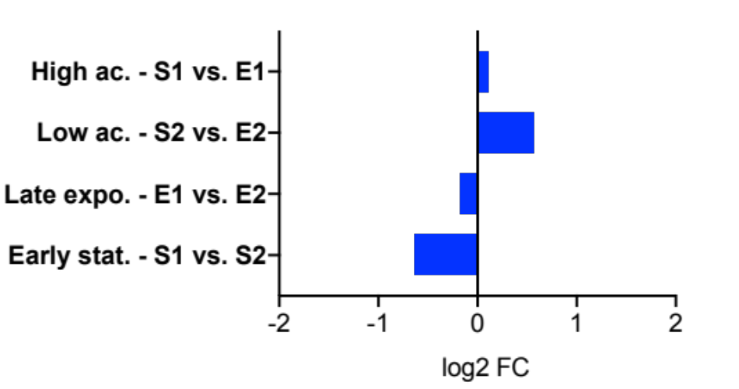
Additional file 3
Figure S2. Expression of the CG447_03795 gene, encoding the MAM protein, across the late exponential (E/Ea time points) and early stationary (S/Sa time points) phases in low- (blue symbol) and high- (orange symbol) acetate conditions, using RNA-Seq.
A
Expo.
Stat.
Sa
Ea
Sa vs. Ea
S vs. E
S
E
Ea vs. E
Sa vs. S

Slide 4
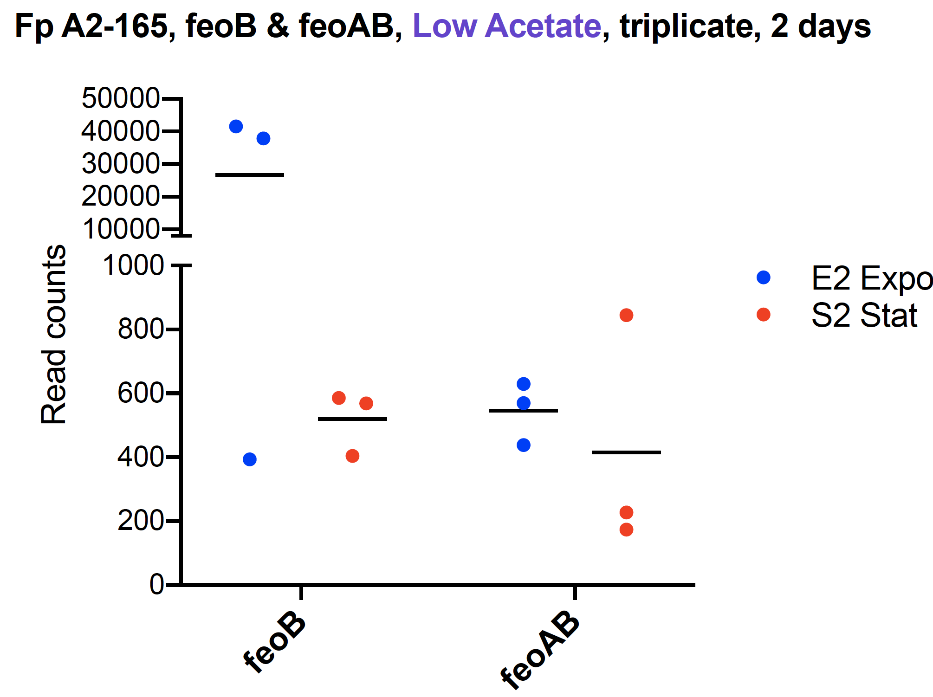
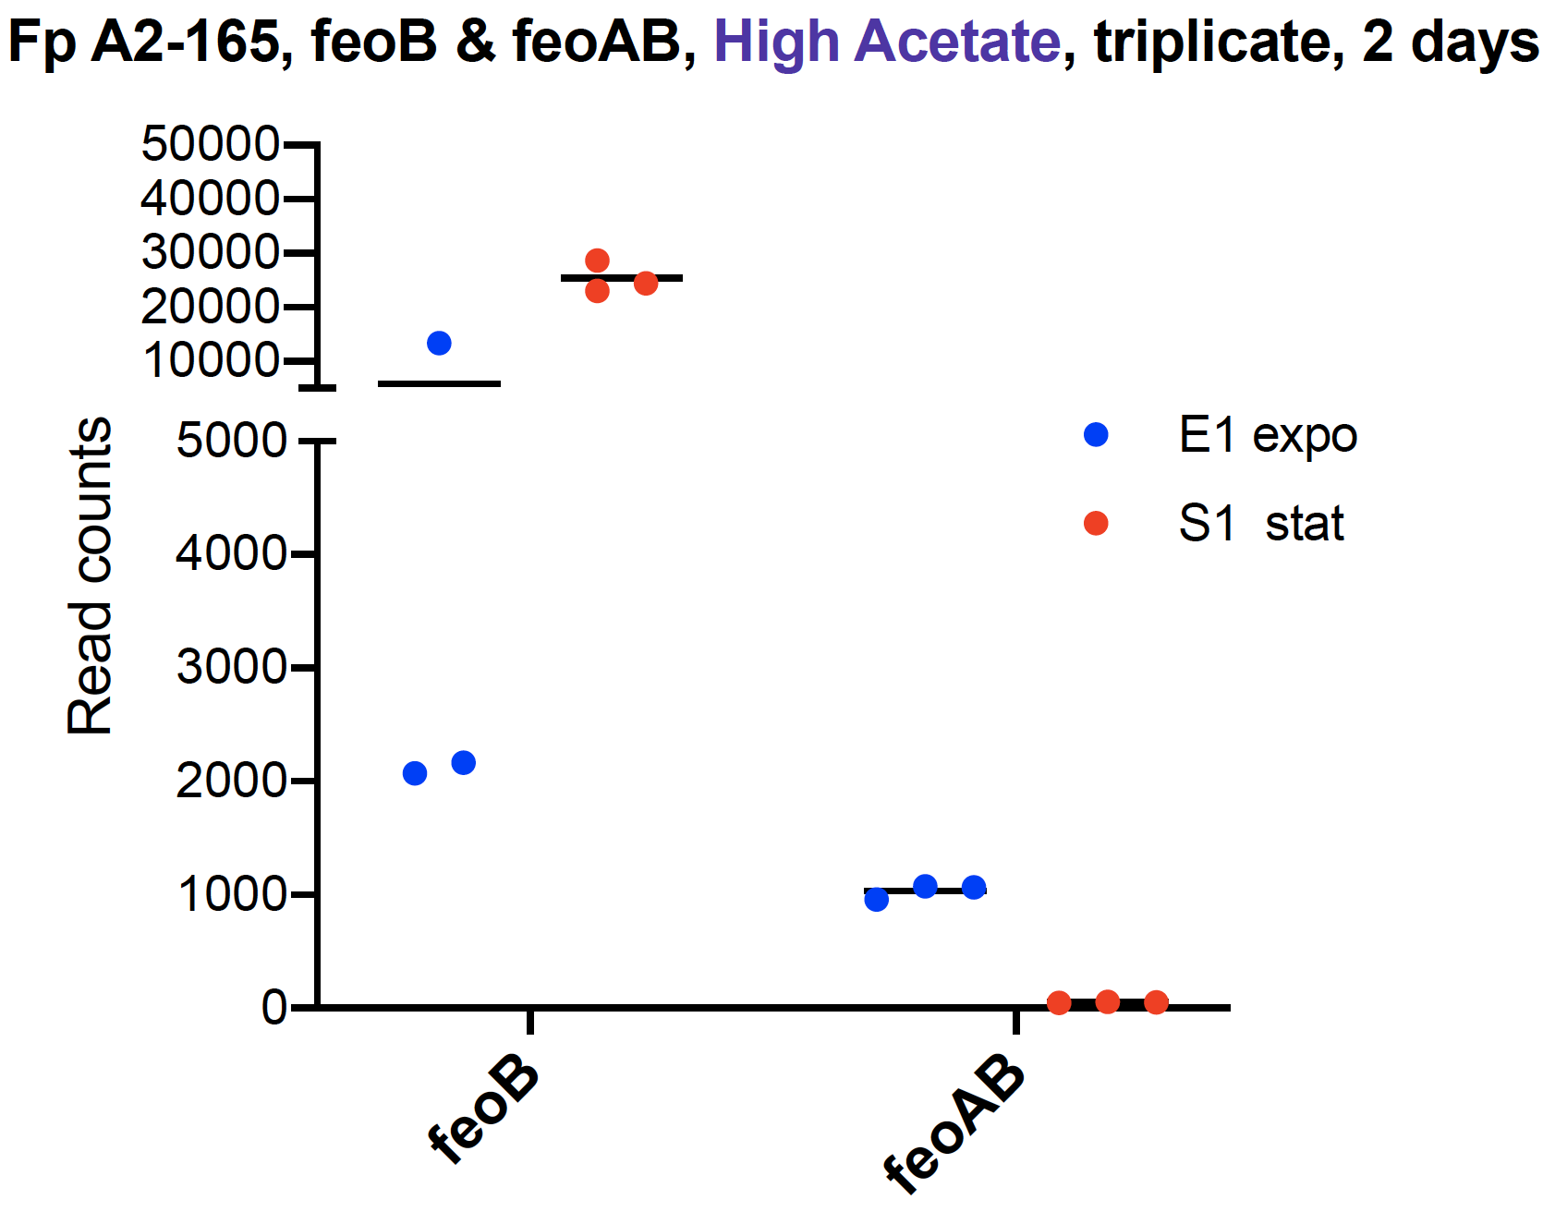
Additional file 4

Slide 5
Additional file 5
See Excell file Tables S1-S6. Metaproteomic data

Slide 6
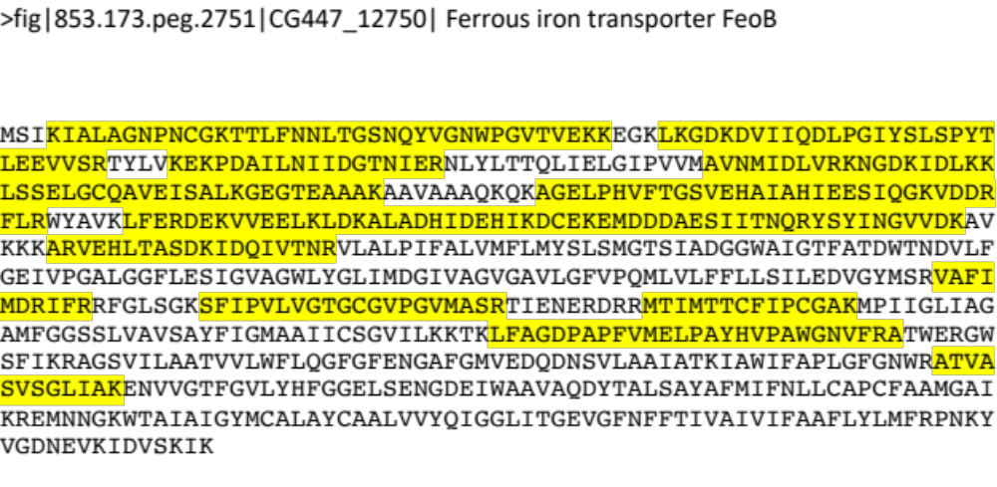
Additional file 6:
Figure S4. Localization of the detected peptides that match with the FeoB sequence (729 aa) of F. duncaniae strain A2-165.

Slide 7
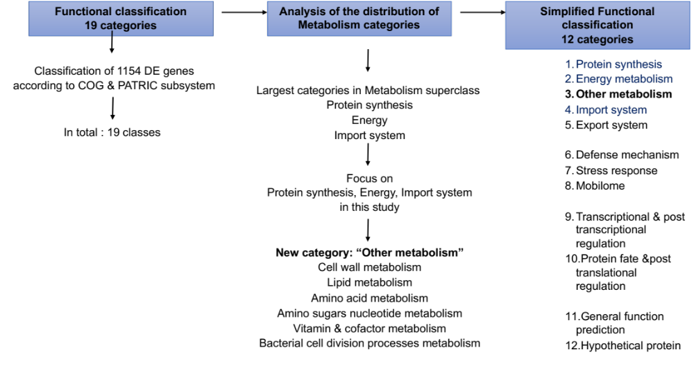
Additional file 7:
Figure S5. Functional classification workflow in this study

