Slide 1
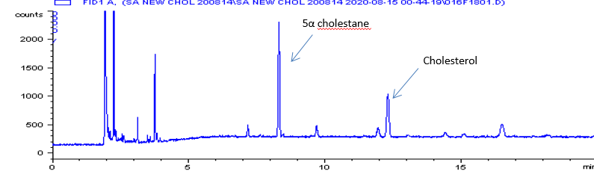
α –tocopherol
Supplement Figure 1. GC chromatogram of trimethylsilyl-derivatized SRM-1869.

Slide 2
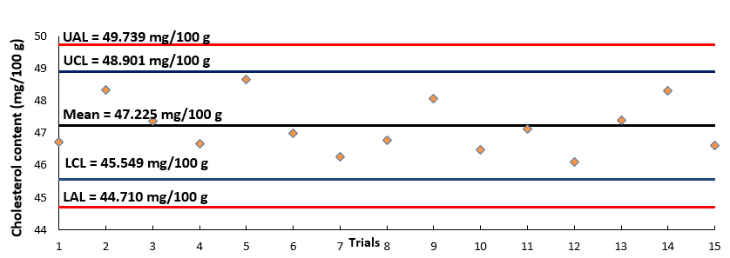
Supplement Figure 2. A quality control chart of cholesterol analysis by saponification-derivatization coupled with gas chromatography.

