Slide 1
S2 Literature Case teaching design
The structure of Sars-CoV-2 virus protein
(Biochemistry and Molecular Biology)

Slide 2
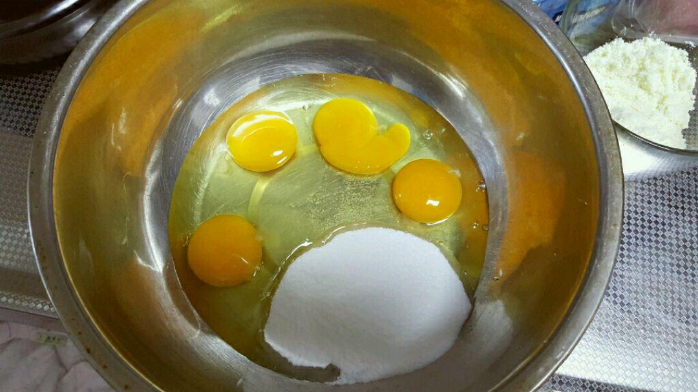
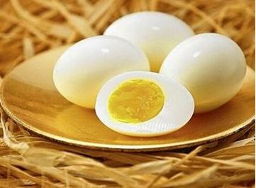

Can a hard-boiled egg return to its normal state?
煮熟前 煮熟后

Slide 3
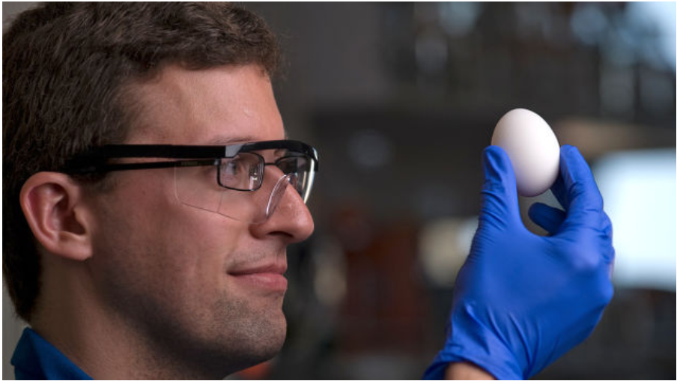
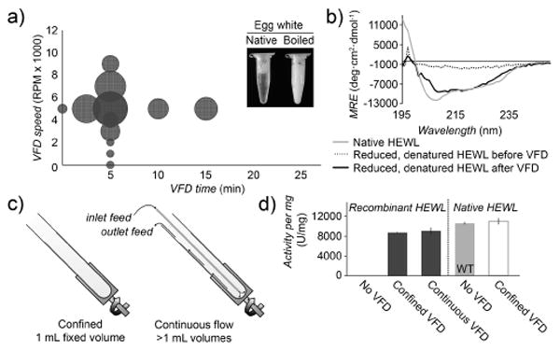
Proteins that have a complete conformation are functional
Chembiochem. 2015 Feb 9;16(3):393-6. doi: 10.1002/cbic.201402427.

Slide 4
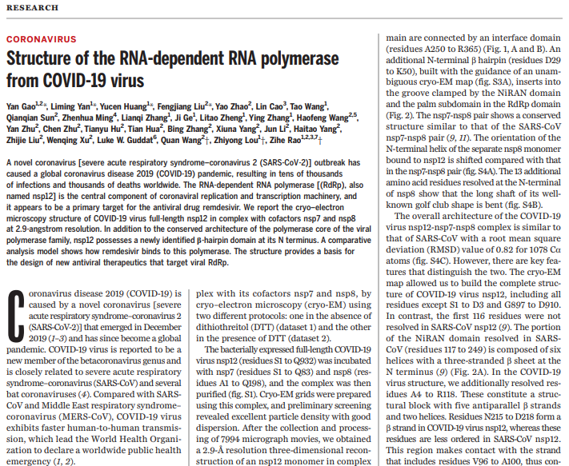
Literature Case 1： Structure of Sars-cov-2 virus RNA replicase
Rao Z. Science. 2020 May 15;368(6492):779-782. doi: 10.1126/science.abb7498.

Slide 5
Part A（Team Discuss）
Hint Questions：
1. How many levels of structure do RNA replicases have?
2. What are the subunits, domains, and motifs of RNA replicases?
3. What secondary structure is newly discovered at the N-terminus of RNA replicase?
4. To which subunit of the RNA replicase does RNA binding occur primarily?
5. In what mode does RNA replicase bind RNA mainly?
6. What are the two conformations of RNA replicase binding RNA? Through what bonds?

Slide 6
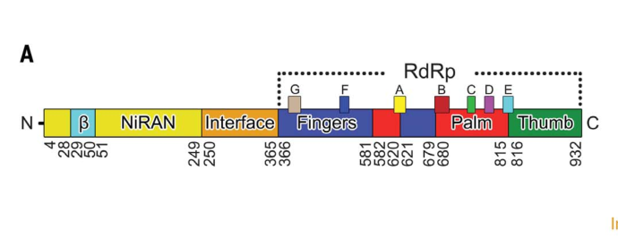
Protein structure of SARS-CoV-2 virus RNA Replicase

Slide 7
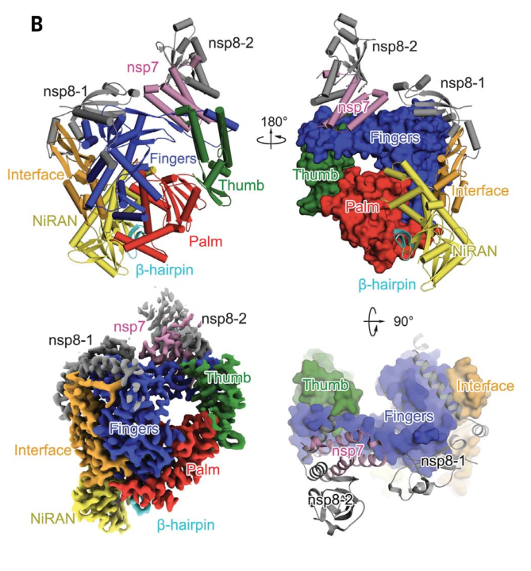
Protein structure of SARS-CoV-2 virus RNA Replicase

Slide 8
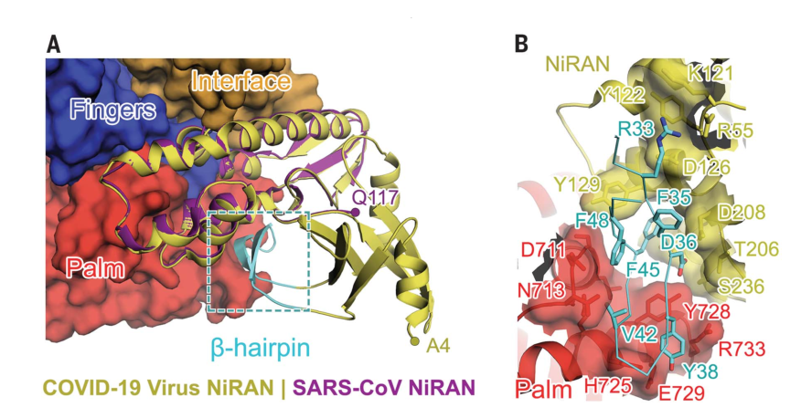
Protein structure of SARS-CoV-2 virus RNA Replicase

Slide 9
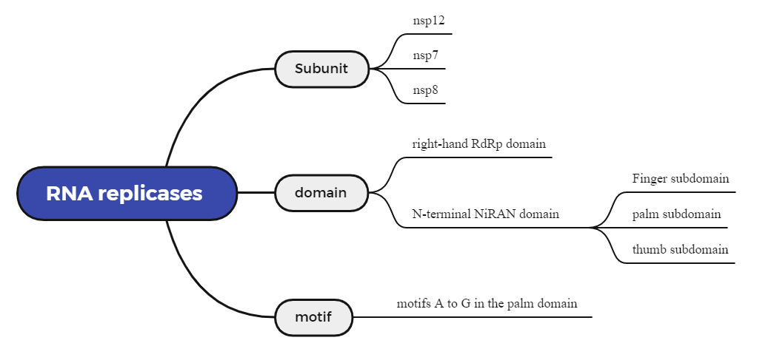
Summary :(1) RNA replicases have a complex quaternary structure

Slide 10
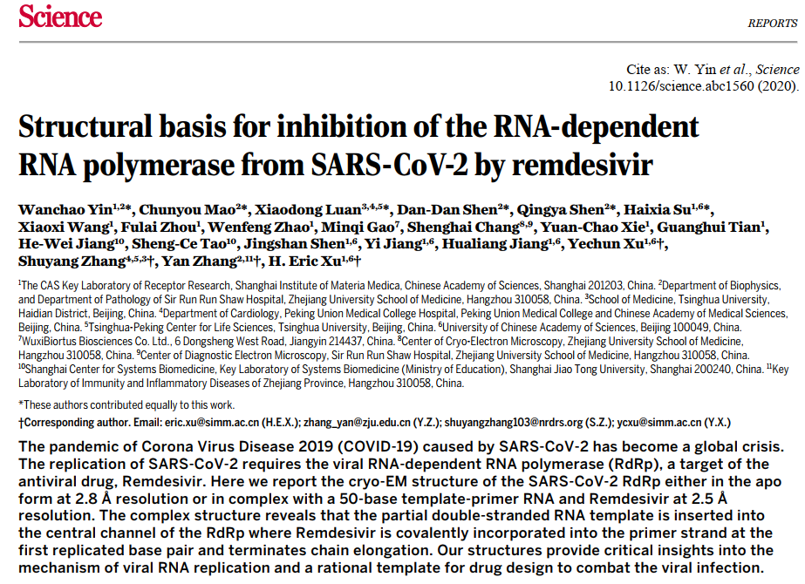
Literature Case 2： Sars-cov-2 virus RNA replicase bind remdesivir
Rao Z. Science. 2020 May 15;368(6492):779-782. doi: 10.1126/science.abb7498.

Slide 11
Part B （Team Discuss）
Hint Questions：
1. What is the nature of Sars-cov-2 virus RNA replicase?
2. How many stages of Sars-cov-2 virus RNA replicase activity does it have? How many subunits does the active center have?
3. How does the drug remdesivir relate to nucleotides?
4. Through which bonds does remdesivir bind the enzyme?
5. How does remdesivir inhibit RNA replicase function?
W. Yin et al., Science. 10.1126/science.abc1560 (2020).

Slide 12
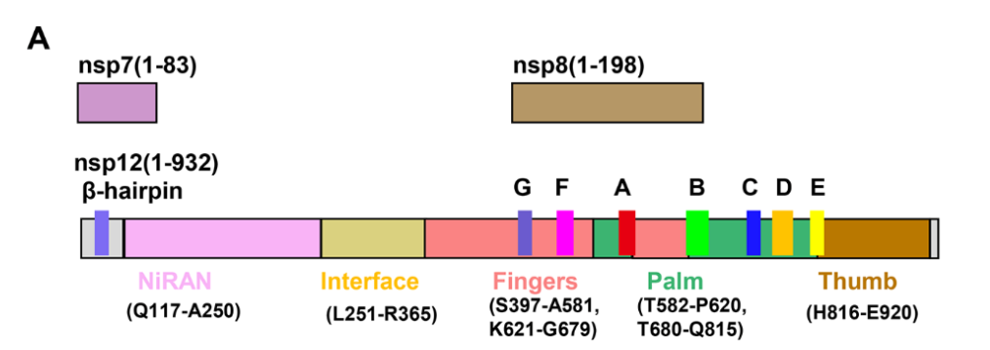
Sars-cov-2 virus RNA replicase binds template RNA

Slide 13
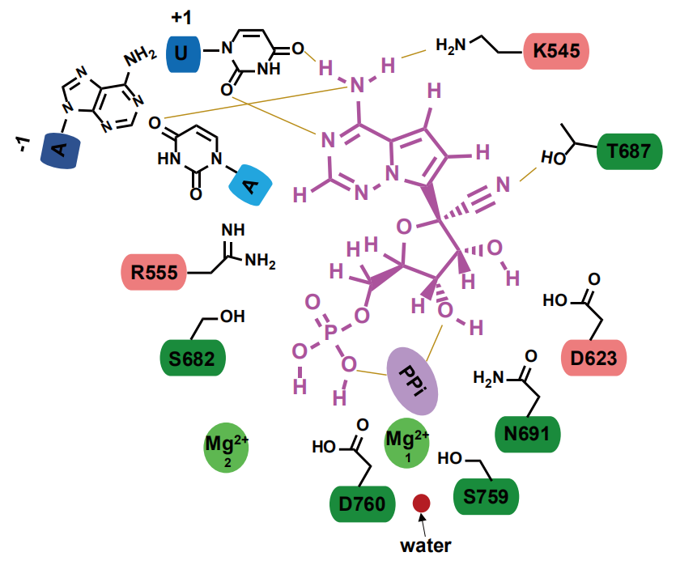
Structure of SARS-CoV-2 virus RNA replicase binding remdesivir
The secondary key in the "pocket" of RNA replicase
(Remdesivir is shown in red)
W. Yin et al., Science. 10.1126/science.abc1560 (2020).

Slide 14
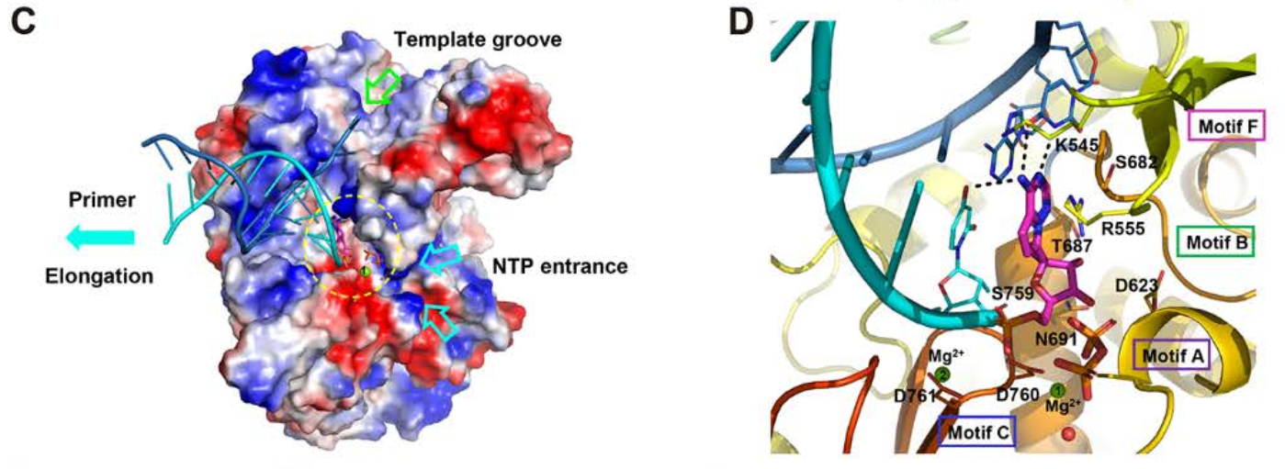
Structure of SARS-CoV-2 virus RNA replicase binding remdesivir
RNA Replicase "Pocket"
W. Yin et al., Science. 10.1126/science.abc1560 (2020).

Slide 15
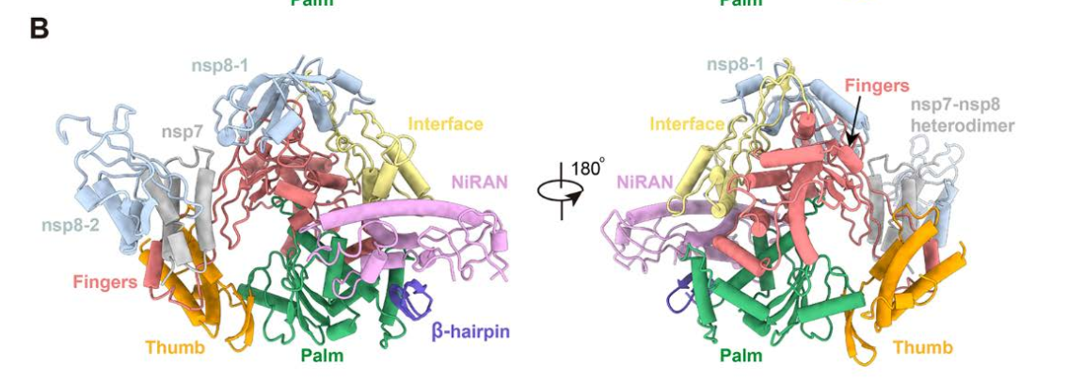
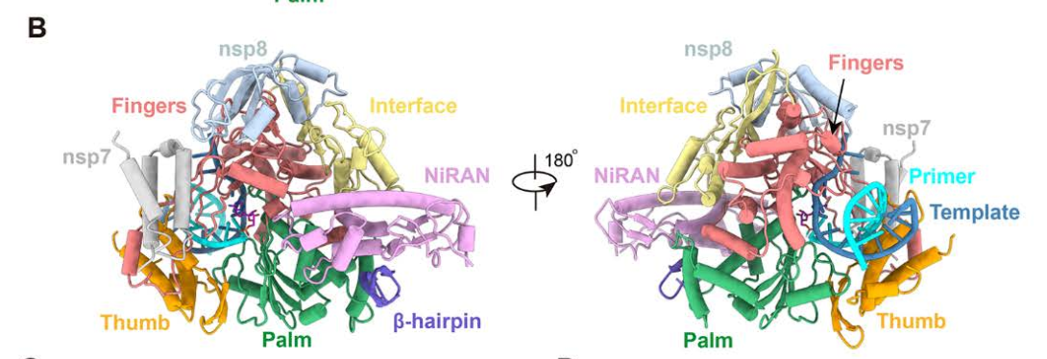
Sars-cov-2 virus RNA replicase binds template RNA
Open State
Closed State

Slide 16
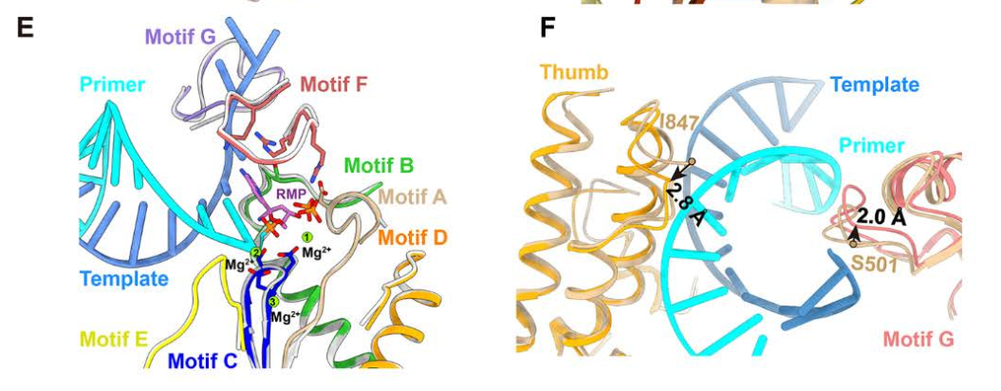
Sars-cov-2 virus RNA replicase binds template RNA

Slide 17
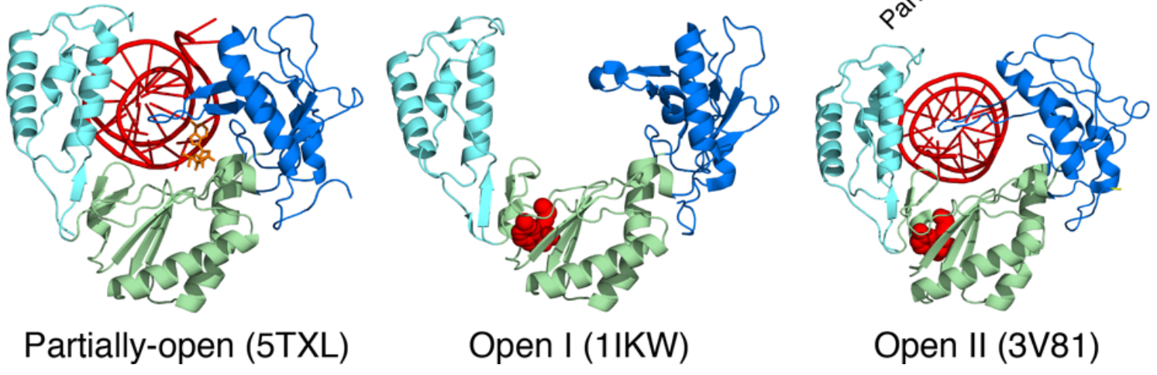
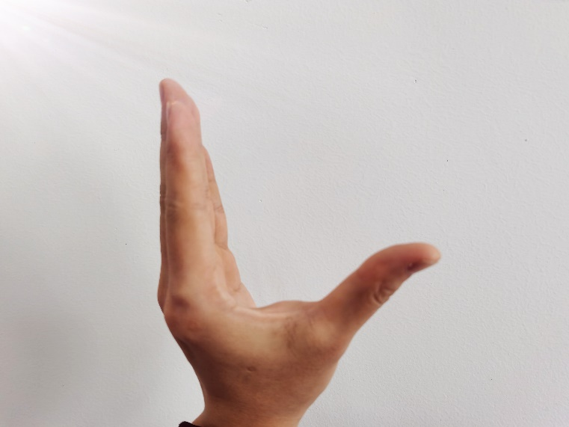
Summary: (2) Binding to RNA: "thumbs-palm-fingers" model
Thumb
Finger
Palm
“OPEN”state

Slide 18
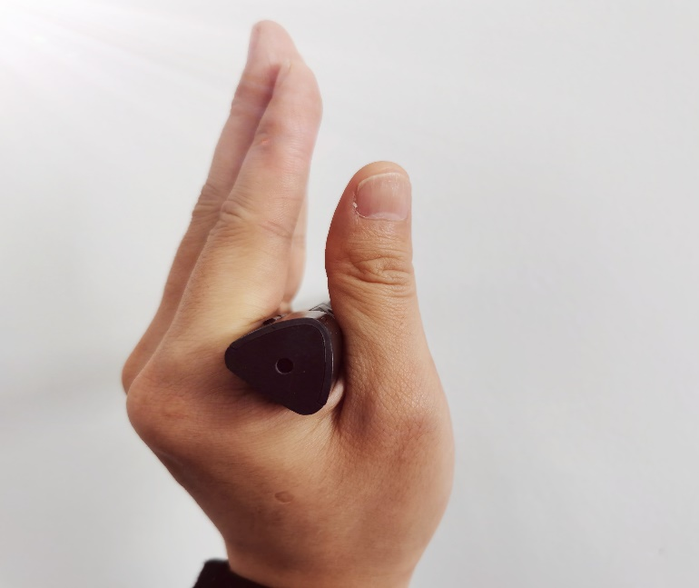
Thumb
Finger
Palm
"CLOSED" state (red helix shows RNA)

Slide 19
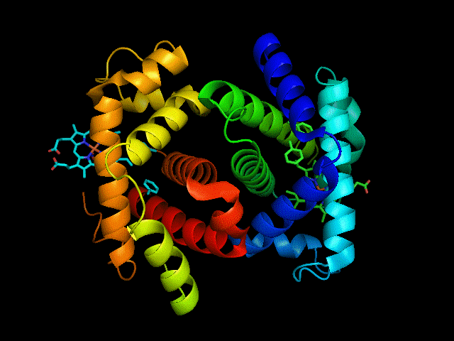
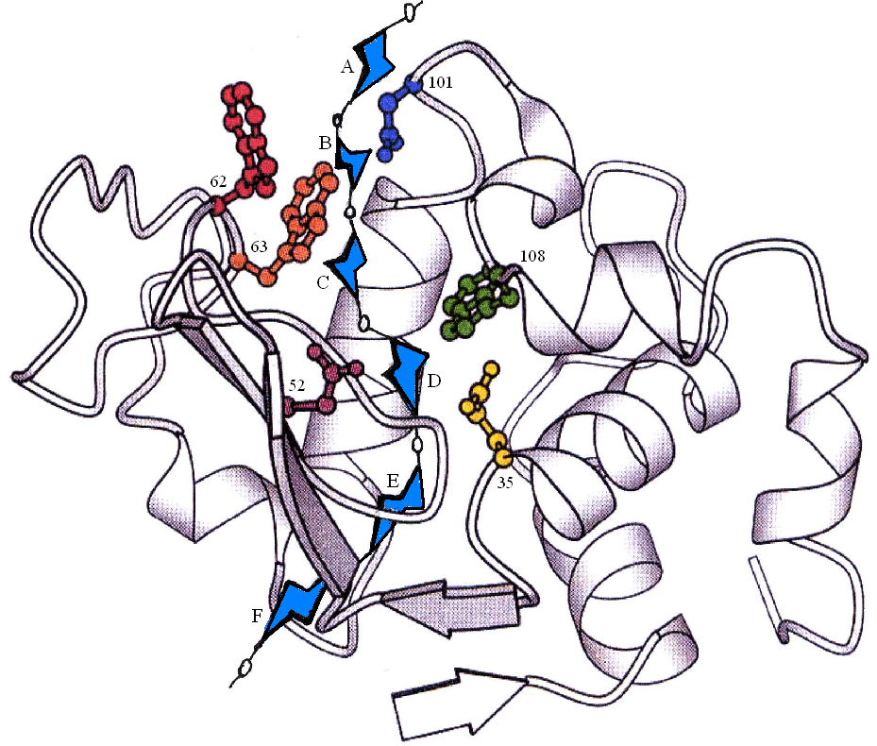
Summary :(2) combination with active center -- "pocket or cleft"
The "pocket" of hemoglobin
(The green ring shows the porphyrin ring)
"Cleft" in enzyme protein
(The N-acetylglucose ring is shown in blue.)

Slide 20
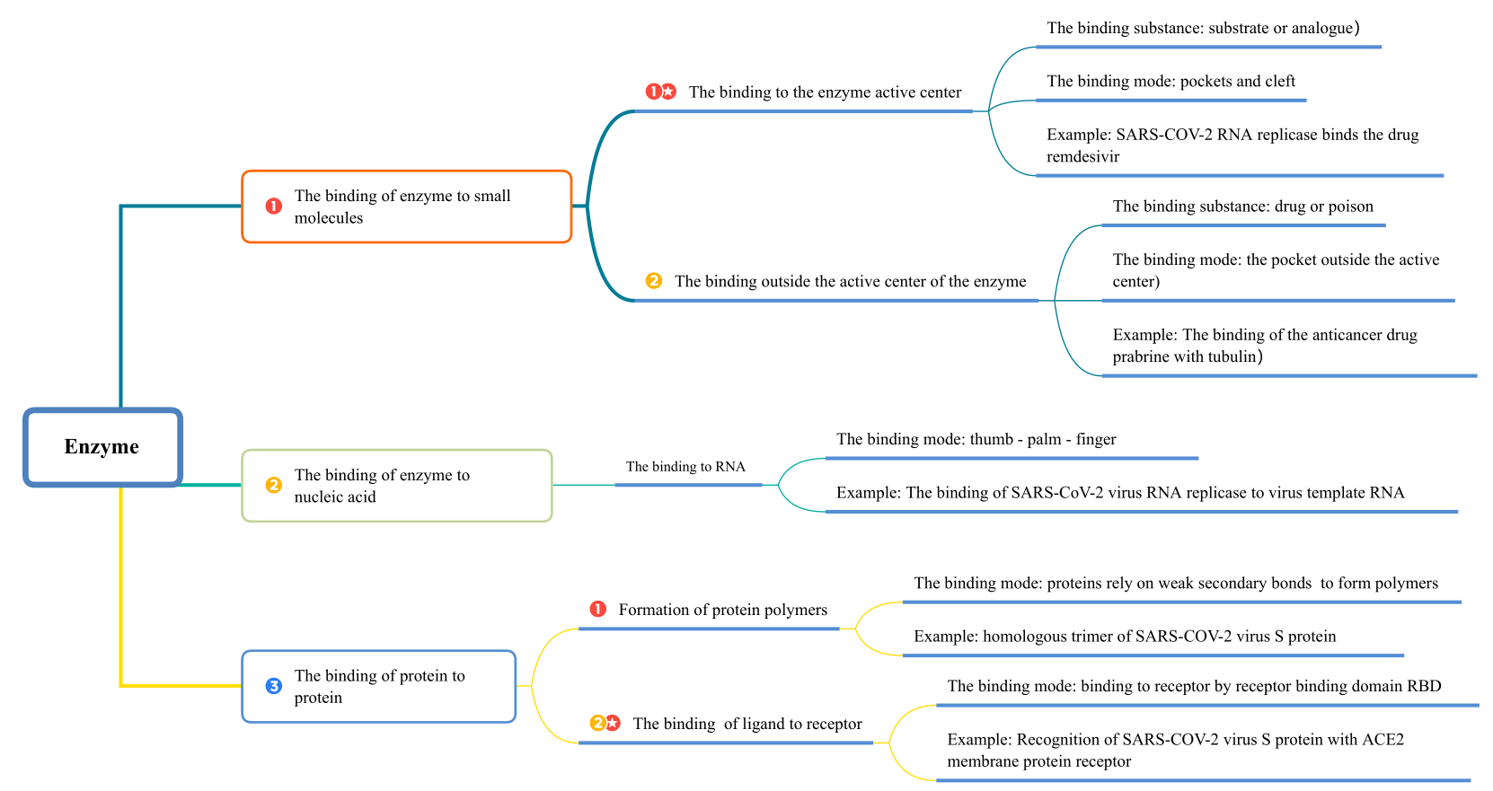
Key points Summary :

