Slide 1
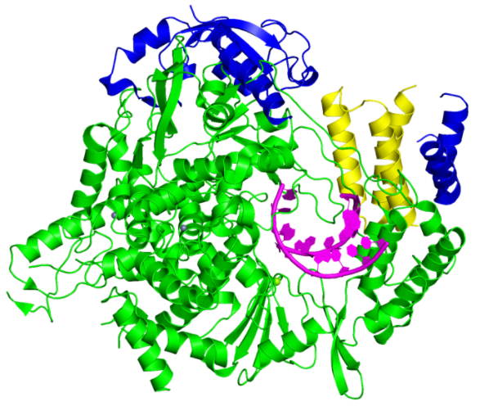
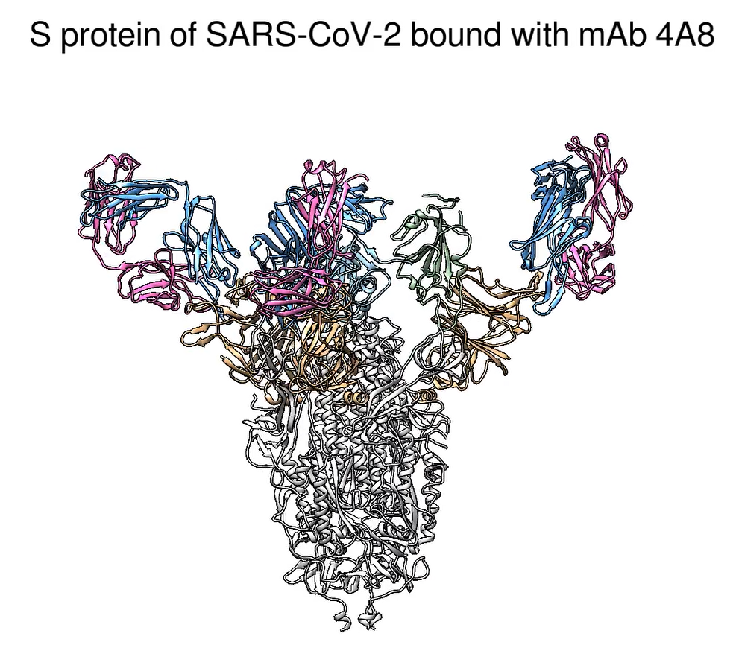
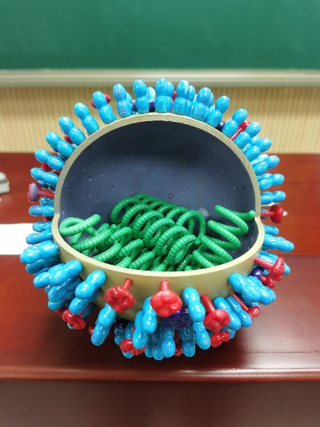
S3 The blended teaching mode in Biochemistry and Molecular Biology
(Case, Literatures and questions distribution)
(Case reading review of literatures)
(Online TBL under tutors’ help)
( Use the teaching AIDS：A：Structure of proteins on website; B: 3D suspension projection; C: 3D printed model)
(Learning behavior evaluation: a scientific scale to evaluate students' classroom performance)
(Knowledge summary: Mind mapping)
(Online homework : Exercises for Chapter Enzymology)
(Course feedback: Online questionnaire survey)
A
B
C
2 weeks before class
2 weeks before class
2 weeks before class
1 week after class
1 week after class
1 week after class
(Construct knowledge links between proteins and enzymes)
10 min
10 min
(Online)
(Offline)
(Online)
Teaching objectives
(Understand the intrinsic relationship between studies on the enzyme conformation and treatment of COVID-19)
5 min
5 min
50 min
10 min
(Problem introducing: Are boiled eggs functional?)
(Introduction to novel coronavirus protein studies : scientific research achievements)
(Team discussion: answer questions and discuss the structure and function of the novel coronavirus RNA replicase)
(Teachers’ corrections and comments: comments and corrections based on students' answers to questions)

