Slide 1
Aunt Huang's liver cancer
Clinical Case from the First Affiliated Hospital of Chengdu Medical College
(Patient's personal information is hidden to protect patient's privacy)
S1 Clinical Case teaching design

Slide 2
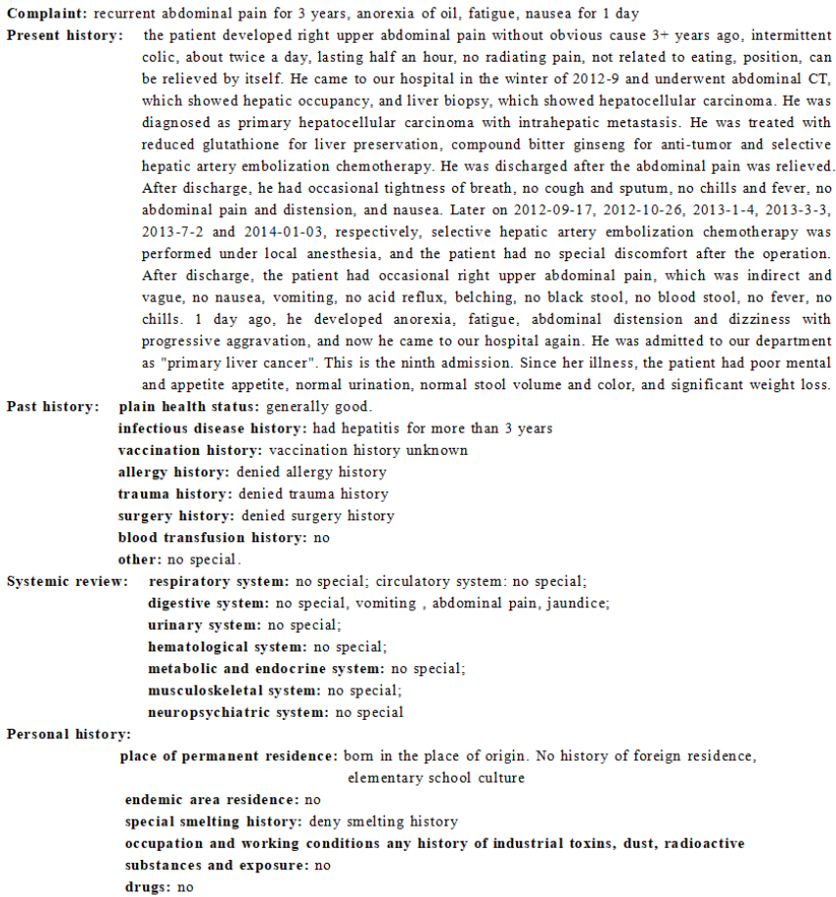
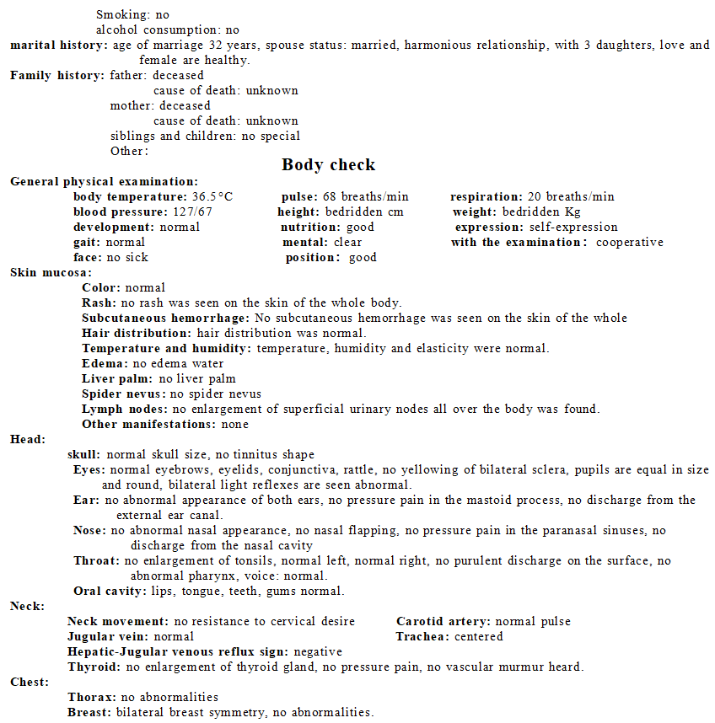
1. History of Disease
2. Body check

Slide 3
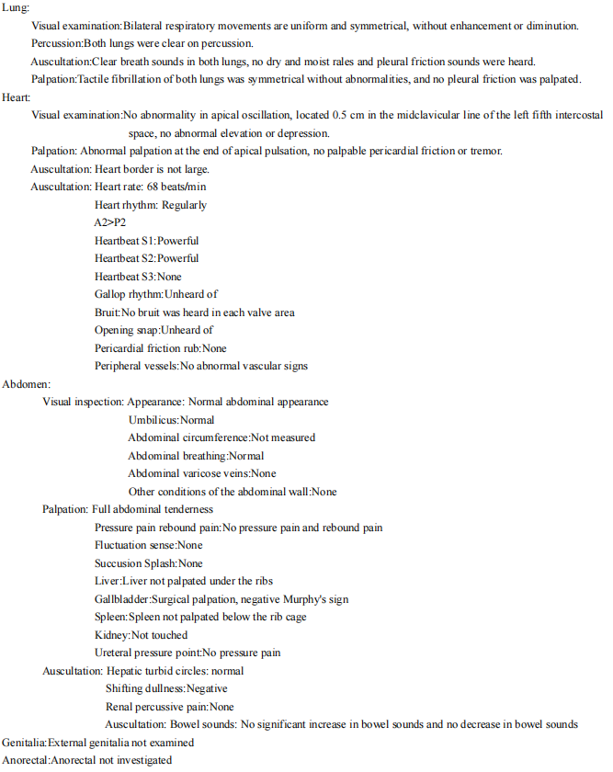
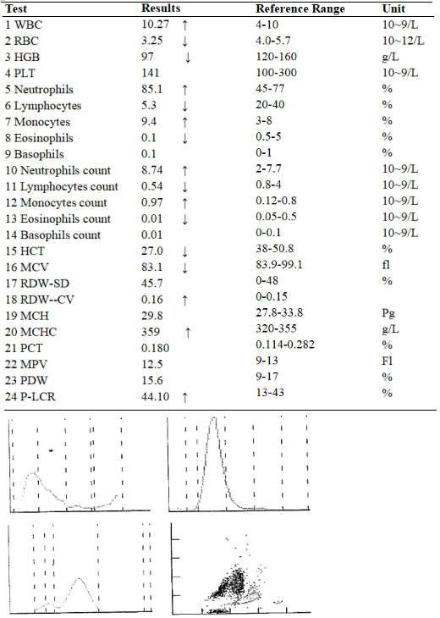
2. Body check
3. Blood analysis report form

Slide 4
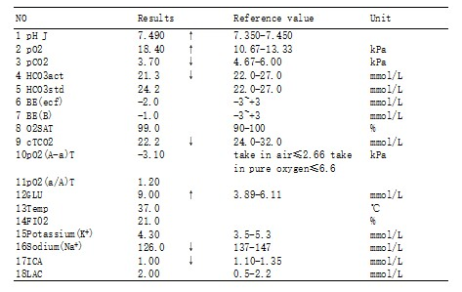
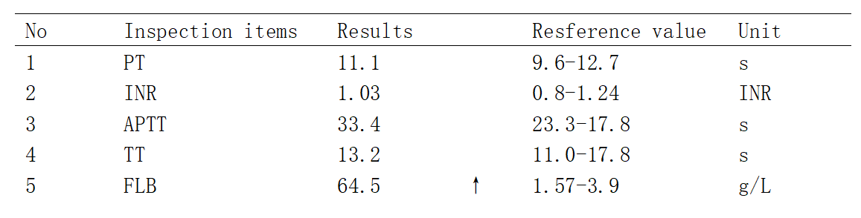
4. Arterial blood gas analysis
5. Blood coagulation function test

Slide 5
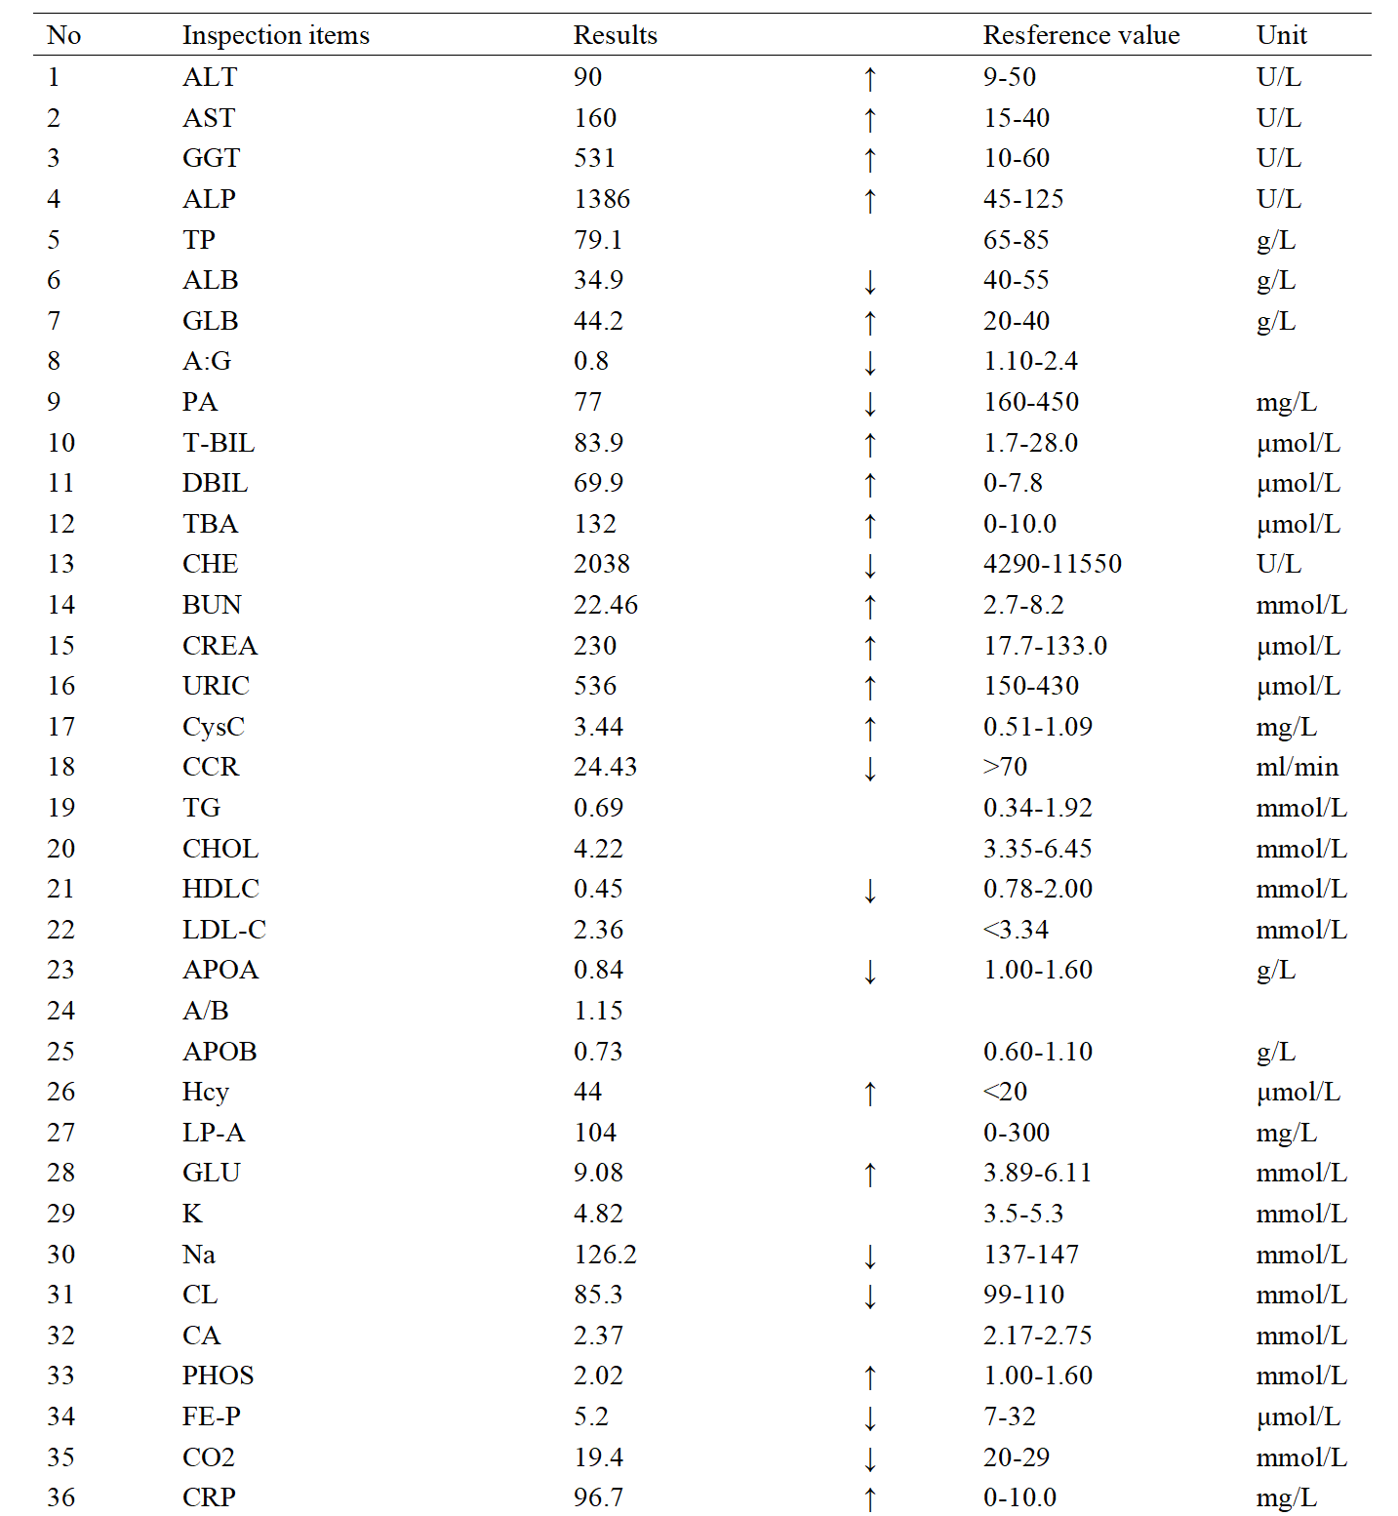
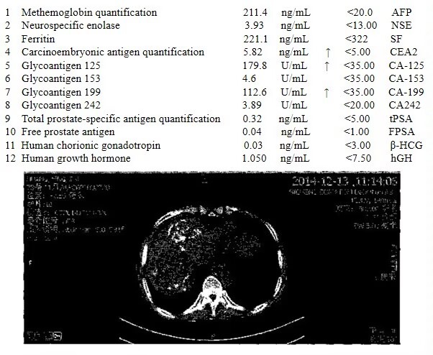
6. Liver and Kidney function test
7. Detection of tumor biomarkers

Slide 6
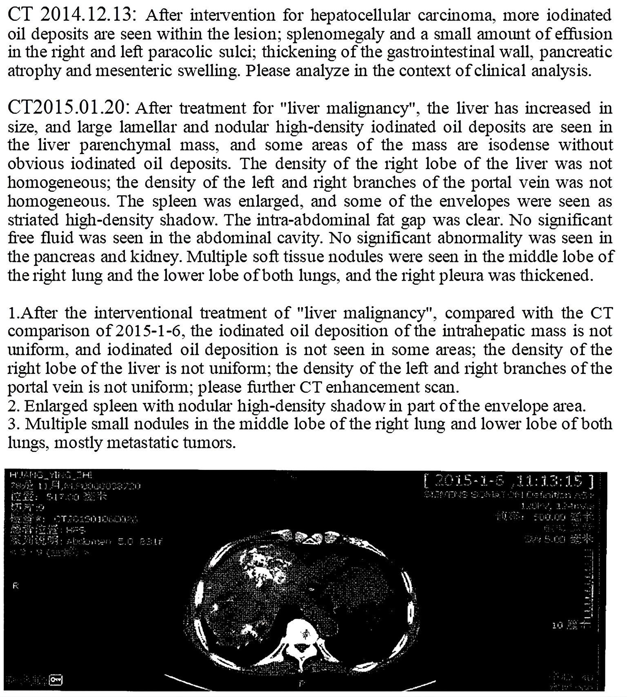
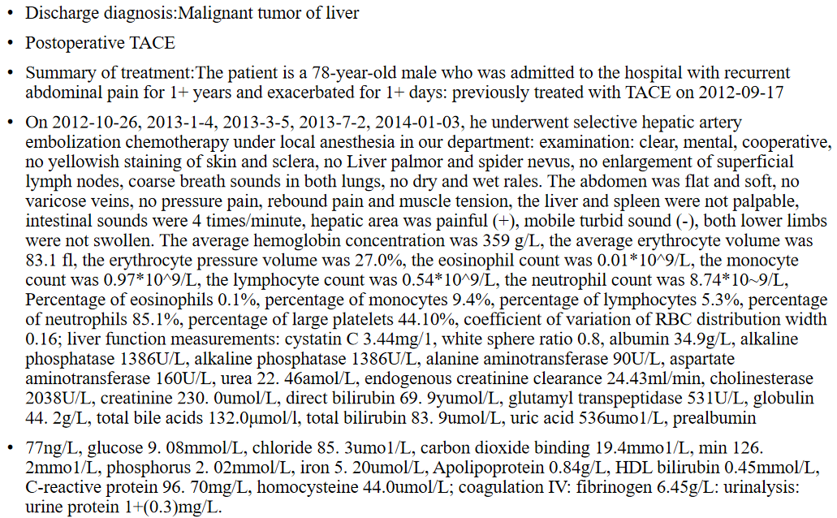
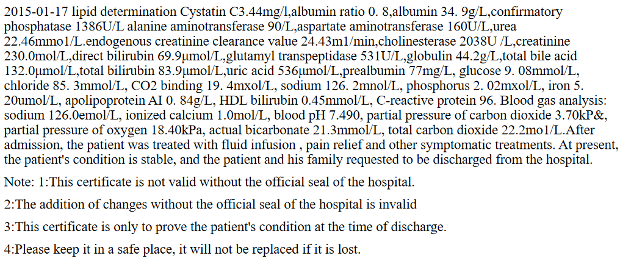
8. CT detection of tumor after interventional therapy
9. Diagnosis and treatment summary

Slide 7
Discussion section 1 (3 classes)
[Distribution of patient's medical records] omitted
【 Main Discussion Direction 】
1. Abnormal lipid metabolism and clinical manifestations during hepatocellular carcinoma.
2. Abnormal glucose metabolism and clinical manifestations during the occurrence of liver cancer.
【Hint questions]】
1. In the chief complaint, why do patients have the clinical manifestations of oil aversion? Please briefly describe the digestion and absorption characteristics of lipids.
2. The patient reviewed the previous history of the chief complaint of jaundice, please tell the mechanism of jaundice, how to detect, what is the significance of liver cancer?
3. What are the indicators of blood lipid detection? What is the physiological significance of each? What is the diagnostic and clinical value of this patient?
4. What other abnormalities may occur in glucose metabolism in patients with liver cancer, and what are the mechanisms? Why was the blood glucose test high in this patient?

Slide 8
Discussion section 2 (3 classes)
[Distribution of patient's medical records] omitted
【 Main Discussion Direction 】
1. Exchange and learn the key self-study problems arranged in the last discussion class.
2. Abnormal protein metabolism and clinical manifestations during hepatocellular carcinoma.
【Hint questions】
1. What is the significance of hemoglobin detection?
2. what does the index of liver function test have? What's the physiological significance?
3. What is the significance of urea, creatinine, uric acid and cystatin C tests in the project? What is the significance for patients with liver cancer?
4. In addition to the items listed in this laboratory sheet, what other serum markers and test items reflect liver tumors? What is the significance of each?

Slide 9
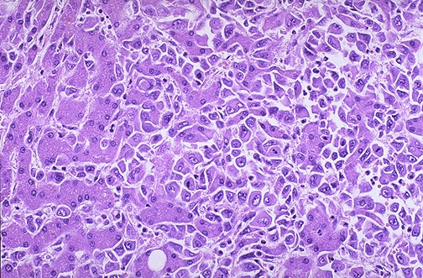
Discussion section 3 (3 classes)
[Distribution of patient's medical records] omitted
【 Main Discussion Direction 】
1. Exchange and learn the key self-study problems arranged in the last discussion class.
2. Liver puncture and cytological examination of liver cancer.
【Hint questions】
1. Which cells in the figure above are normal liver cells and which are liver cancer cells? What is the basis for the judgment?
2. What are the subtypes of liver cancer? What is the difference in cell morphology?
3. What are the mechanisms of liver cancer?
4. What is the relationship between HBV and liver cancer? What is the relationship between HBV and tumor suppressor genes such as P53?

