Slide 1
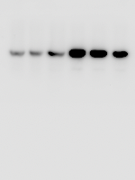
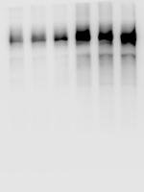
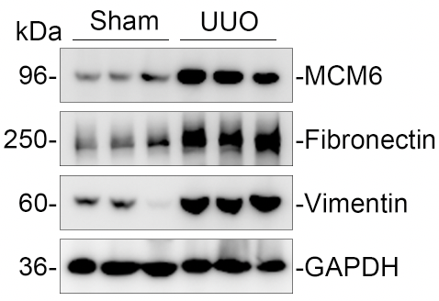
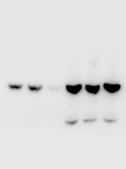
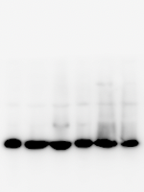
sham
UUO
sham
UUO
Figure 1E
180-
130-
250-
-Fibronectin
100-
-MCM6
180-
70-
130-
55-
100-
42-
33-
70-
25-
55-
sham
UUO
sham
UUO
180-
180-
130-
130-
100-
100-
70-
70-
-Vimentin
55-
55-
42-
42-
33-
-GAPDH
33-
25-
25-

Slide 2
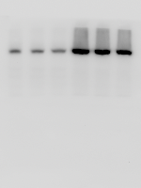
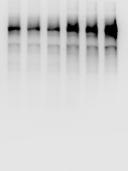
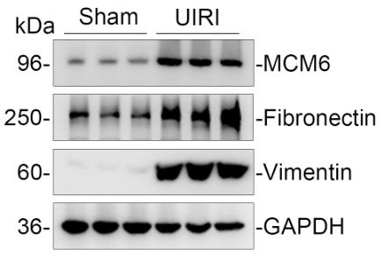
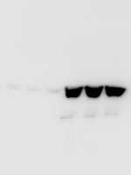
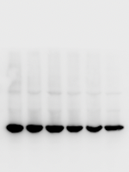
sham
UIRI
sham
UIRI
Figure 1E
180-
130-
250-
-Fibronectin
100-
180-
-MCM6
70-
130-
55-
100-
42-
70-
33-
25-
55-
sham
UIRI
sham
UIRI
180-
180-
130-
130-
100-
100-
70-
70-
-Vimentin
55-
55-
42-
42-
33-
-GAPDH
33-
25-
25-

Slide 3
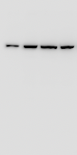
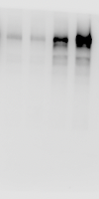
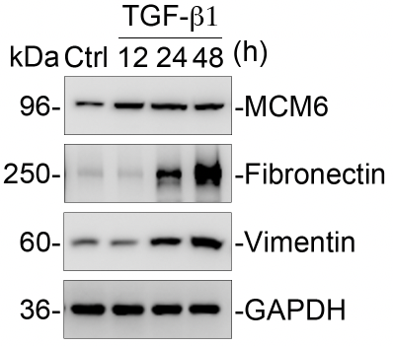

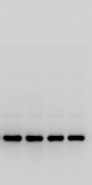
TGF-β1
TGF-β1
Figure 1L
kDa
Ctrl
12
24
48
(h)
kDa
Ctrl
12
24
48
180-
130-
250-
-Fibronectin
100-
-MCM6
180-
70-
130-
55-
100-
42-
70-
33-
25-
55-
TGF-β1
TGF-β1
kDa
Ctrl
12
24
48
(h)
kDa
Ctrl
12
24
48
180-
180-
130-
130-
100-
100-
70-
70-
-Vimentin
55-
55-
42-
42-
33-
-GAPDH
33-
25-
25-

Slide 4
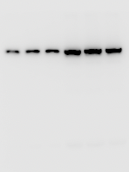
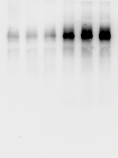
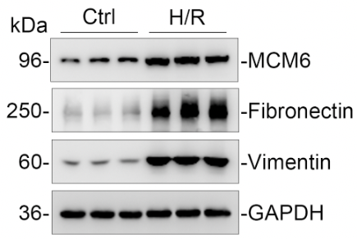
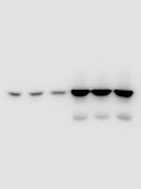
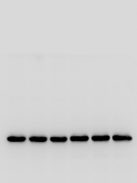
Ctrl
H/R
Ctrl
H/R
Figure 1N
180-
130-
250-
-Fibronectin
100-
-MCM6
180-
70-
130-
55-
100-
42-
70-
33-
25-
55-
Ctrl
H/R
Ctrl
H/R
180-
180-
130-
130-
100-
100-
70-
70-
-Vimentin
55-
55-
42-
42-
33-
-GAPDH
33-
25-
25-

Slide 5
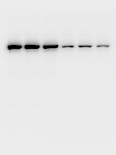
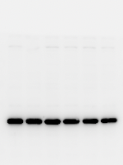
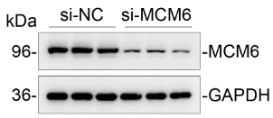
Figure 2A
si-NC
si-MCM6
si-NC
si-MCM6
180-
180-
130-
130-
100-
-MCM6
100-
70-
70-
55-
55-
42-
42-
-GAPDH
33-
33-
25-
25-

Slide 6
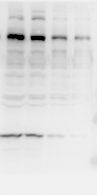
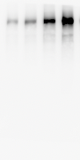
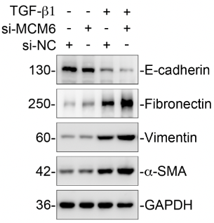

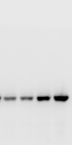
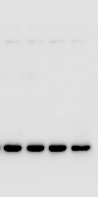
TGF-β1
-
-
+
+
TGF-β1
-
-
+
Figure 2E
+
si-MCM6
-
+
-
+
si-MCM6
-
+
-
+
-
-
si-NC
+
+
-
-
si-NC
+
+
180-
250-
-Fibronectin
130-
-E-cadherin
100-
180-
70-
130-
55-
100-
42-
33-
70-
25-
55-
TGF-β1
-
-
+
TGF-β1
-
-
+
+
TGF-β1
-
-
+
+
+
-
si-MCM6
-
+
-
+
si-MCM6
-
+
-
+
si-MCM6
+
-
+
-
-
-
-
si-NC
+
+
-
-
si-NC
+
+
si-NC
+
+
180-
180-
180-
130-
130-
130-
100-
100-
100-
70-
70-
70-
-Vimentin
55-
55-
55-
42-
42-
-α-SMA
42-
33-
-GAPDH
33-
33-
25-
25-
25-

Slide 7
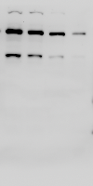

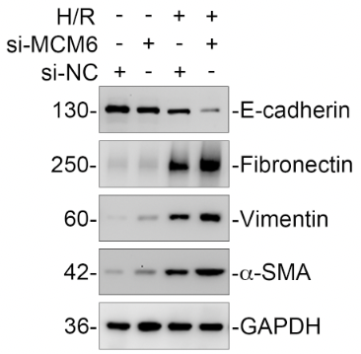

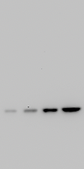
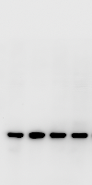
H/R
-
-
+
+
H/R
-
-
+
Figure 2I
+
si-MCM6
-
+
-
+
si-MCM6
-
+
-
+
-
-
si-NC
+
+
-
-
si-NC
+
+
180-
130-
-E-cadherin
250-
-Fibronectin
100-
180-
70-
130-
55-
100-
42-
33-
70-
25-
55-
-
-
+
-
-
+
H/R
+
-
-
+
H/R
+
H/R
+
-
si-MCM6
-
+
-
+
si-MCM6
-
+
-
+
si-MCM6
+
-
+
-
-
-
-
si-NC
+
+
-
-
si-NC
+
+
si-NC
+
+
180-
180-
180-
130-
130-
130-
100-
100-
100-
70-
70-
70-
-Vimentin
55-
55-
55-
42-
-α-SMA
42-
42-
-GAPDH
33-
33-
33-
25-
25-
25-

Slide 8
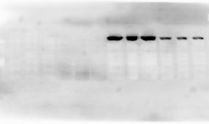
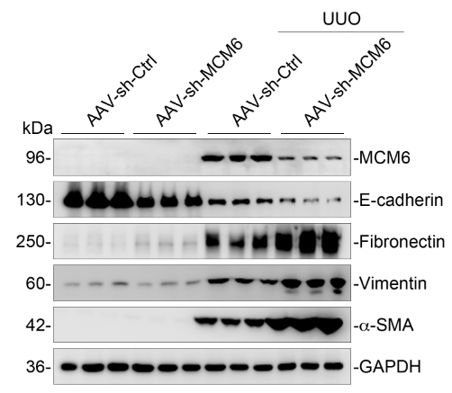
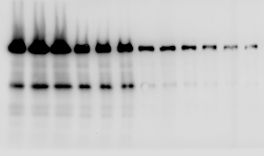
Figure 3F
UUO
AAV-sh-Ctrl
AAV-sh-Ctrl
AAV-sh-MCM6
AAV-sh-MCM6
kDa
180-
130-
100-
-MCM6
70-
55-
42-
33-
UUO
AAV-sh-MCM6
AAV-sh-Ctrl
AAV-sh-Ctrl
AAV-sh-MCM6
kDa
180-
130-
-E-cadherin
100-
70-
55-
42-

Slide 9
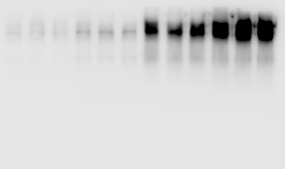
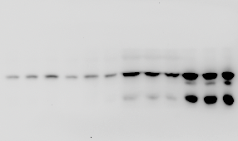
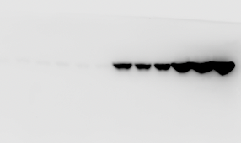
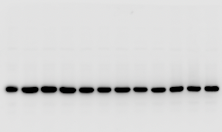
UUO
UUO
AAV-sh-MCM6
AAV-sh-Ctrl
AAV-sh-Ctrl
AAV-sh-MCM6
AAV-sh-Ctrl
AAV-sh-MCM6
AAV-sh-Ctrl
AAV-sh-MCM6
kDa
kDa
180-
250-
-Fibronectin
130-
180-
100-
130-
70-
-Vimentin
100-
70-
55-
42-
55-
33-
UUO
UUO
AAV-sh-MCM6
AAV-sh-Ctrl
AAV-sh-Ctrl
AAV-sh-MCM6
AAV-sh-Ctrl
AAV-sh-MCM6
AAV-sh-Ctrl
AAV-sh-MCM6
kDa
kDa
100-
130-
70-
100-
55-
70-
42-
-α-SMA
55-
33-
42-
-GAPDH
25-
33-
17-
25-

Slide 10
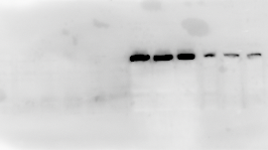
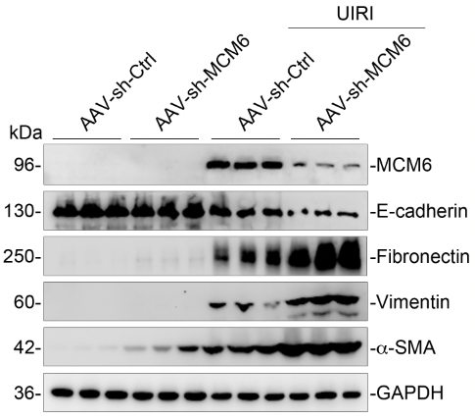
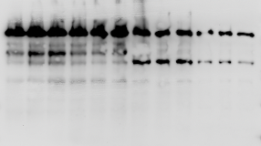
Figure 4F
UIRI
AAV-sh-Ctrl
AAV-sh-Ctrl
AAV-sh-MCM6
AAV-sh-MCM6
kDa
180-
130-
100-
-MCM6
70-
55-
42-
33-
UIRI
AAV-sh-MCM6
AAV-sh-Ctrl
AAV-sh-Ctrl
AAV-sh-MCM6
kDa
180-
130-
-E-cadherin
100-
70-
55-
42-

Slide 11
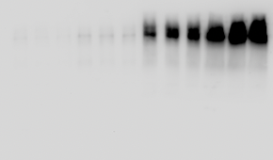
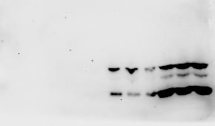
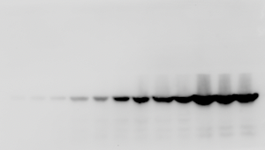
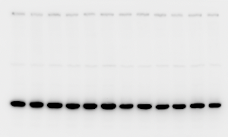
UIRI
UIRI
AAV-sh-MCM6
AAV-sh-Ctrl
AAV-sh-Ctrl
AAV-sh-MCM6
AAV-sh-Ctrl
AAV-sh-MCM6
AAV-sh-Ctrl
AAV-sh-MCM6
kDa
kDa
180-
250-
-Fibronectin
130-
180-
100-
130-
70-
-Vimentin
100-
55-
70-
42-
55-
33-
UIRI
UIRI
AAV-sh-MCM6
AAV-sh-Ctrl
AAV-sh-Ctrl
AAV-sh-MCM6
AAV-sh-Ctrl
AAV-sh-MCM6
AAV-sh-Ctrl
AAV-sh-MCM6
kDa
kDa
180-
130-
130-
100-
100-
70-
70-
55-
55-
42-
-α-SMA
42-
33-
33-
-GAPDH
25-
25-

Slide 12
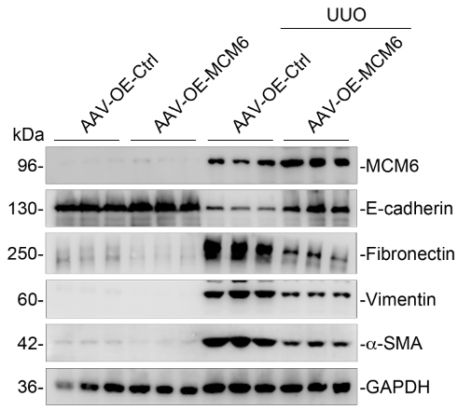
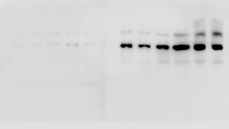
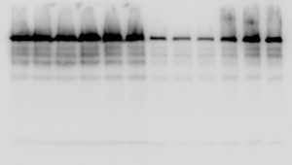
UUO
Figure 5F
AAV-OE-Ctrl
AAV-OE-Ctrl
AAV-OE-MCM6
AAV-OE-MCM6
kDa
180-
130-
100-
-MCM6
70-
55-
42-
33-
UUO
AAV-OE-MCM6
AAV-OE-Ctrl
AAV-OE-Ctrl
AAV-OE-MCM6
kDa
180-
130-
-E-cadherin
100-
70-
55-
42-
33-

Slide 13
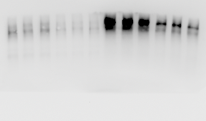
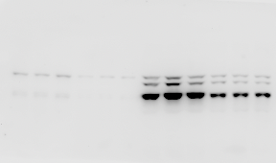


UUO
UUO
AAV-OE-MCM6
AAV-OE-Ctrl
AAV-OE-Ctrl
AAV-OE-MCM6
AAV-OE-Ctrl
AAV-OE-MCM6
AAV-OE-Ctrl
AAV-OE-MCM6
kDa
kDa
180-
250-
-Fibronectin
130-
180-
100-
130-
70-
100-
-Vimentin
55-
70-
42-
55-
33-
UUO
UUO
AAV-OE-MCM6
AAV-OE-Ctrl
AAV-OE-Ctrl
AAV-OE-MCM6
AAV-OE-Ctrl
AAV-OE-MCM6
AAV-OE-Ctrl
AAV-OE-MCM6
kDa
kDa
130-
130-
100-
100-
70-
70-
55-
55-
42-
-α-SMA
42-
33-
33-
-GAPDH
25-
25-

Slide 14



UIRI
Figure 6F
AAV-OE-Ctrl
AAV-OE-Ctrl
AAV-OE-MCM6
AAV-OE-MCM6
kDa
180-
130-
100-
-MCM6
70-
55-
42-
33-
UIRI
AAV-OE-MCM6
AAV-OE-Ctrl
AAV-OE-Ctrl
AAV-OE-MCM6
kDa
180-
130-
-E-cadherin
100-
70-
55-
42-
33-
25-

Slide 15




UIRI
UIRI
AAV-OE-MCM6
AAV-OE-Ctrl
AAV-OE-Ctrl
AAV-OE-MCM6
AAV-OE-Ctrl
AAV-OE-MCM6
AAV-OE-Ctrl
AAV-OE-MCM6
kDa
kDa
180-
250-
-Fibronectin
130-
180-
100-
130-
70-
-Vimentin
100-
55-
70-
42-
55-
33-
UIRI
UIRI
AAV-OE-MCM6
AAV-OE-Ctrl
AAV-OE-Ctrl
AAV-OE-MCM6
AAV-OE-MCM6
AAV-OE-Ctrl
AAV-OE-Ctrl
AAV-OE-MCM6
kDa
kDa
130-
130-
100-
100-
70-
70-
55-
55-
42-
-α-SMA
42-
33-
33-
-GAPDH
25-
25-

Slide 16



Figure 7A
UUO
AAV-sh-Ctrl
AAV-sh-Ctrl
AAV-sh-MCM6
AAV-sh-MCM6
kDa
130-
100-
70-
55-
42-
-p-ERK
33-
25-
UUO
AAV-sh-MCM6
AAV-sh-Ctrl
AAV-sh-Ctrl
AAV-sh-MCM6
kDa
130-
100-
70-
55-
42-
-ERK
33-
25-

Slide 17




UUO
UUO
AAV-sh-Ctrl
AAV-sh-Ctrl
AAV-sh-MCM6
AAV-sh-MCM6
AAV-sh-Ctrl
AAV-sh-Ctrl
AAV-sh-MCM6
AAV-sh-MCM6
kDa
kDa
130-
130-
100-
100-
70-
70-
55-
42-
-p-GSK-3β
55-
42-
-GSK-3β
33-
33-
25-
25-
UUO
UUO
AAV-sh-MCM6
AAV-sh-MCM6
AAV-sh-Ctrl
AAV-sh-Ctrl
AAV-sh-Ctrl
AAV-sh-Ctrl
AAV-sh-MCM6
AAV-sh-MCM6
kDa
kDa
100-
100-
70-
70-
55-
55-
42-
42-
-GAPDH
33-
33-
-Snail1
25-
25-
17-
17-

Slide 18



UUO
Figure 7C
AAV-OE-Ctrl
AAV-OE-Ctrl
AAV-OE-MCM6
AAV-OE-MCM6
kDa
130-
100-
70-
55-
42-
-p-ERK
33-
25-
UUO
AAV-OE-MCM6
AAV-OE-Ctrl
AAV-OE-Ctrl
AAV-OE-MCM6
kDa
130-
100-
70-
55-
42-
-ERK
33-
25-

Slide 19




UUO
UUO
AAV-OE-Ctrl
AAV-OE-Ctrl
AAV-OE-Ctrl
AAV-OE-Ctrl
AAV-OE-MCM6
AAV-OE-MCM6
AAV-OE-MCM6
AAV-OE-MCM6
kDa
kDa
130-
180-
100-
130-
70-
100-
55-
70-
42-
-p-GSK-3β
55-
42-
-GSK-3β
33-
33-
UUO
UUO
AAV-OE-MCM6
AAV-OE-Ctrl
AAV-OE-Ctrl
AAV-OE-MCM6
AAV-OE-MCM6
AAV-OE-Ctrl
AAV-OE-Ctrl
AAV-OE-MCM6
kDa
kDa
100-
130-
70-
100-
55-
70-
42-
55-
33-
42-
-Snail1
-GAPDH
25-
33-
17-
25-

Slide 20






-
-
+
TGF-β1 (1h)
-
-
+
Figure 7E
TGF-β1 (1h)
+
+
si-MCM6
-
+
-
+
si-MCM6
-
+
-
+
-
-
+
-
+
-
si-NC
+
+
si-NC
180-
180-
130-
130-
100-
100-
70-
70-
55-
55-
42-
-p-ERK
42-
-ERK
33-
33-
25-
25-
TGF-β1 (1h)
-
-
+
+
si-MCM6
-
+
-
+
-
-
-
TGF-β1 (1h)
-
-
+
si-NC
+
+
TGF-β1 (1h)
-
+
+
+
si-MCM6
-
+
-
+
si-MCM6
-
+
-
+
180-
-
-
-
-
+
+
si-NC
+
+
si-NC
130-
180-
130-
130-
100-
100-
100-
70-
70-
70-
55-
55-
55-
42-
-GSK-3β
42-
-p-GSK-3β
-GAPDH
42-
33-
33-
33-
25-
25-

Slide 21



Figure 7G
TGF-β1 (48h)
-
-
+
TGF-β1 (48h)
-
-
+
+
+
si-MCM6
-
+
-
+
si-MCM6
-
+
-
+
-
-
-
-
si-NC
+
+
si-NC
+
+
130-
130-
100-
100-
70-
70-
55-
55-
42-
42-
33-
33-
-GAPDH
-Snail1
25-
25-
17-
17-

Slide 22



Figure 7I
SB216763
-
-
-
-
+
+
SB216763
-
-
-
-
+
+
U0126
-
-
-
+
-
+
U0126
-
-
-
+
-
+
TGF-β1 (1h)
-
+
+
+
+
+
TGF-β1 (1h)
-
+
+
+
+
+
si-MCM6
-
-
+
+
+
+
si-MCM6
-
-
+
+
+
+
si-NC
+
+
-
-
-
-
si-NC
+
+
-
-
-
-
130-
130-
100-
100-
70-
70-
55-
55-
42-
-p-ERK
42-
-ERK
33-
33-
25-
25-

Slide 23



SB216763
-
-
-
-
+
+
SB216763
-
-
-
-
+
+
SB216763
-
-
-
-
+
+
U0126
-
-
-
+
-
+
U0126
-
-
-
+
-
+
U0126
-
-
-
+
-
+
TGF-β1 (1h)
-
+
+
+
+
+
TGF-β1 (1h)
-
+
+
+
+
+
TGF-β1 (1h)
-
+
+
+
+
+
si-MCM6
-
-
+
+
+
+
si-MCM6
-
-
+
+
+
+
si-MCM6
-
-
+
+
+
+
si-NC
+
+
-
-
-
-
si-NC
+
+
-
-
-
-
si-NC
+
+
-
-
-
-
130-
130-
130-
100-
100-
100-
70-
70-
70-
55-
55-
55-
42-
-p-GSK-3β
42-
-p-GSK-3β
42-
33-
-GAPDH
33-
33-
25-
25-
25-

Slide 24



Figure 7K
SB216763
-
-
-
-
+
+
SB216763
-
-
-
-
+
+
U0126
-
-
-
+
-
+
U0126
-
-
-
+
-
+
TGF-β1 (48h)
-
+
+
+
+
+
TGF-β1 (48h)
-
+
+
+
+
+
si-MCM6
-
-
+
+
+
+
si-MCM6
-
-
+
+
+
+
si-NC
+
+
-
-
-
-
si-NC
+
+
-
-
-
-
130-
130-
100-
100-
70-
70-
55-
55-
42-
33-
42-
-Snail1
-GAPDH
25-
33-
17-
25-

Slide 25






Figure 7C
sham
UUO
sham
UUO
180-
180-
130-
130-
100-
100-
70-
70-
55-
55-
42-
-DUSP6
42-
-GAPDH
33-
33-
25-
25-
sham
UIRI
sham
UIRI
180-
180-
130-
130-
100-
100-
70-
70-
55-
55-
-DUSP6
42-
42-
-GAPDH
33-
33-
25-
25-

Slide 26






Figure 8E
Ctrl
TGF-β1
Ctrl
TGF-β1
180-
130-
130-
100-
100-
70-
70-
55-
55-
42-
-DUSP6
-GAPDH
42-
33-
33-
25-
25-
Ctrl
H/R
Ctrl
H/R
180-
130-
130-
100-
100-
70-
70-
55-
55-
42-
-DUSP6
-GAPDH
42-
33-
33-
25-
25-

Slide 27



Figure 8G
UUO
AAV-sh-Ctrl
AAV-sh-Ctrl
AAV-sh-MCM6
AAV-sh-MCM6
kDa
180-
130-
100-
70-
55-
42-
-DUSP6
33-
UUO
AAV-sh-Ctrl
AAV-sh-Ctrl
AAV-sh-MCM6
AAV-sh-MCM6
kDa
180-
130-
100-
70-
55-
42-
33-
-GAPDH
25-

Slide 28



UUO
Figure 8I
AAV-OE-Ctrl
AAV-OE-Ctrl
AAV-OE-MCM6
AAV-OE-MCM6
kDa
180-
130-
100-
70-
55-
42-
-DUSP6
33-
UUO
AAV-OE-Ctrl
AAV-OE-Ctrl
AAV-OE-MCM6
AAV-OE-MCM6
kDa
130-
100-
70-
55-
42-
33-
-GAPDH
25-

