Slide 1
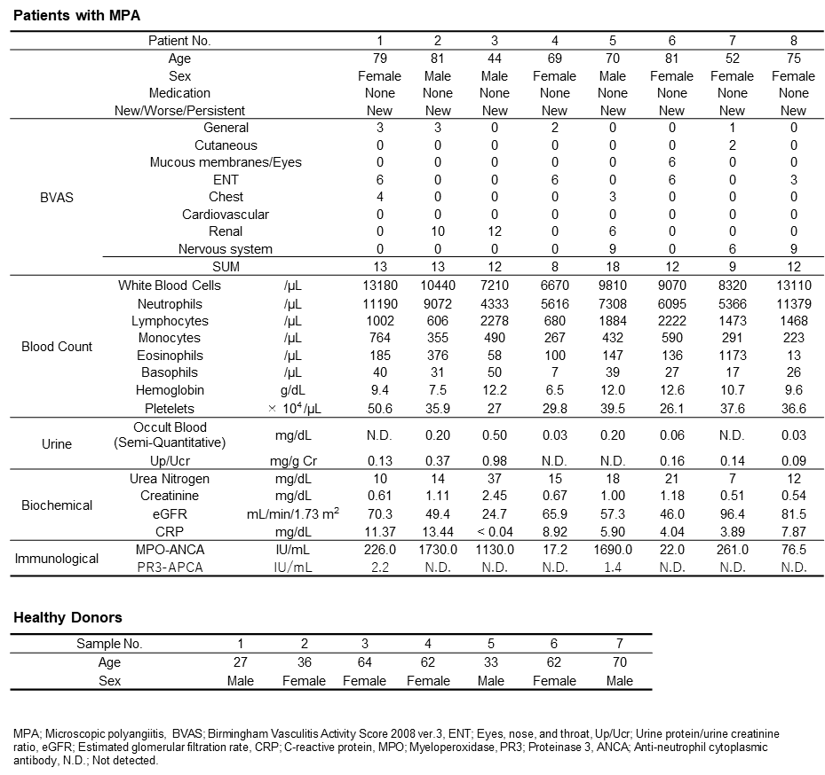
Supplementary Table 1.
Characteristics of eight patients with microscopic polyangiitis and seven healthy donors recruited for CITE-seq and CyTOF.

Slide 2
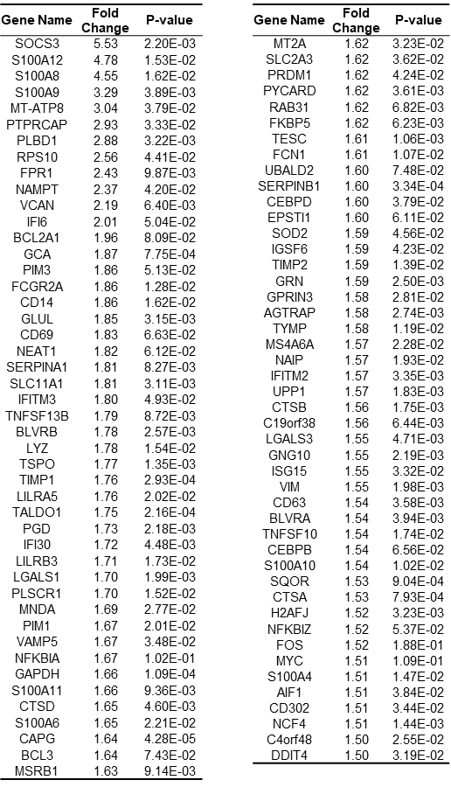
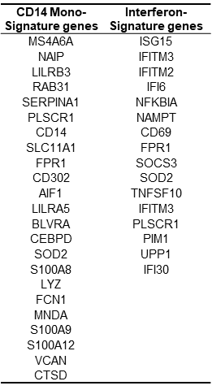
Supplementary Table 2.
Pseudo-bulk differential expressed genes (DEG) analysis in PBMCs derived from patients with MPA and healthy donors.
a
b
(a) The top 100 genes significantly upregulated in PBMCs derived from patients with MPA compared to healthy donors. (b) A list of the genes related to CD14⁺ monocyte signature genes and interferon signature genes.

Slide 3
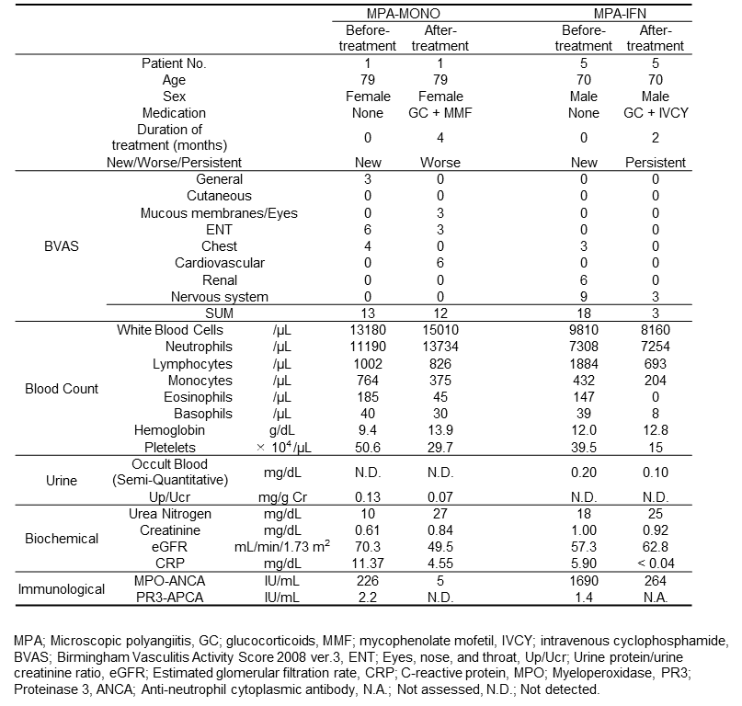
Supplementary Table 3.
Clinical course of patients MPA-1 and MPA-5.

Slide 4
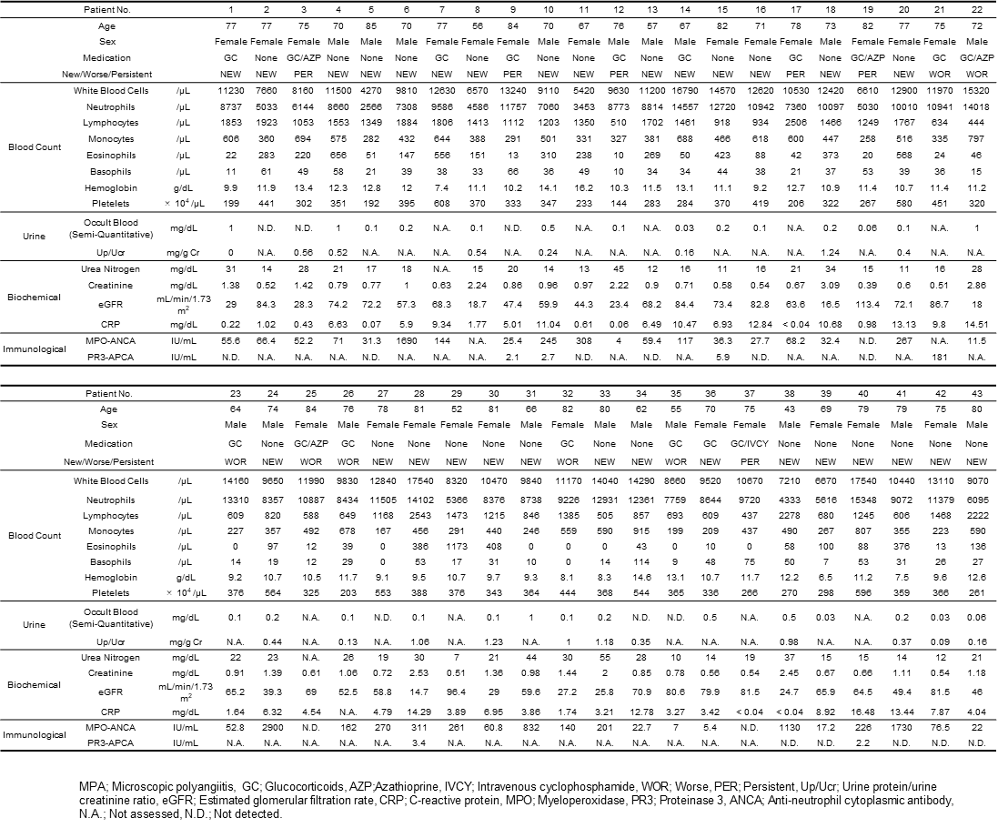
Supplementary Table 4.
Characteristics of 43 patients with microscopic polyangiitis recruited for assessing clinical parameters.

Slide 5
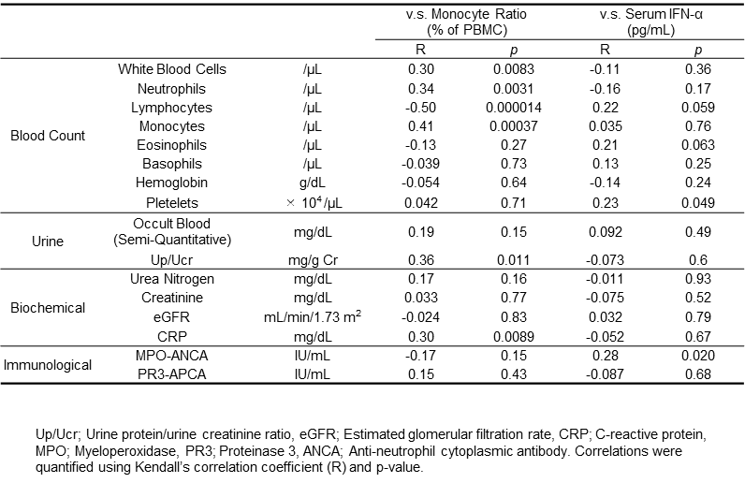
Supplementary Table 5.
Correlation between the percentage of monocytes and representative clinical parameters, and between serum IFN-α concentrations and representative clinical parameters.

Slide 6
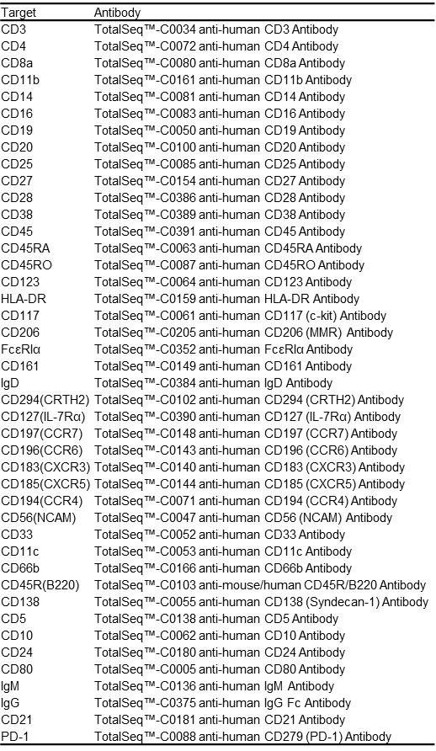
Supplementary Table 6.
List of Total-seq C antibodies for CITE-seq.

Slide 7
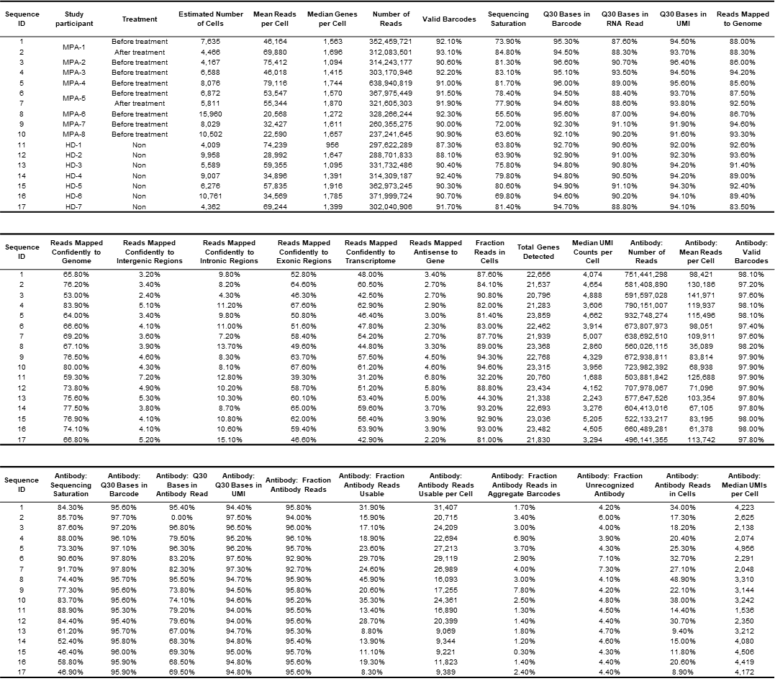
Supplementary Table 7.
Sequence information of each study participant.

Slide 8
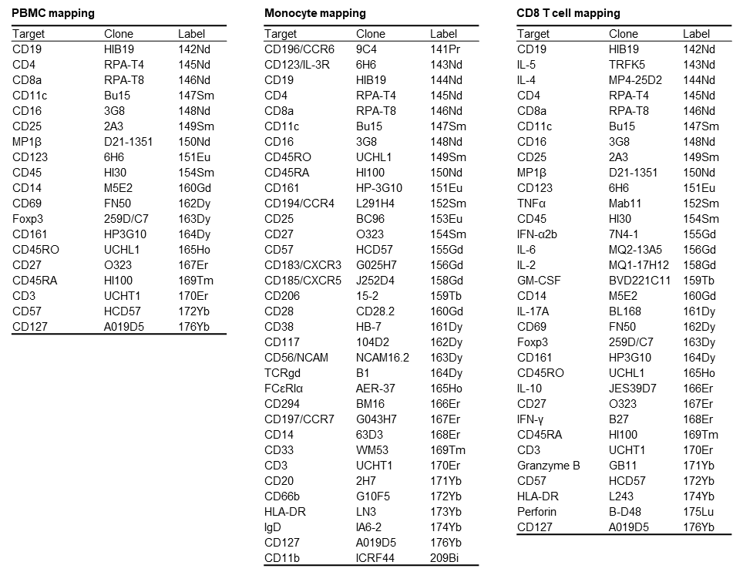
Supplementary Table 8.
List of heavy metal-conjugated antibodies for CyTOF.

