Slide 1
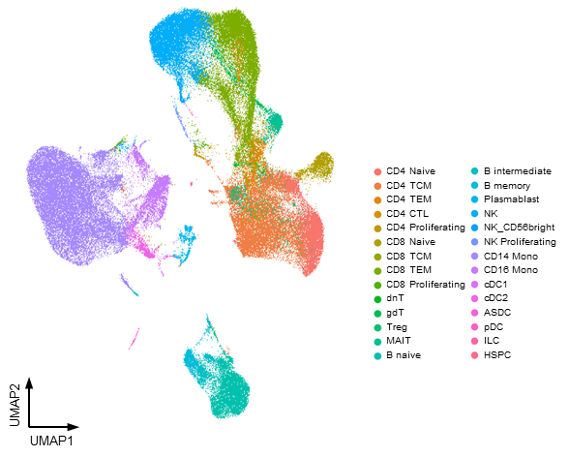
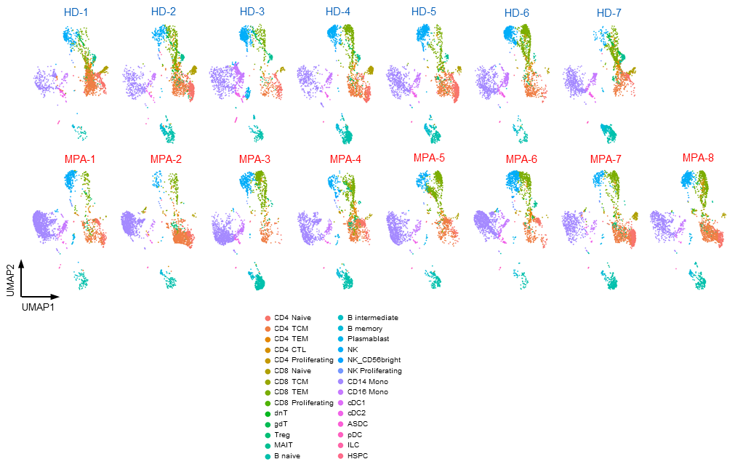
Extended Data Fig. 1. UMAP plots of PBMCs derived from each study participant.
a
b
(a) UMAP plots showing CITE-seq data of 109,350 PBMCs derived from 15 total participants including healthy donors (n = 7) and patients with MPA (n = 8). Each cellular cluster was annotated with reference mapping. (b) Individual UMAP plots of PBMCs derived from each study participant.

Slide 2
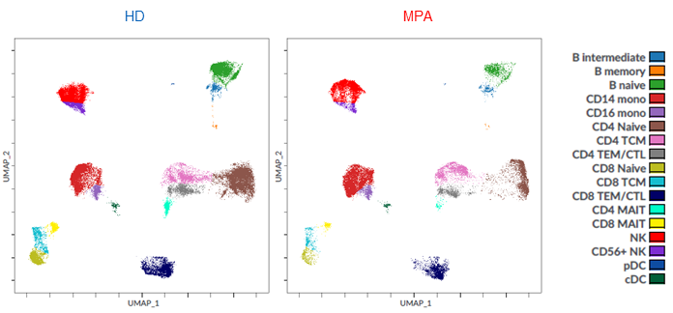
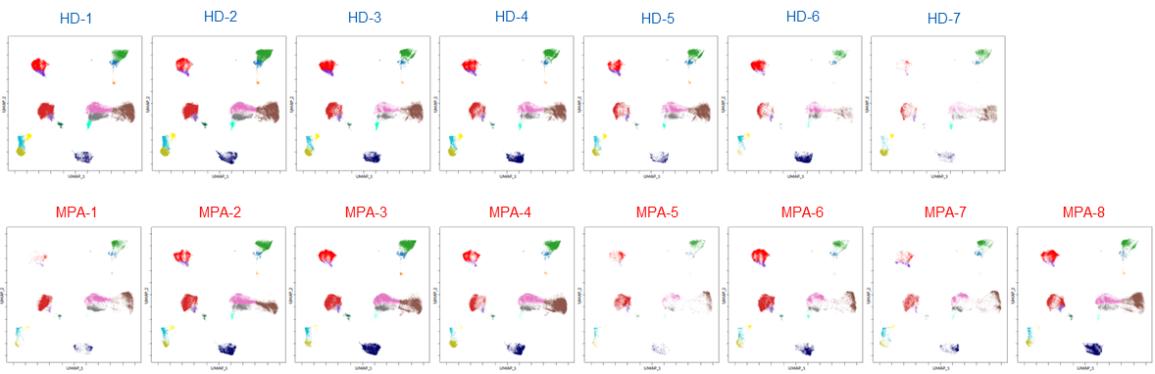
Extended Data Fig. 2. CyTOF analysis of PBMCs derived from each study participant.
a
b
c
*
*
*
(a) UMAP plots showing CITE-seq data of 737,794 PBMCs derived from healthy donors (n = 7) and patients with MPA (n = 8). Each cellular cluster was manually annotated based on surface marker expression. The color-coded columns indicate cell types. (b) Individual UMAP plots of PBMCs derived from each study participant. Each cellular cluster was manually annotated based on surface marker expression. (c) Percentage of each cellular subpopulation relative to the total number of PBMCs. Values are means with SEMs, *p < 0.05, **p < 0.01, ***p < 0.001, using a Mann-Whitney U test.

Slide 3
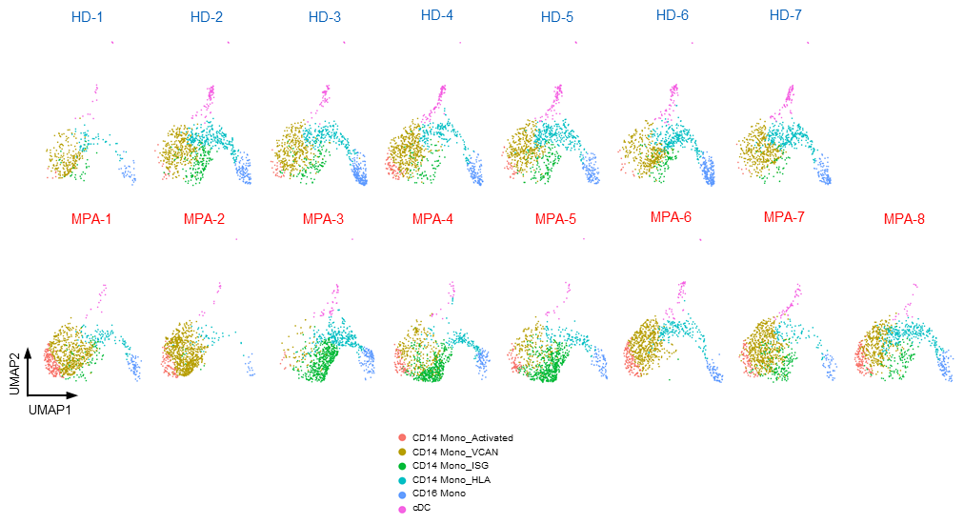
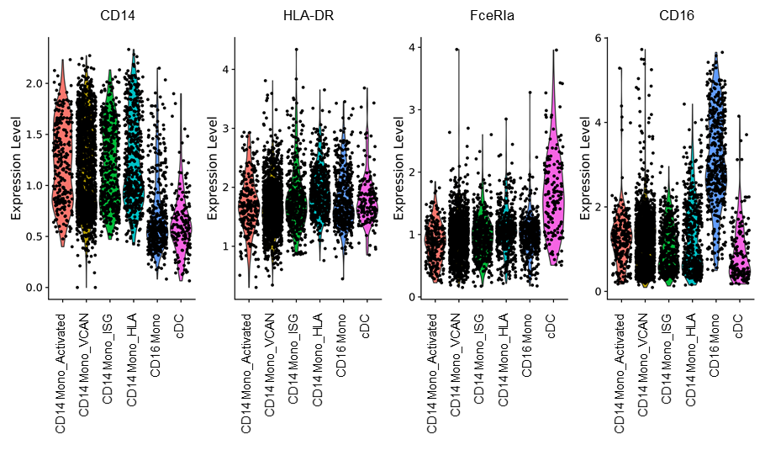
Extended Data Fig. 3. UMAP plots of monocytes derived from each study participant.
a
b
(a) UMAP plots showing the monocyte subpopulations in each study participant. Six cellular clusters were identified as shown in Fig. 2a. (b) Violin plots showing the scaled expression of representative cellular indexing of transcriptomes and epitopes (CITE) proteins that characterize each cellular cluster.

Slide 4
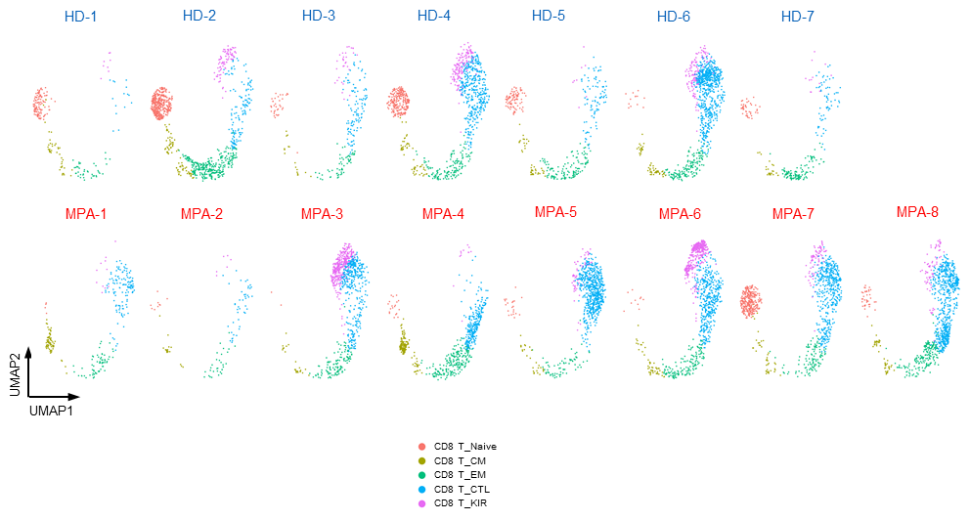
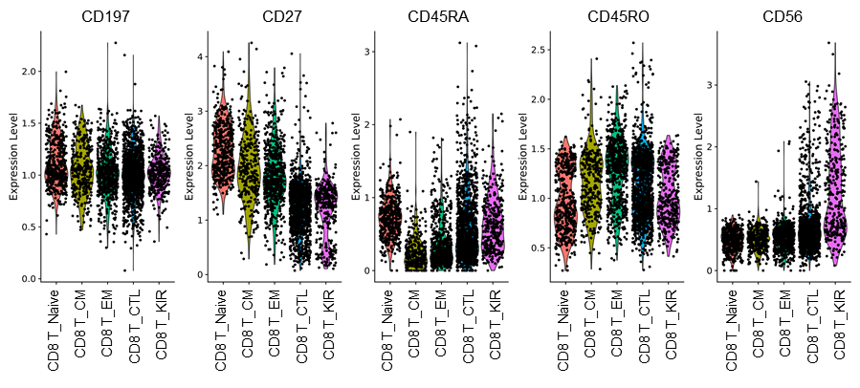
Extended Data Fig. 4. UMAP plots of CD8+ T cells derived from each study participant.
a
b
(a) UMAP plots showing the CD8⁺ T cell subpopulations in each study participant. Five cellular clusters were identified as shown in Fig. 2e. (b) Violin plots showing the scaled expression of representative cellular indexing of transcriptomes and epitopes (CITE) proteins that characterize each cellular cluster.

Slide 5
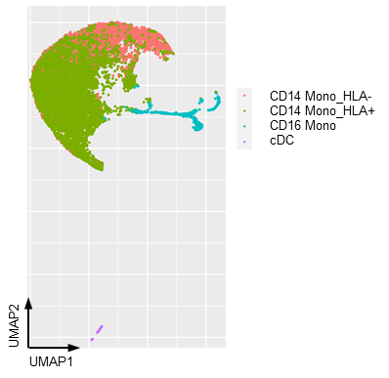
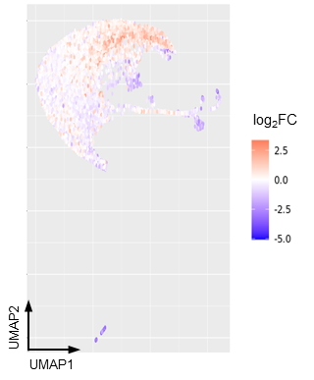
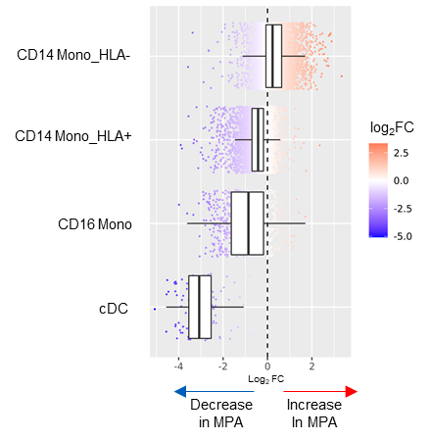
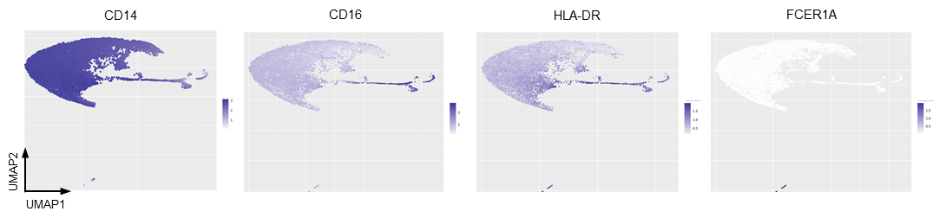
Extended Data Fig. 5. Cydar analysis on monocyte subsets of CyTOF data.
a
b
c
d
(a) UMAP plots showing CyTOF data of monocytes derived from a total of 15 study participants including healthy donors (n = 7) and patients with MPA (n = 8). Each cellular cluster was manually annotated based on surface marker expression. (b) Neighborhood graph of monocytes based on Cydar differential abundance testing. Nodes represent neighborhoods from the monocyte population. Colors indicate log₂-fold differences between patients with MPA and healthy donors. Neighborhoods that increased in patients with MPA are shown in red. Neighborhoods decreased in patients with MPA are shown in blue. (c) Beeswarm and box plots showing the distribution of log₂-fold differences in neighborhoods in different cell type clusters. Colors are represented similarly to (b). (d) Feature plots of surface proteins based on Cydar analysis of monocytes. Each dot represents a hypersphere from the monocyte population. The average expression level of each protein on the cells included in each hypersphere was calculated.

Slide 6
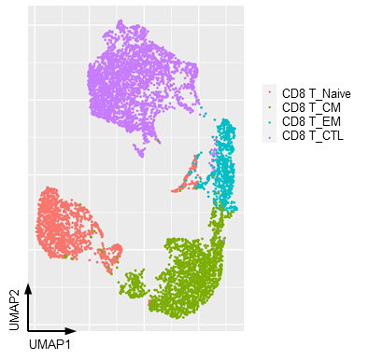
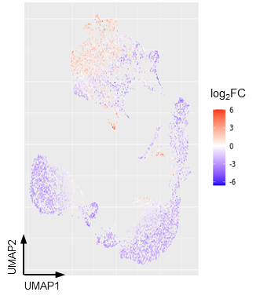
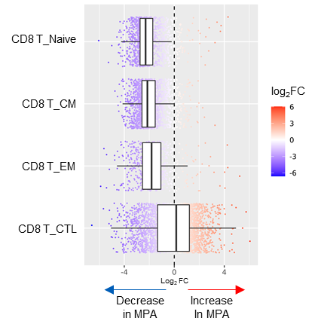
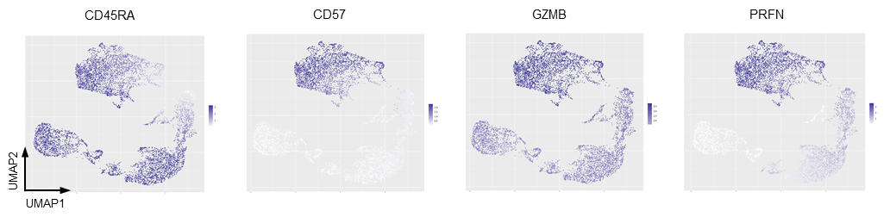
Extended Data Fig. 6. Cydar analysis on CD8+ T cell subsets of CyTOF data.
a
b
c
d
(a) UMAP plots showing CyTOF data of CD8⁺ T cells derived from a total of 15 study participants including healthy donors (n = 7) and patients with MPA (n = 8). Each cellular cluster was manually annotated based on surface marker expression. (b) Neighborhood graph of CD8⁺ T cells based on Cydar differential abundance testing. Nodes represent neighborhoods from the CD8⁺ T cell population. Colors indicate log₂-fold differences between patients with MPA and healthy donors. Neighborhoods that increased in patients with MPA are shown in red. Neighborhoods decreased in patients with MPA are shown in blue. (c) Beeswarm and box plots showing the distribution of log₂-fold differences in neighborhoods in different cell type clusters. Colors are represented similarly to (b). (d) Feature plots of surface proteins based on Cydar analysis of CD8⁺ T cells. Each dot represents a hypersphere from the CD8⁺ T cell population. The average expression level of each protein on the cells included in each hypersphere was calculated. CD45RA and CD57 are surface proteins. GZMB and PRF1 are intracellular cytokines. GZMB: Granzyme B, PRF1: Perforin1.

Slide 7
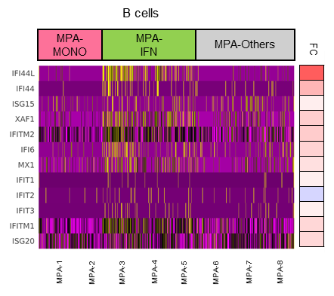
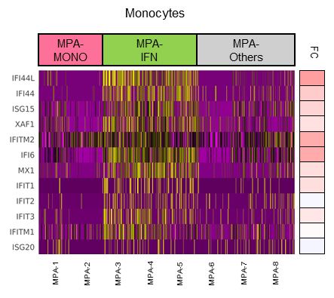
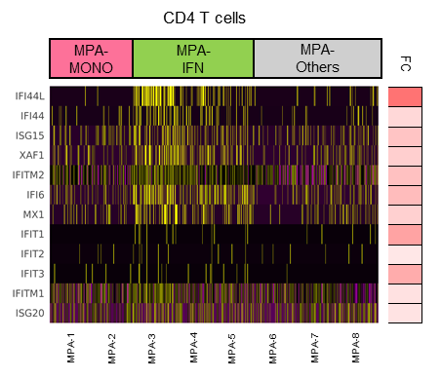
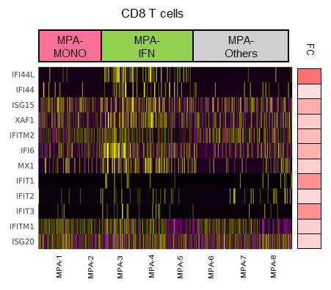
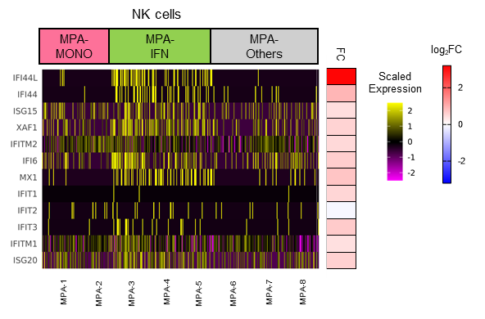
Extended Data Fig. 7. Heatmaps of interferon signature genes in each subset of PBMC.
Heatmap showing the scaled expression of interferon signature genes (ISGs) in B cells, monocytes, CD4+ T cells, CD8+ T cells, and natural killer (NK) cells at the single-cell level. Each column represents a patient with MPA. Log₂-fold difference in the average expression of each ISG between MPA-MONO (MPA-1 and MPA-2) and MPA-ISG (MPA-3, MPA-4, and MPA-5) is shown.

Slide 8
Extended Data Fig. 8. Correlation between clinical parameters and CITE-seq-based gene signature scores.
a
b
R = 0.71
p = 0.0067
R = 0.52
p = 0.049
(a) Correlation between monocyte ratio in the blood cell count relative to the number of PBMCs and CD14⁺ monocyte signature scores. (b) Correlation between serum IFN-α concentrations and interferon signature gene scores. Each signature score was calculated based on CITE-seq data as shown in Fig. 3c. Correlations were quantified using Kendall’s correlation coefficients (R).

