Slide 1
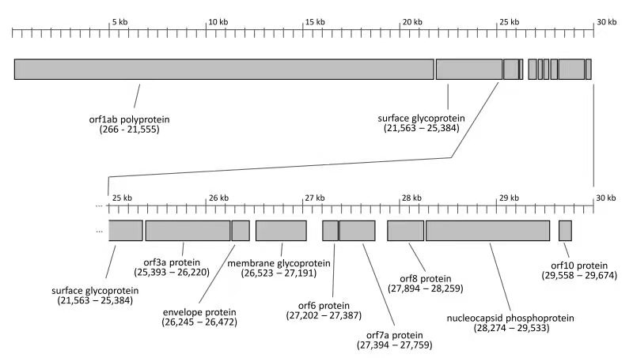
Supplementary Figure 1. Map of the predicted ORFs in the SARS-CoV-2 genome sequence.

Slide 2
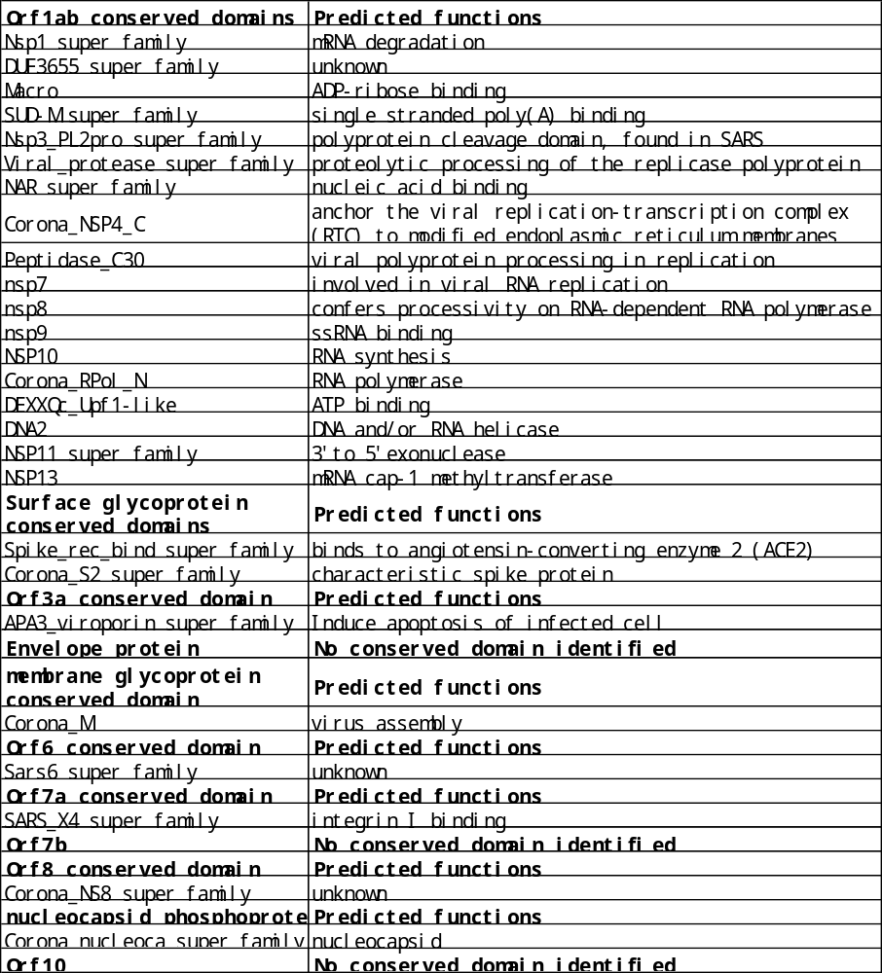
Supplementary Table 1. Conserved domains in the predicted polyproteins and polypeptides

Slide 3
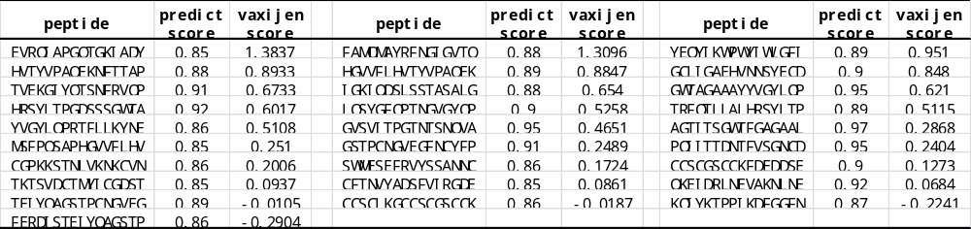
Supplementary Table 2 B-cell epitope in SARS-CoV-2 spike protein predicted via ABCpred server are presented along with antigenicity scores
Supplementary Table 3 B-cell epitope in SARS-CoV-2 spike protein predicted via BepiPred server are presented along antigenicity scores
peptide | vaxijen score |  | peptide | vaxijen score |  | peptide | vaxijen score |  | peptide | vaxijen score
SKRVDFCGK | 1.7321 |  | TSNFRVQPTE | 1.3571 |  | EVRQIAPGQTGKIADYNYKLP | 1.3005 |  | ASFSTFKCYGVSPTKLNDLCFTNVYA | 1.288
GKYEQY | 1.2821 |  | TNLCPF | 1.2508 |  | PTNGVG | 1.1441 |  | GFNCYFPLQSY | 0.9224
LDSKVGGNYNYLY | 0.8331 |  | DPSKPSKRSF | 0.8148 |  | QLTPTWRVYSTGSNVFQTRA | 0.7725 |  | EPQIITTDNT | 0.7545
CKFDEDDSEPVLKGVKLHY | 0.7324 |  | PINLVRDLPQGFSALE | 0.724 |  | TMSLGAENSVAYSNNS | 0.6687 |  | NSYECDIPIG | 0.6533
VNLTTRTQLPPAYTNSFTRGVYY | 0.6474 |  | NVTWFHAIHVSGTNGTKRFDNPV | 0.5663 |  | EGKQGNFKNLREFV | 0.3419 |  | VYYHKNNKSWMESEFRVYSSANN | 0.3028
RKSNLKPFERDISTEIYQAGSTPC | 0.2884 |  | EVFNATRFASVYAWNRKRI | 0.2655 |  | NTVYDPLQPELDSFKEELDKYFKNHTSPDVDLGDISGINA | 0.1853 |  | DAGFIKQYGDCLGDIA | 0.1826
TPGDSSSGWTAGA | 0.1212 |  | QTQTNSPRRARSVASQSII | 0.0809 |  | LHAPATVCGPKKSTNLVKNK | 0.0777 |  | IYKTPPIKDFGGFNF | 0.0696
CTEVPVA | -0.0348 |  | AEVQIDR | -0.4355 |  | NIIR | NA |  | VEKG | NA
FLPFQ | NA |  | TSNQ | NA |  | NTQEV | NA

Slide 4
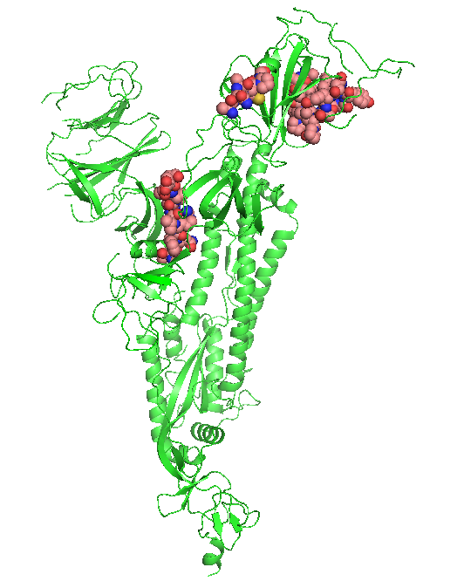
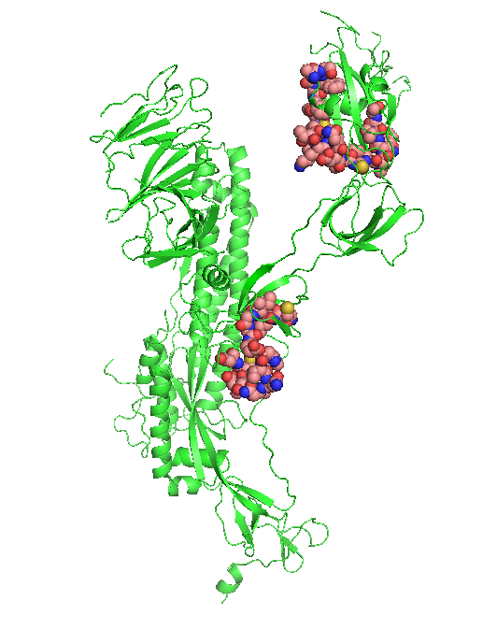
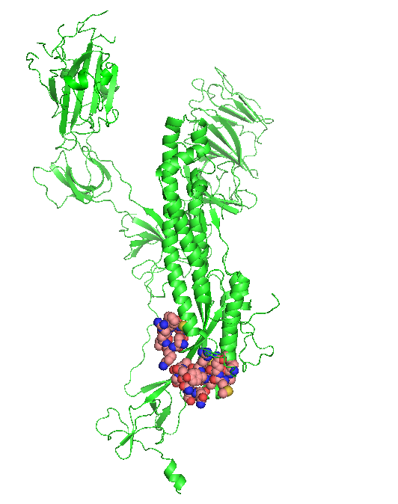
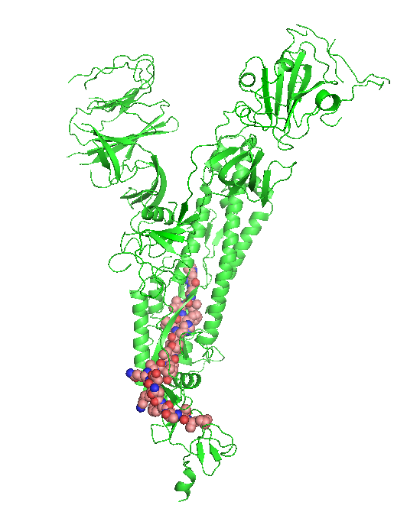
Spike₃₃₃₋₃₃₈
Spike₃₇₂₋₃₉₇
Spike₄₀₆₋₄₂₆
Spike₃₁₅₋₃₂₄
Spike₆₄₈₋₆₆₃
A
B
Spike₁₀₃₇₋₁₀₄₅
Spike₁₀₅₈₋₁₀₇₃
Spike₈₉₈₋₉₁₃
Spike₁₀₆₄₋₁₀₇₉
C
D
Supplementary Figure 2. Site of linear B-cell epitopes predicted in SARS-CoV2 spike protein monomer
B-cell epitopes predicted were highlighted in sphere with sequence information indicated. Colors of elements presented in the sphere of protein structure of spike monomer: carbon, tint; hydrogen, gray; nitrogen, blue; oxygen, red; sulfur, yellow

Slide 5
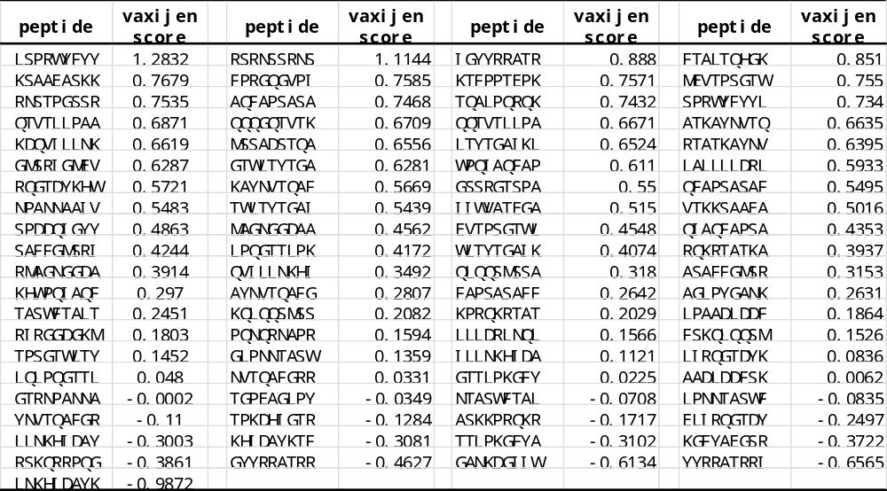
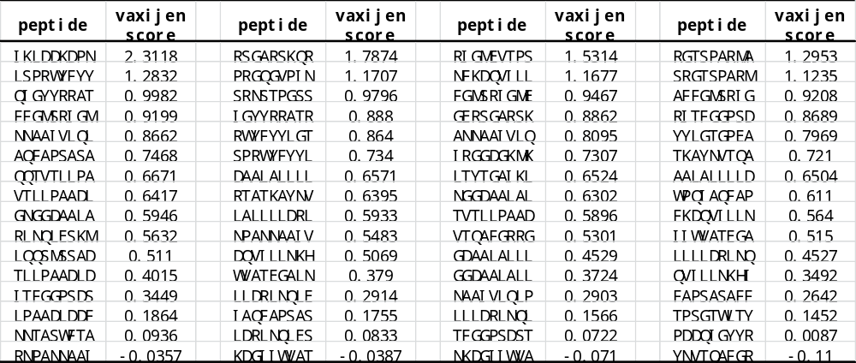
Supplementary Table 4. HLA class-I alleles binding epitopes on SARS-CoV-2 nucleocapsid protein predicted by IEDB server
Supplementary Table 5. HLA class-II alleles binding epitopes on SARS-CoV-2 nucleocapsid protein predicted by IEDB server

Slide 6
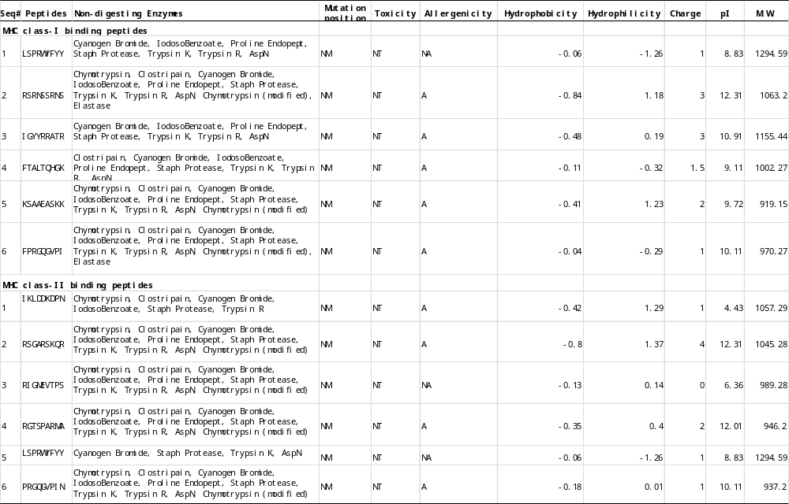
Supplementary Table 6 Digestion, mutation, toxicity, allergenicity, hydro and physiochemical profiling of selected peptides.

Slide 7
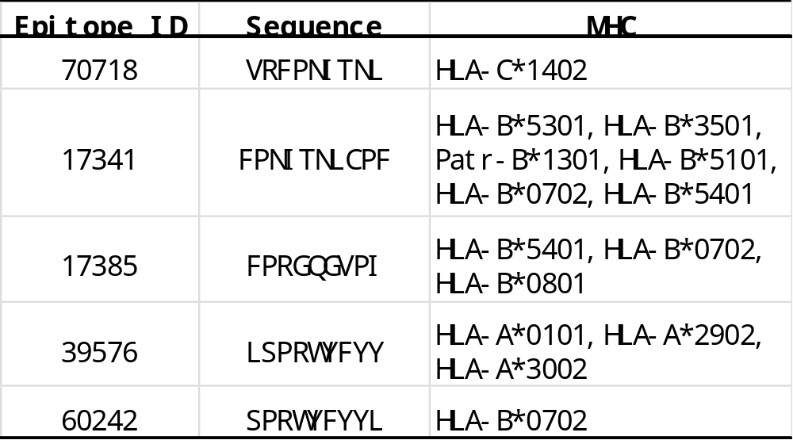
Supplementary Table 7. Experimentally verified epitopes contained in the vaccine construct.

