Slide 1
Supplementary Figure S1. Mean number +/- standard deviation of detections oobtained with Single Particle Tracking of fluorescent beads diffusing in aqueous solutions with different glycerol proportions.

Slide 2
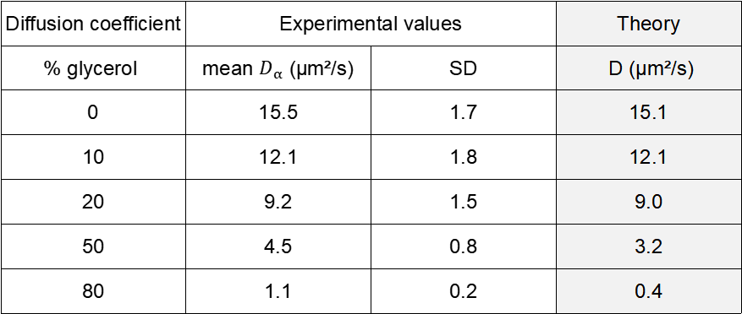
A
Anomaly coefficient | Experimental values |  | Theory
% glycerol | mean α | SD | α
0 | 0.96 | 0.01 | 1
10 | 0.94 | 0.02 | 1
20 | 0.97 | 0.02 | 1
50 | 1.02 | 0.02 | 1
80 | 0.7 | 0.02 | 1
B
Diffusion coefficient | Experimental values |  | Theory
% glycerol | mean $D_{α}$ (µm²/s) | SD | D (µm²/s)
0 | 15.5 | 1.7 | 15.1
10 | 12.1 | 1.8 | 12.1
20 | 9.2 | 1.5 | 9.0
50 | 4.5 | 0.8 | 3.2
80 | 1.1 | 0.2 | 0.4
SupplementaryTable S1. Comparison of experimental vs theoretical values of anomaly coefficients (A) and diffusion coefficients (B) computed from the ACF of FCS measurements performed with fluorescent beads diffusing in aqueous solutions with different glycerol proportions.

Slide 3
Supplementary Figure S2. Representation of subpopulations identified through the GMM (Gaussian Mixture Model) after mixing batches of trajectories obtained in different conditions, as detailed within the graphics legend.

Slide 4
A
 |  | Input | Calculated by H-MSD analysis
Mix 1 (m1) | D1 (µm²/s) | 4.0 | 3.76 (SD=0.65)
 | % pop 1 | 42% | 40%
 | D2 (µm²/s) | 0.1 | 0.09 (SD=0.02)
 | % pop 2 | 58% | 60%
Mix 2 (m2) | D1 (µm²/s) | 4.0 | 3.68 (SD=0.61)
 | % pop 1 | 75% | 73%
 | D2 (µm²/s) | 0.1 | 0.09 (SD=0.06)
 | % pop 2 | 25% | 27%
Mix 3 (m3) | D1 (µm²/s) | 4.0 | 3.76 (SD=0.63)
 | % pop 1 | 25% | 24%
 | D2 (µm²/s) | 0.1 | 0.09 (SD=0.04)
 | % pop 2 | 75% | 76%
B
 |  | Input | Calculated by H-MSD analysis
Mix 1 (m1) | D1 (µm²/s) | 0.9 | 0.88 (SD=0.07)
 | % pop 1 | 46% | 43%
 | D2(µm²/s) | 0.1 | 0.10 (SD=0.05)
 | % pop 2 | 54% | 57%
Mix 2 (m2) | D1 (µm²/s) | 0.9 | 0.84 (SD=0.06)
 | % pop 1 | 58% | 66%
 | D2 (µm²/s) | 0.1 | 0.11 (SD=0.04)
 | % pop 2 | 42% | 34%
Mix 3 (m3) | D1(µm²/s) | 0.9 | 0.90 (SD=0.07)
 | % pop 1 | 25% | 23%
 | D2 (µm²/s) | 0.1 | 0.10 (SD=0.04)
 | % pop 2 | 75% | 77%
C
 |  | Input | Calculated by H-MSD analysis
Mix 1 (m1) | D1 (µm²/s) | 4.0 | 3.95 (SD=0.93)
 | % pop 1 | 20% | 15%
 | D2 (µm²/s) | 0.9 | 0.81 (SD=0.04)
 | % pop 2 | 80% | 85%
Mix 2 (m2) | D1(µm²/s) | 4.0 | 4.01 (SD=0.45)
 | % pop 1 | 51% | 41%
 | D2(µm²/s) | 0.9 | 0.82 (SD=0.74)
 | % pop 2 | 49% | 59%
Mix 3 (m3) | D1(µm²/s) | 4.0 | 4.10 (SD=0.45)
 | % pop 1 | 78% | 67%
 | D2 (µm²/s) | 0.9 | 0.87 (SD=0.42)
 | % pop 2 | 22% | 33%
D
 |  | Input | Calculated by H-MSD analysis
Mix 1 (m1) | D1 (µm²/s) | 4.0 | 1 population detected D=3.5µm²/s (SD=0.7)
 | % pop 1 | 13%
 | D2 (µm²/s) | 3.8
 | % pop 2 | 87%
Mix 2 (m2) | D1 (µm²/s) | 4.0 | 1 population detected D=3.6µm²/s (SD=0.9)
 | % pop 1 | 46%
 | D2 (µm²/s) | 3.8
 | % pop 2 | 54%
Mix 3 (m3) | D1(µm²/s) | 4.0 | 1 population detected D=3.8µm²/s (SD=0.8)
 | % pop 1 | 75%
 | D2 (µm²/s) | 3.8
 | % pop 2 | 25%
Supplemental Table S2. Comparison of input values vs h-MSD computed values after mixing batches of trajectories obtained in different conditions.

Slide 5
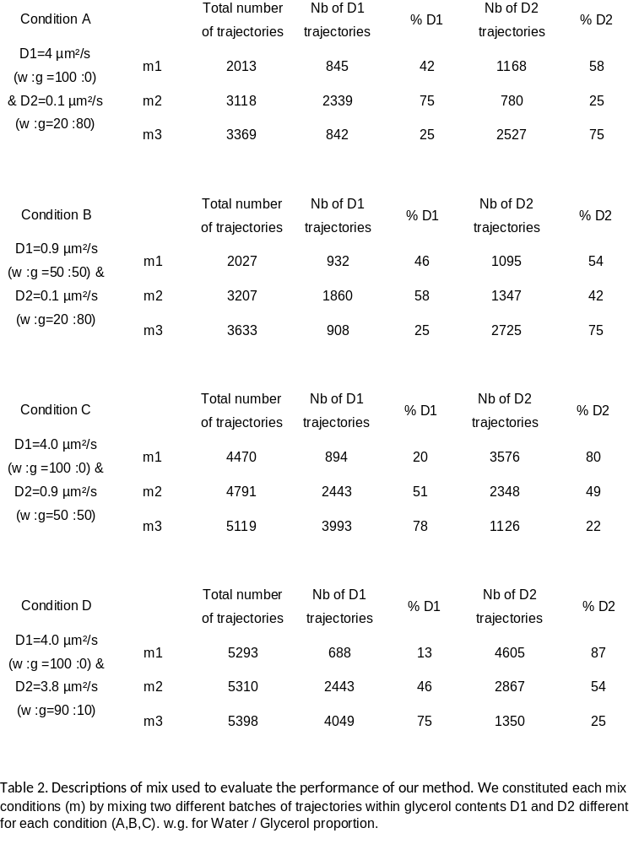
Supplementary Table S3. Descriptions of mix used to evaluate the performance of our method. We constituted each mix conditions (m) by mixing two different batches of trajectories within glycerol contents D1 and D2 different for each condition (A,B,C). w.g. for Water / Glycerol proportion.

Slide 6
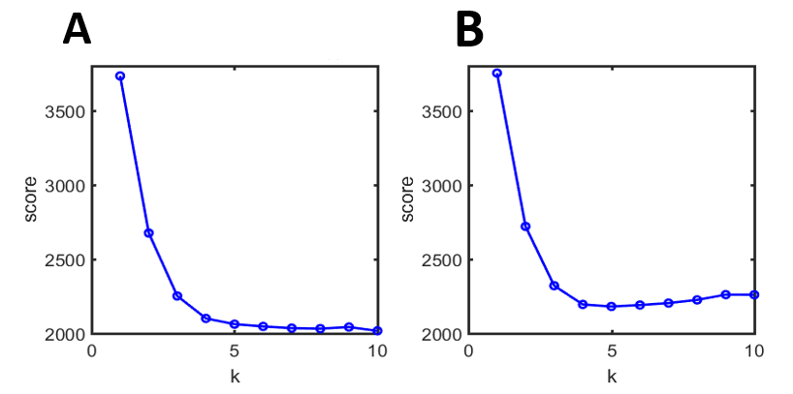
Supplementary Figure S3. AIC (Akaike Information Criteria) (panel A) and BIC (Bayesian Information Criteria) (panel B) scores corresponding to the n-population analysis of RPB1 SPT trajectories

Slide 7
FCS measurement of RPB1
SPT Measurement of RPB1 pop 1
SPT Measuremnt of RPB1 pop 2
anomalous coefficient α
Supplementary Figure S4. Diffusion parameters for RPB1 measured by FCS (red dots) and SPT (green dots and blue dots, respectively corresponding to the main and minority subpopulations detected) are gathered in this scatter plot.

