Slide 2
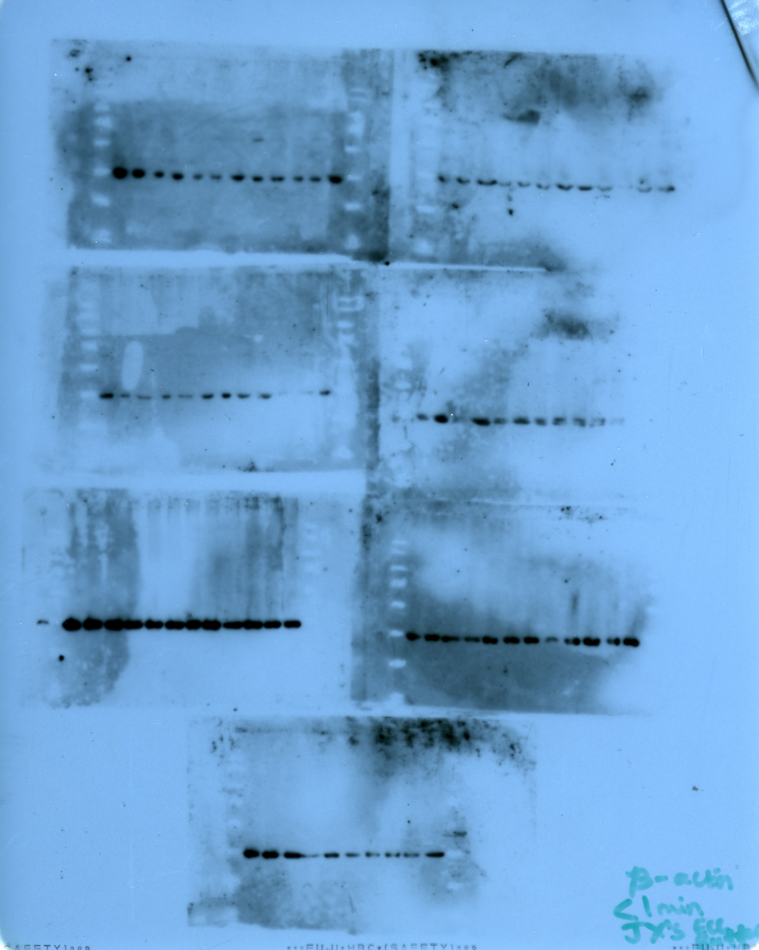
1C
H446
PARP
ß-actin

Slide 3
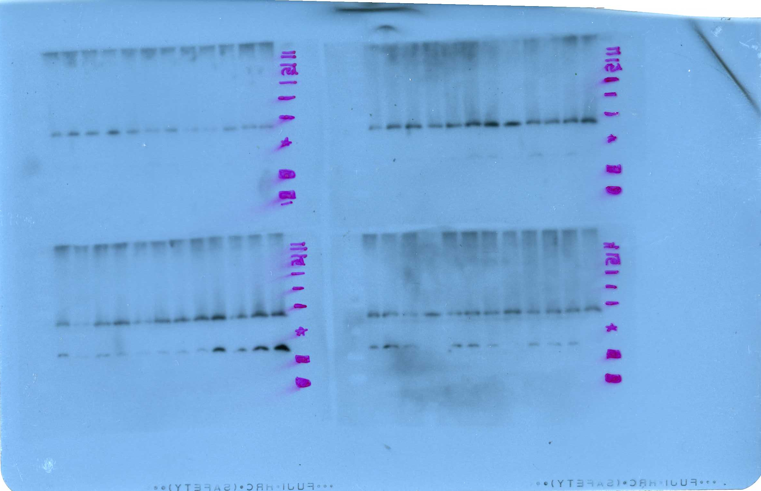
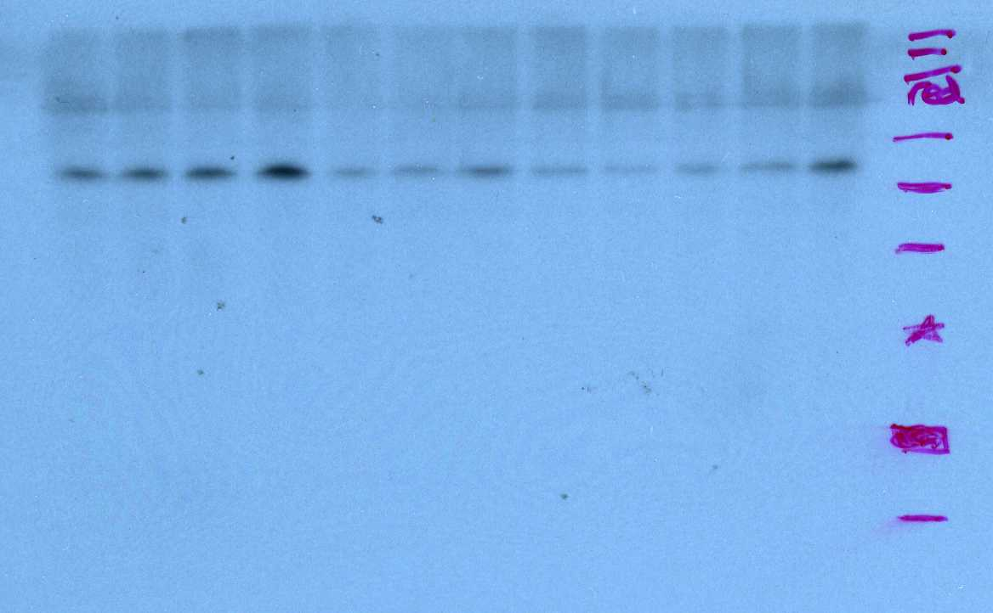
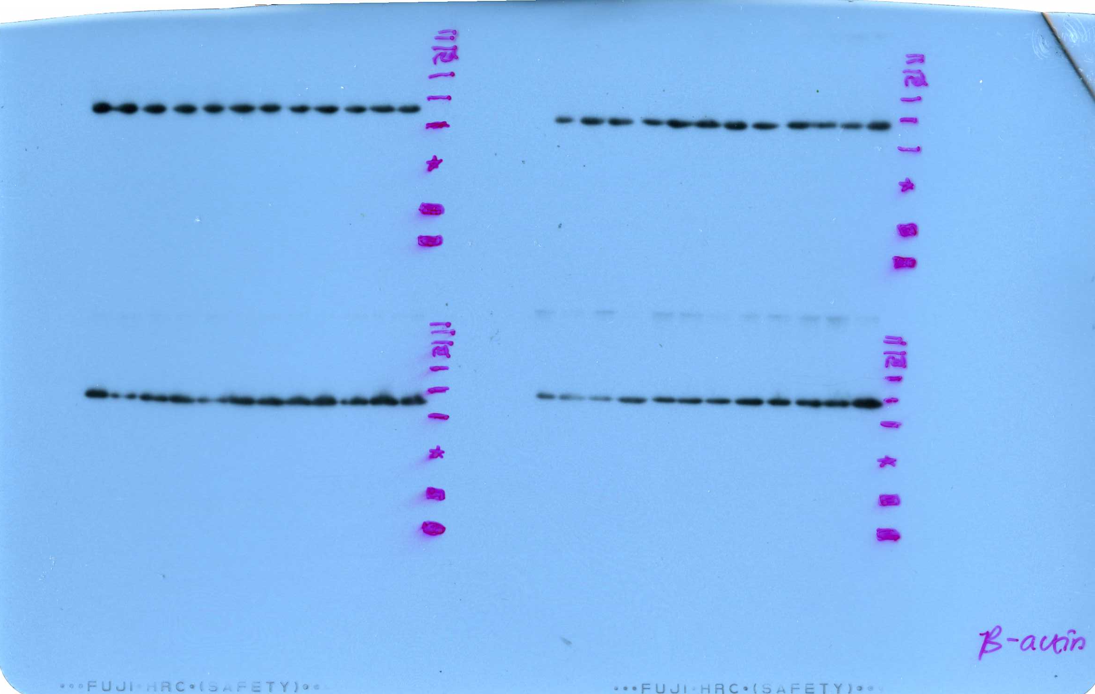
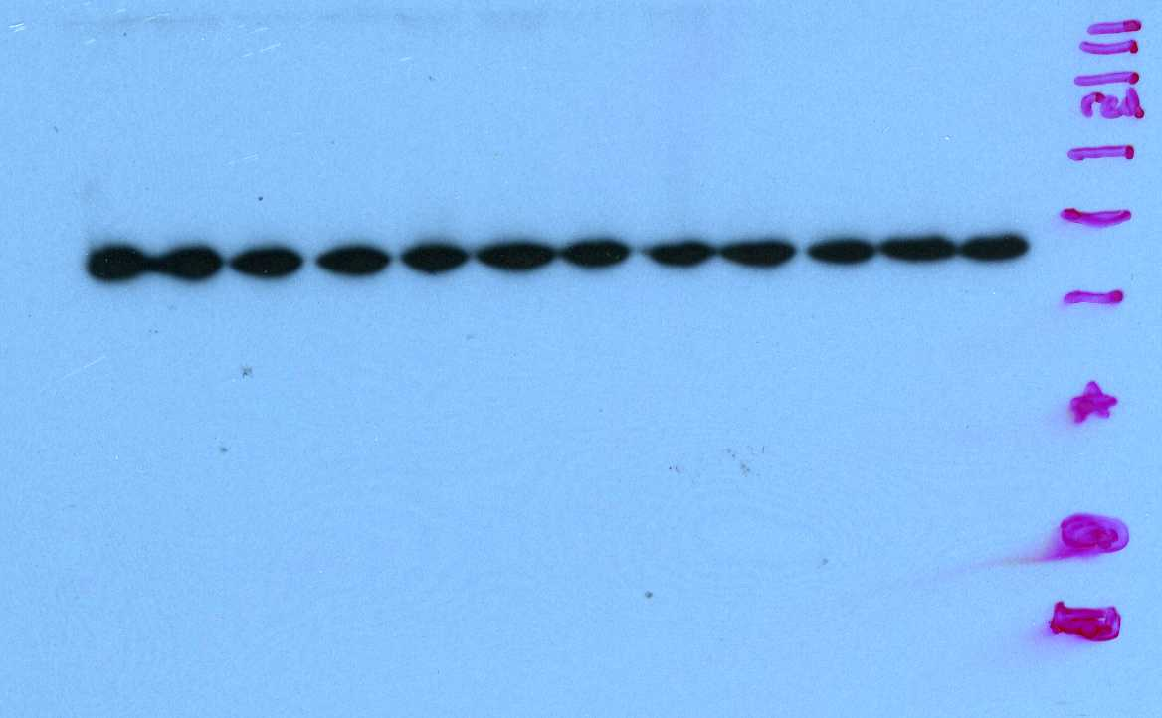
H69
2B
H841
Cyclin D3
Cyclin B1
ß-actin
ß-actin

Slide 4
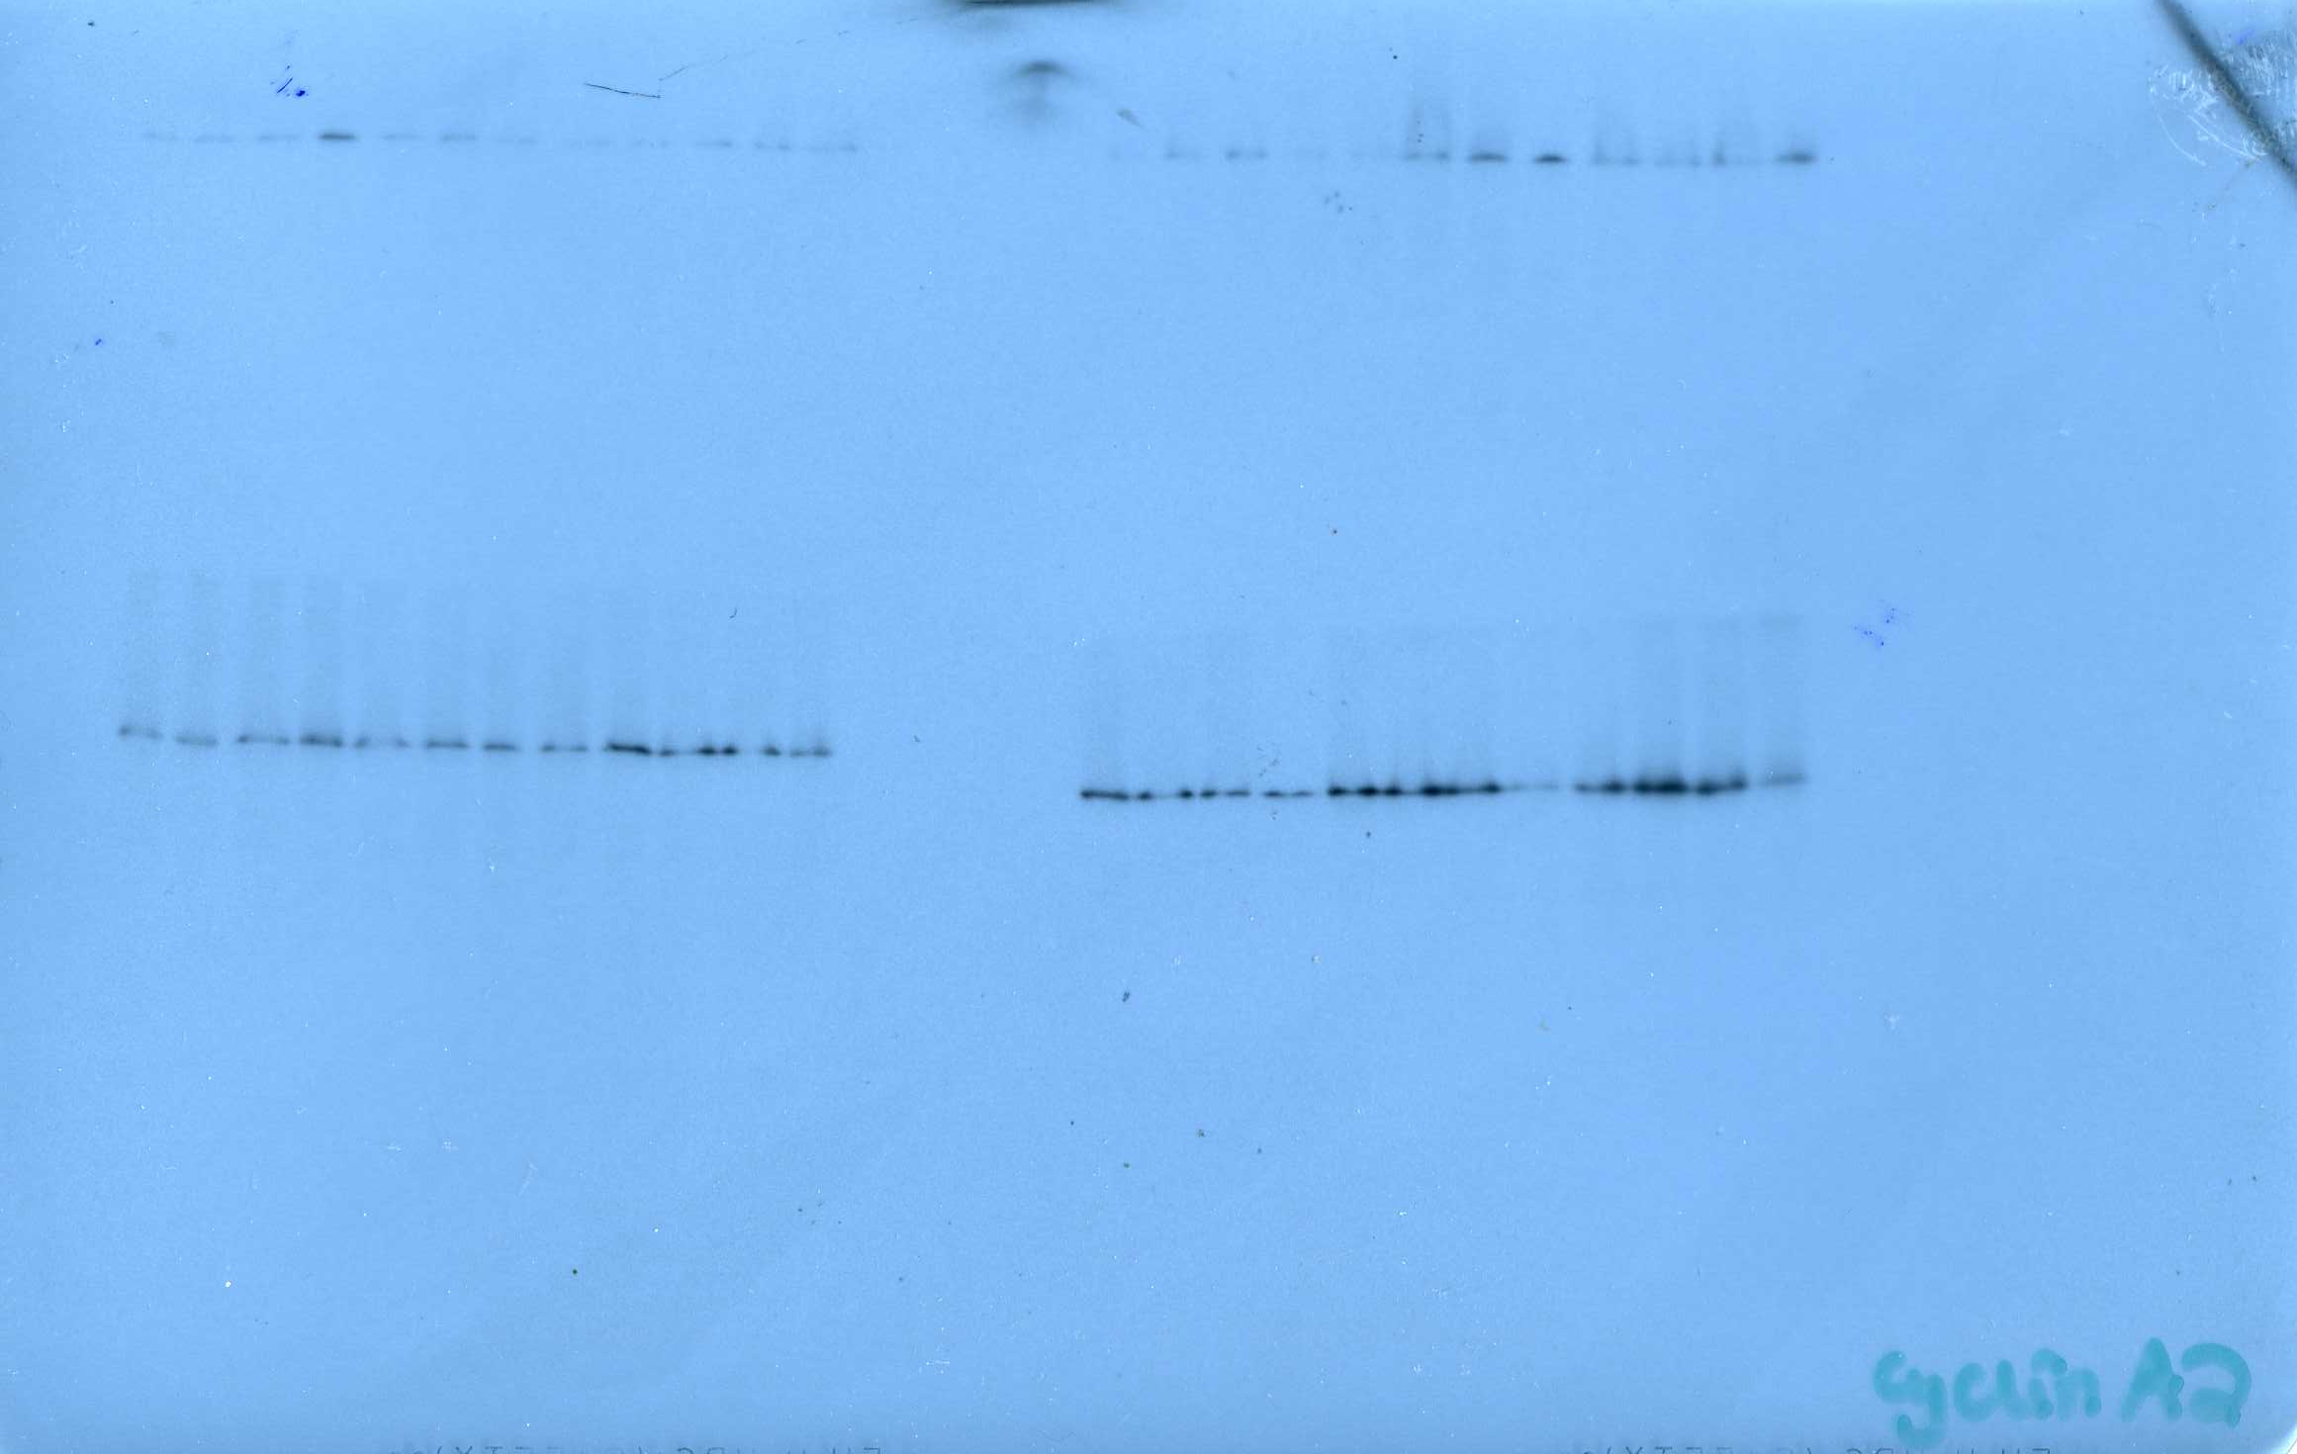
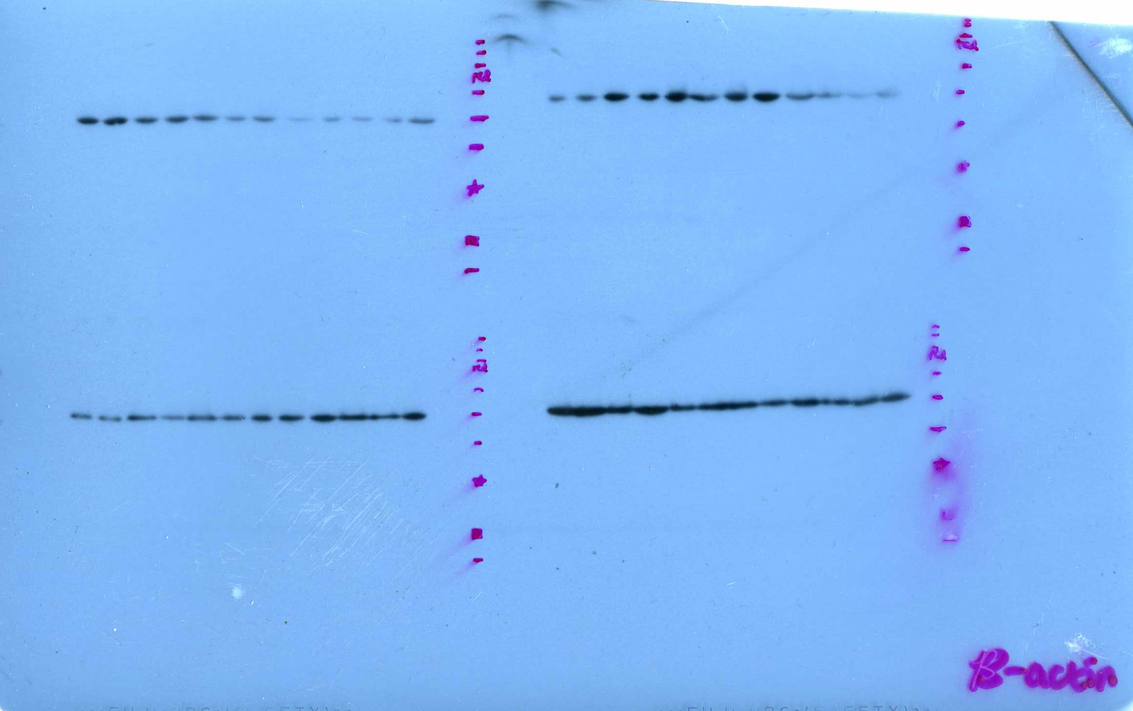
SW1271
SW1271
Cyclin A2
Cyclin D3
ß-actin
ß-actin

Slide 5
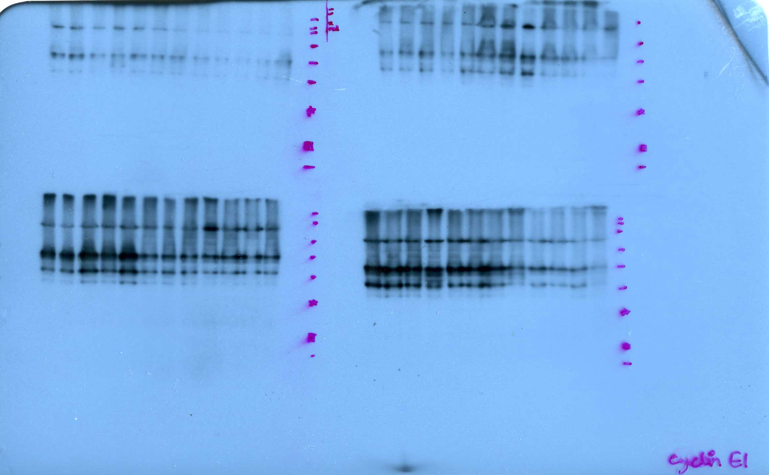
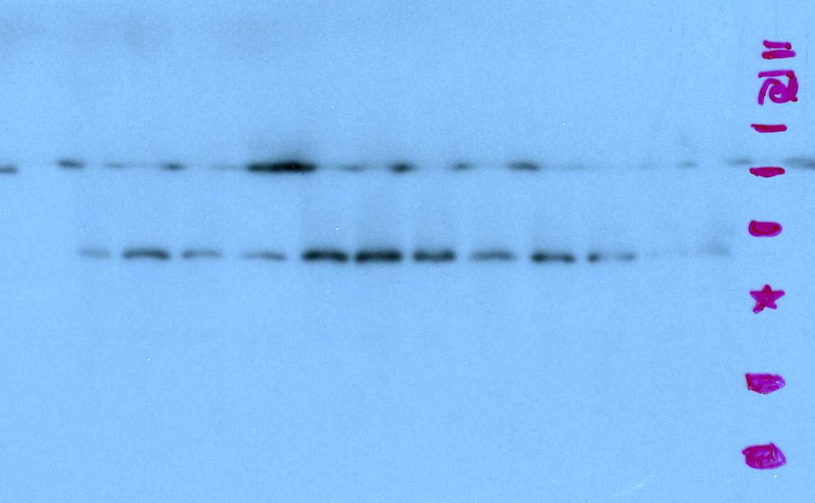
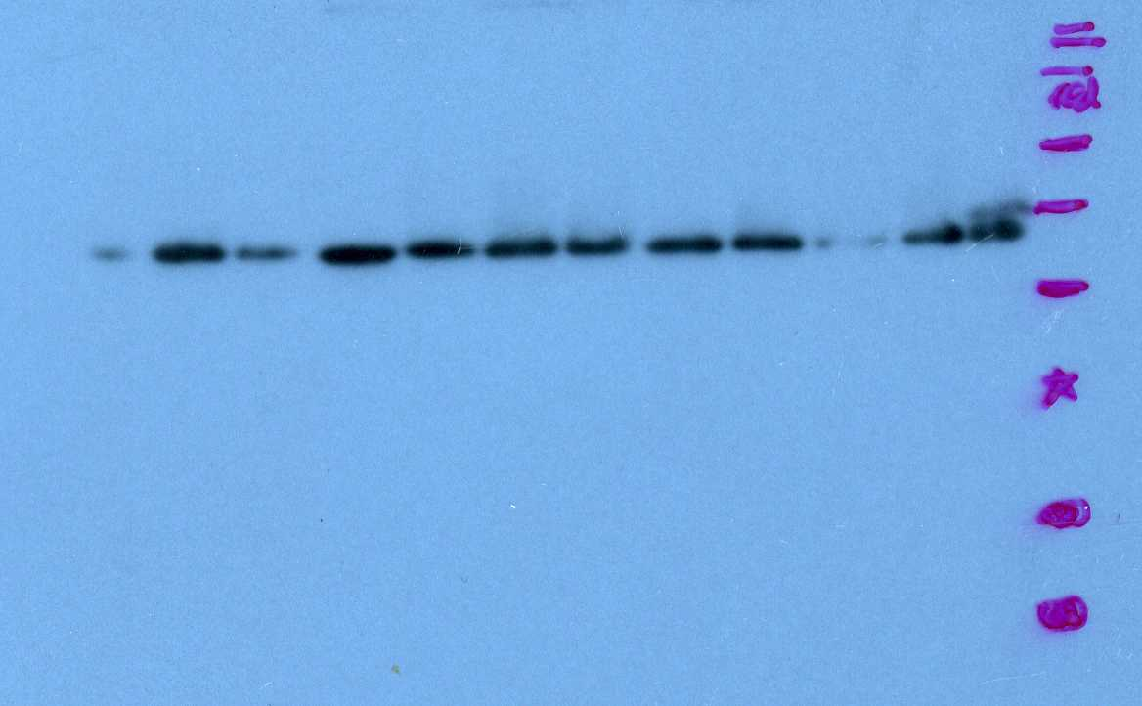
SW1271
SW1271
cdc2
Cyclin E1
ß-actin
ß-actin

Slide 6
3B
DMS79
Bcl-2
ß-actin

Slide 7
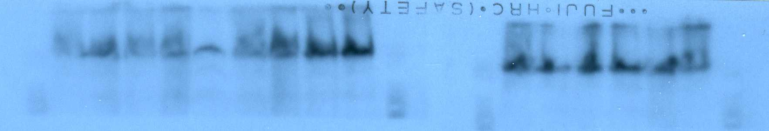
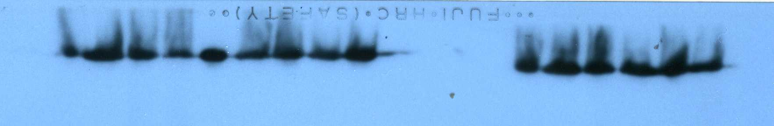
5D
H446 xenograft
PARP
ß-actin

