Slide 1
Supplementary Figures
Figure 1 : Model validation graph on test set (actual and predicted values) (a) for Zero Inflated Poisson (ZIP) and (b) for zero Inflated Poisson Mixed Models, (ZIPMM)
Figure 2: Anopheles gambiae females gonotrophic status per day of mosquito catch (a) in both VK3 and VK5 villages and (b) summary of catches over the study period
Figure 3: (a): normal ovary from the control VK5, 10X, 24 h post contact, (b): normal egg in development from the control VK5, 24h post contact at 20X, (c): impact of PPF on egg development from VK3 24h post exposure at 20 X

Slide 2
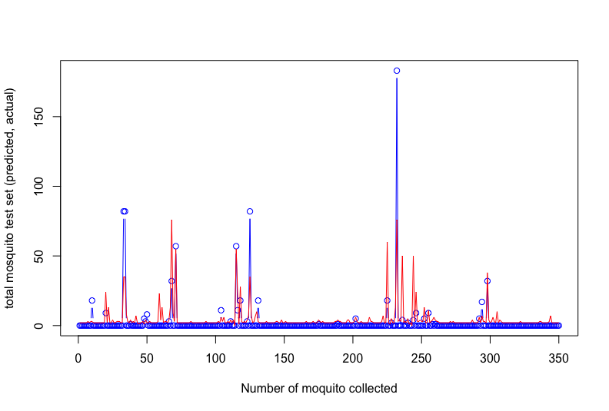
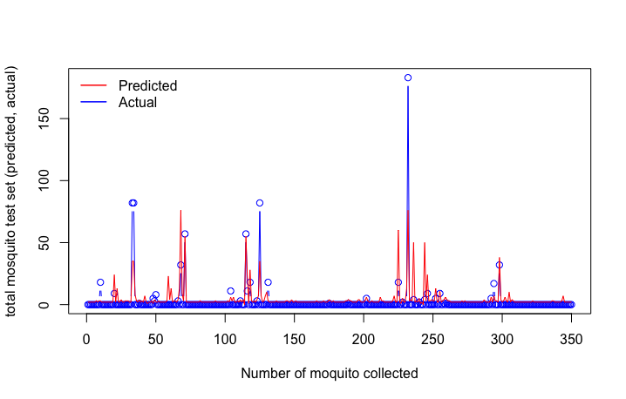
a
b
Figure 1 : Model validation graph on test set (actual and predicted values) (a) for Zero Inflated Poisson (ZIP) and (b) for zero Inflated Poisson Mixed Models, (ZIPMM)

Slide 3
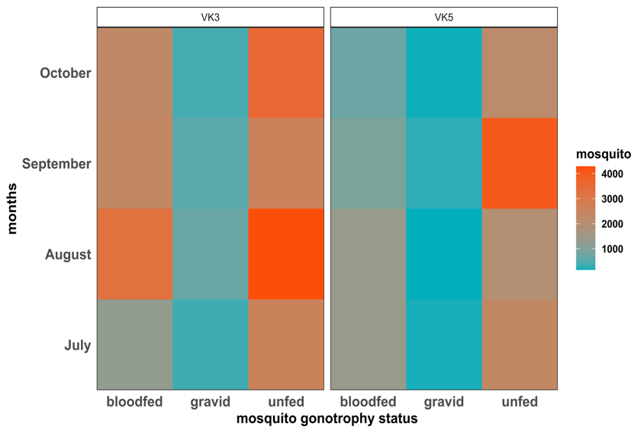
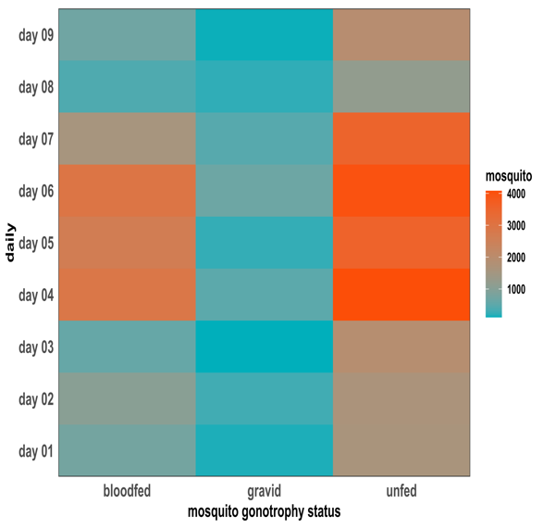
a
b
Figure 2: Anopheles gambiae females gonotrophic status per day of mosquito catch (a) in both VK3 and VK5 villages and (b) summary of catches over the study period

Slide 4
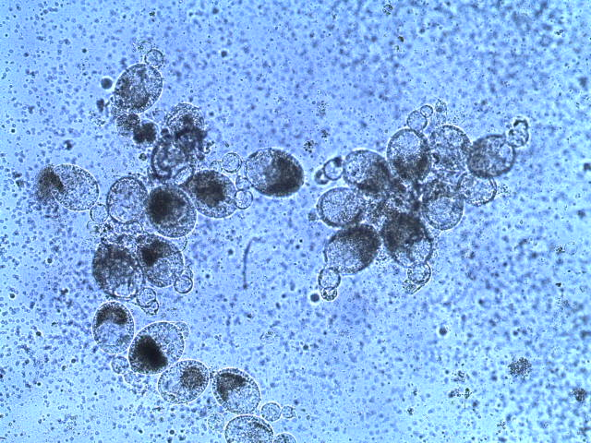
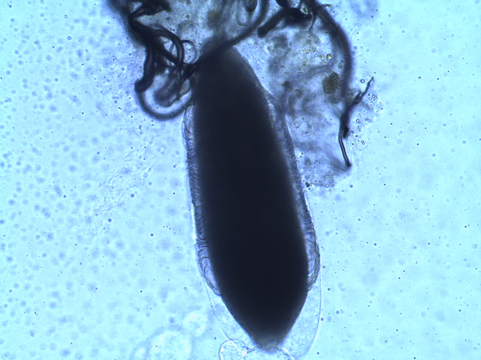
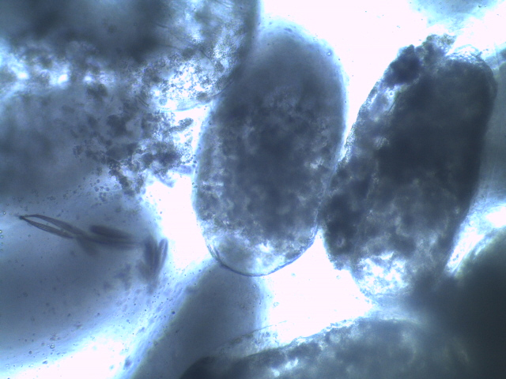
(a)
(b)
(c)
Figure 1: (a): normal ovary from the control VK5, 10X, 24 h post contact, (b): normal egg in development from the control VK5, 24h post contact at 20X, (c): impact of PPF on egg development from VK3 24h post exposure at 20 X

