Slide 1
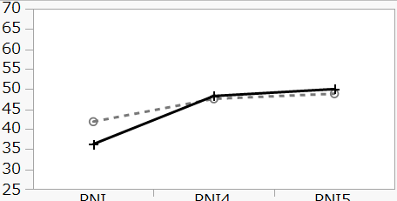
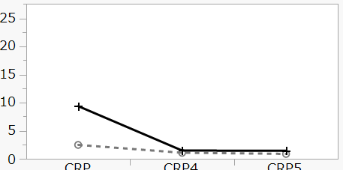
Supplementary Figure 1
PNI
CRP
Without NAFLD
With NAFLD
With NAFLD
Without NAFLD
At the time of CT scan
After 6 months
One year later
At the time of CT scan
After 6 months
One year later
P<0.05
P<0.005
(a)
(b)

Slide 2
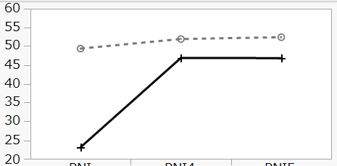
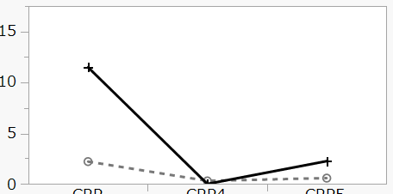
Supplementary Figure 2
PNI
CRP
Without NAFLD
With NAFLD
With NAFLD
Without NAFLD
At the time of CT scan
After 6 months
One year later
At the time of CT scan
After 6 months
One year later
P=0.0847
P＝0.0824
(a)
(b)

