Slide 1
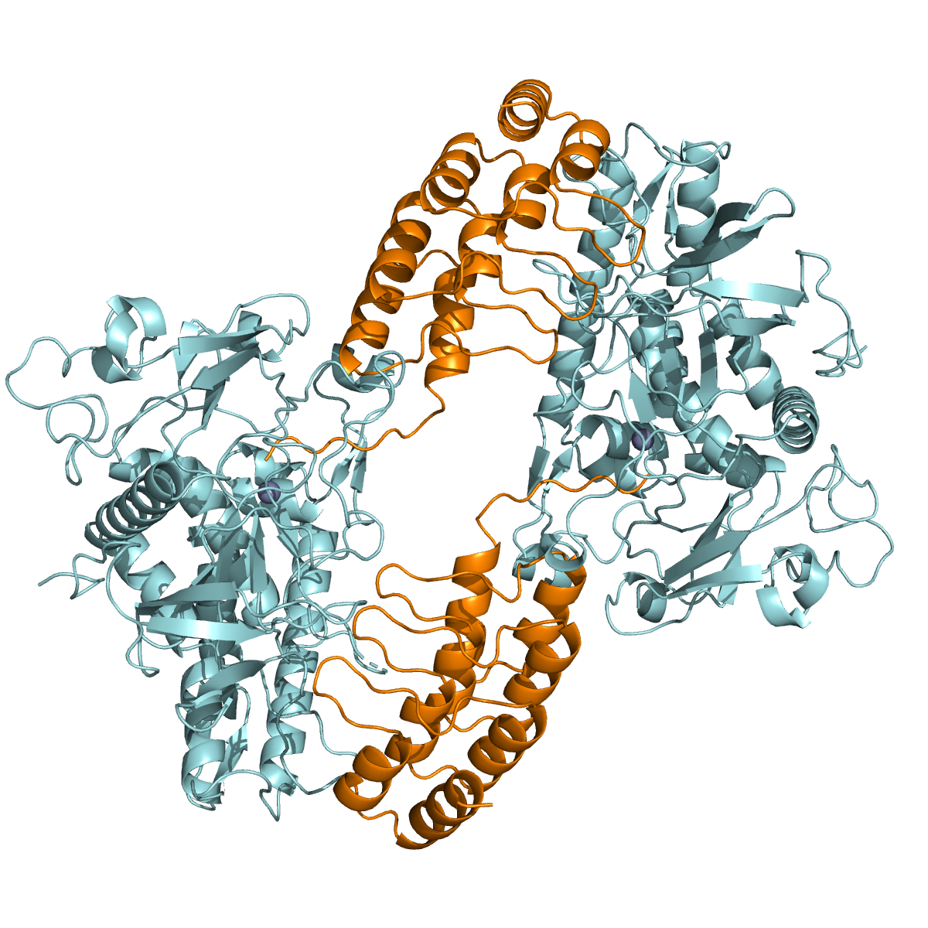
Chain D
Chain B
Chain A
Zn²⁺
Chain C
Zn²⁺
Supplementary Figure S1. Crystal structure of the LC/A1-DARPin18 complex. (a) Cartoon representation of the four polypeptide chains in the asymmetric unit. (PDB code 8HKH). LC/A1 is shown in cyan (chain A and B) and DARPin18 (chain C and D) in orange. The zinc ion is shown as grey sphere.

Slide 2
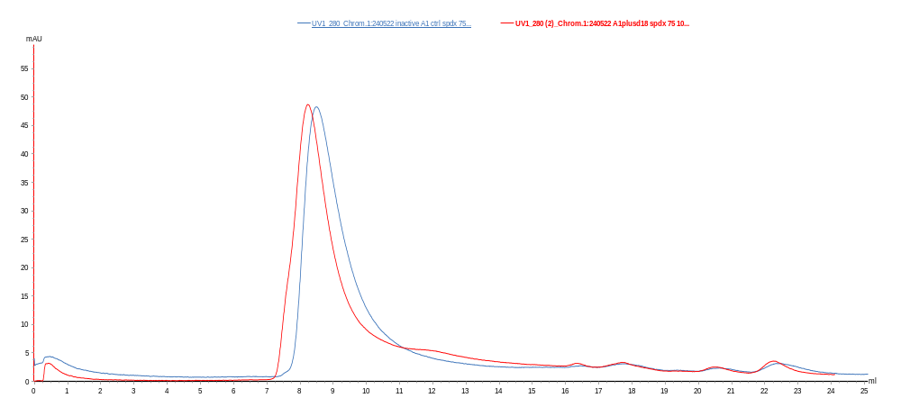
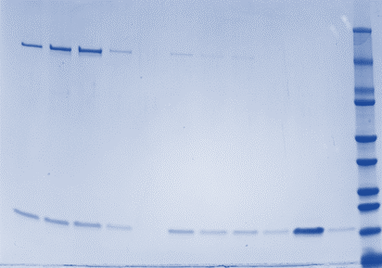
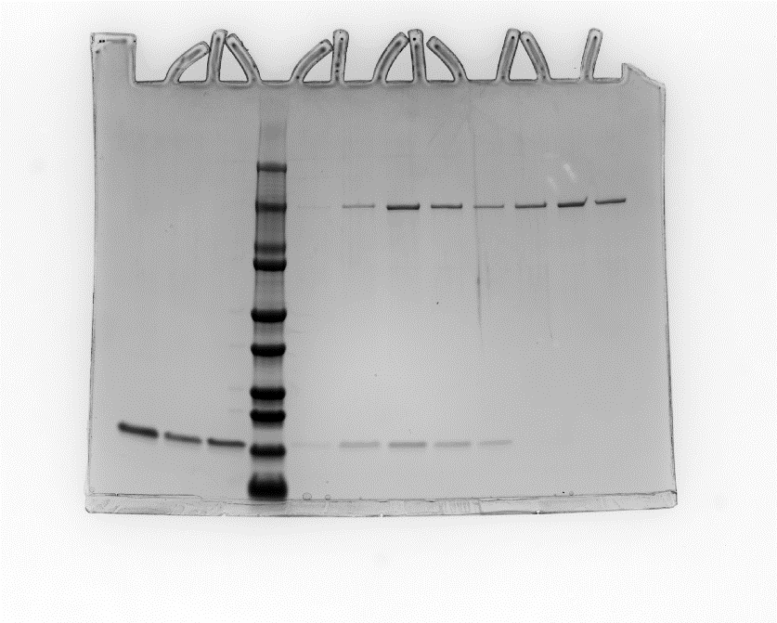
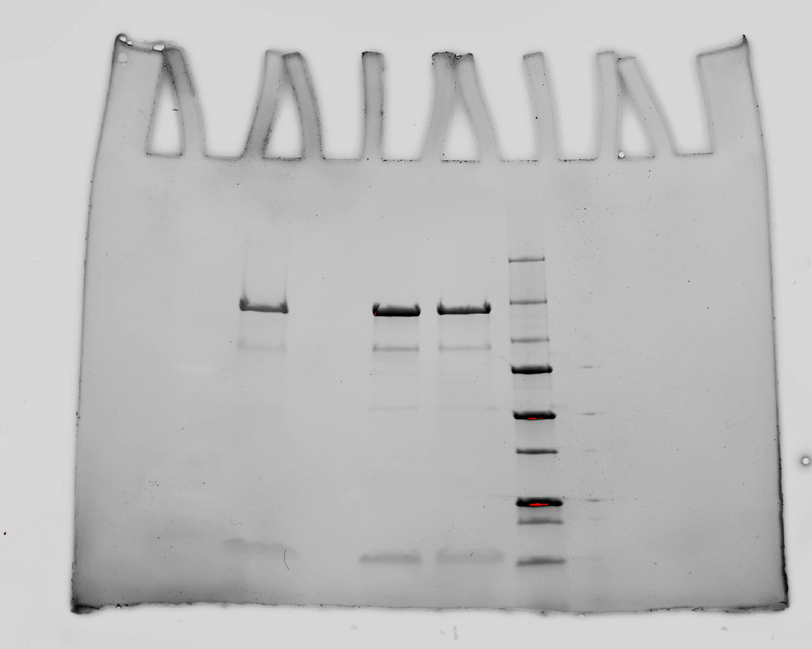
DARPin-F5-
BoNT/A1
DARPin-F5-
BoNT/A1 at pH 5.2
BoNT/A1
Abs 280 nm (a.u.)
Elution volume (ml)
Supplementary Figure S2. Size exclusion chromatography (SEC) and SDS-PAGE analysis of DARPin-F5-BoNT/A1 complex. BoNT/A1 (blue trace), DARPin-F5-BoNT/A1 (red trace). SEC analysis was performed with a Superdex 75 10/300 column (GE Healthcare) in 20 mM Tris-HCl pH 7.4, 100 mM NaCl (or in 20 mM Sodium Acetate pH 5.2, 100 mM NaCl) and fractions from respective peaks were analyzed on a gradient SDS-PAGE gel (BioRad). Left side gel fraction from peak complex DARPin-F5-BoNT/A1 at pH 7.4, middle gel BoNT/A1 alone, right side gel fraction from peak complex DARPin-F5-BoNT/A1 at pH 5.2.

Slide 3
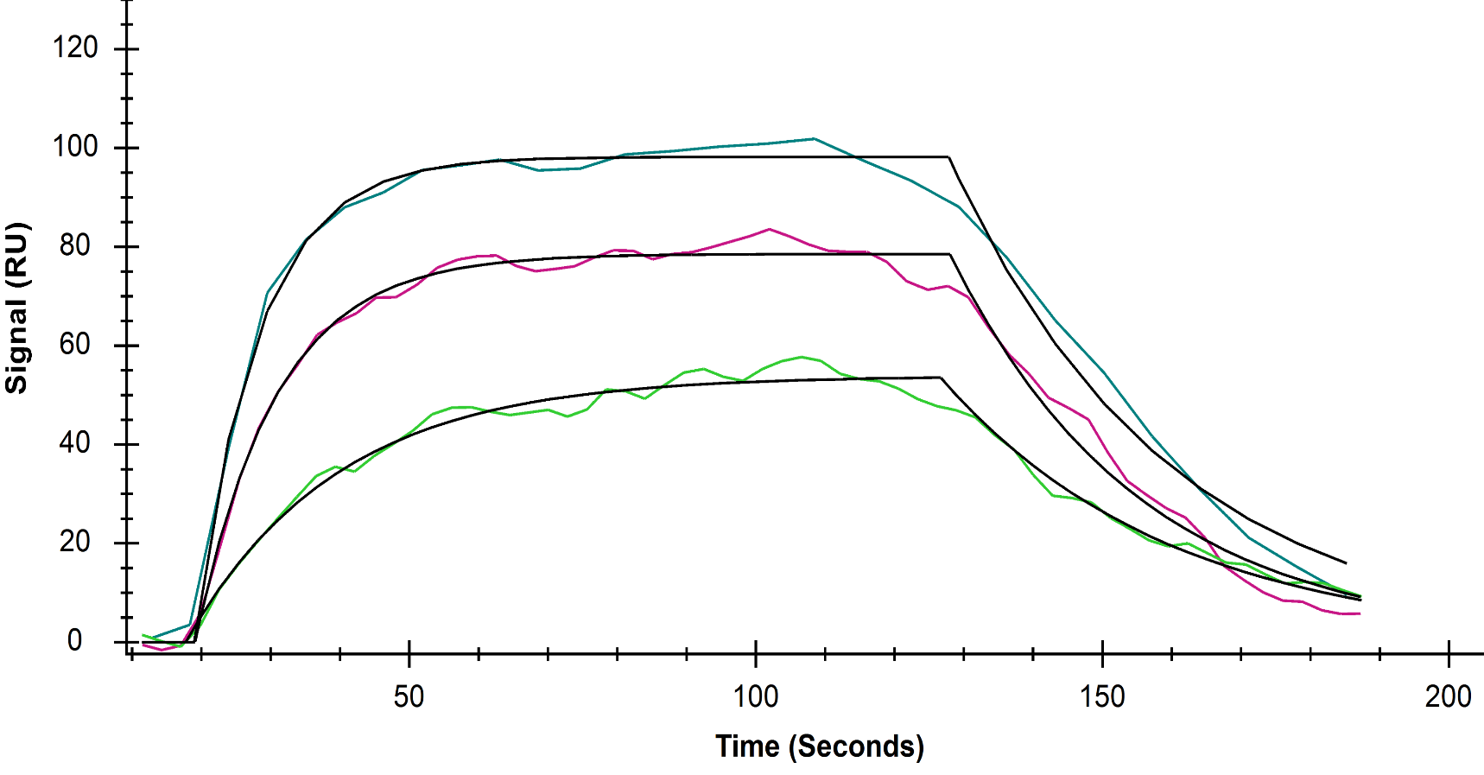
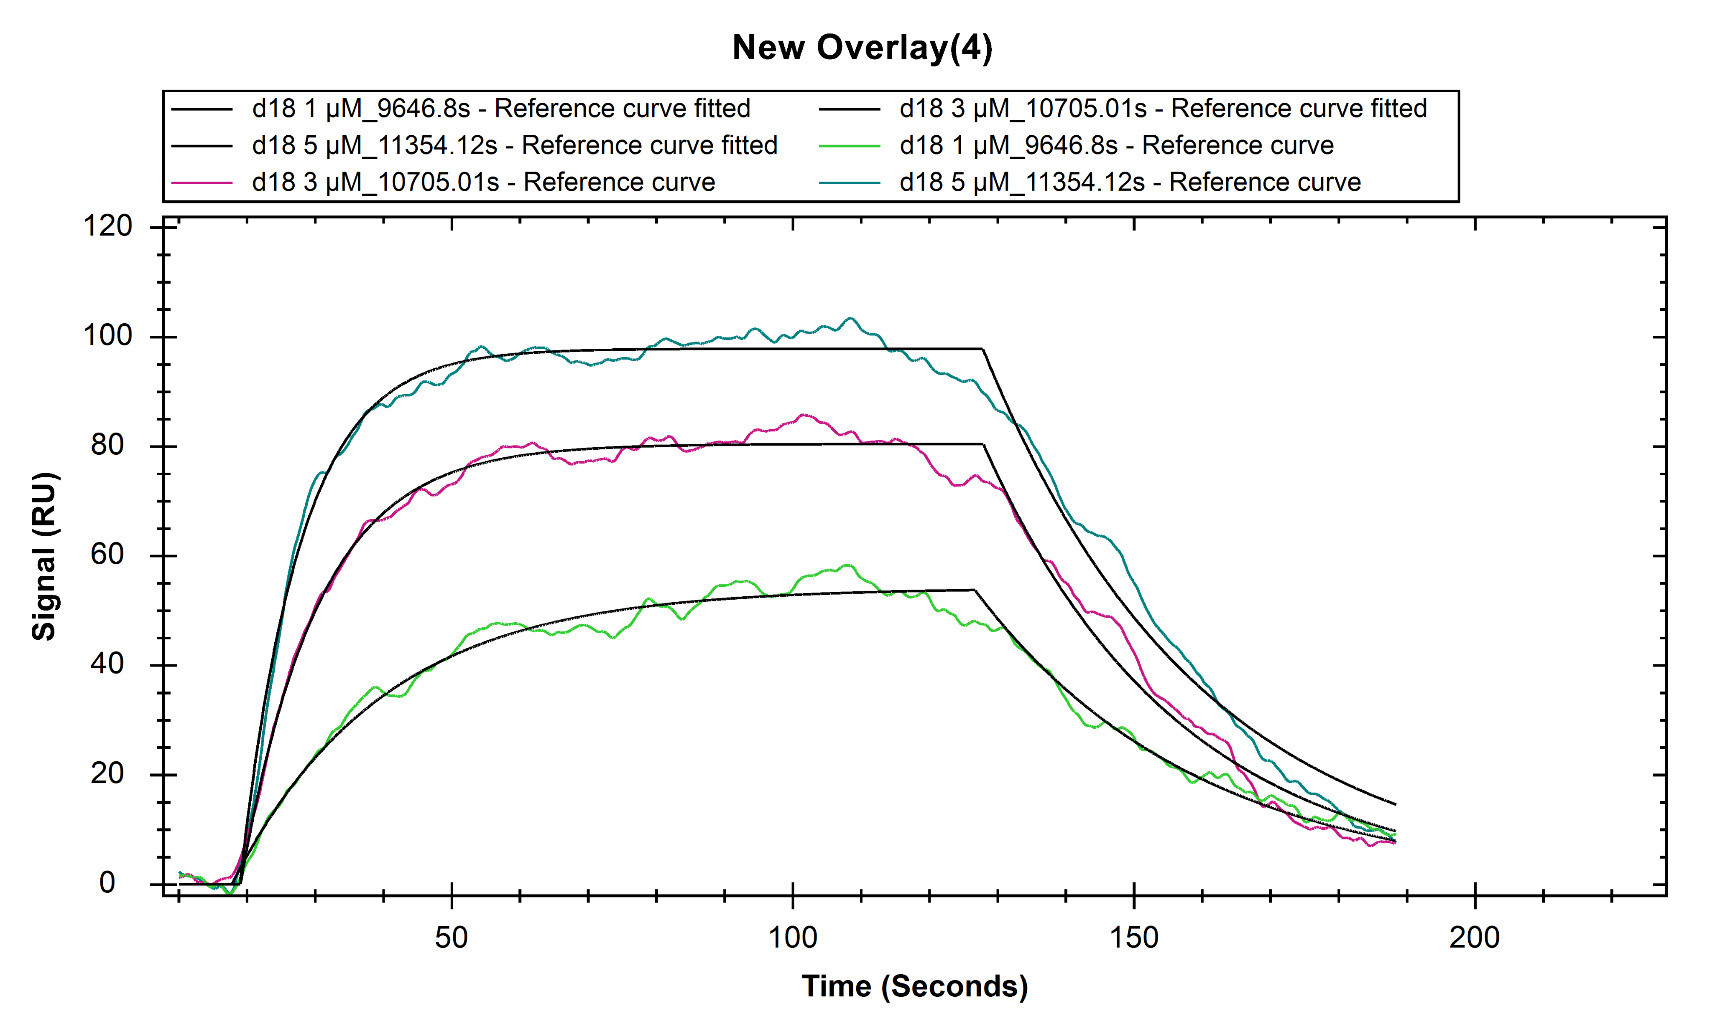

Supplementary Figure S3. Binding affinity and kinetic parameters of the interaction of DARPin18 with LC/A3.
SPR analysis of DARPin-F5 binding to the LC/A3, performed on the Nicoya OpenSPR™; overlaid with a fit of 1:1 binding model (black line). Increasing DARPin-F5 concentrations ranging from 1 to 5 µM were applied. The Kd value of 1.68 ± 0.58 µM value was calculated from the raw data using the TraceDrawer Software (Ridgeview Instruments AB)

Slide 4
Data collection
Resolution range (Å) | 49.19 - 2.55 (2.62 - 2.55)
Space group | P1
Polypeptide chains/AU | 4
Unit cell parameters
a, b, c (Å) | 59.56, 59.63, 102.18
α, β, γ (°) | 74.976 89.904 73.154
Observed reflections | 147652 (10839)
Unique reflections | 39460 (2962)
Multiplicity | 3.7 (3.8)
Completeness (%) | 93.4 (94.2)
Mean I/sigma(I) | 4.49 (1.17)
CC(1/2) | 0.976 (0.452)
Wilson B-factor | 47.03
Refinement
Resolution range (Å) | 49.19 - 2.7 (2.797 - 2.7)
R_{work} (%) | 26.99
R_{free} (%) | 30.77
Protein atoms | 8840
rmsd of bond lengths | 0.003
rmsd of bond angles | 0.555
Average B-factor (Å²) | 47.91
Ramachandran plot (%)
Favored | 97.27
Allowed | 2.73
Outliers | 0
Crystallization condition | 0.1 M HEPES pH 7.5 28 % w/v Jeffamine ED-2003
Supplementary Table S1. Values in parentheses refer to the outermost resolution shell.

Slide 5
Residue (LC/A1 chain A) | Distance (Å) | Residue (DARPin-F5 chain C)
Glu 171 [O] | 3.5 | Arg 25 [NE]
Glu 171 [OE1] | 3.2 | Tyr 50 [OH]
Glu 171 [OE2] | 2.5 | Lys 91 [NZ]
Lys 128 [NZ] | 2.9 | Asp 124 [O]
Asp 131 [OD1] | 3.2 | Trp 113 [NE1]
Asp 131 [OD1] | 3.4 | Arg 116 [NH1]
Supplementary Table S2. Table summarizing interacting residues of the interface between chain A and chain C.

Slide 6
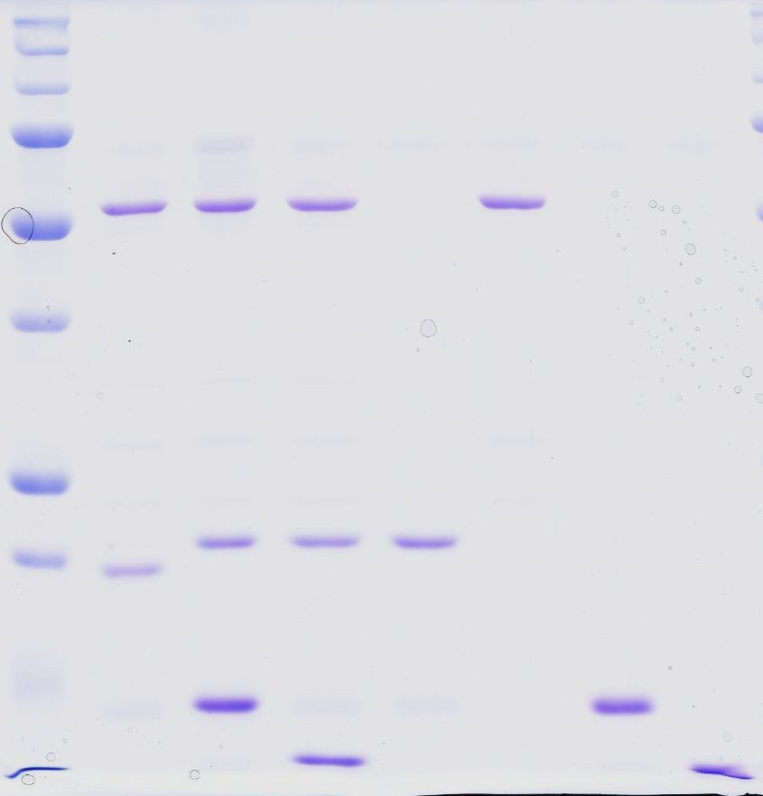
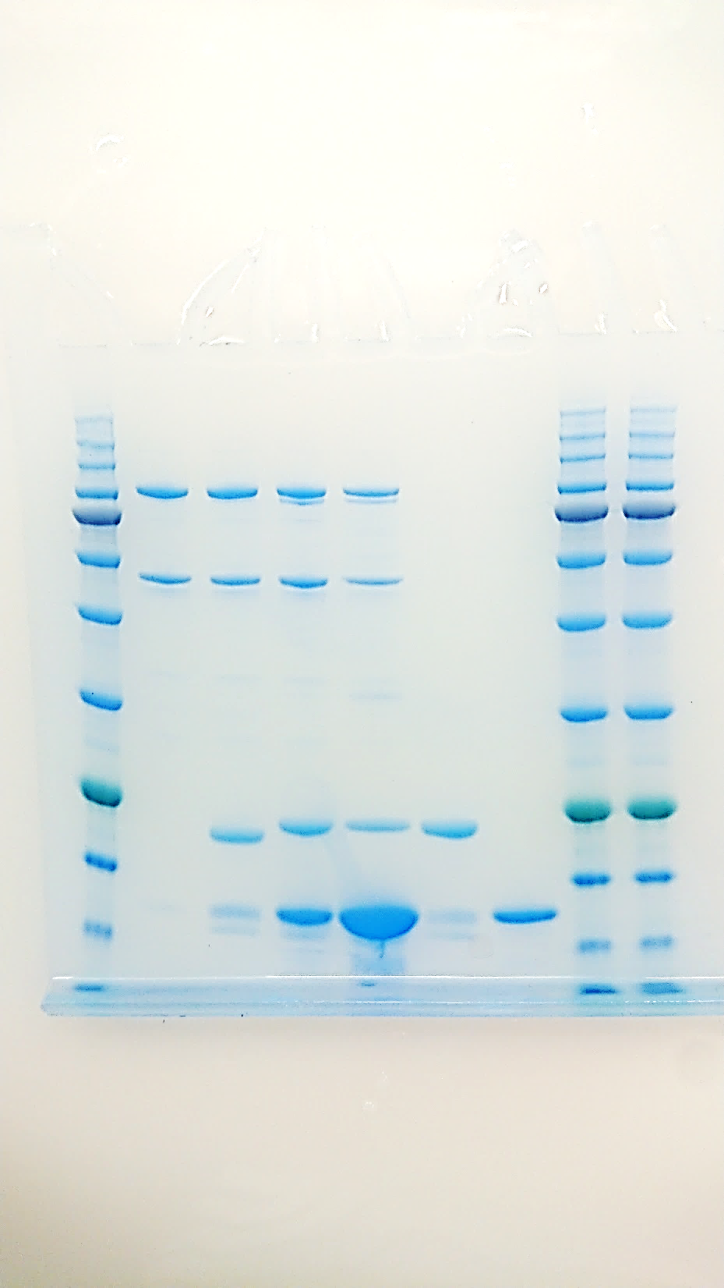
Uncropped Gels Figure 1
(a)
(b)
LC/A1
Trx-SNAP25
DARPin-F5
DARPin-H10
+ - - - | + + + - | + + - + | - + - - | + - - - | - - + - | - - - +
BoNT/A1
Trx-SNAP25
DARPin-F5
+ - - | + + - | + + + | + + + | - + -
kDa
kDa
125 -
HC/A1
93 -
LC/A1
72 -
50 -
57 -
42 -
LC/A1
37 -
31 -
25 -
20 -
Trx-SNAP25
Cleaved Trx-SNAP25
24 -
Trx-SNAP25
Cleaved Trx-SNAP25
18 -
15 -
DARPin-F5
15 -
DARPin-F5
DARPin-H10

Slide 7
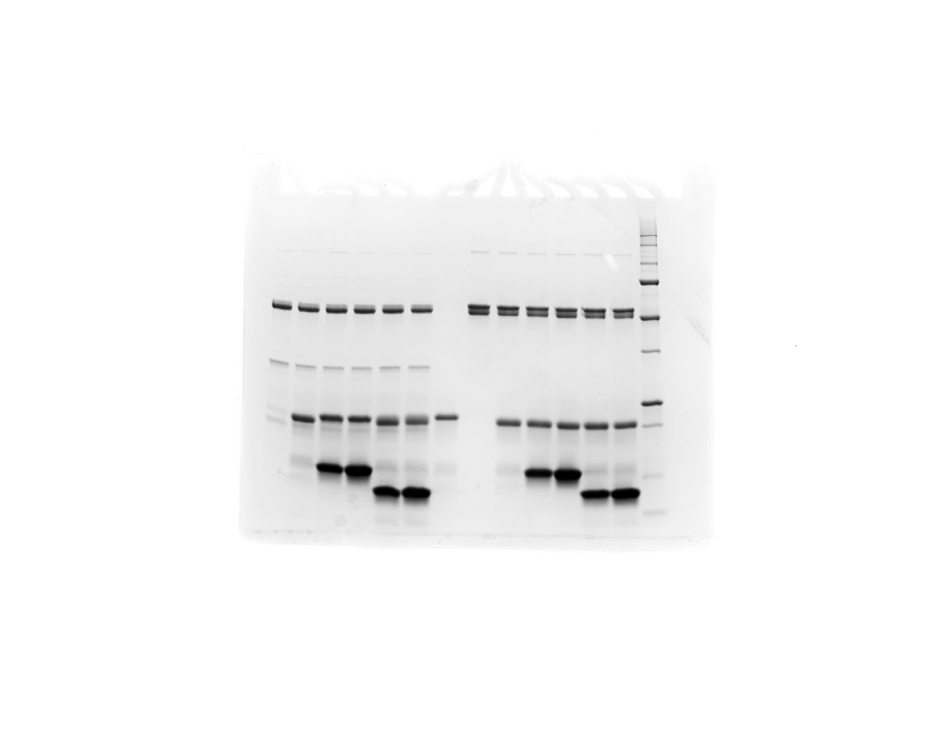
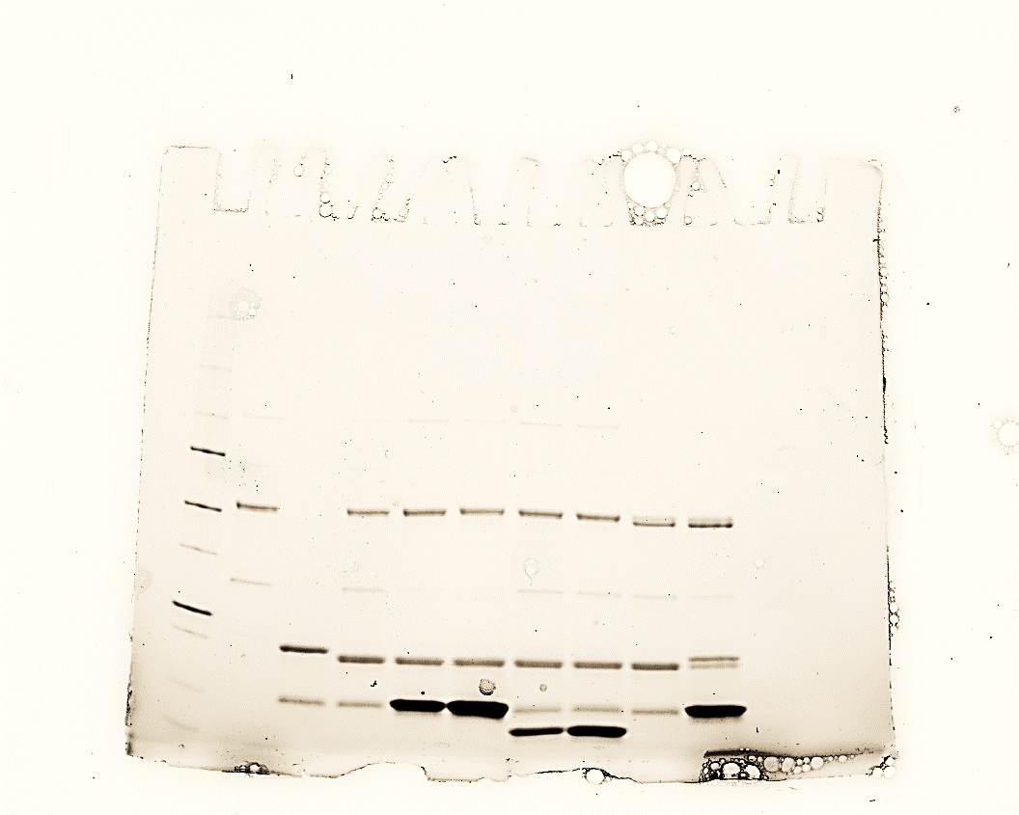
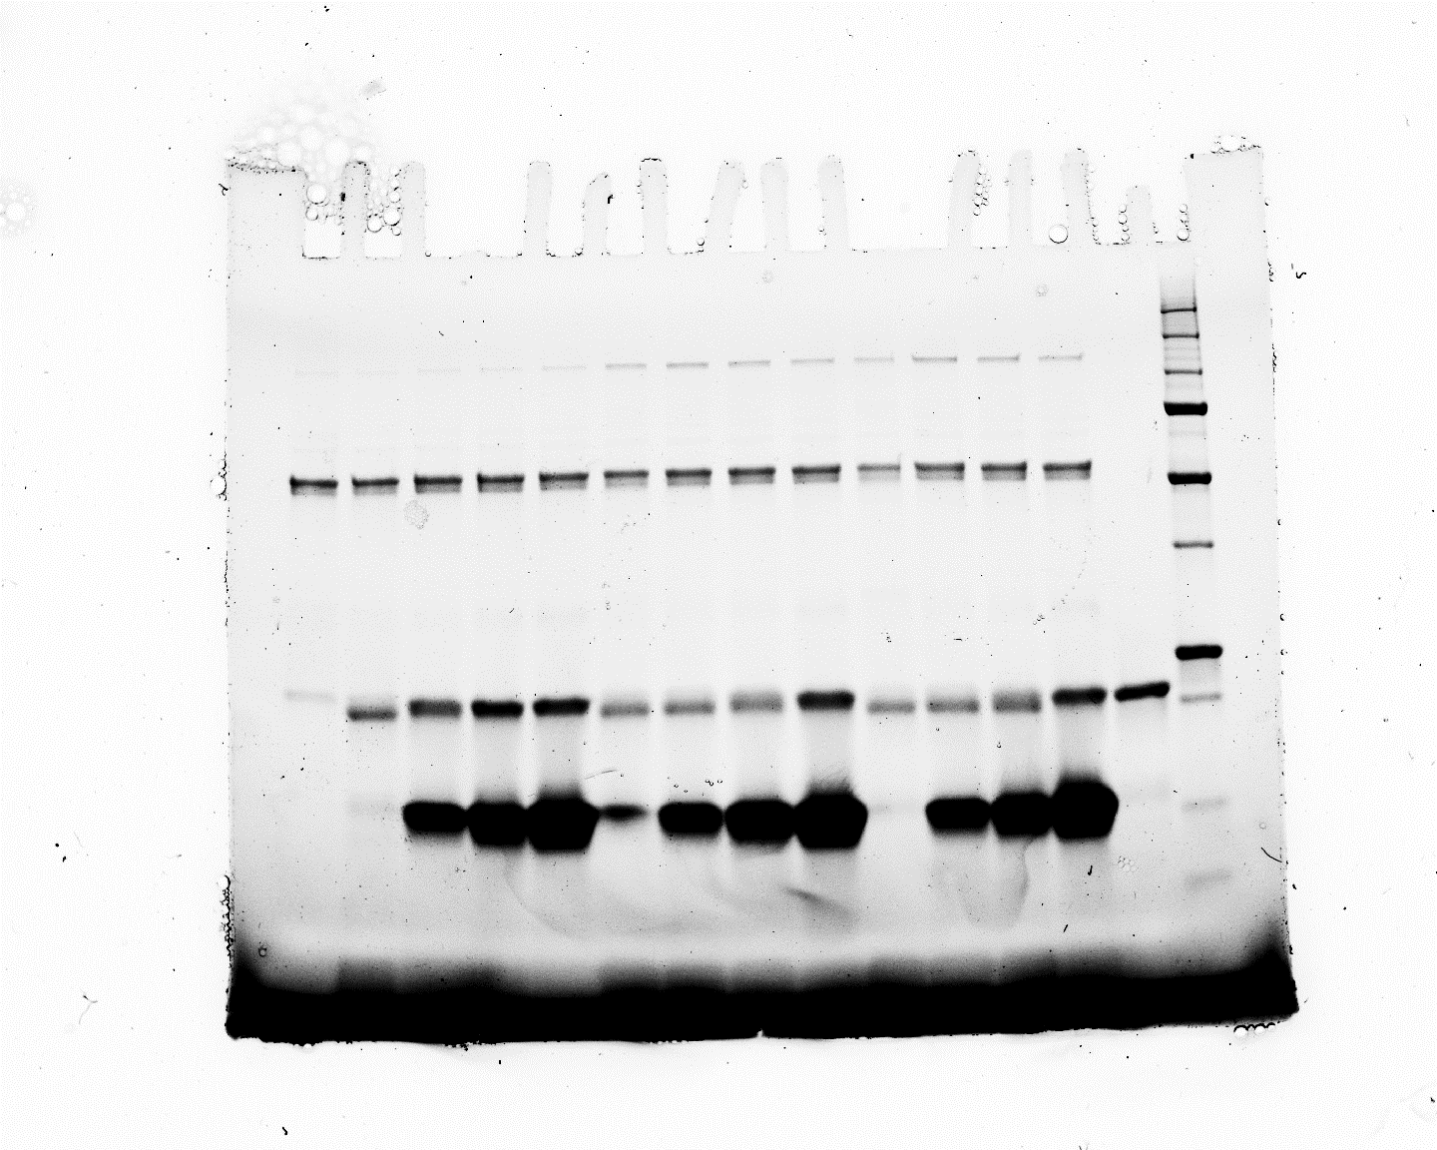
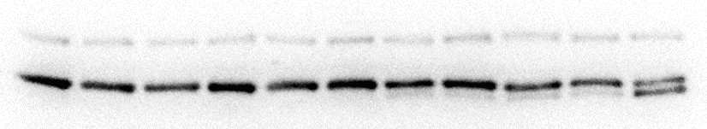
Uncropped Gels Figure 3c
LC/A1-448
LC/A3-444
LC/A1-448 E171D
LC/A3-448 D171E
Trx-SNAP-25
DARPin-F5
DARPin-H10
+ - - | + + - | + + - | + - + | + - + | + - -
+ - - | + + - | + + - | + - + | + - +
+ - - | + - - | + + - | + + - | + - + | + - +
- - - | + - - | + + - | + + + | + + +
kDa
50 -
37 -
25 -
20 -
15 -
10 -
Supplementary Western Blot Figure 5b
NC 2,5 2,5 5 5 10 10 15 15 60 60
SYNTAXIN
SMI81

