Slide 1
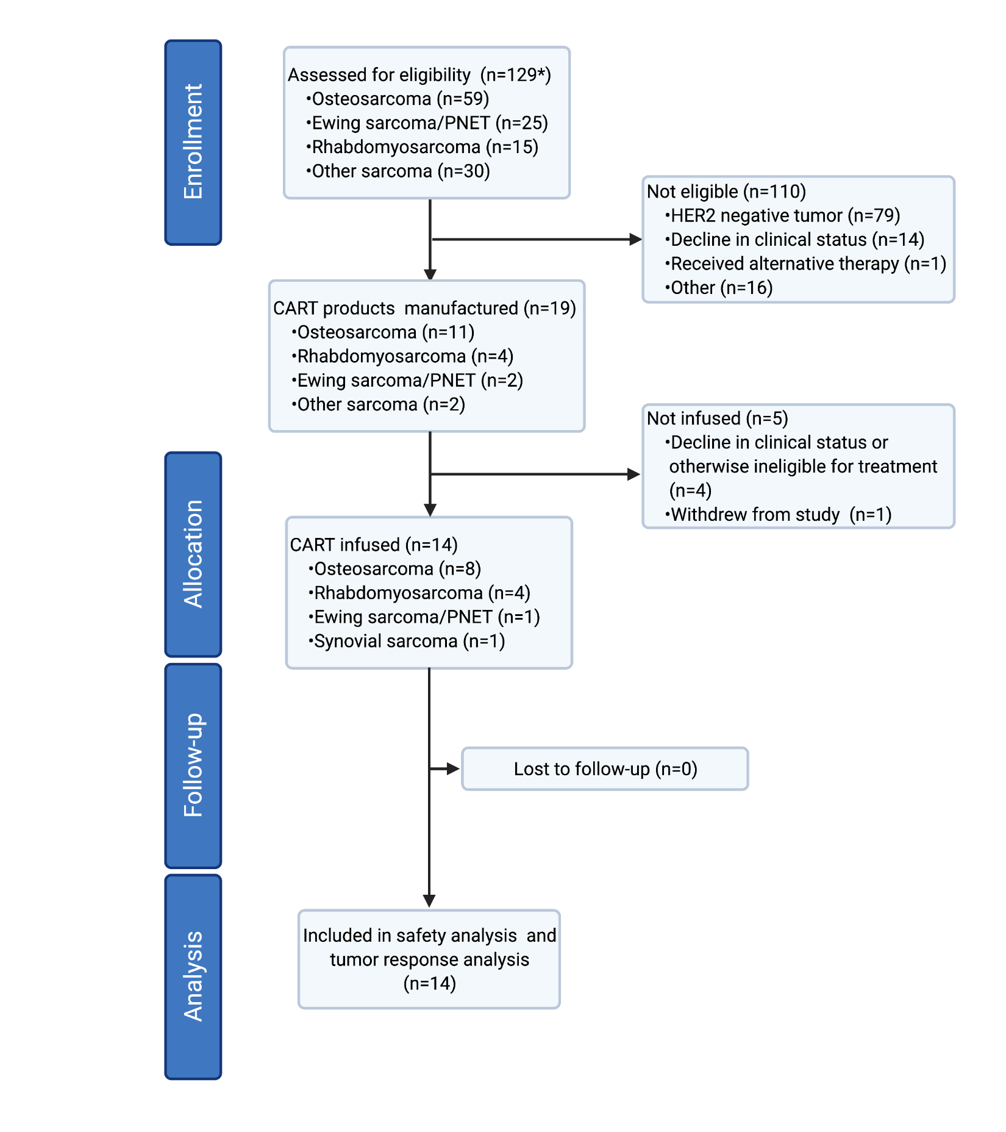
Supplementary Figure 1: Consort flow chart. Consort flow chart summarizing the number of patients screened, enrolled, treated and followed on the study. *one patient was re-assessed for eligibility at recurrence and re-enrolled on the study. Created with BioRender.com.
Supplementary Figure 1

Slide 2
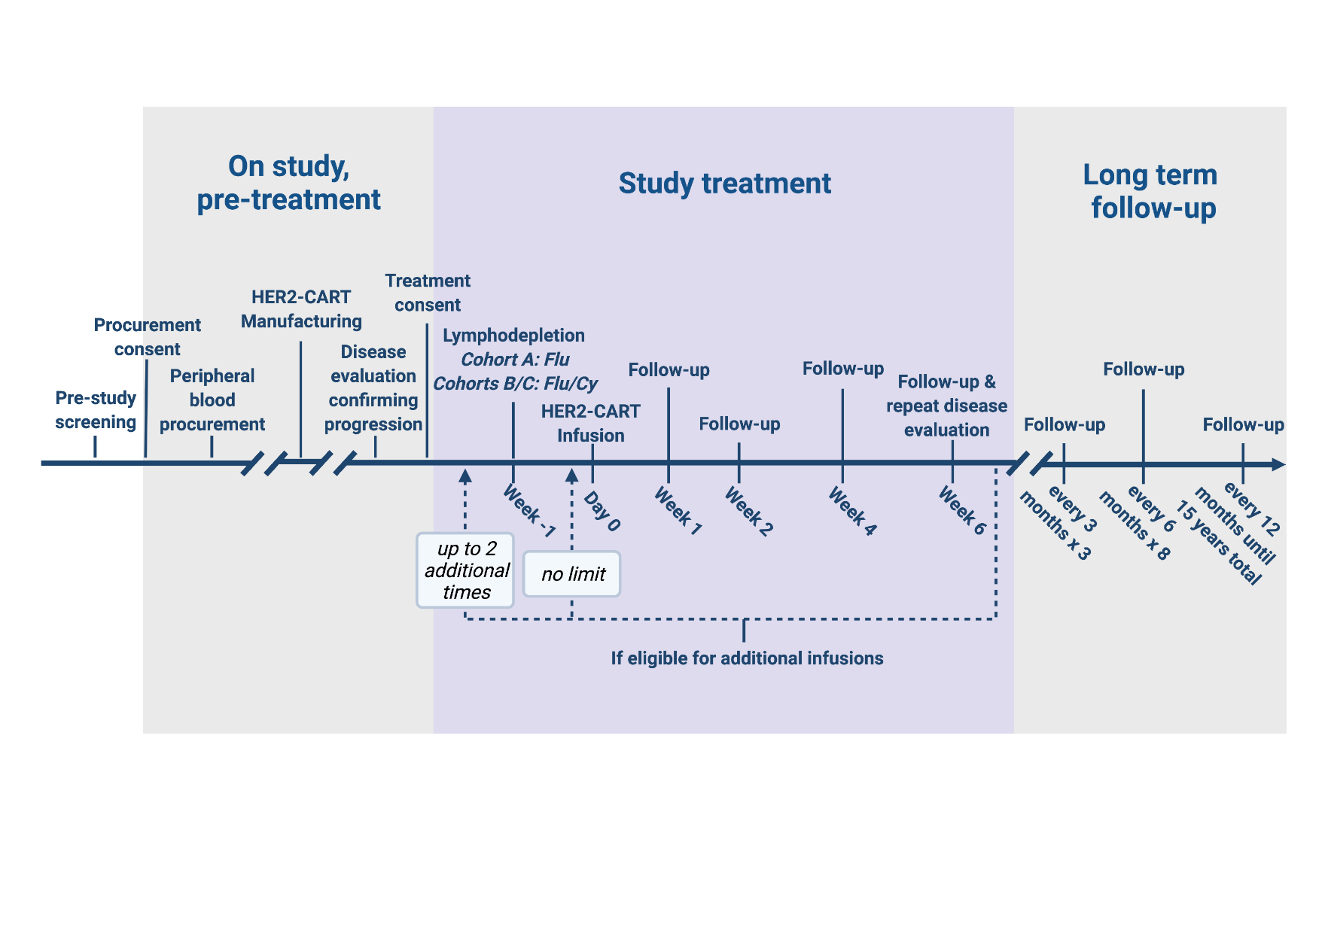
Supplementary Figure 2: Study schema. Schematic representation of HER2-CART manufacturing, treatment with lymphodepletion and CART infusion, follow-up for safety and disease response assessment, plan for repeat treatment cycle(s), and other study evaluations. Created with BioRender.com.
Supplementary Figure 2

Slide 3
A.
B.
C.
D.
Supplementary Figure 3

Slide 4
E.
Supplementary Figure 3: Study-related cytopenia. (A) Absolute lymphocyte count (ALC) on day 0 fludarabine (Flu; n=3 patients) and Flu and cyclophosphamide (Flu/Cy; n=11 patients) lymphodepletion (Flu vs. Flu/Cy, p<0.0001, two-tailed t-test). (B) Absolute neutrophil count (ANC) nadir by lymphodepletion received (Flu vs. Flu/Cy, p<0.0001, two-tailed t-test). (C) Time to recovery from severe neutropenia in Flu/Cy group (median time: 14 days, range: 7 to 28 days) from CART infusion. (D) Hemoglobin levels (g/dL) and (E) platelet count (x10³/µL) during the 6-week safety monitoring period compared to baseline prior to study treatment. Unpaired t-test; p values, ns – not significant, **<0.001, ***<0.0001. Wk, week.
Supplementary Figure 3

Slide 5
Pre-infusion serum cytokine concentration (pg/mL)
Supplementary Figure 4: Pre-infusion serum cytokines. Heatmap of serum cytokine concentrations after lymphodepletion and prior to first CAR T-cell infusion (day 0) in patients conditioned with fludarabine (Flu; n=3) or Flu and cyclophosphamide (Flu/Cy; n=11). Serum homeostatic cytokines were quantified using the Luminex® Multiplex assay (Millipore, TX).
Supplementary Figure 4

Slide 6
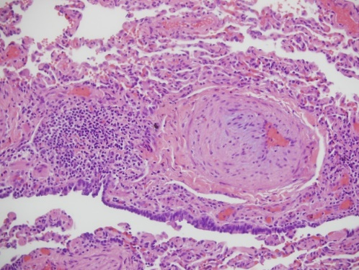
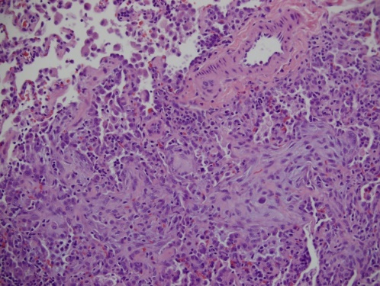
A.
Lymphoid aggregates
B.
Organizing pneumonia
Supplementary Figure 5: Benign lymphocytic lung lesion post-treatment. Hematoxylin and eosin (H&E) staining of right lung biopsy tissue in Patient 5/7 at 16 months off therapy showing (A) benign perivascular lymphoid aggregate (yellow arrow) adjacent to muscularized vessel with intimal hyperplasia (black arrow) markedly obscuring the vessel (200X) and (B) area of organizing pneumonia (yellow arrow) obscuring airway and alveolar architecture of lung (200X). Panels (A) and (B) show representative microscopic images; scale bar 100 µm.
Supplementary Figure 5

Slide 7
A.
B.
Supplementary Figure 6

Slide 8
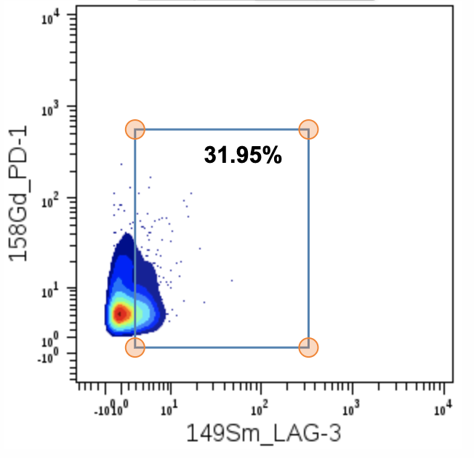
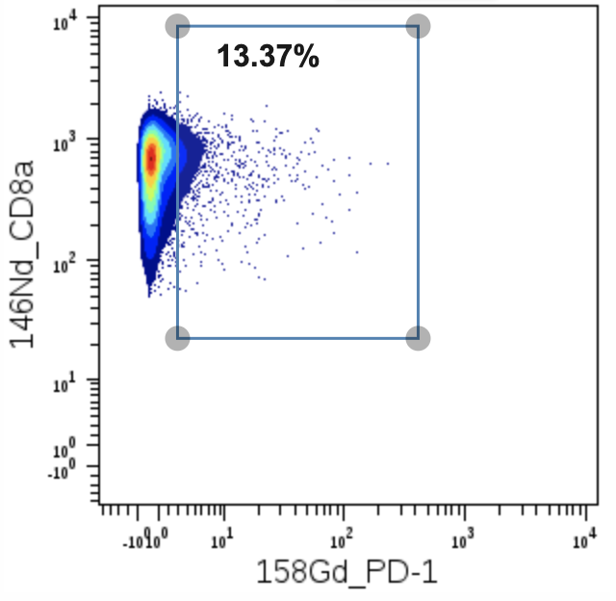
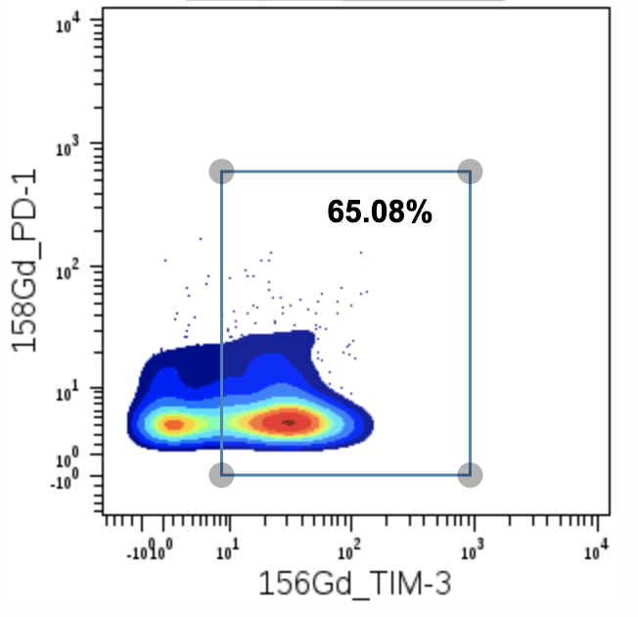
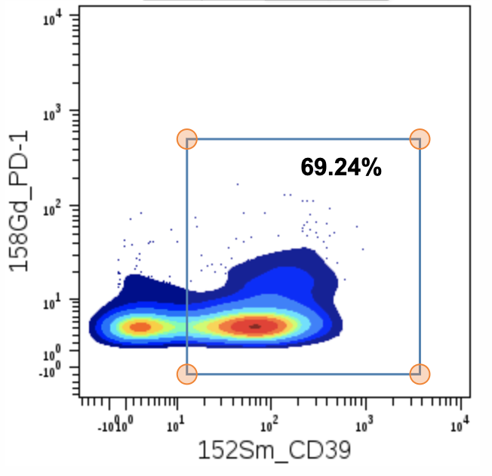
C.
Supplementary Figure 6

Slide 9
Supplementary Figure 6: HER2-CART product characteristics and gating strategy for mass cytometry analysis. (A) Transduction efficiency of HER2-CART products manufactured for all study patients (n=14). Data shown as individual values. Horizontal lines represent the median value. (B) 4-hour chromium release assay demonstrating HER2-specific cytotoxic function of infused CART products (n=14). LM7 and NCI-H1299 tumor cell lines expressed HER2. K562 and MDA-MB-468 tumor cell lines were used as negative controls. Data are shown as individual values. Error bars represent the mean value +/- standard deviation. (C) CyTOF (Fluidigm; CA) was performed on cryopreserved CART products and corresponding non-transduced T-cell samples for a subset of infused patients. Pre-conjugated metal-tagged antibodies were purchased from Fluidigm. Calibration beads (Fluidigm) were added to all samples. Data were analyzed using Cytobank (Beckman Coulter, IN). viSNE high-dimensionality reduction analysis was performed using all 36 metal-tagged antibody parameters. Gating was done to select for intact singlets and to exclude CD19⁺ and CD56⁺ cells. The resultant analysis on T-cells with z-axis coloration for CD4⁺ (left upper panel) and CD8 (right upper panel), respectively, is shown for a representative CART product sample. Further analysis on T-cell subsets was performed to examine co-expression of activation and exhaustion markers on CD8⁺PD-1⁺ T cells (lower panel). First, CD8⁺ T-cells were gated on PD-1⁺ subsets. These were then analyzed for co-expression of TIM-3, LAG-3, and CD39, respectively.
Supplementary Figure 6

