Slide 1
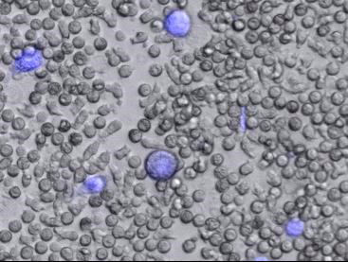
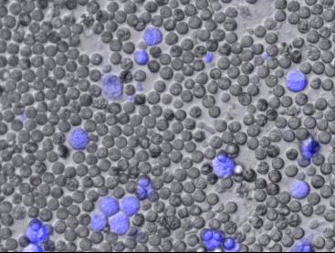
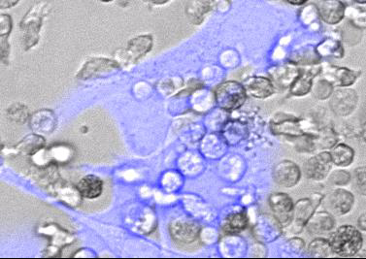
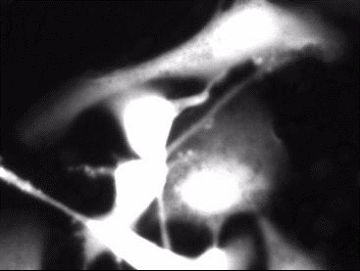
Supplementary Figure 1.
Live cell microscopy of neutrophil-mediated targeted cell killing of HER2+ SKOV3 cells by Tmab-fMet bactabody.
a)
Tmab-fMIFLK-peg12
Tmab
b)
Brightfield + Calcein AM
Calcein-AM
Notes:
Supplementary Figure 1. Live cell microscopy of neutrophil-mediated targeted cell killing of HER2+ SKOV3 cells by Tmab-fMet bactabody. a) Impact of Tmab-fMIFLK-peg12 on neutrophil mediated cell killing was visualized following exposure to Tmab-fMILFK-perg12 (left) and Tmab parent (right) added to wells containing primary human neutrophils (grey cells) and SKOV3 cells (blue cells) at 50:1 effector-to-target cell ratio. Videos were capture on the Cytation-5 platform using 10x objective at 37oC and 5% CO2; videos are 4mins/second relative time (1hr total); B) The mechanism of cell killing was examined by adding Tmab-fMIFLK-peg12 to co-cultures of calcein-AM labeled HER2+ SKOV3 cells and primary human neutrophils. Video reveals neutrophil swarming and loss of cytoplasm in SKOV3 cells, consistent with target cell death due to neutrophil-mediated trogoptosis. Videos were captured on the Cytation-5 using a 20x objective at 37oC and 5% CO2; videos are 3mins/second relative time (1 hour total); 25:1 effector-to-target cell ratio; 30 nM treatments.

Slide 2
Supplementary Figure 2.
In vivo stability of Tmab-fMet bioconjugates containing natural amino molecules or non-coding amino acids.
Notes:
Supplementary Figure 2. In vivo stability of Tmab-fMet bioconjugates containing natural amino molecules or non-coding amino acids. In vivo stability of Tmab-fMet bioconjugates containing natural amino acids or non-coding amino acids following IV administration to mice as assessed by mass spectrometry. a) Tmab-fMIFLK-peg12 was rapidly degraded in vivo, with most of the 4CR species (CR: conjugation ratio of 4 peptides per antibody) degraded by 6 hrs. b) In vivo stability of Tmab-fM(ncAA)4-peg12 over time following IV administration to mice. c) Evaluation of trastuzumab binding to HER2 following eCys modifications, Fc modifications and conjugation to fMet peptides as assessed by antigen-down HER2 ELISA.

Slide 3
Supplementary Figure 3:
Plasma concentration time course of Tmab parent compared to Tmab bioconjugate following IV injection.
a)
Notes:
Supplementary Figure 3: Plasma concentration time course of Tmab parent compared to Tmab bioconjugate following IV injection. In vivo exposure concentration over time was determined for Tmab parent antibody with effector null modifications (Tmab EN) and Tmab EN-fM(ncAA)4-peg12 conjugate with non-coding amino acids. Clearance values were calculated from plasma concentration ove time. Relative exposure was simulated using a two-compartment model to determine anticipated exposure ratio of Tmab EN-fM(ncAA)4-peg12 relative to Tmab EN through 28 days with weekly dosing. AUC(0 - last dose) = 2.95 (Tmab EN / Tmab EN–fM(ncAA)4-peg12.

Slide 4
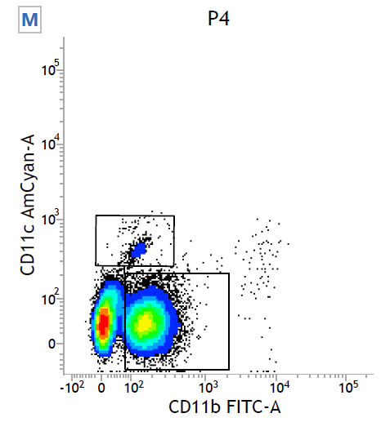
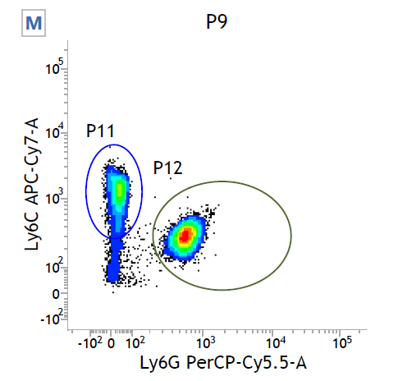
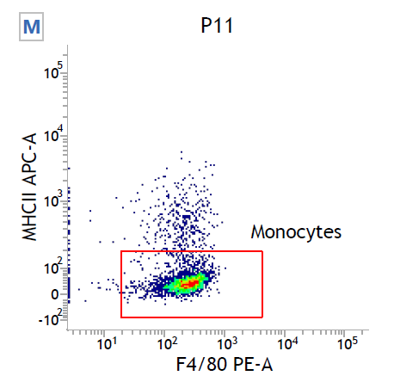
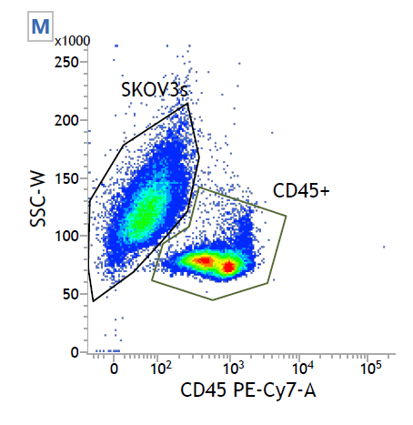
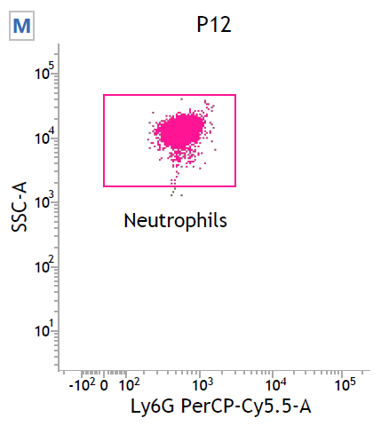
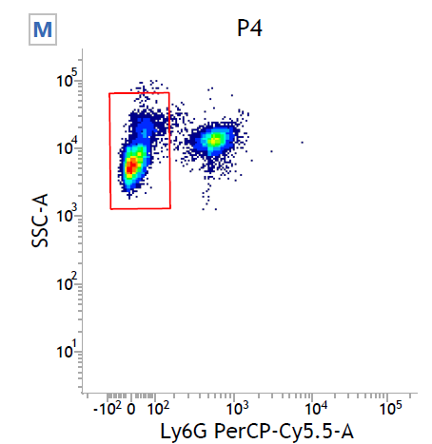
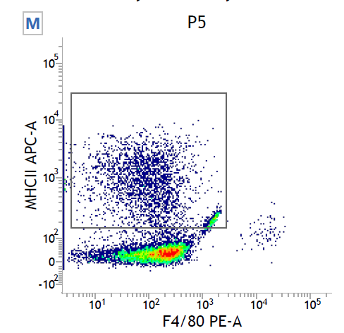
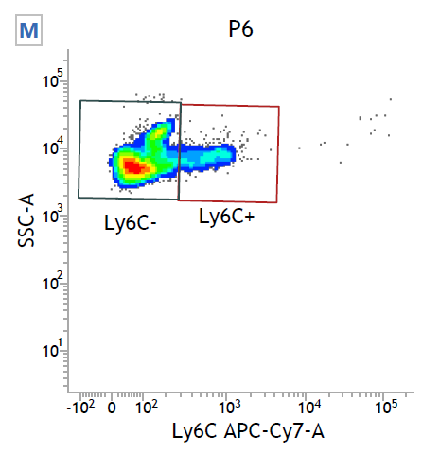
Supplementary Figure 4:
Gating strategy for identification of mouse whole blood neutrophils and tumor infiltrating neutrophils
Monocytes
Neutrophils
Macrophages

