Slide 1
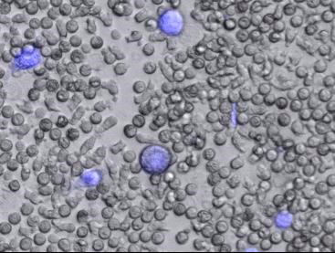
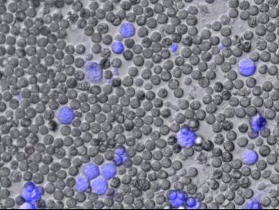
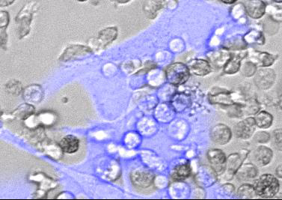
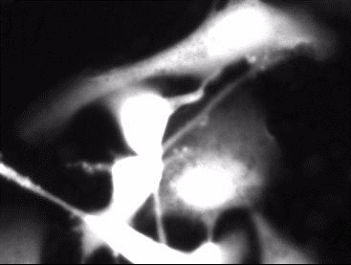
Supplementary Figure 1.
Live cell microscopy of neutrophil-mediated targeted cell killing of HER2+ SKOV3 cells by Tmab-fMet bactabody.
a)
Tmab-fMIFLK-peg12
Tmab
b)
Brightfield + Calcein AM
Calcein-AM
Notes:
Supplementary Figure 1. Live cell microscopy of neutrophil-mediated targeted cell killing of HER2+ SKOV3 cells by Tmab-fMet bactabody. a) Impact of Tmab-fMIFLK-peg12 on neutrophil mediated cell killing was visualized following exposure to Tmab-fMILFK-perg12 (left) and Tmab parent (right) added to wells containing primary human neutrophils (grey cells) and SKOV3 cells (blue cells) at 50:1 effector-to-target cell ratio. Videos were capture on the Cytation-5 platform using 10x objective at 37oC and 5% CO2; videos are 4mins/second relative time (1hr total); B) The mechanism of cell killing was examined by adding Tmab-fMIFLK-peg12 to co-cultures of calcein-AM labeled HER2+ SKOV3 cells and primary human neutrophils. Video reveals neutrophil swarming and loss of cytoplasm in SKOV3 cells, consistent with target cell death due to neutrophil-mediated trogoptosis. Videos were captured on the Cytation-5 using a 20x objective at 37oC and 5% CO2; videos are 3mins/second relative time (1 hour total); 25:1 effector-to-target cell ratio; 30 nM treatments.

