Slide 1
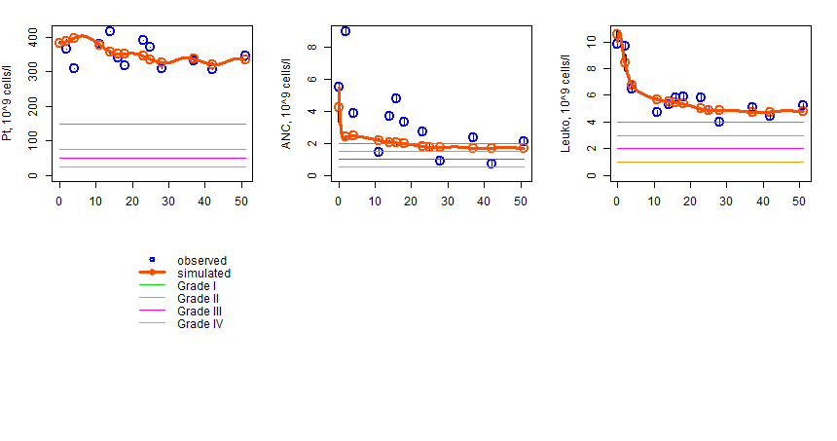
Figure S24. Patient 1

Slide 2
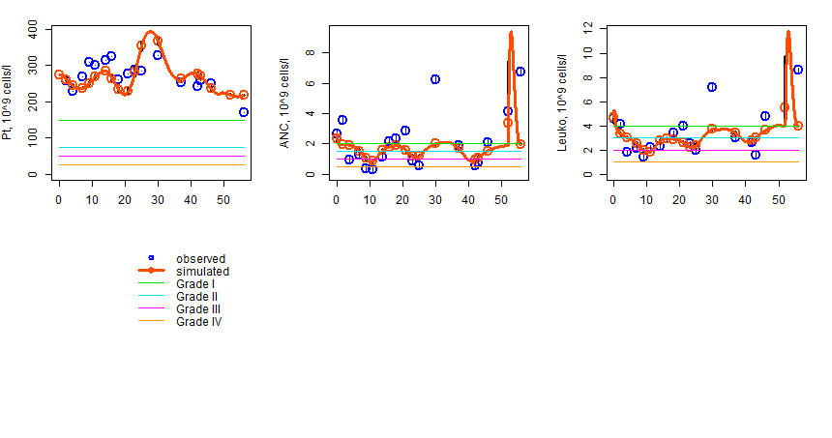
Figure S25. Patient 2

Slide 3
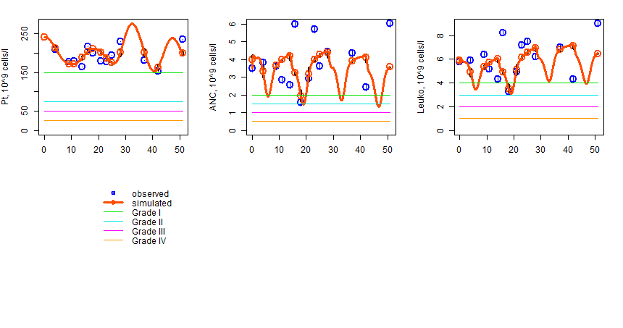
Figure S26. Patient 3

Slide 4
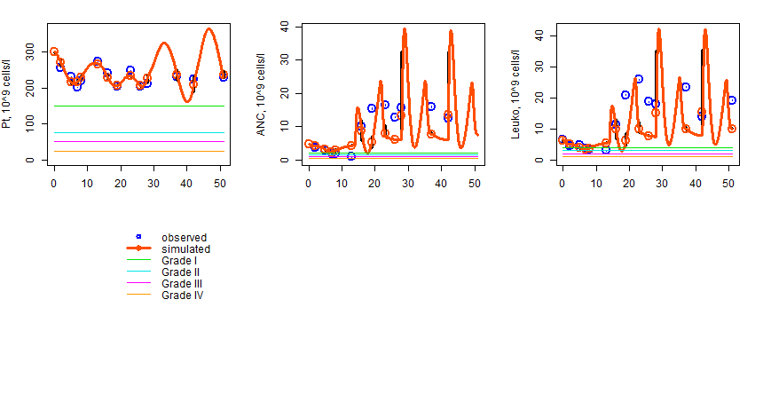
Figure S27. Patient 4

Slide 5
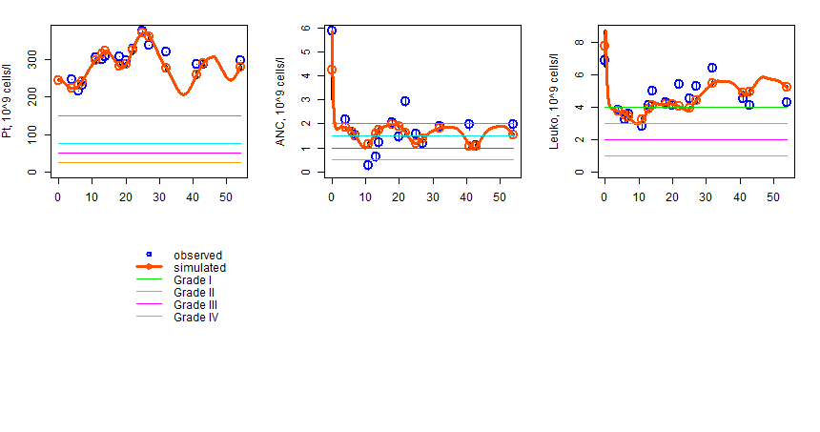
Figure S28. Patient 5

Slide 6
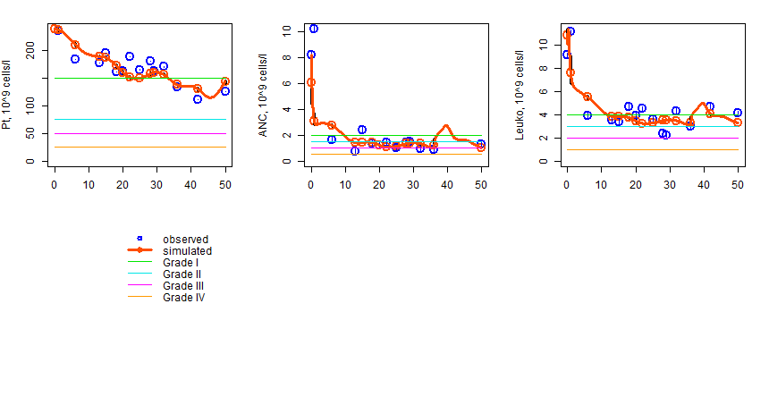
Figure S29. Patient 6

Slide 7
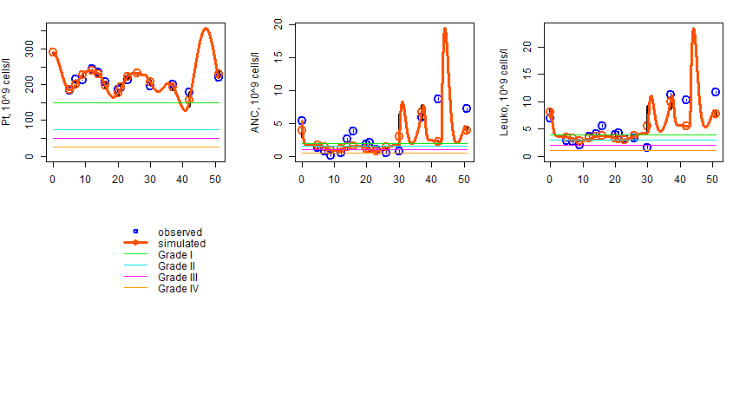
Figure S30. Patient 7

Slide 8
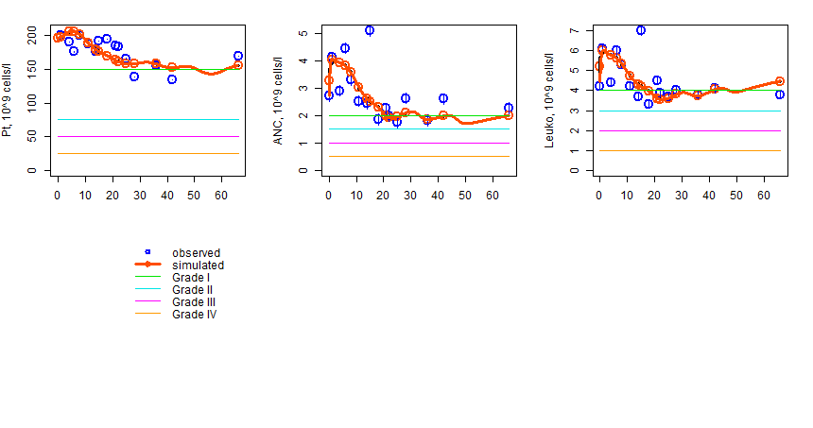
Figure S31. Patient 8

Slide 9
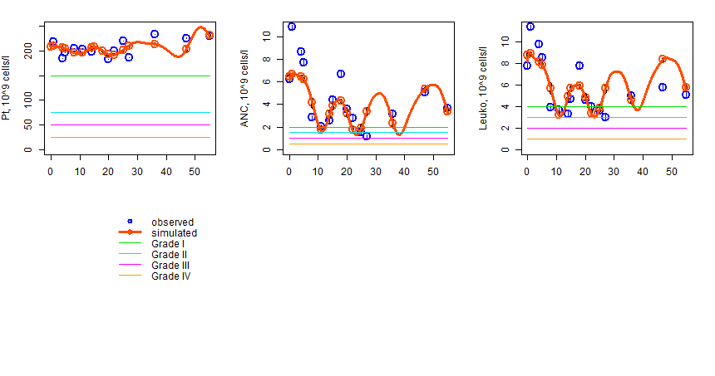
Figure S32. Patient 9

Slide 10
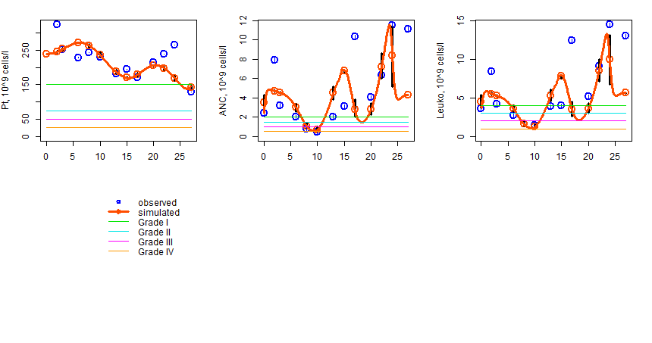
Figure S33. Patient 10

Slide 11
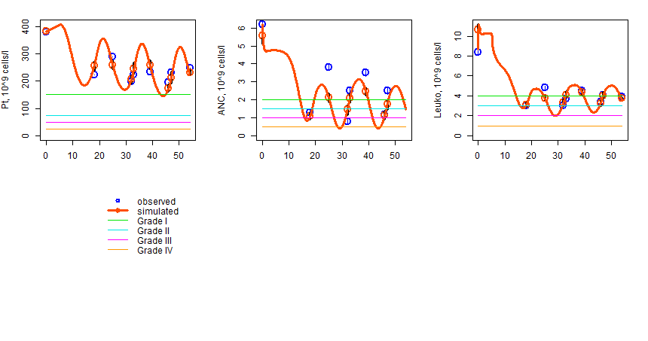
Figure S34. Patient 11

Slide 12
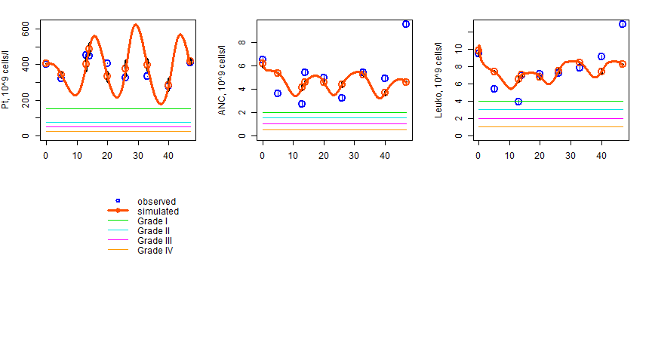
Figure S35. Patient 12

Slide 13
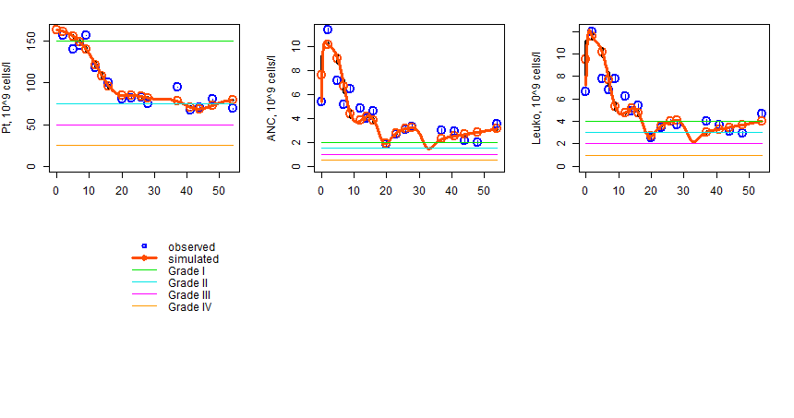
Figure S36. Patient 13

Slide 14
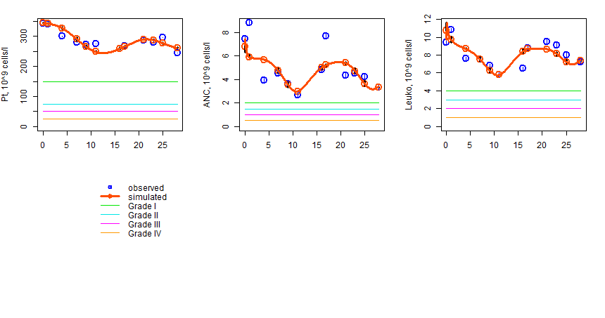
Figure S37. Patient 14

Slide 15
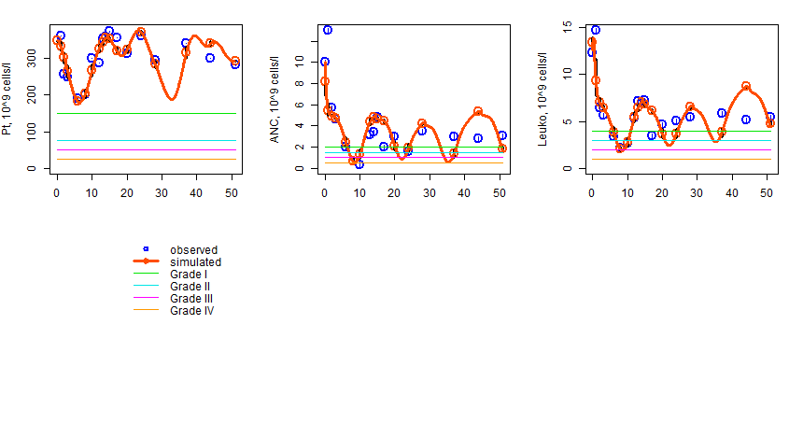
Figure S38. Patient 15

Slide 16
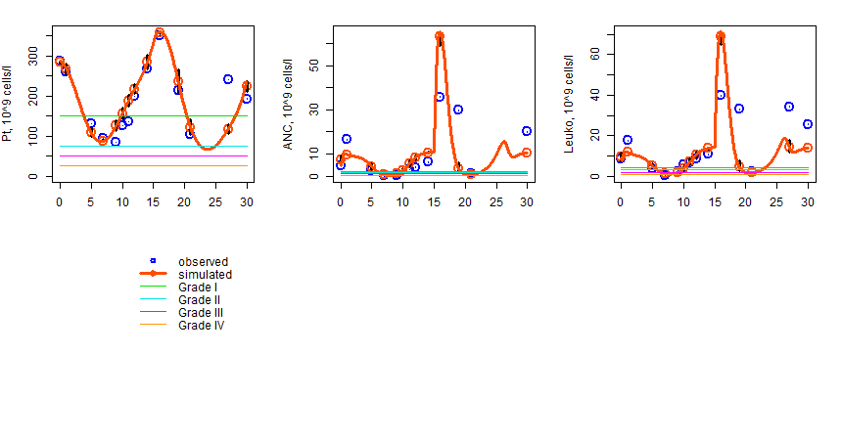
Figure S39. Patient 16

Slide 17
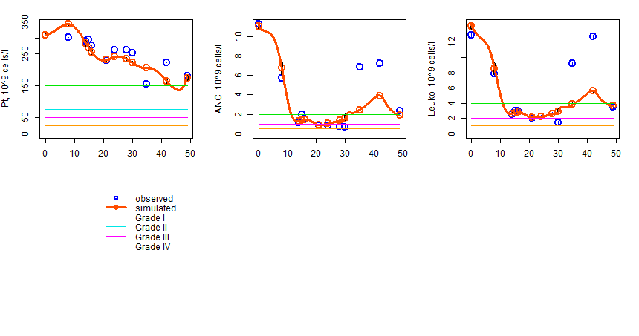
Figure S40. Patient 17

Slide 18
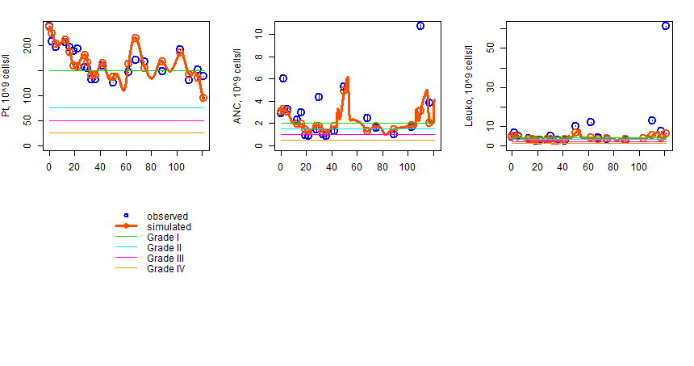
Figure S41. Patient 18

Slide 19
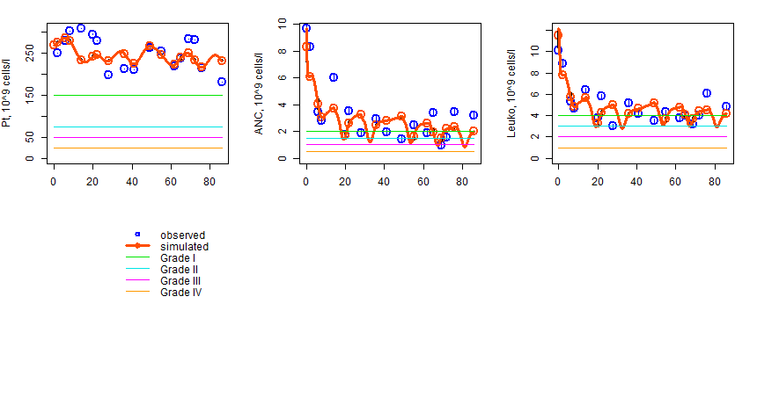
Figure S42. Patient 19

Slide 20
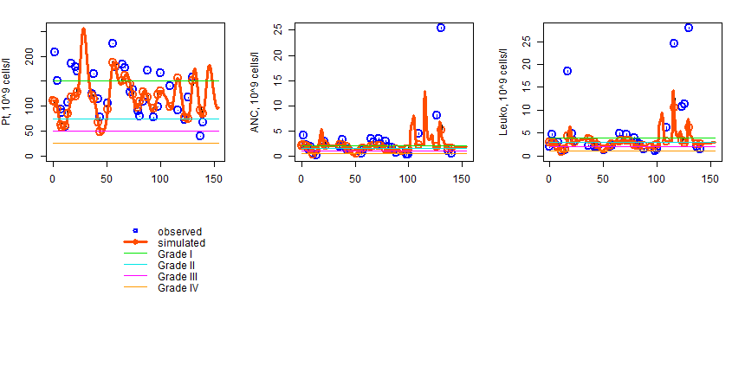
Figure S43. Patient 20

Slide 21
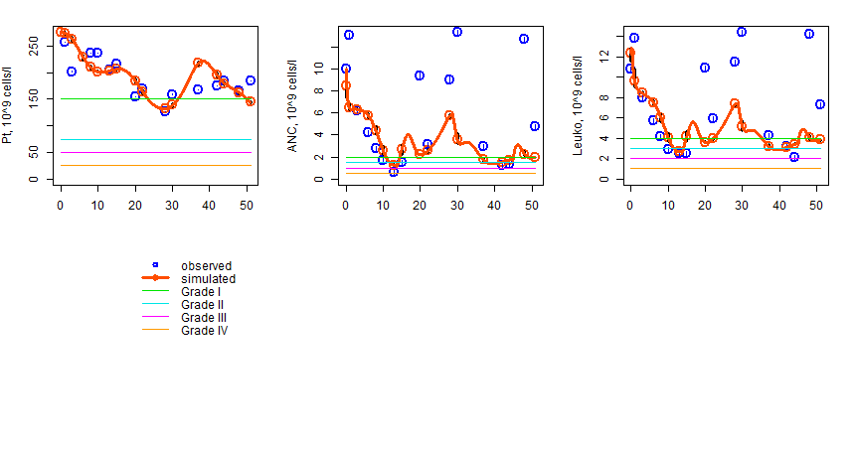
Figure S44. Patient 21

Slide 22
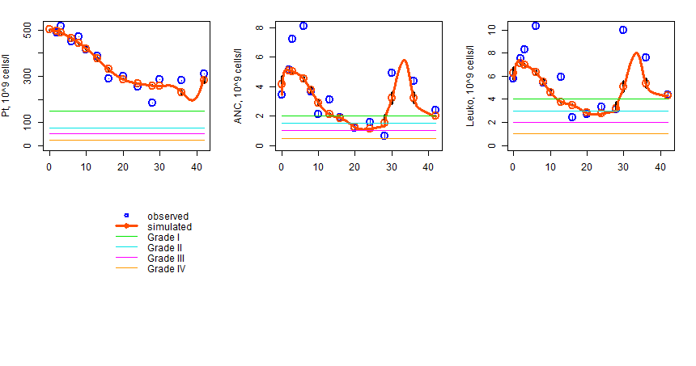
Figure S45. Patient 22

Slide 23
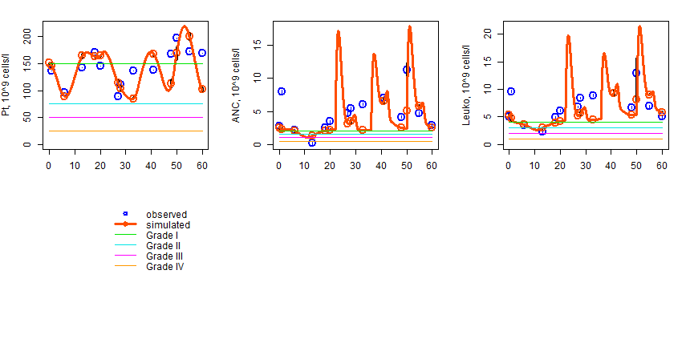
Figure S46. Patient 23

Slide 24
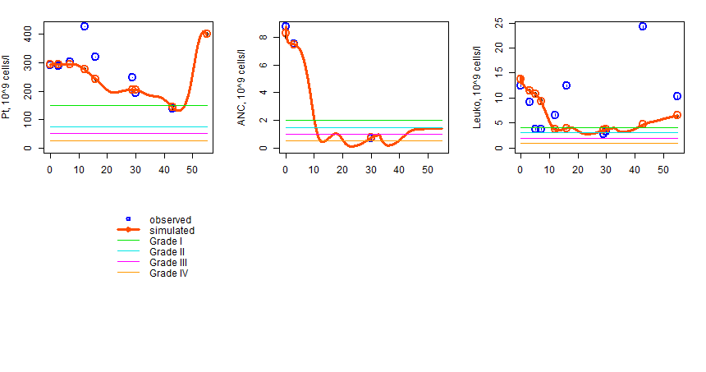
Figure S47. Patient 24

Slide 25
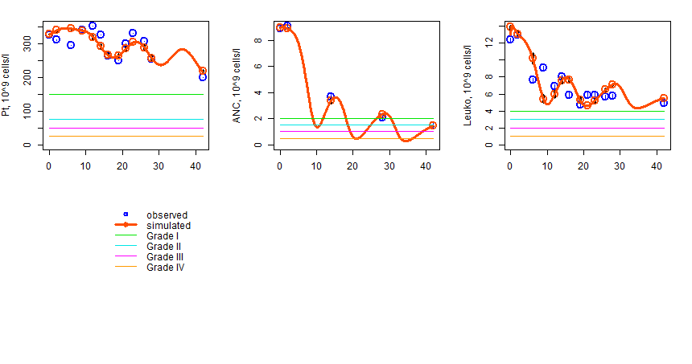
Figure S48. Patient 25

Slide 26
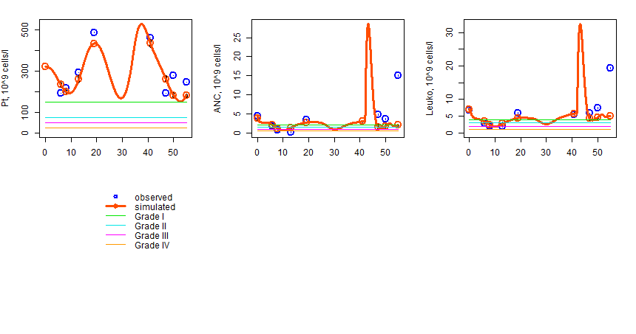
Figure S49. Patient 26

Slide 27
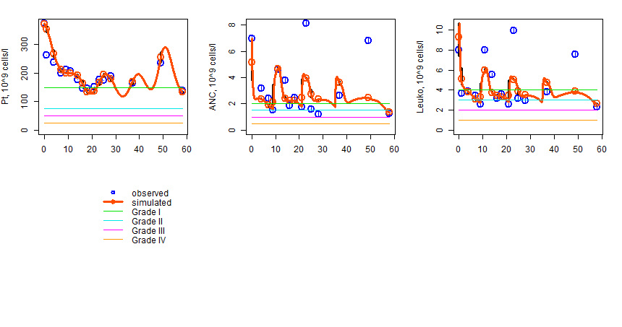
Figure S50. Patient 27

Slide 28
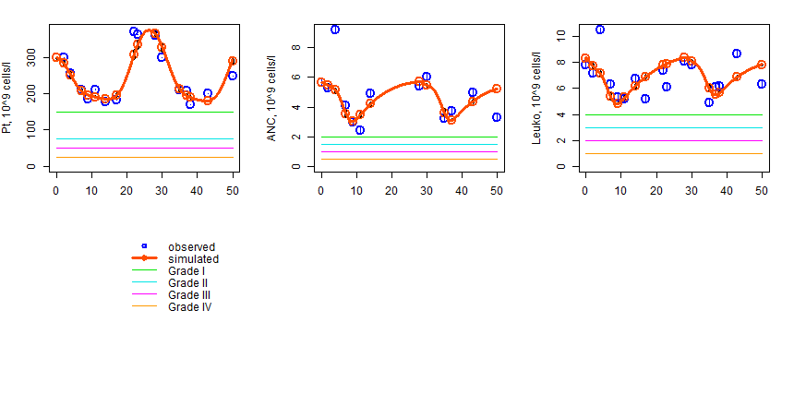
Figure S51. Patient 28

