Slide 1
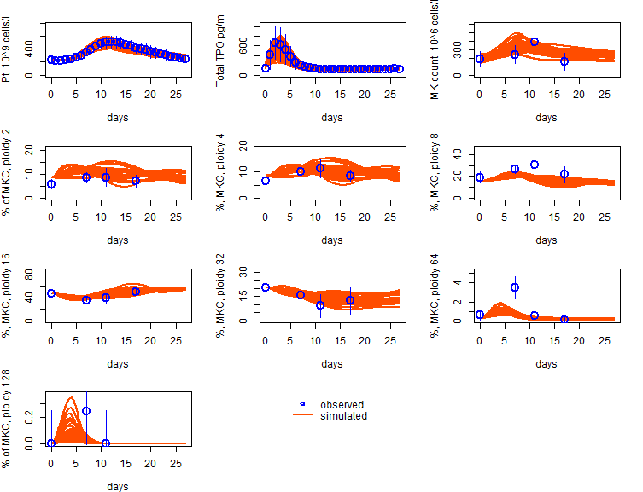
Figure S1. Fitting of Harker et al data
Virtual participation

Slide 2
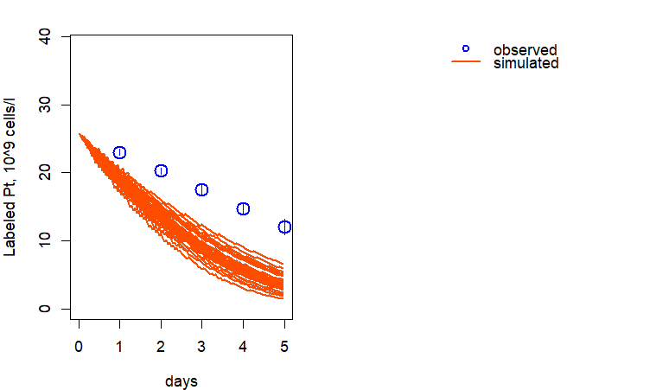
Figure S2. Fitting of Hanson & Slichter data
Platelet basic counts : 50,000 -100,000 cells/µL
Virtual participation

Slide 3
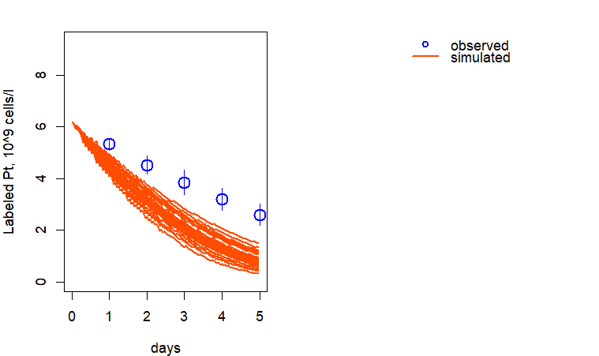
Figure S3. Fitting of Hanson & Slichter data
Platelet basic counts : 62,000 ±7,000 cells/µL
Virtual participation

Slide 4
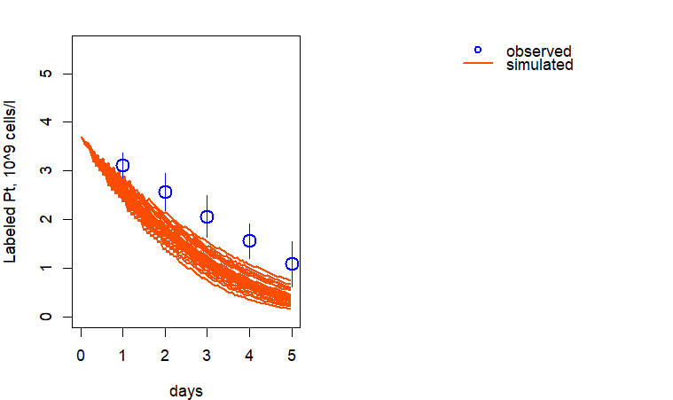
Figure S4. Fitting of Hanson & Slichter data
Platelet basic counts : 37,000 ±9,000 cells/µL
Virtual participation

Slide 5
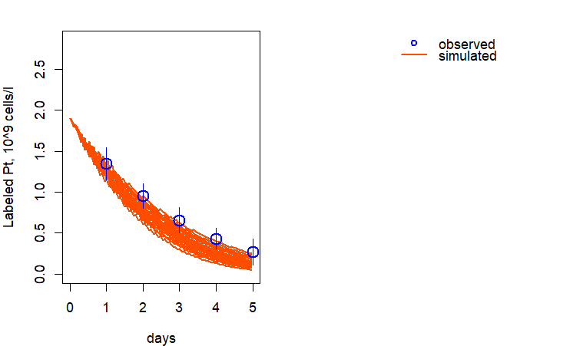
Figure S5. Fitting of Hanson & Slichter data
Platelet basic counts : 19,000 ±6,000 cells/µL
Virtual participation

Slide 6
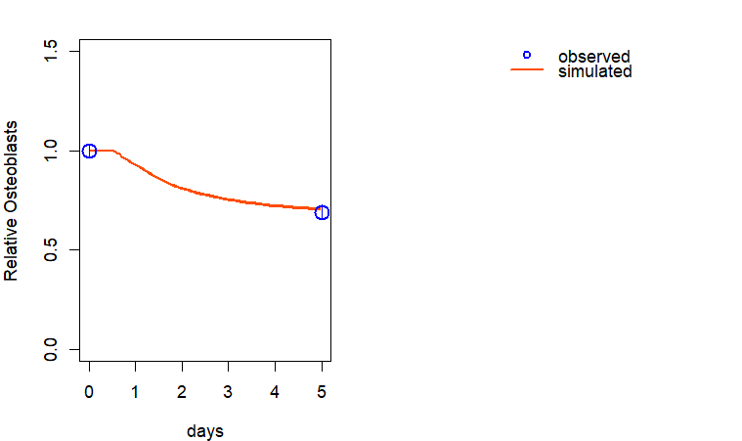
Figure S6. Fitting of Li et al. data
Virtual participation

Slide 7
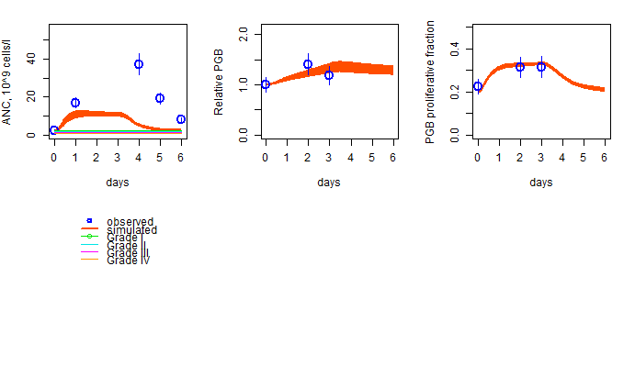
Figure S7. Fitting of Lord et al. data
Patient 1
Virtual participation

Slide 8
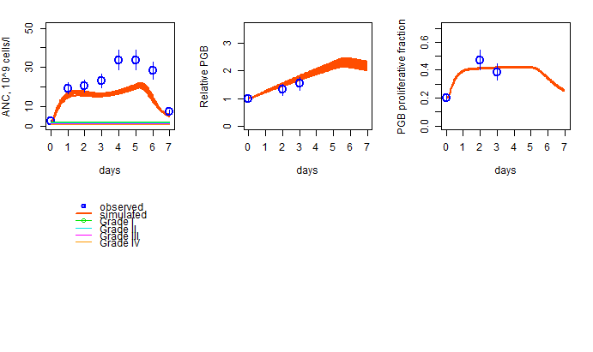
Figure S8. Fitting of Lord et al. data
Patient 2
Virtual participation

Slide 9
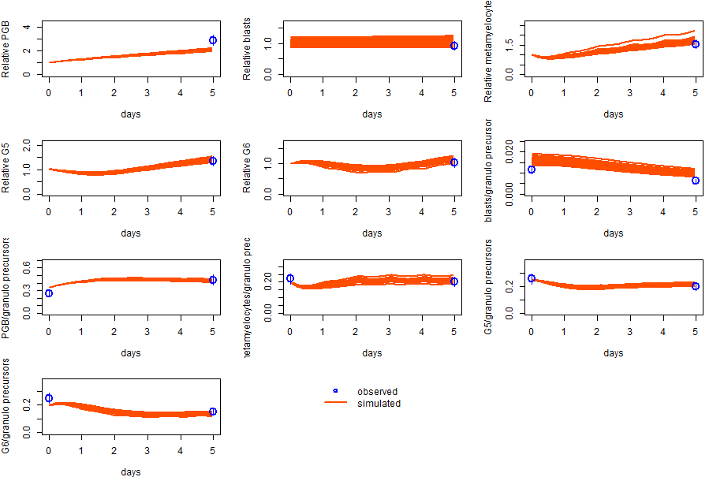
Figure S9. Fitting of Price et al. data
Virtual participation

Slide 10
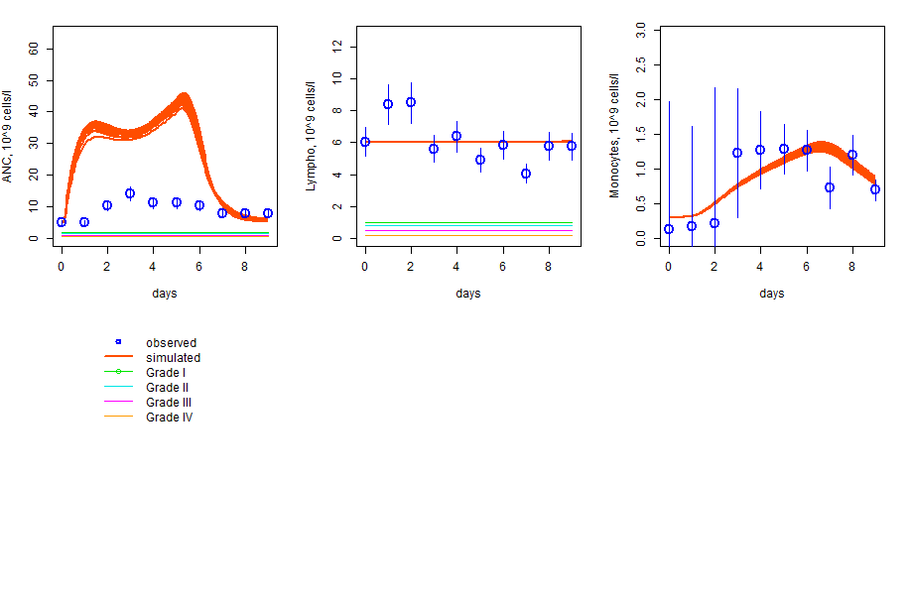
Figure S10. Fitting of Morstyn et al. data
Virtual participation

Slide 11
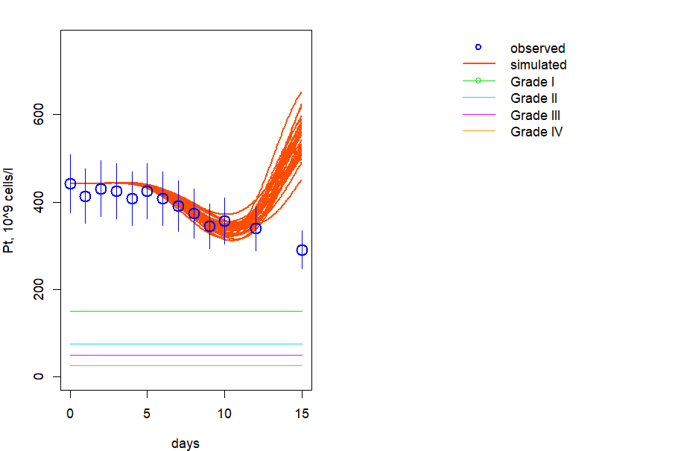
Figure S11. Fitting of data
Filgrastim dose 5 microg/kg/day
Virtual participation

Slide 12
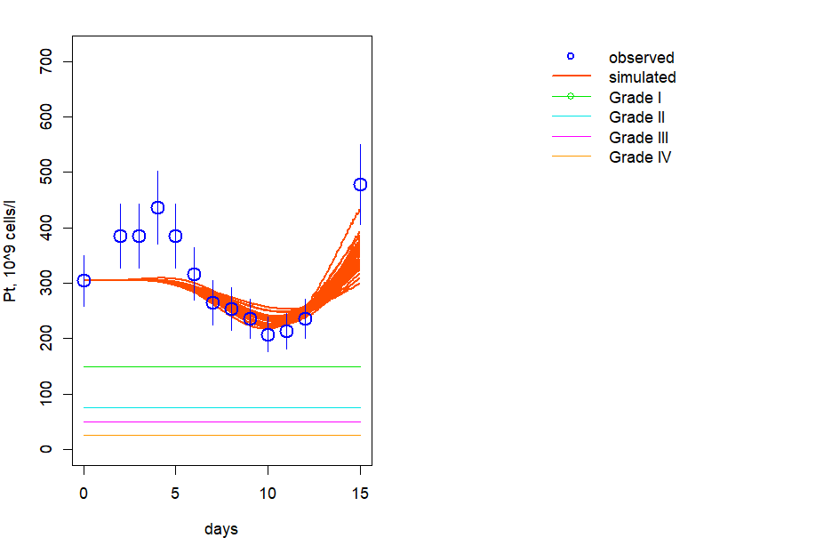
Figure S12. Fitting of data
SD/01 dose 30 microg/kg
Virtual participation

Slide 13
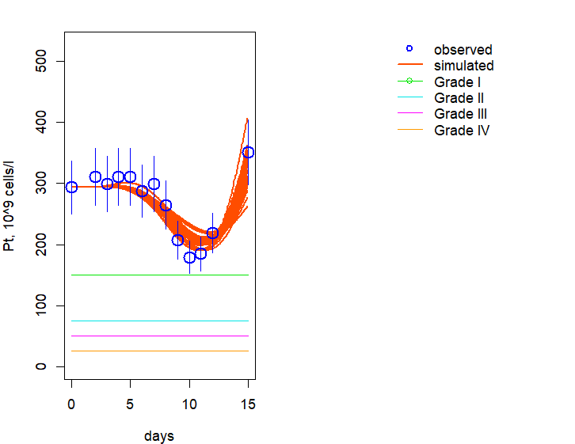
Figure S13. Fitting of data
SD/01 dose 100 microg/kg
Virtual participation

Slide 14
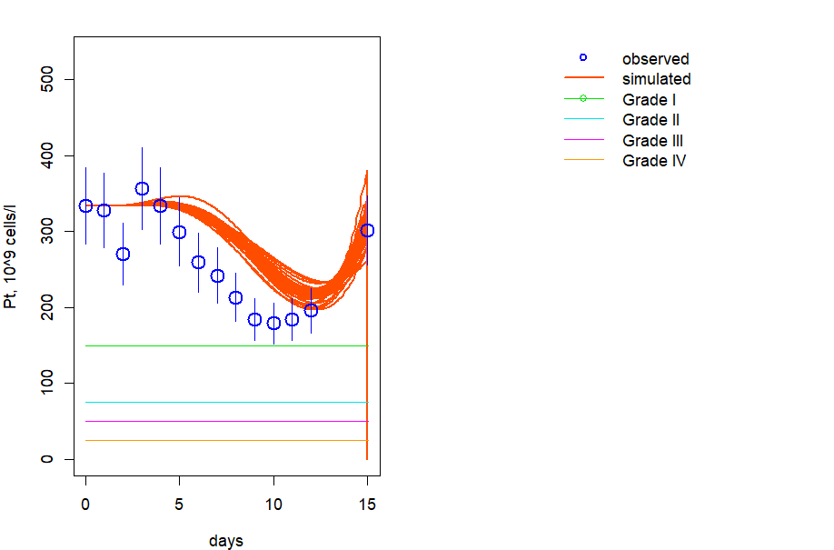
Figure S14. Fitting of data
SD/01 dose 30 microg/kg
Virtual participation

Slide 15
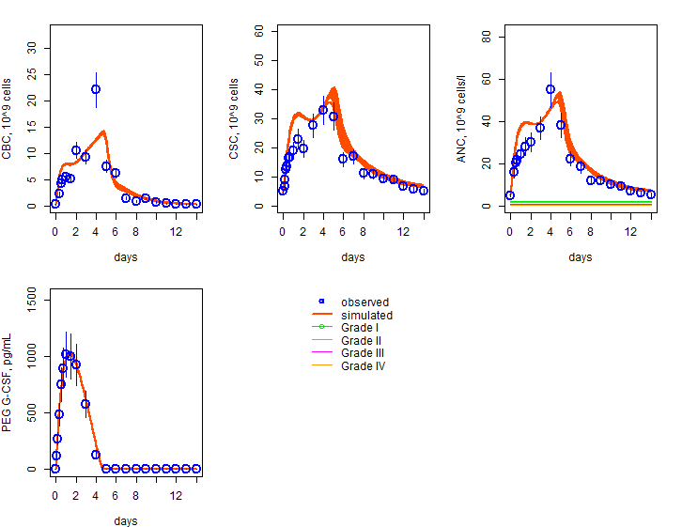
Figure S15. Fitting of Roskos et al. data
Pegfilgrastim dose 30 microg/kg
Virtual participation

Slide 16
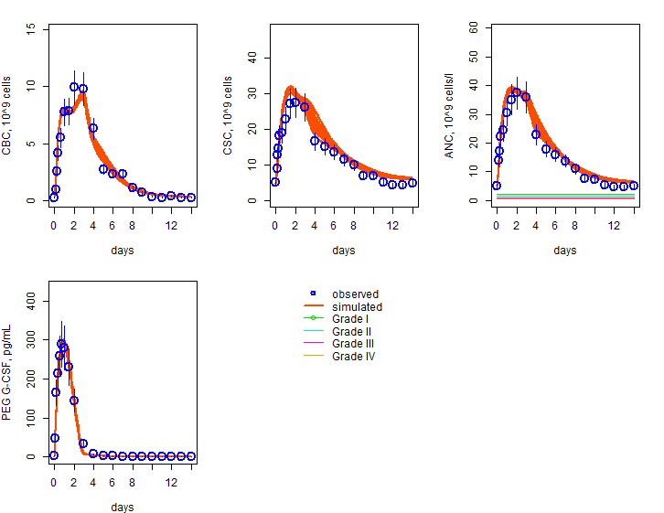
Figure S16. Fitting of data
Pegfilgrastim dose 60 microg/kg
Virtual participation

Slide 17
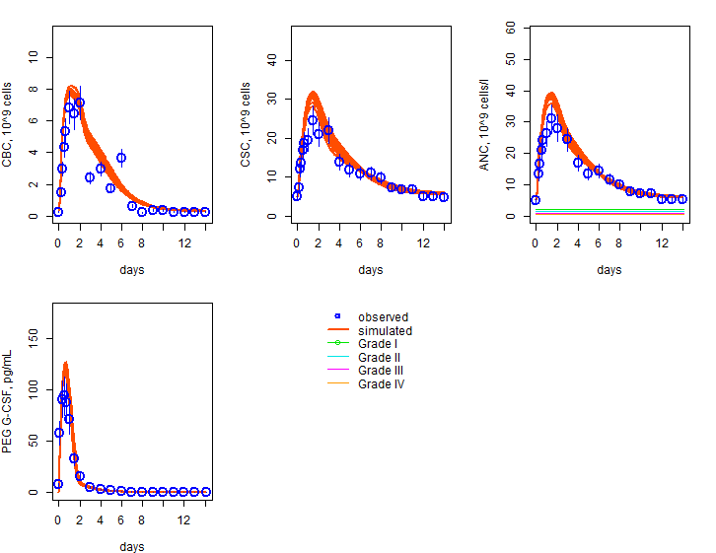
Figure S17. Fitting of data
Pegfilgrastim dose 100 microg/kg
Virtual participation

Slide 18
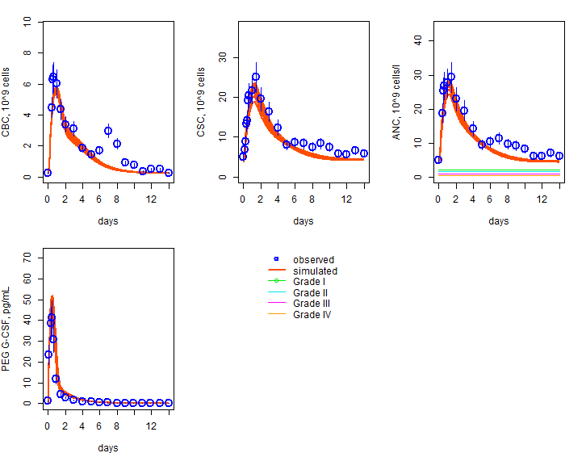
Figure S18. Fitting of data
Pegfilgrastim dose 100 microg/kg
Virtual participation

Slide 19
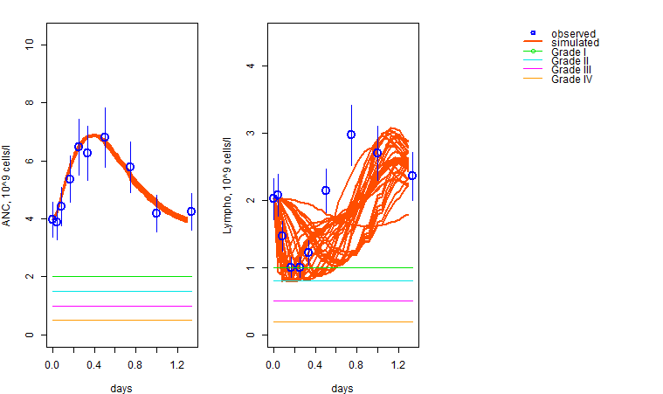
Figure S19. Fitting of Magee et al data
Virtual participation

Slide 20
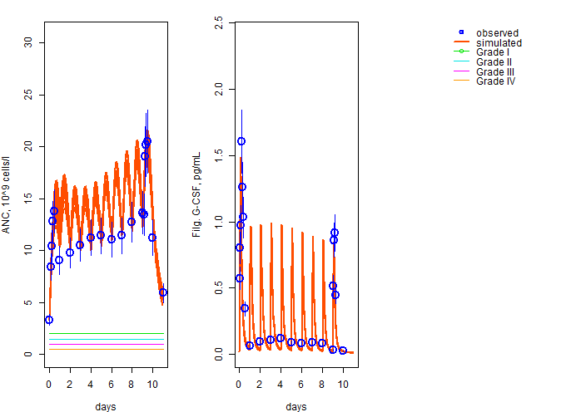
Figure S20. Fitting of Borlefs et al. data
Filgrastim dose 75 microg/kg
Virtual participation

Slide 21
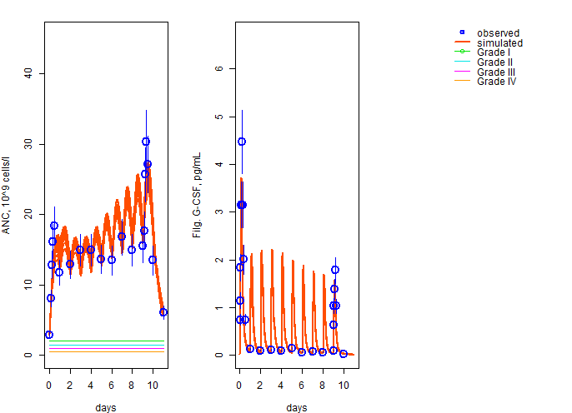
Figure S21. Fitting of Borlefs et al. data
Filgrastim dose 150 microg/kg
Virtual participation

Slide 22
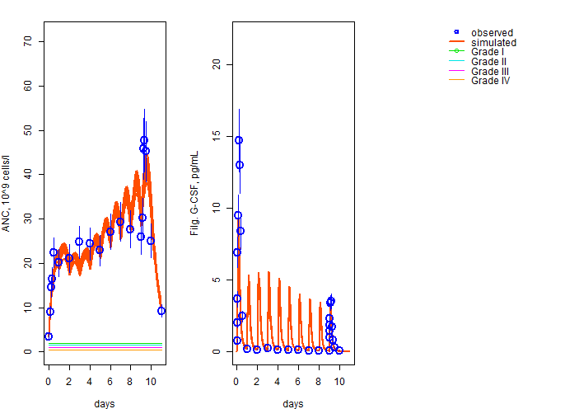
Figure S22. Fitting of Borlefs et al. data
Filgrastim dose 300 microg/kg
Virtual participation

Slide 23
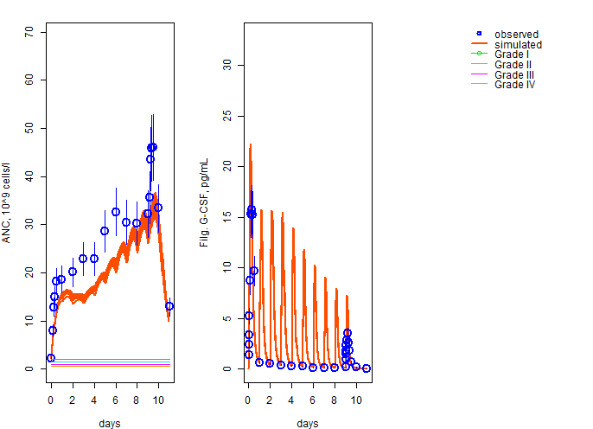
Figure S23. Fitting of Borlefs et al. data
Filgrastim dose 600 microg/kg
Virtual participation

