Slide 1
DITNC1 CTR cells
Day 0
Day 7

Slide 2
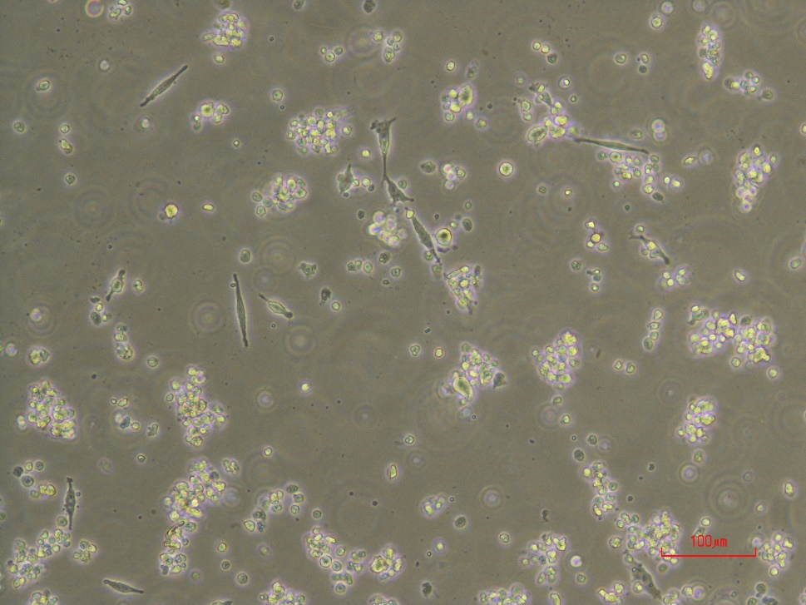
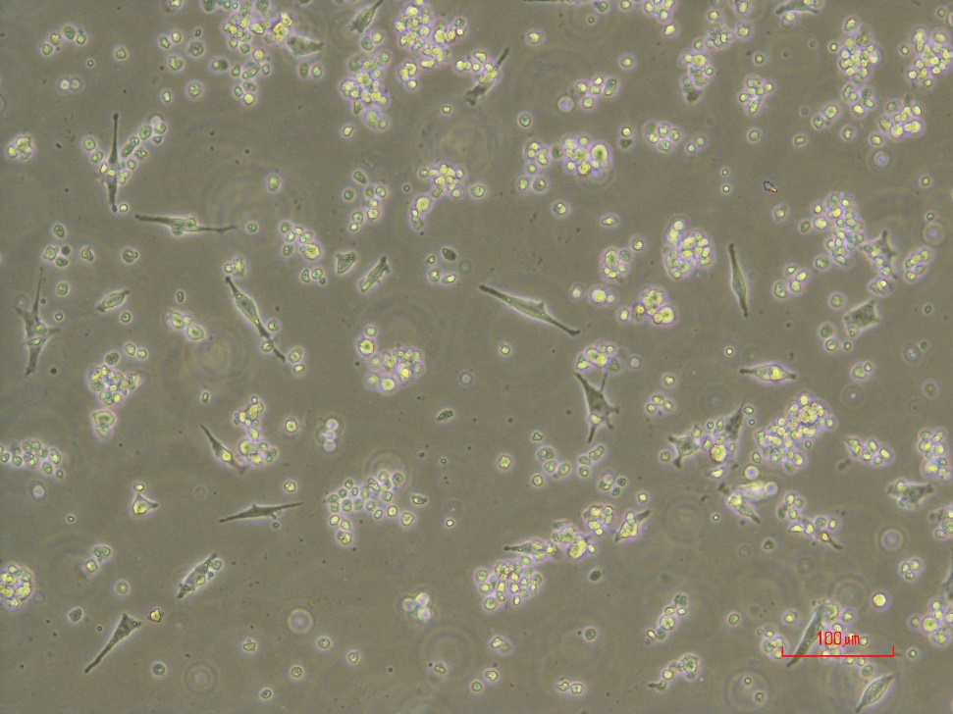
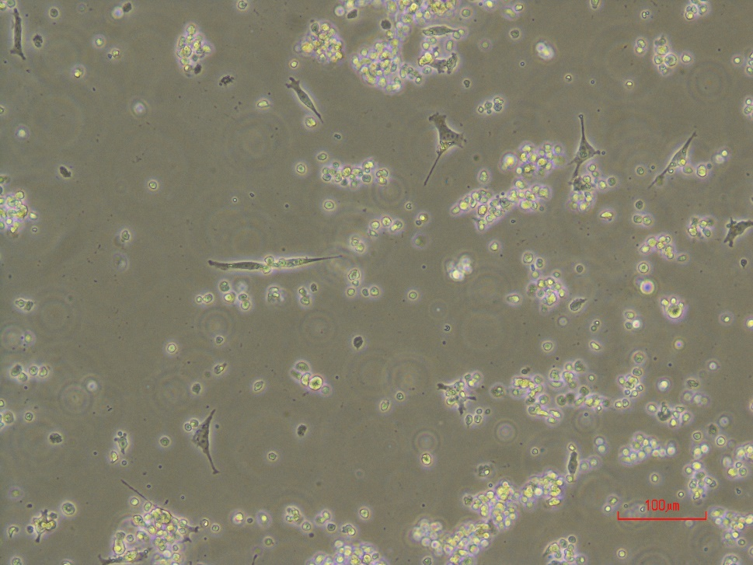
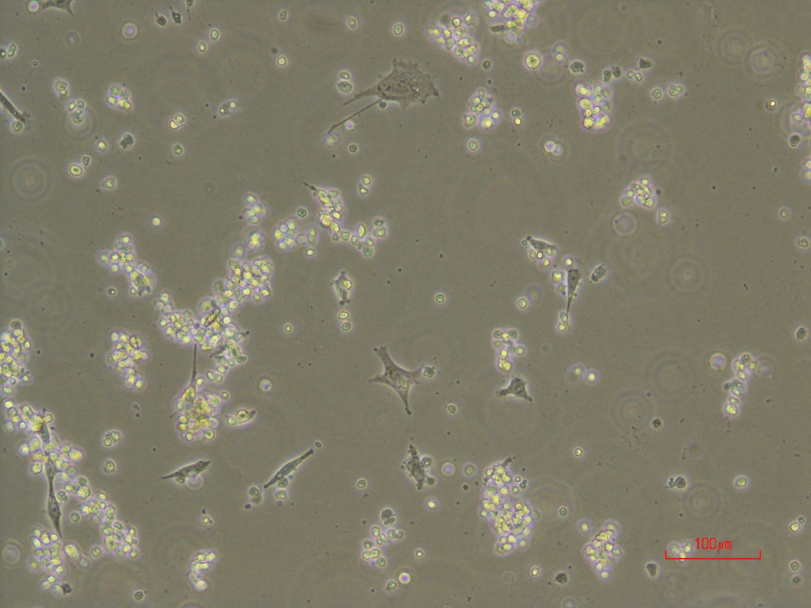
High sensivity to puromycin after infection
DITNC1 LncRNA1 after 48h in puromycin 3ug/ml
DITNC1 LncRNA2 after 48h in puromycin 3ug/ml

Slide 3
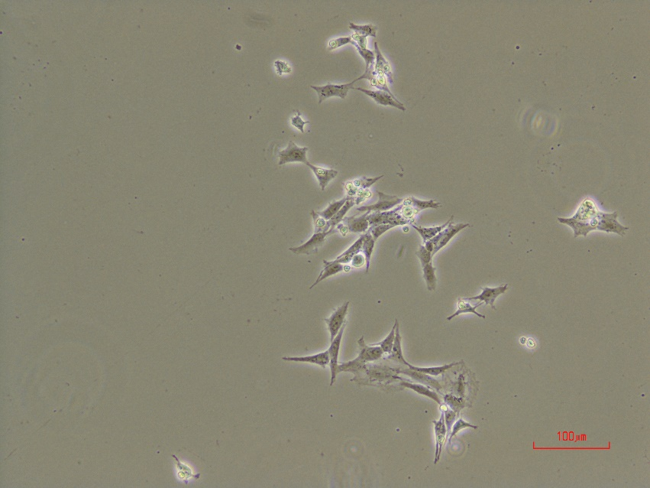
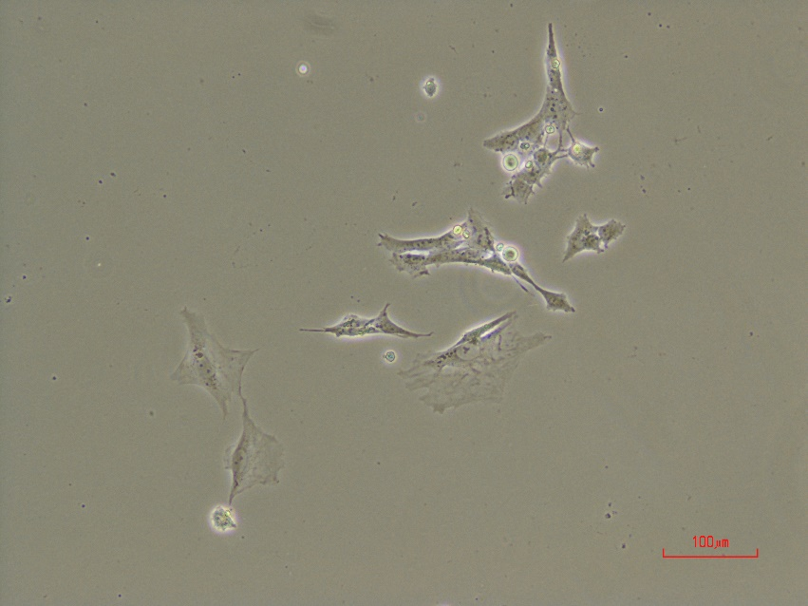
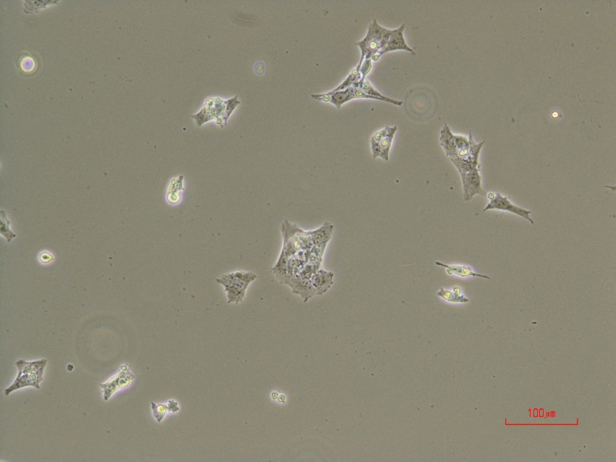
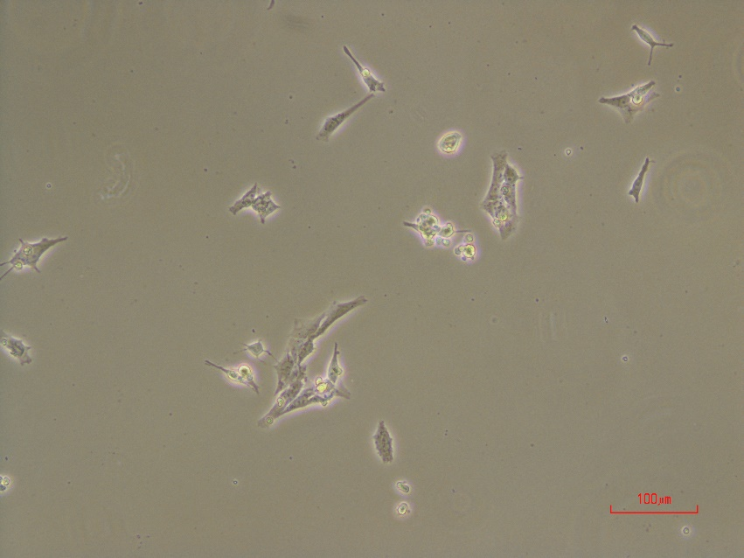
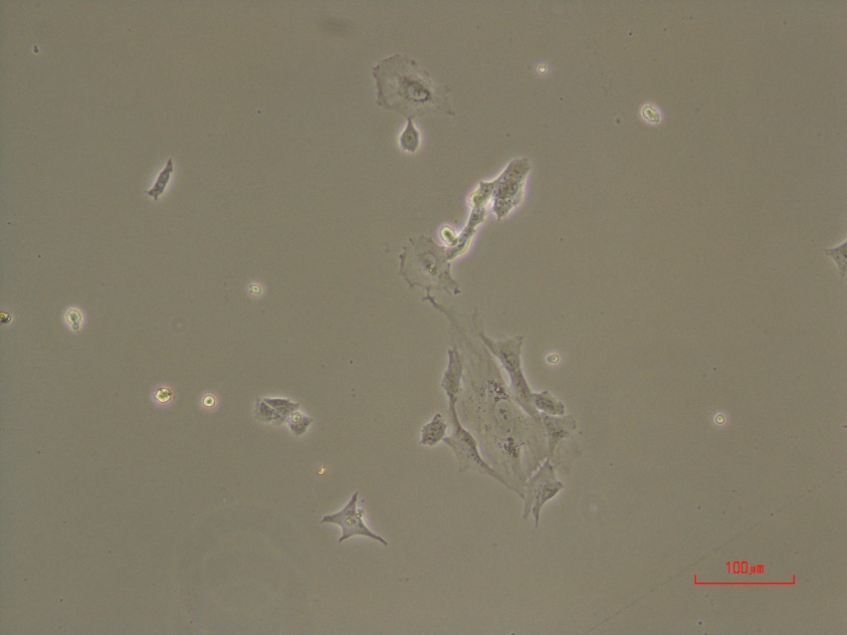
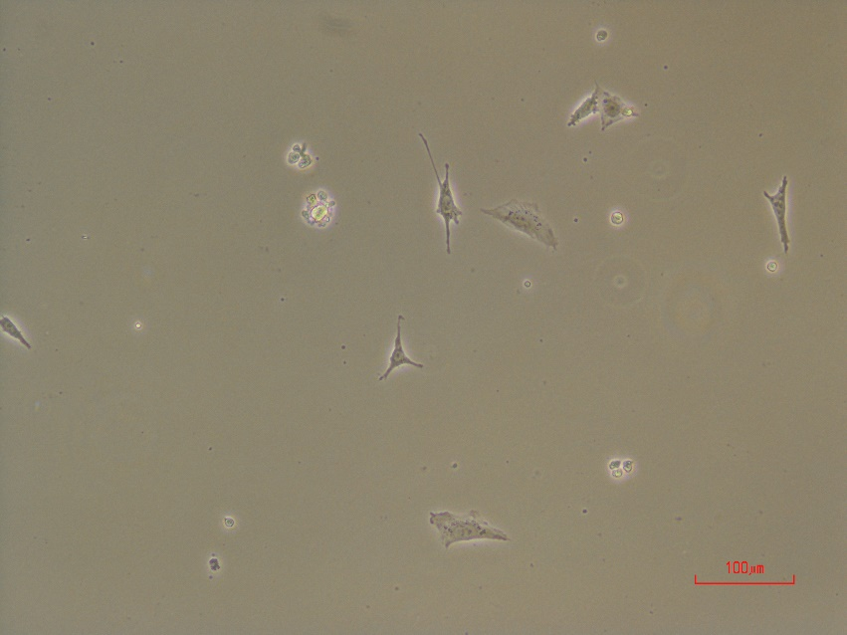
DITNC1 LncRNA1
after 72h in puromycin 3ug/ml
DITNC1 LncRNA2
after 72h in puromycin 3ug/ml

Slide 4
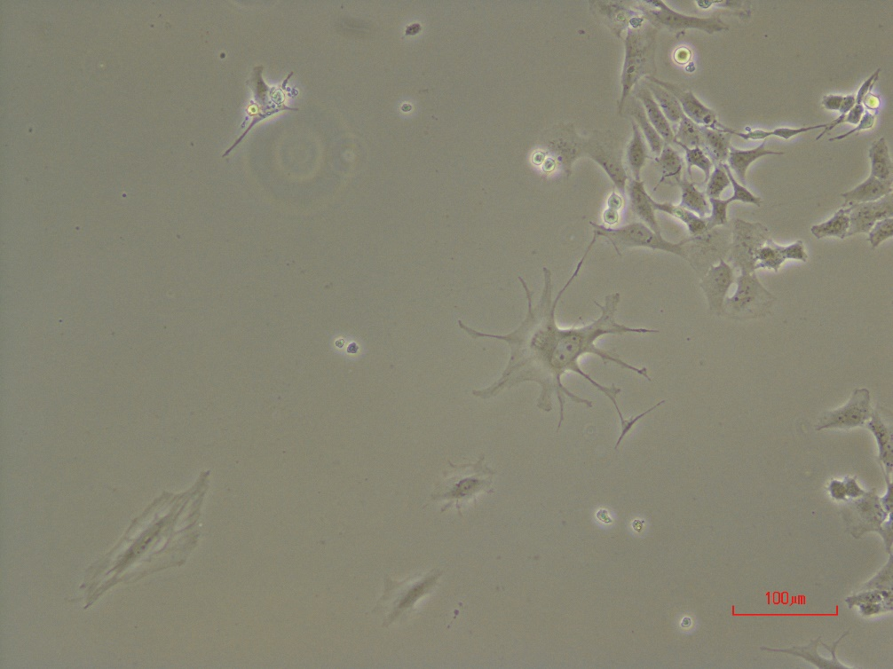
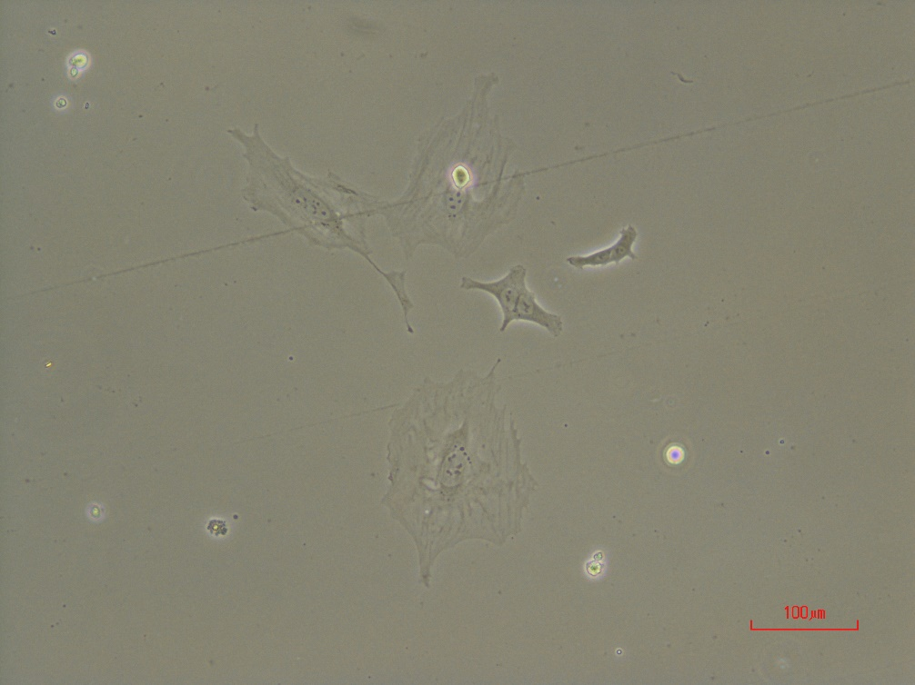
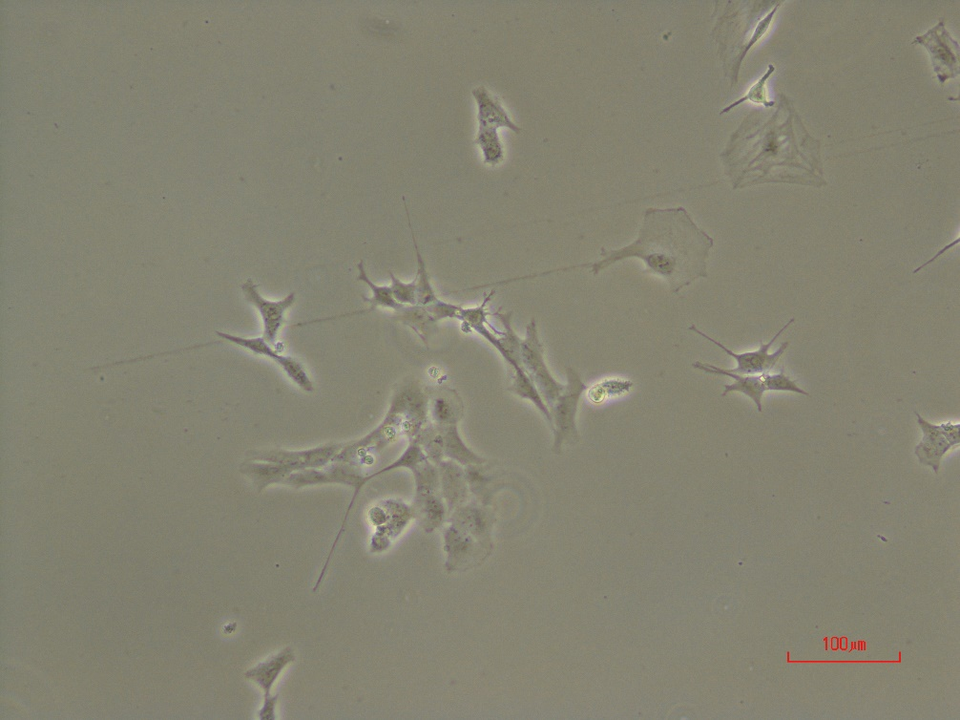
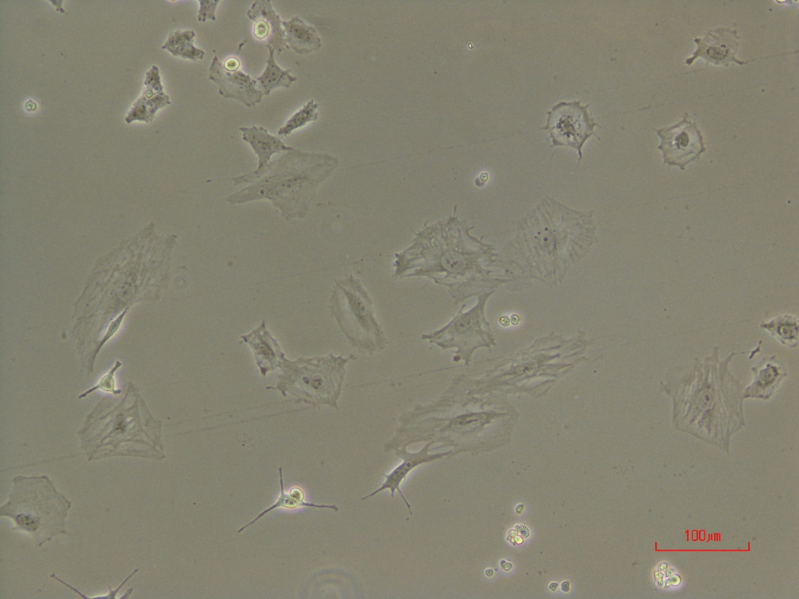
LncRNA1
after 4days in puromycin 3ug/ml

Slide 5
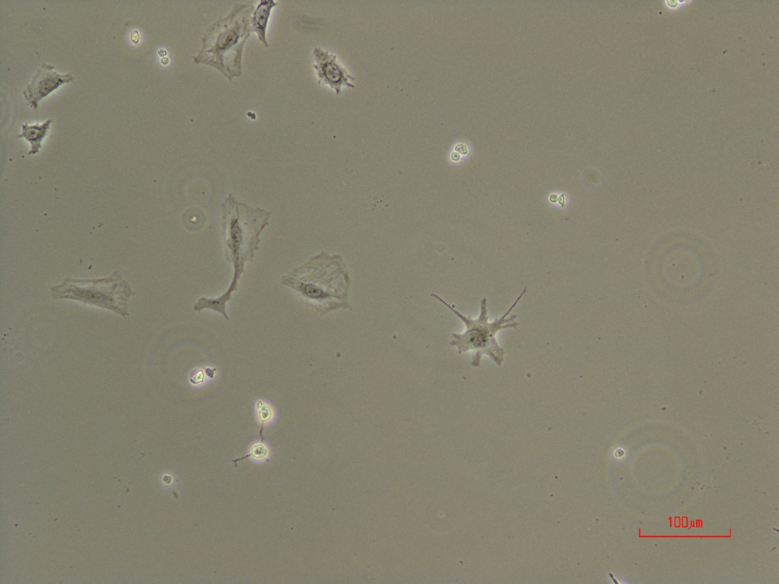
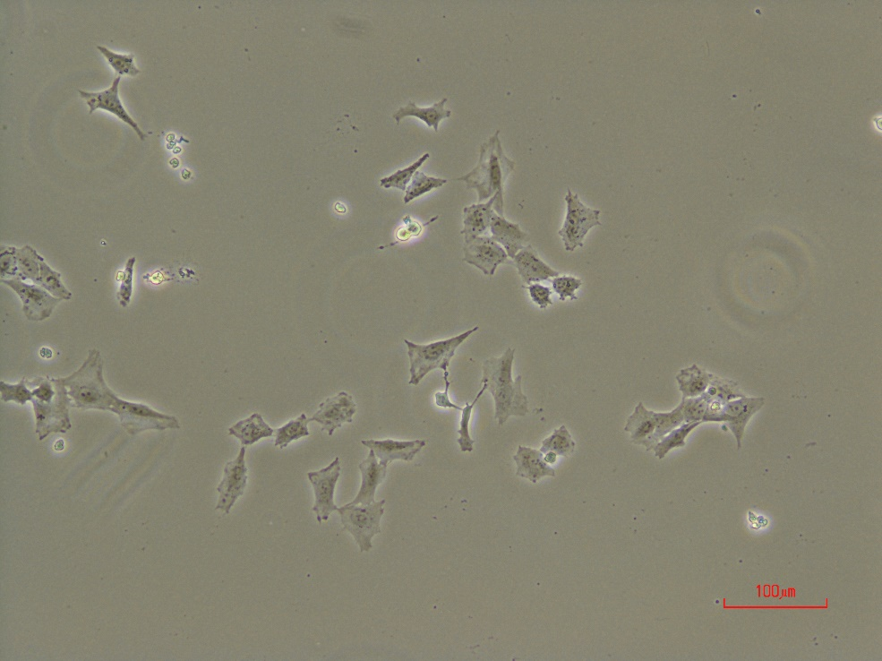
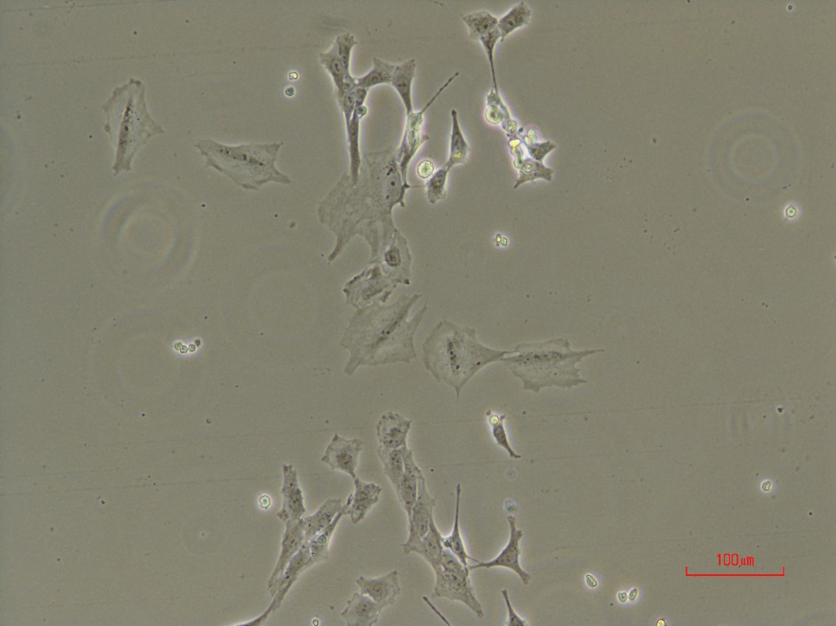
LncRNA2
after 4days in puromycin 3ug/ml

Slide 6
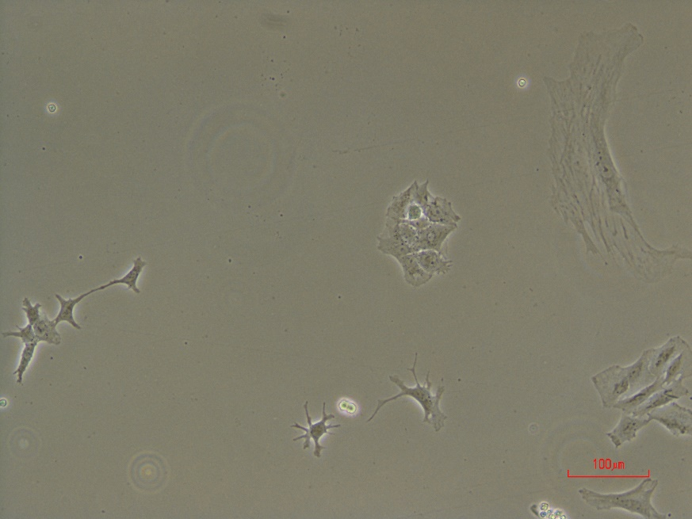
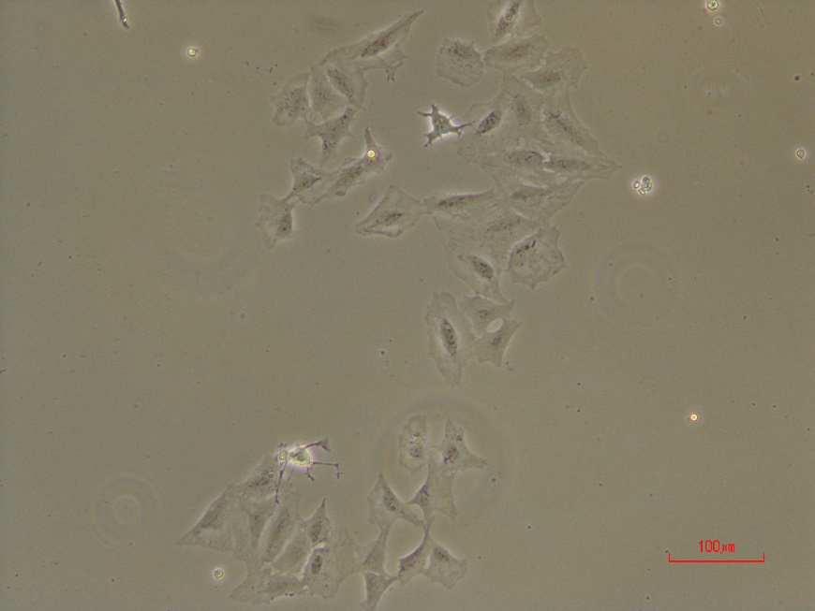
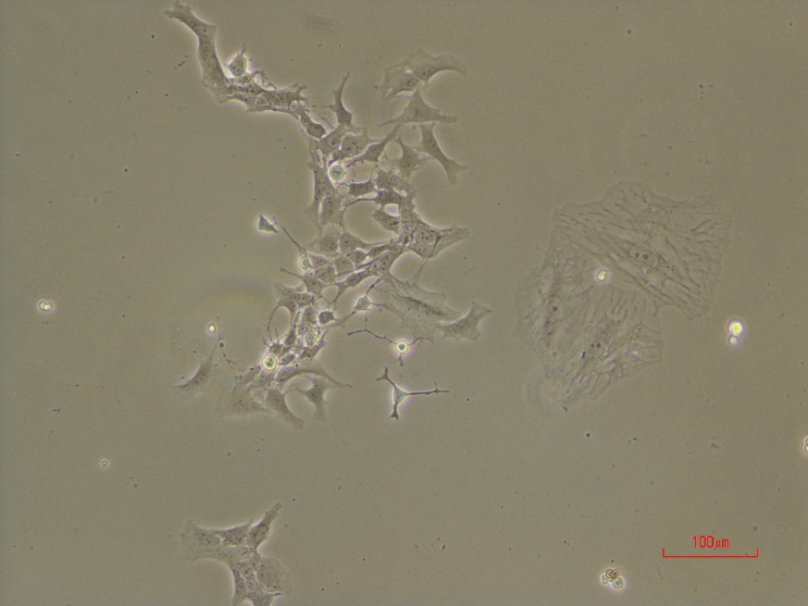
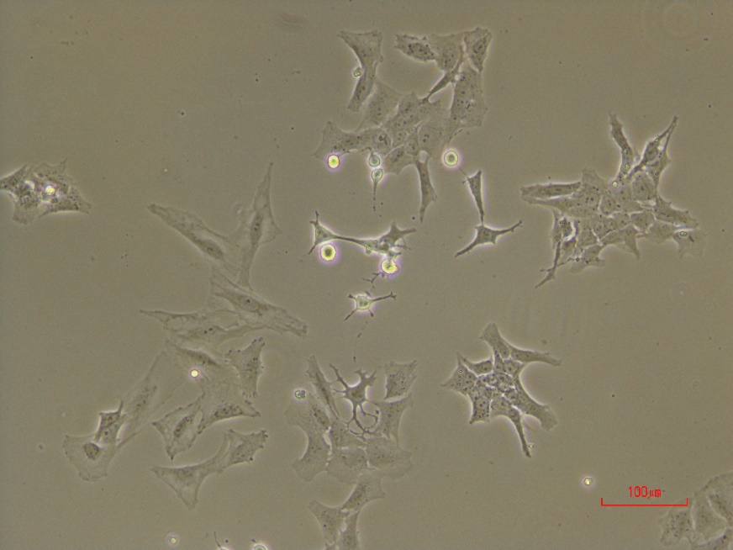
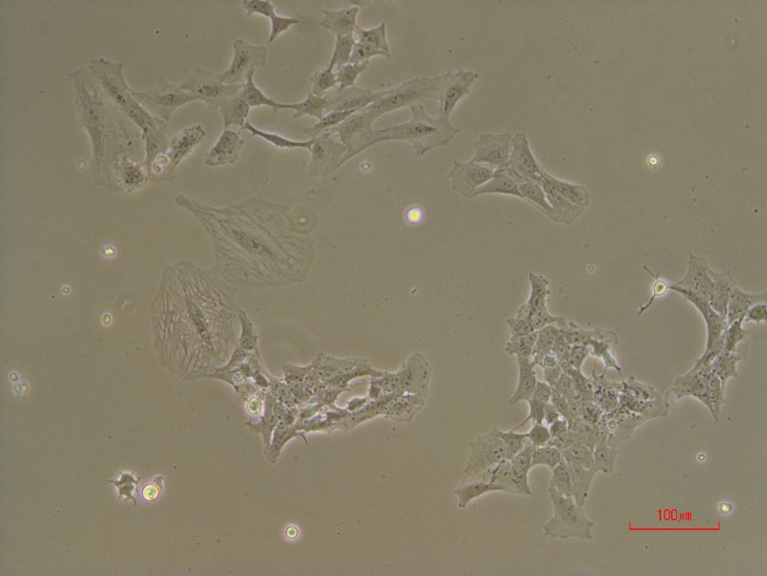
LncRNA1
after 5days in puromycin 3ug/ml

Slide 7
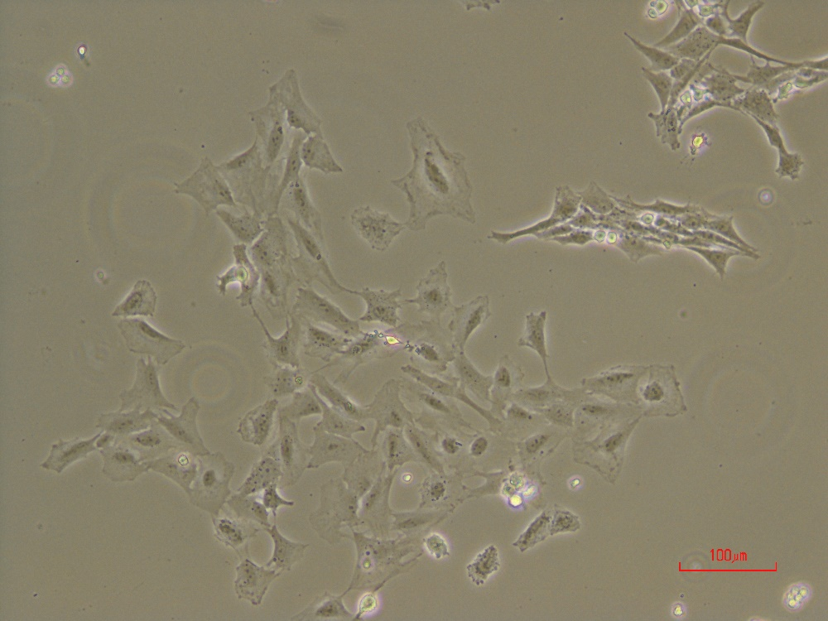
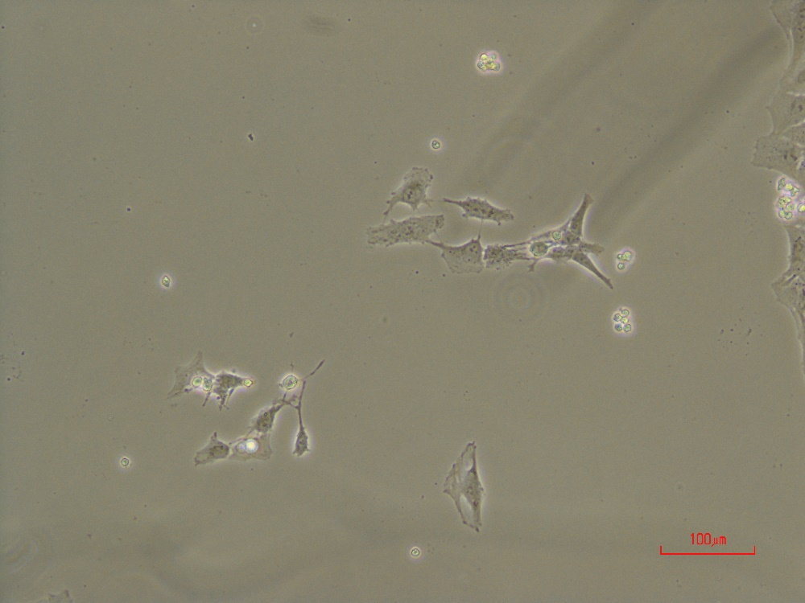
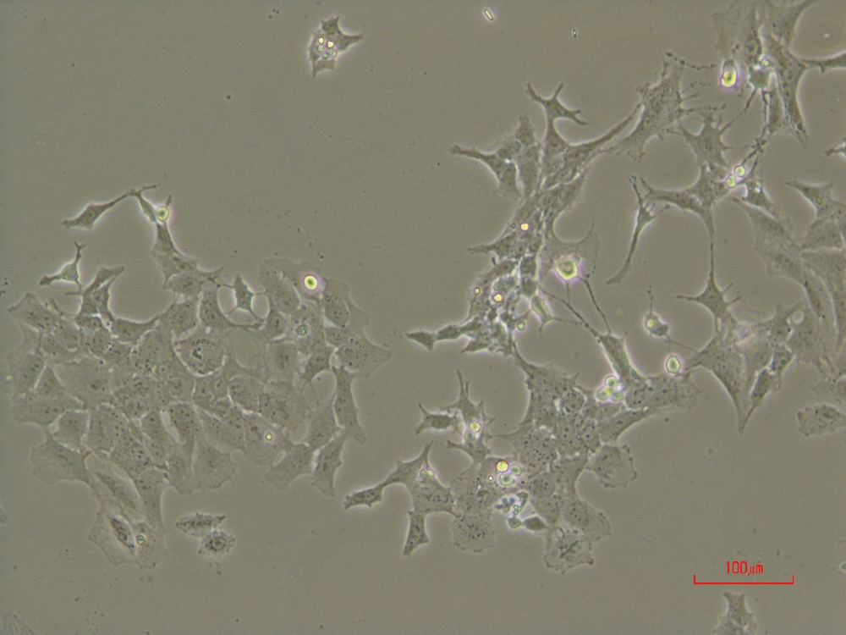
LncRNA1
after 5days in puromycin 3ug/ml

Slide 8
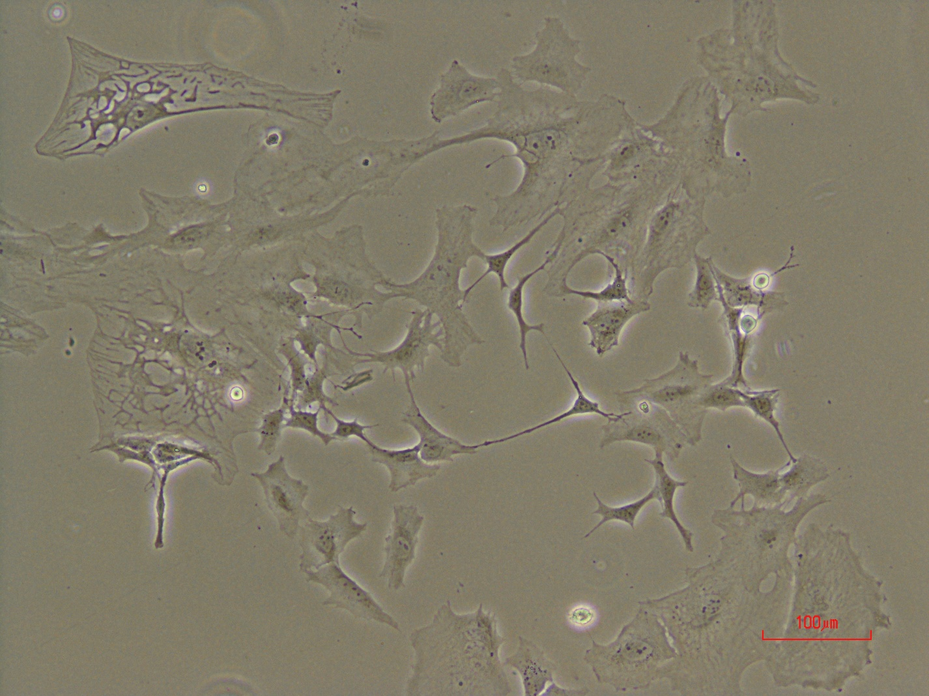
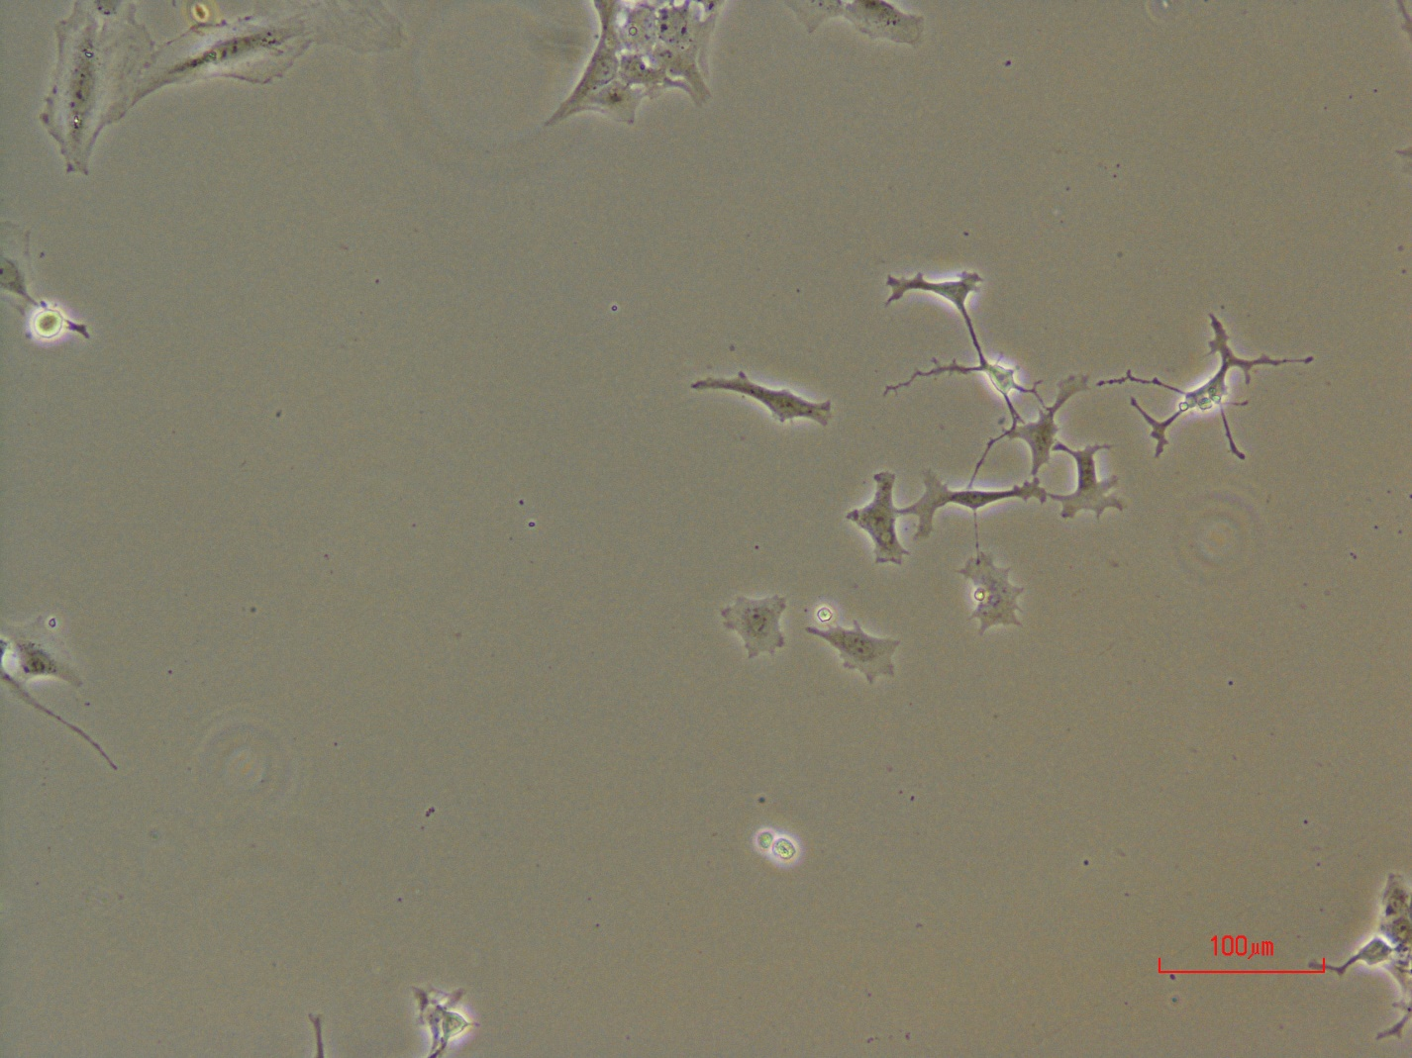
LncRNA1
after 6days in puromycin 3ug/ml

Slide 9
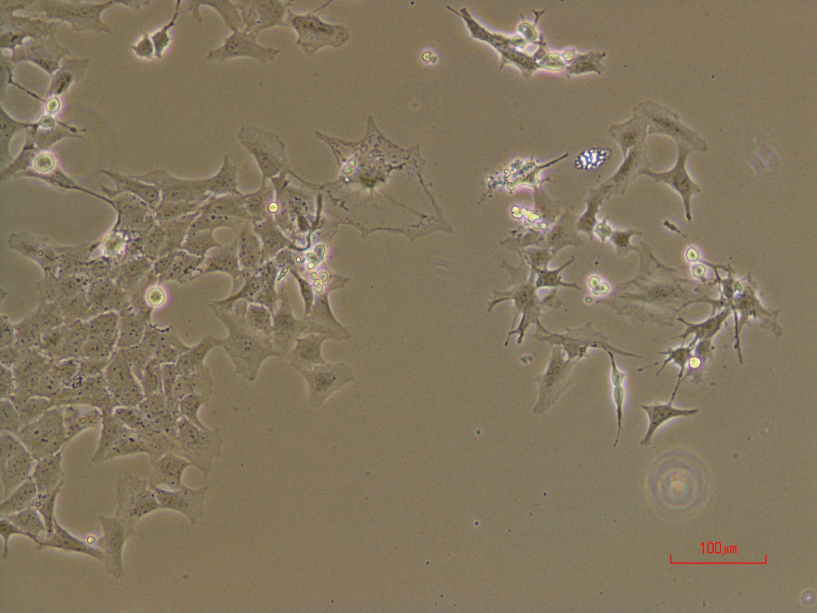
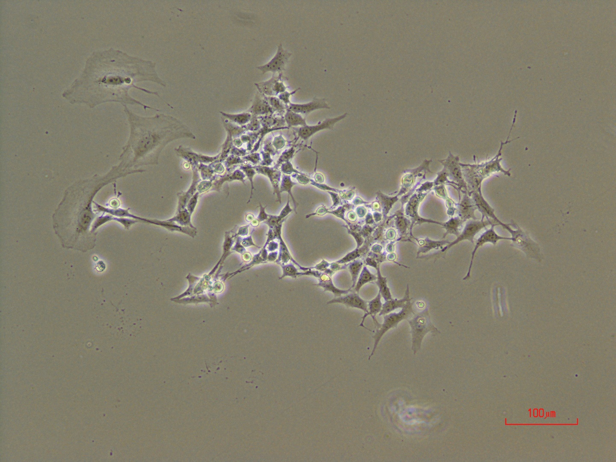
LncRNA1
after 6days in puromycin 3ug/ml

Slide 10
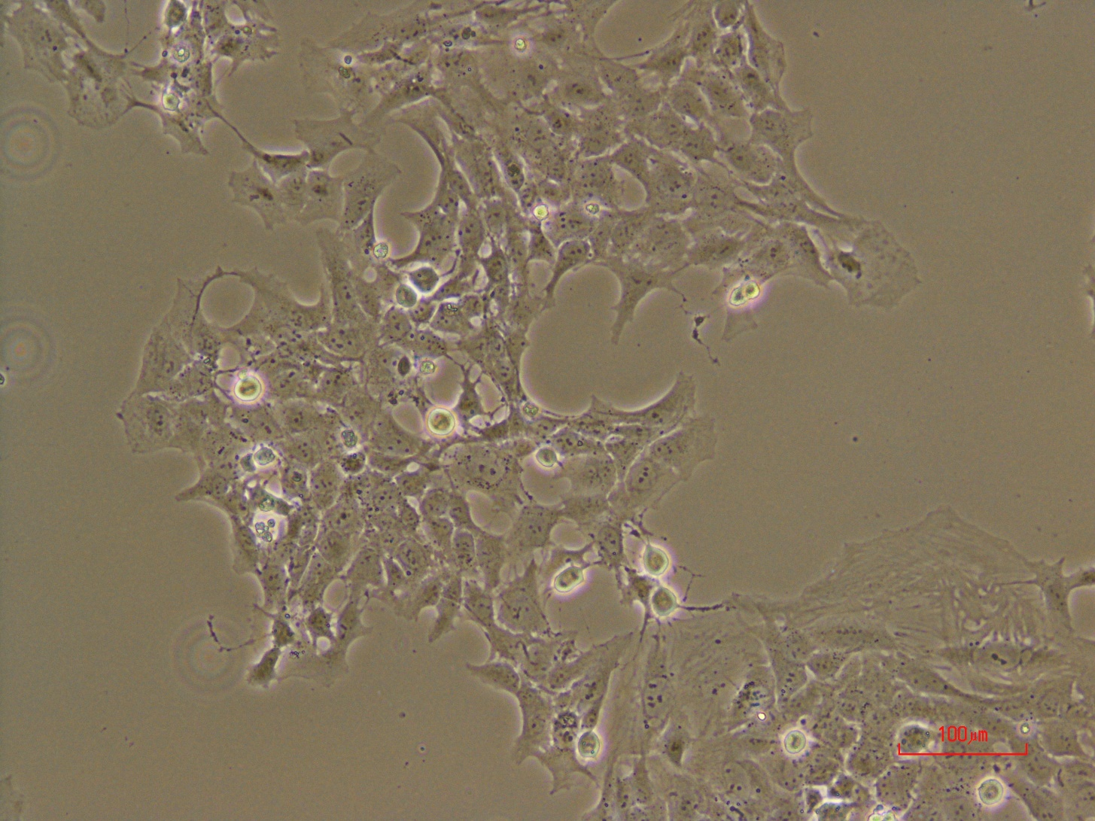
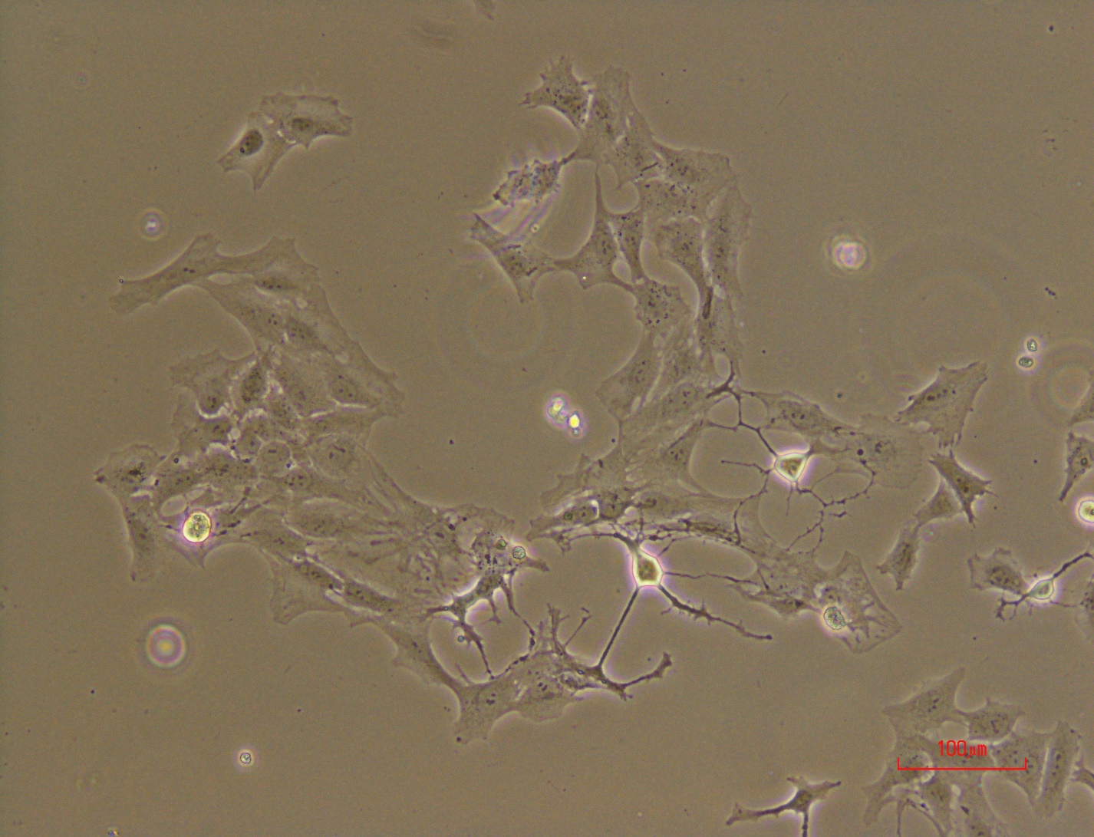
LncRNA1
after 6days in puromycin 3ug/ml

Slide 11
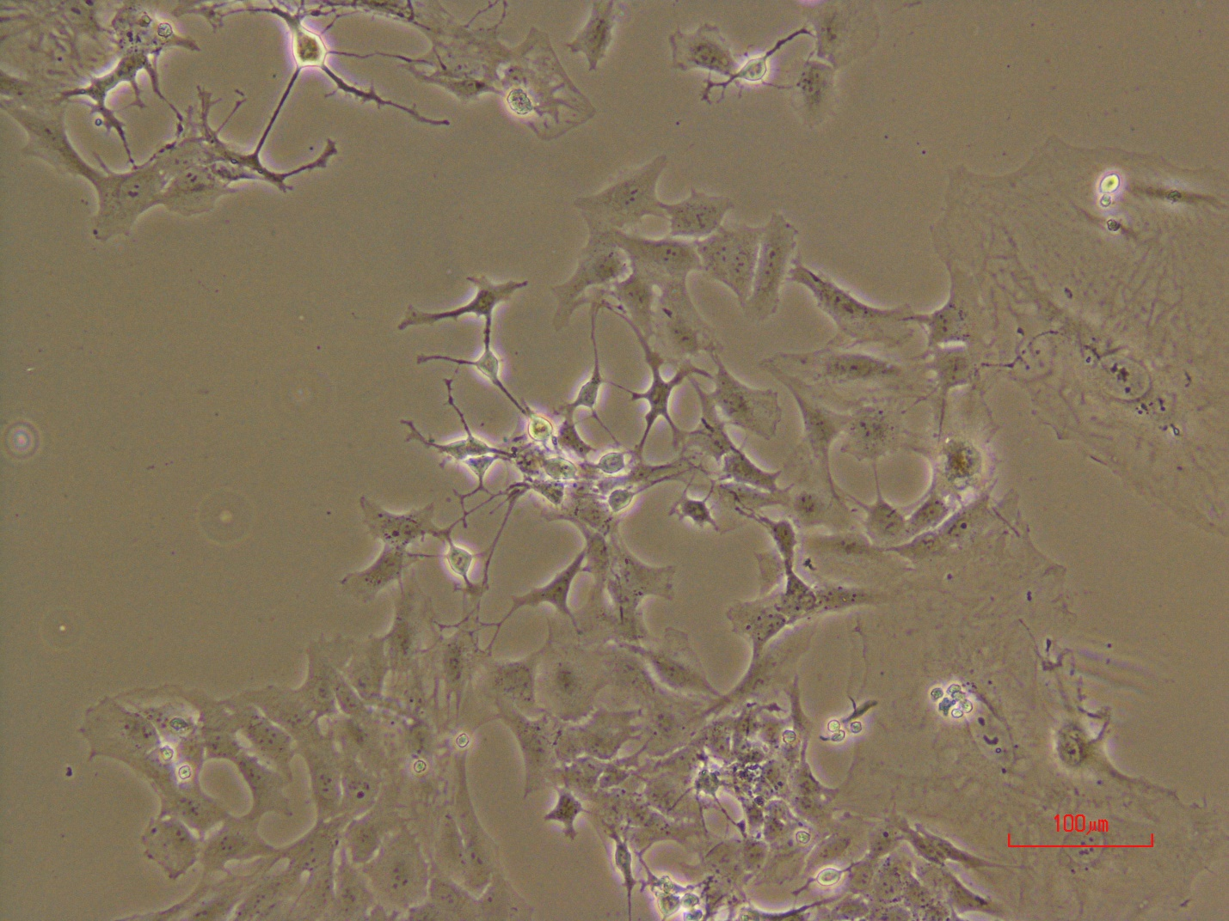
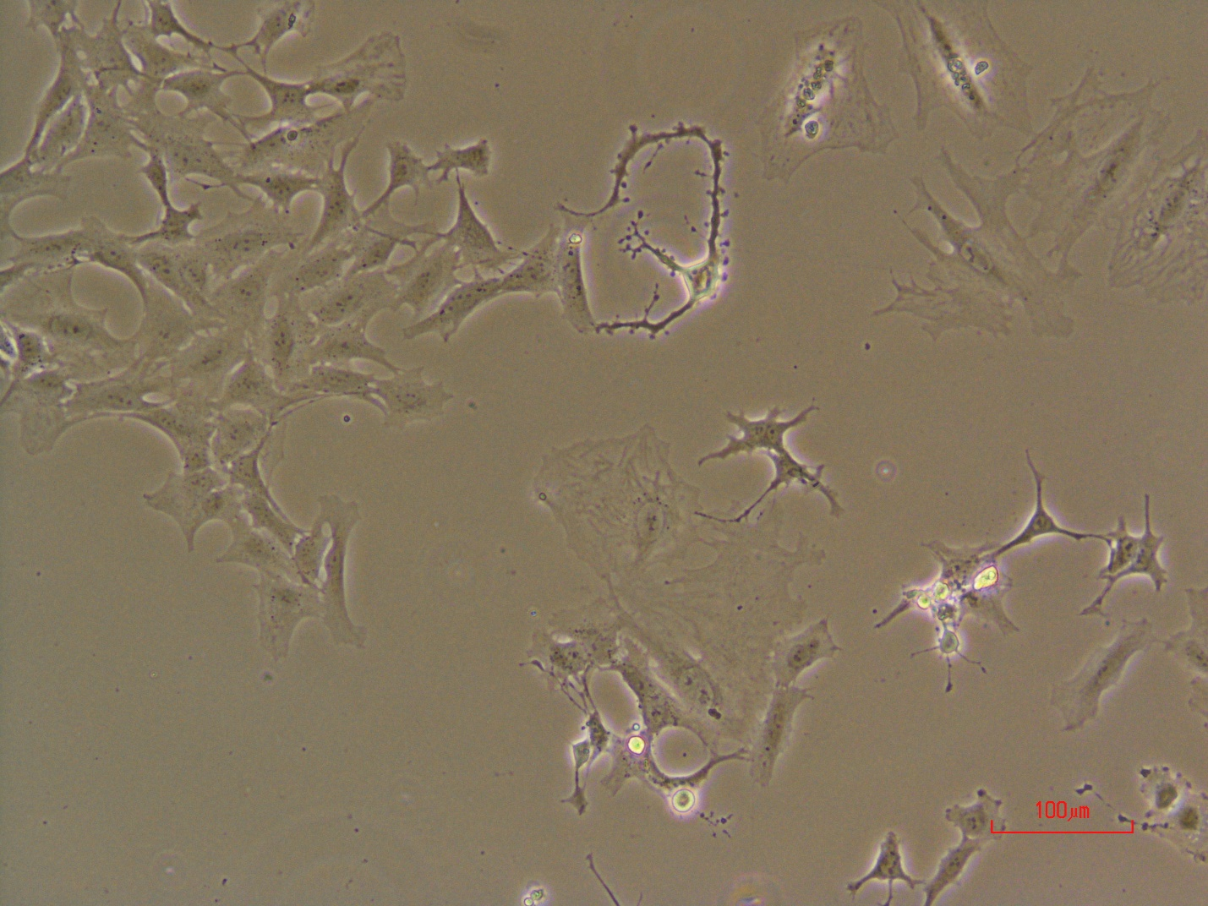
LncRNA1
after 6days in puromycin 3ug/ml

Slide 12
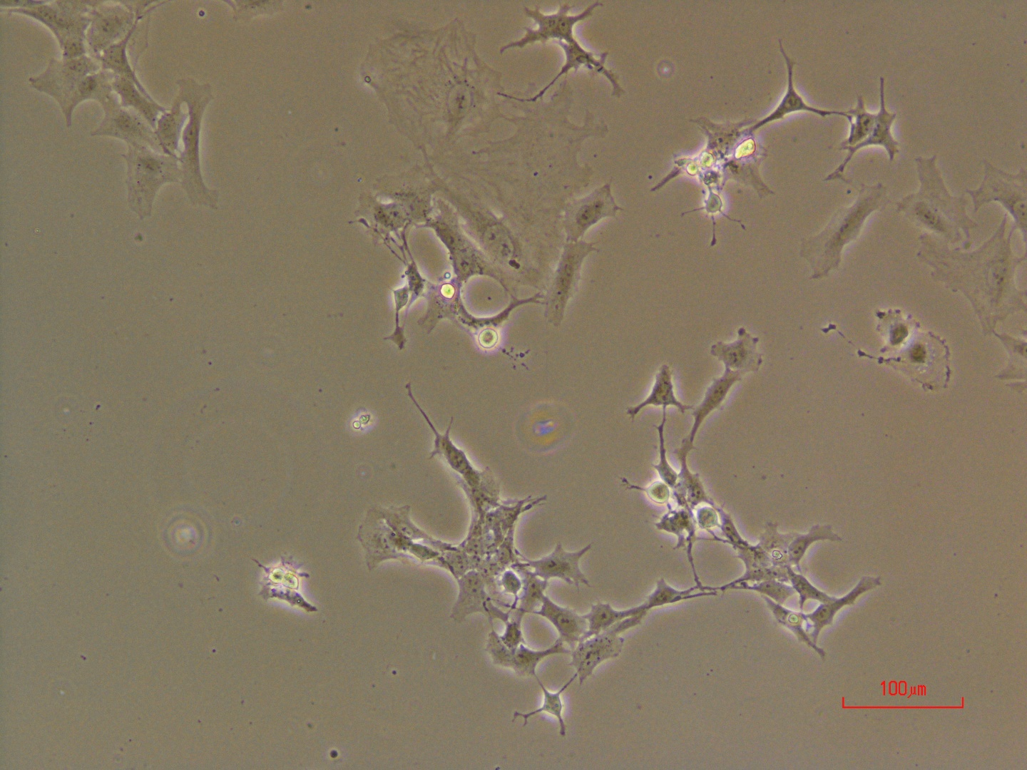
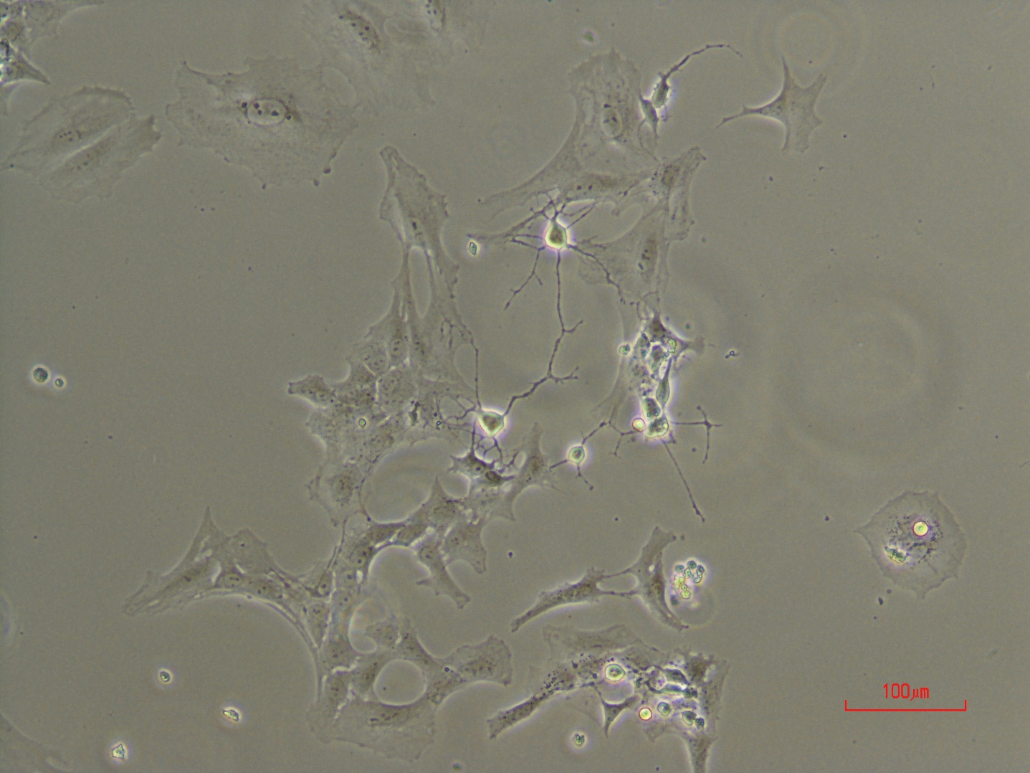
LncRNA1
after 6days in puromycin 3ug/ml

Slide 13
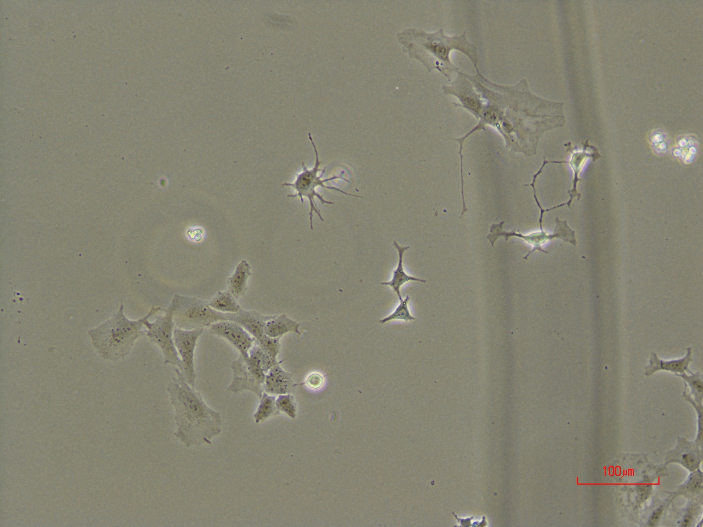
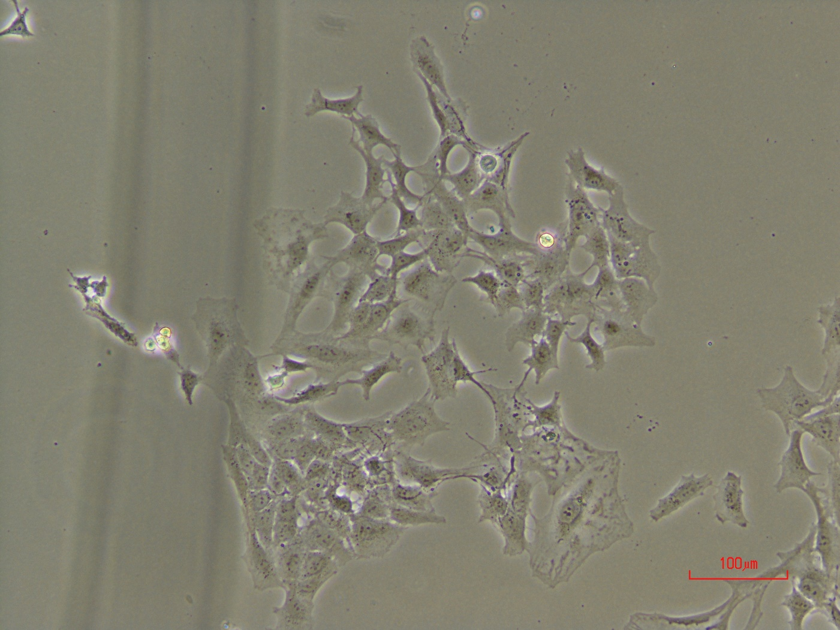
LncRNA2
after 6days in puromycin 3ug/ml

Slide 14
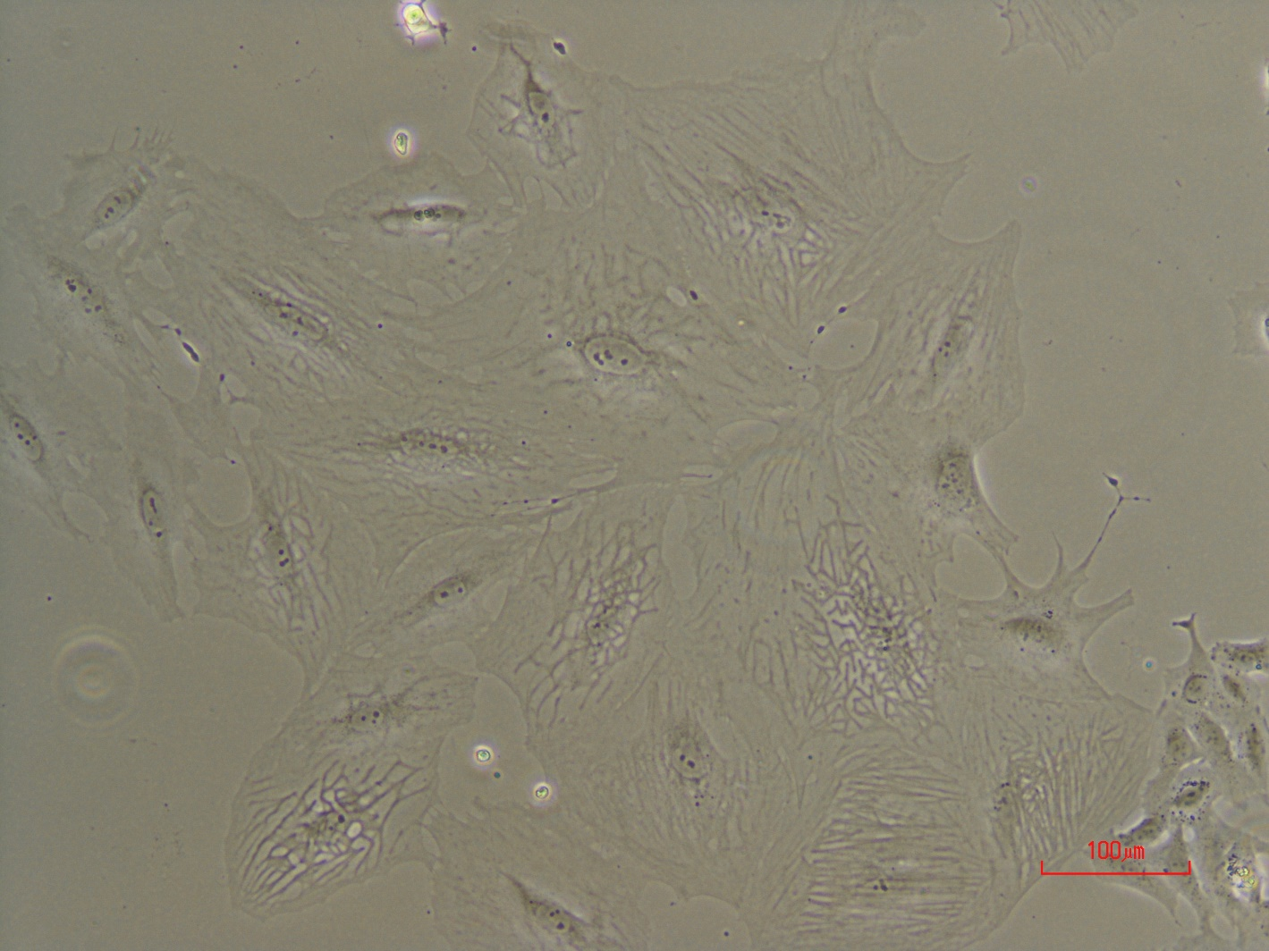
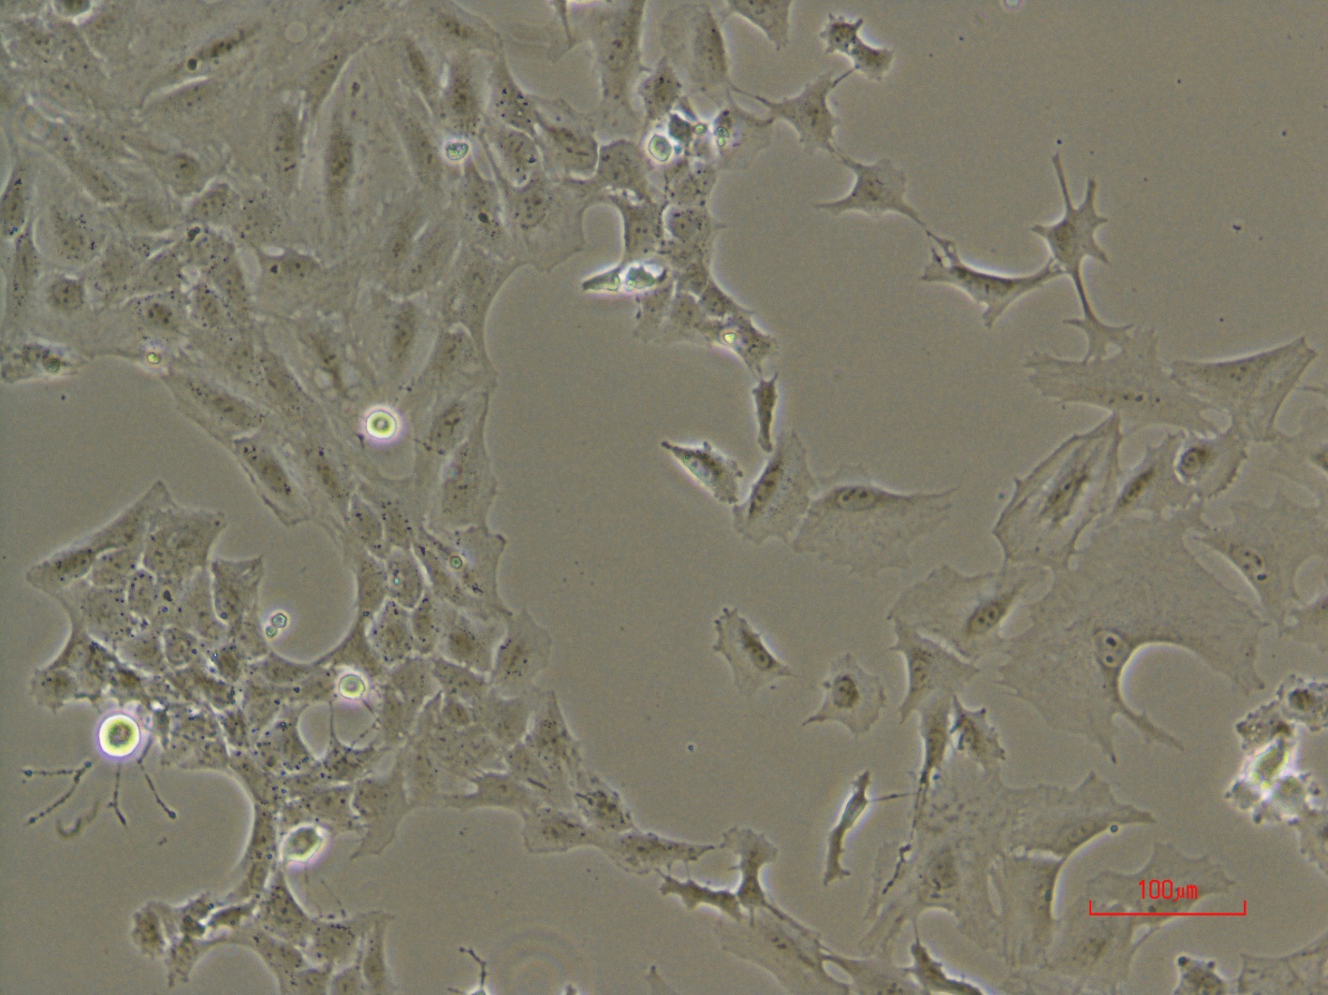
LncRNA2
after 6days in puromycin 3ug/ml

Slide 15
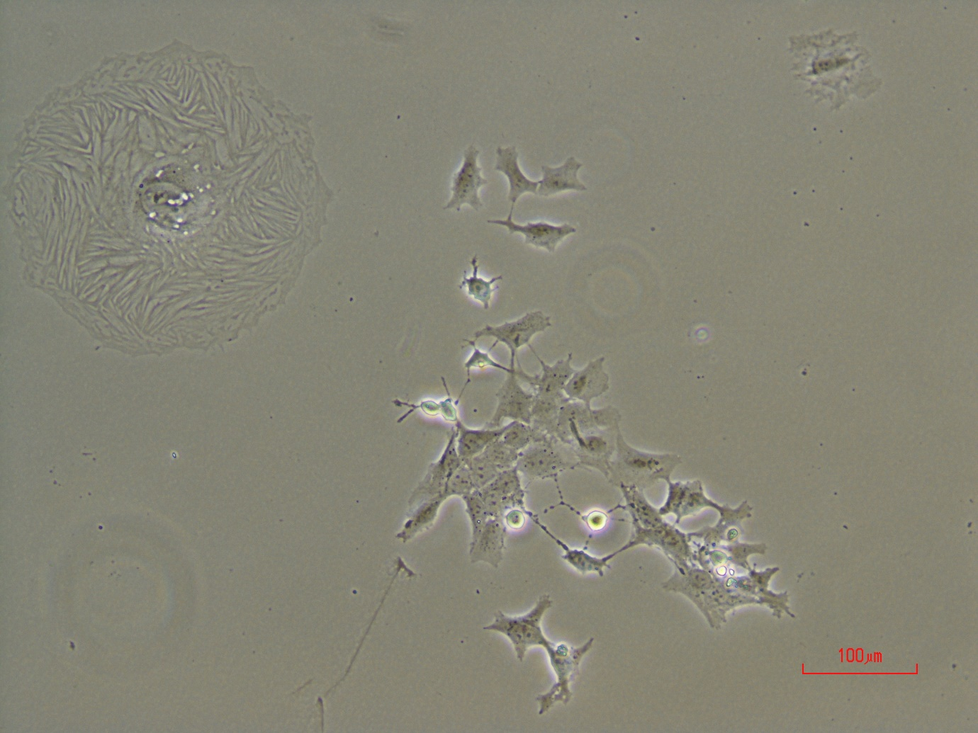
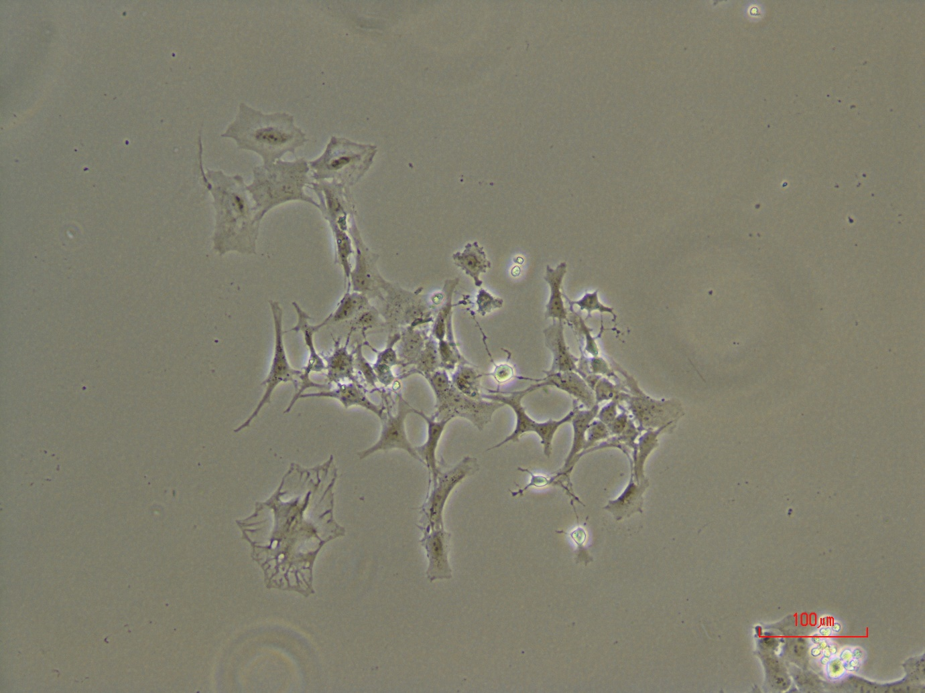
LncRNA2
after 6days in puromycin 3ug/ml

Slide 16
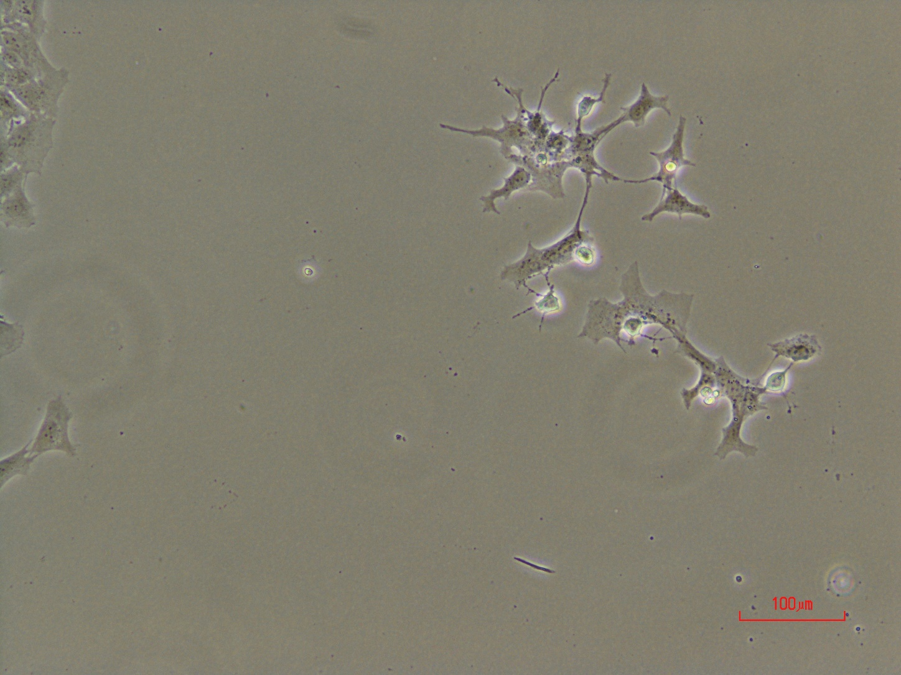
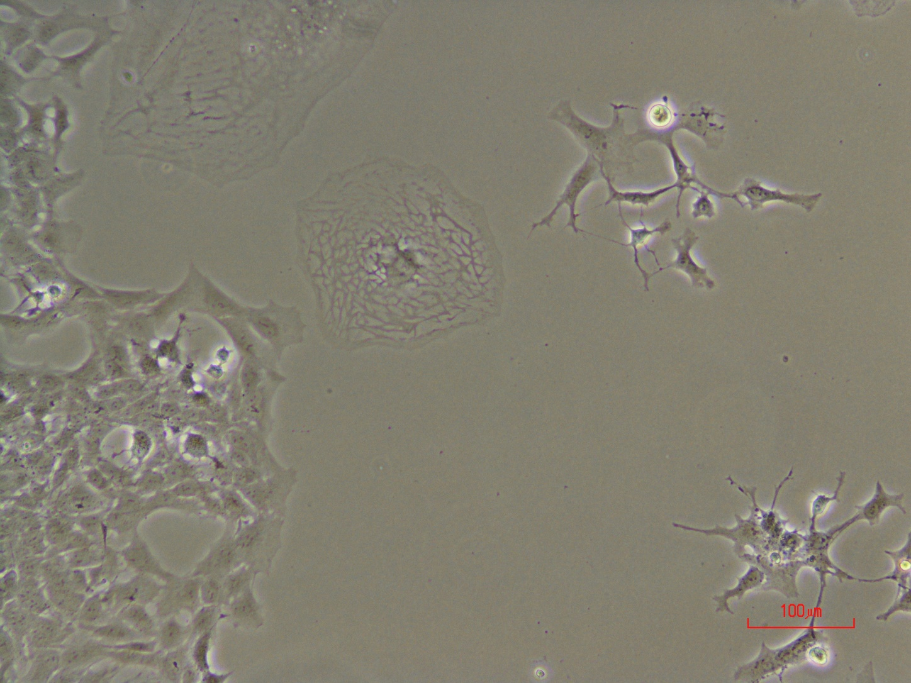
LncRNA1
after 7days in puromycin 3ug/ml

Slide 17
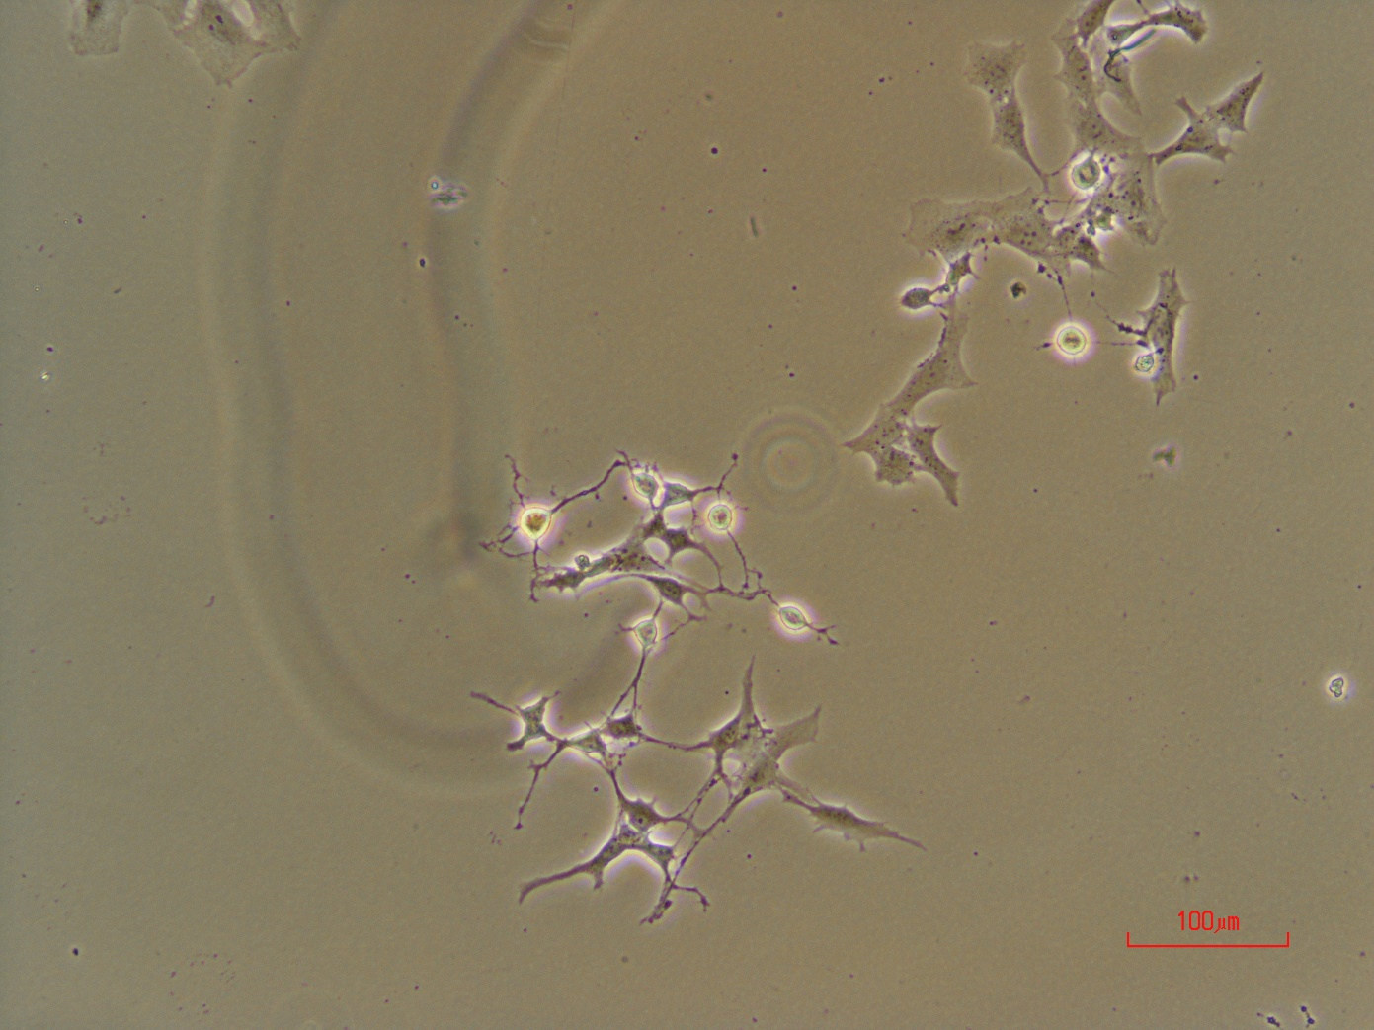
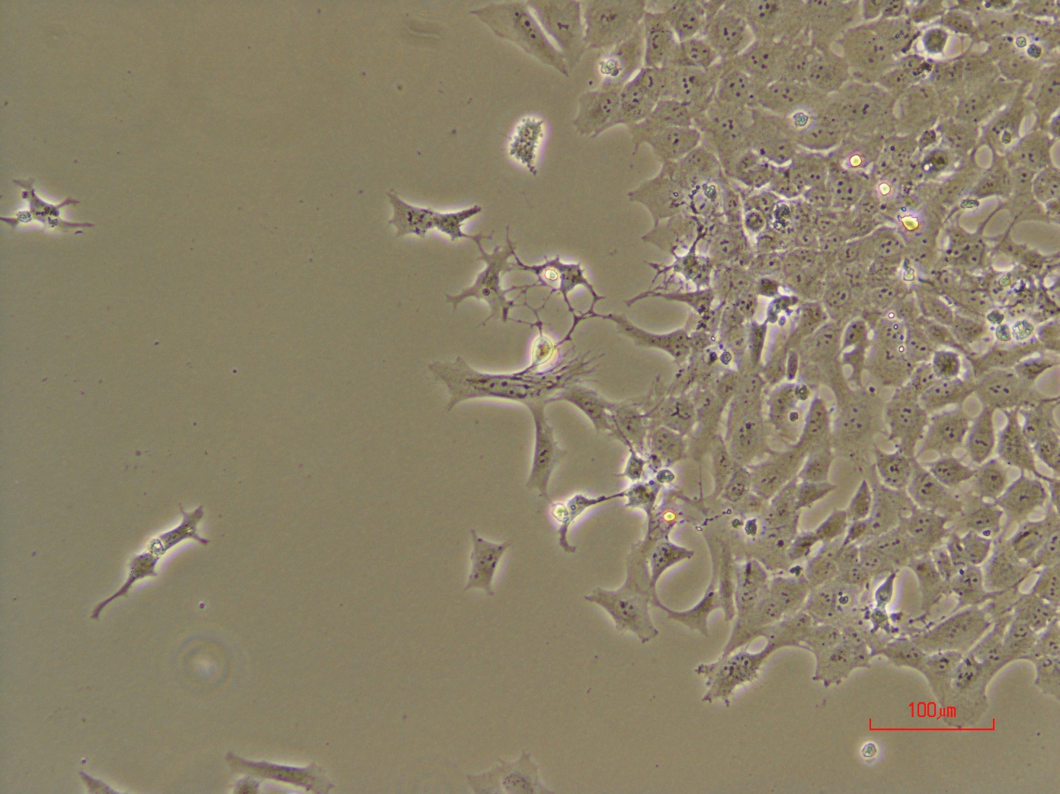
LncRNA1
after 7days in puromycin 3ug/ml

Slide 18
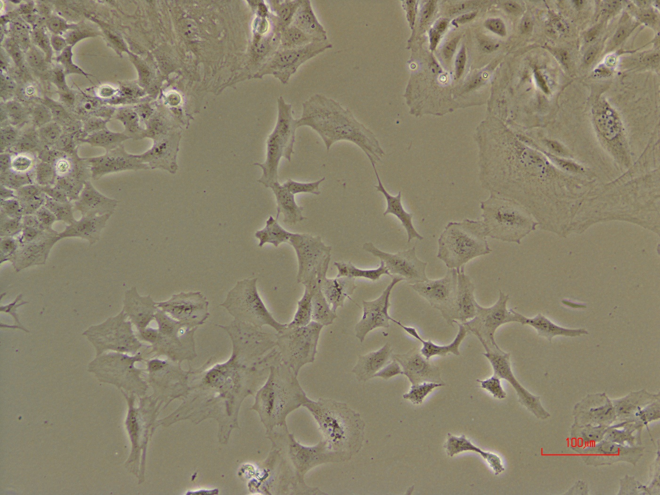
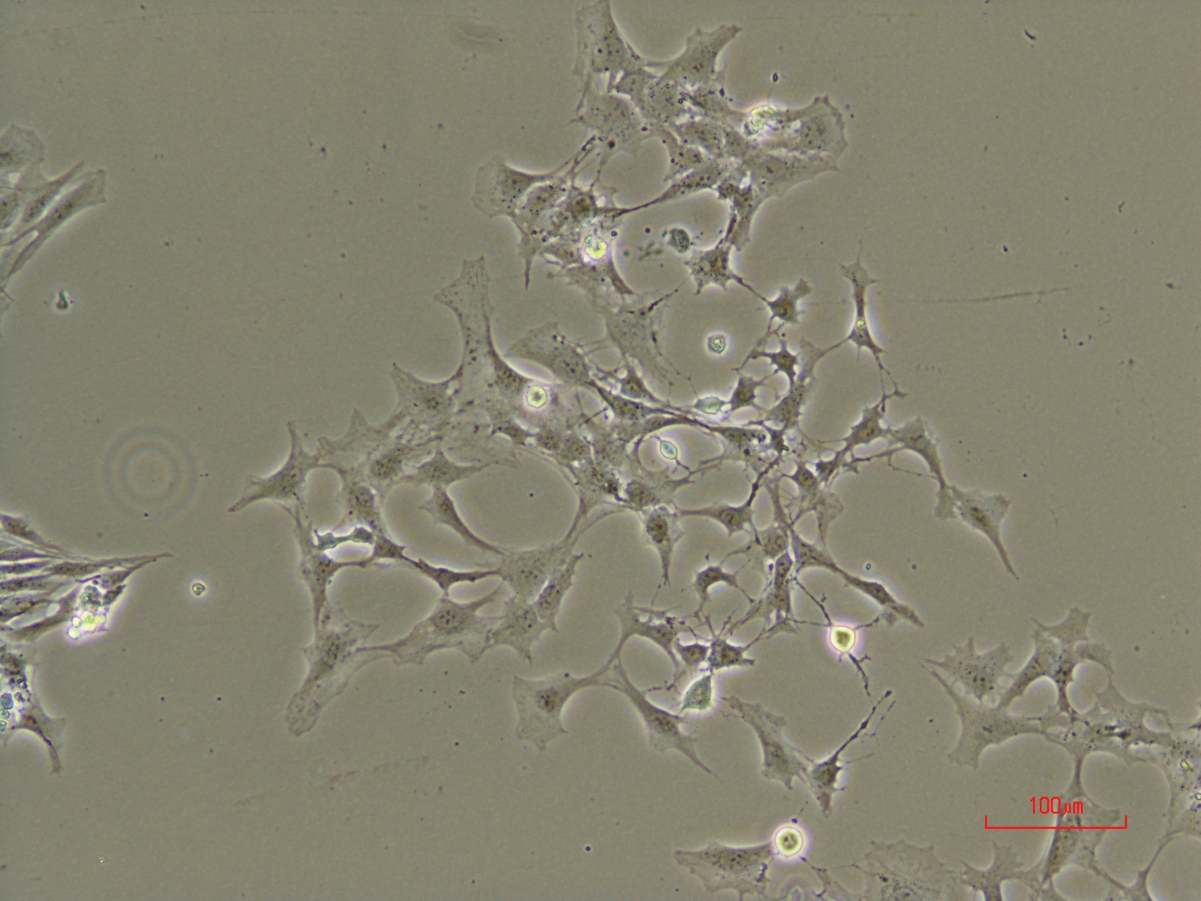
LncRNA1
after 7days in puromycin 3ug/ml

Slide 19
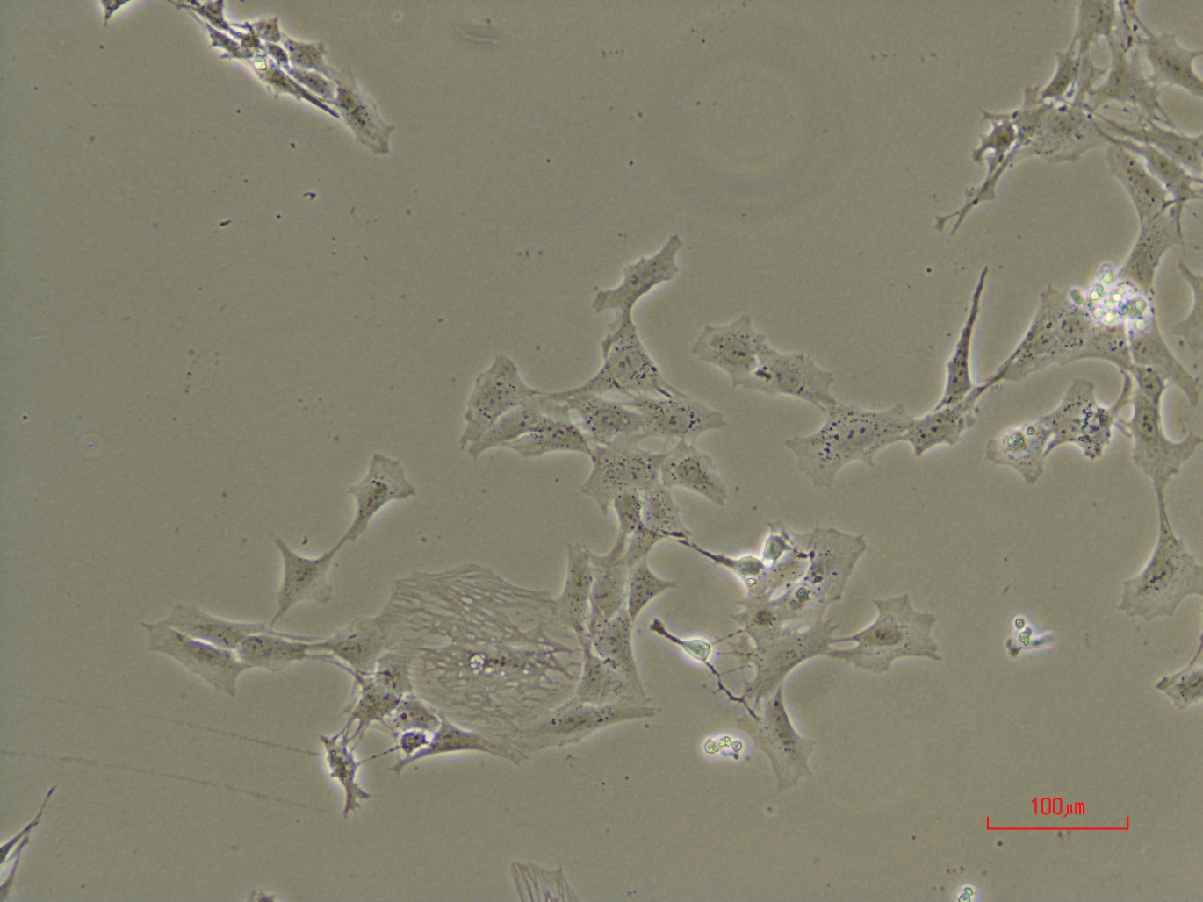
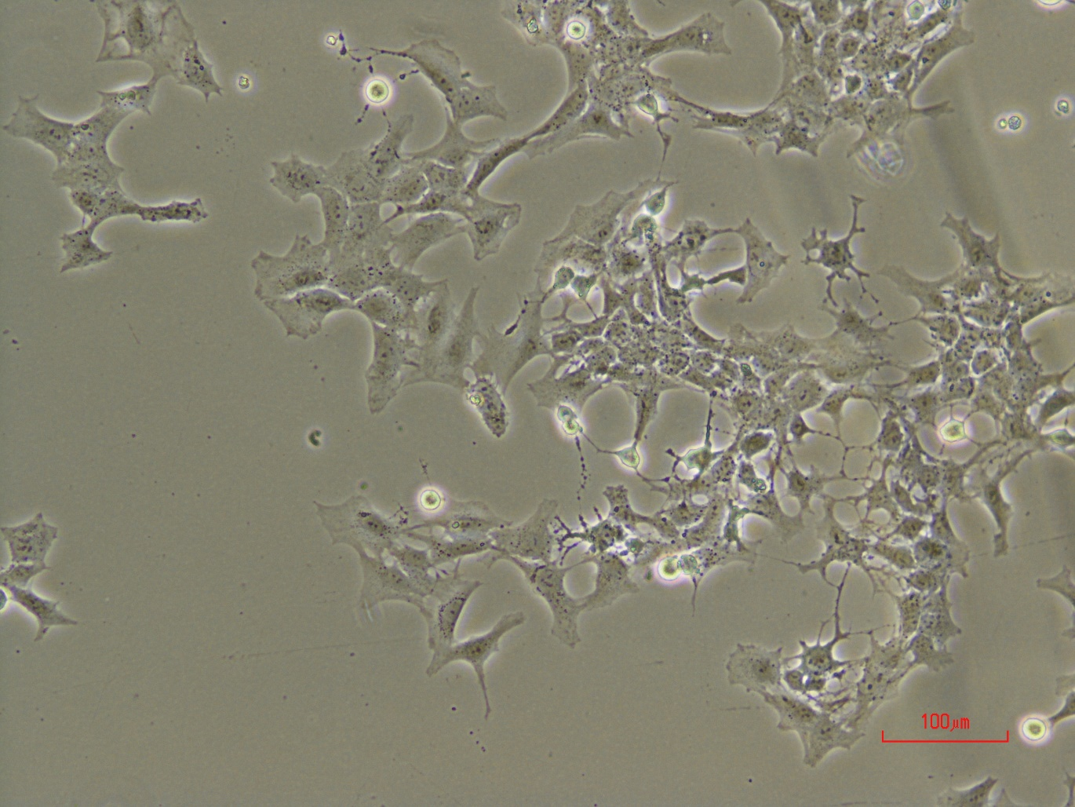
LncRNA1
after 7days in puromycin 3ug/ml

Slide 20
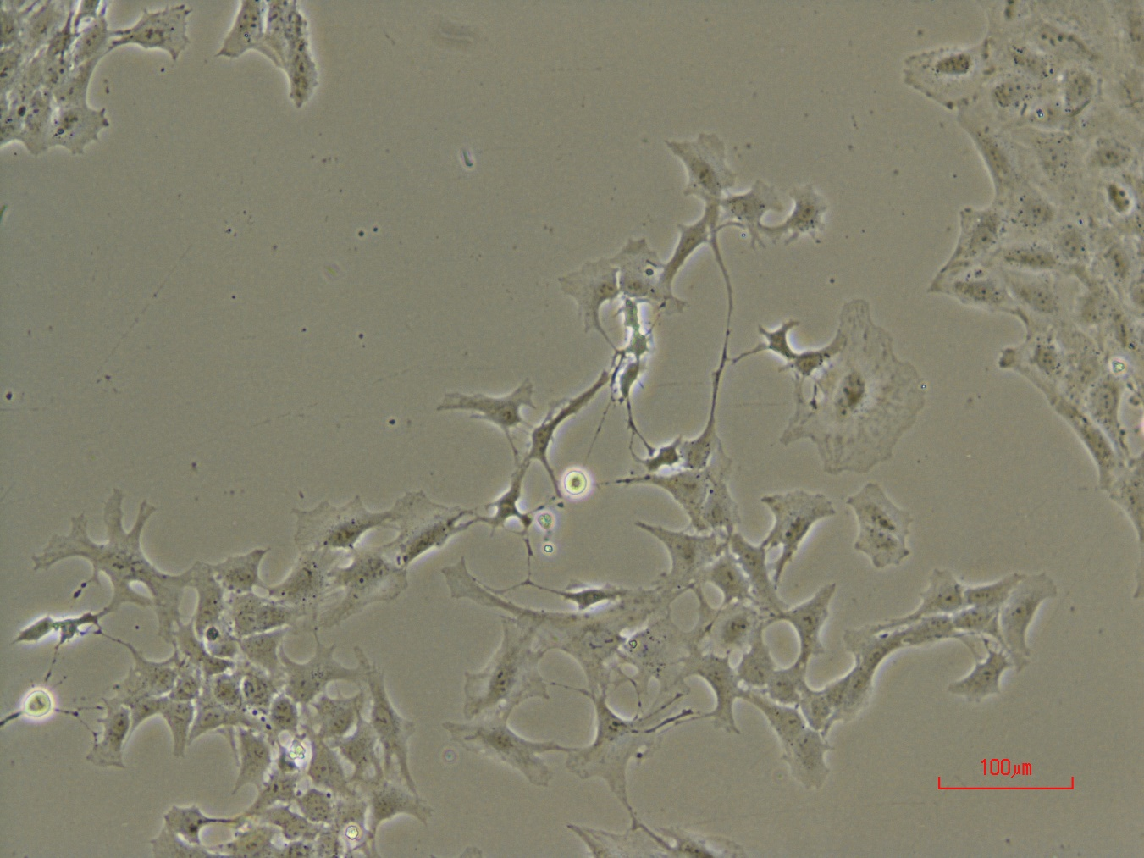

LncRNA1
after 7days in puromycin 3ug/ml

Slide 21


LncRNA2
after 7days in puromycin 3ug/ml

Slide 22


LncRNA2
after 7days in puromycin 3ug/ml

Slide 23


LncRNA2
after 7days in puromycin 3ug/ml

Slide 24


LncRNA2
after 7days in puromycin 3ug/ml

Slide 25

LncRNA2
after 7days in puromycin 3ug/ml

