Slide 1
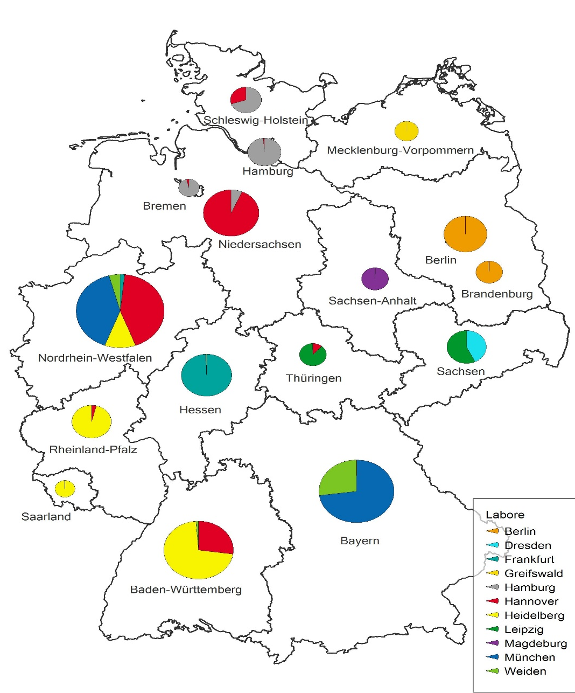
Laboratories
Screening distribution and catchment areas of the 11 screening laboratories across the 16 German federal states.
Circle diameter reflects the number of samples, coloring indicated the testing laboratory/federal state).

